Slide 1
02 Spark Introduction

Slide 2
Spark Eco-System
Schema / sql
Real Time
Machine Learning
Graph processing
Spark
SQL
Spark
Streaming
ML lib
GraphX
Spark Core
Cluster
managers
Stand alone
YARN
MESOS

Slide 3
Spark Core
Distributed compute engine
Task schedulers
Memory management
Fault recovery In case of node failures -> re-computes missing pieces
Interfacing with multiple storage systems

Slide 4
Spark SQL
Adhoc / interactive analytics
ETL workflow
Reporting
Supports HiveQL (Hive Query Language : A subset of SQL)
Natively understands
CSV : “mark, 40, M”
JSON : {“name”: “mark”, “age”: 40}
Parquet : on disk columnar format, heavily compressed
Replaces Shark (earlier SQL engine on Spark)

Slide 5
Spark SQL : Quick Example
{"name":"mark", "age":50, "sex":"M"},
{"name":"mary", "age":45, "sex":"F"},
{"name":"brian", "age":15, "sex":"M"},
{"name":"nancy", "age":17, "sex":"F"}
// … setup …
val teenagers = sqlContext.sql("SELECT name FROM people WHERE age >= 13 AND age <= 19")
[brian, nancy]

Slide 6
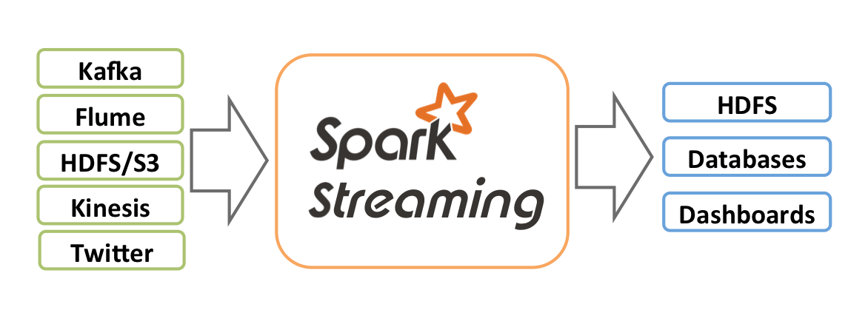
Spark Streaming
Process data streams in real time, in micro-batches
Low latency, high throughput (1000s events / sec)
Stock ticks / sensor data (connected devices / IoT – Internet of Things)
Streaming Sources
Storage

Slide 7
Machine Learning (ML Lib)
Machine learning at scale
TODO : insert diagram of HAL
Out of the box ML capabilities !
Java / Scala / Python language support
Lots of common algorithms are supported
Classification / Regressions
Linear models (linear R, logistic regression, SVM)
Decision trees
Collaborative filtering (recommendations)
K-Means clustering
More to come

Slide 8
Graphx
Graphs are every where
Facebook connections
Linked-In : ‘people you may know’
..etc
TODO : insert screen shots Kevin Bacon 6 degree seperation

Slide 9
GraphX
GraphX is a library for doing graph processing on Spark
Supported Algorithms
Page rank (Google’s)
Distance calculation
…etc

Slide 10
Cluster Managers
Spark can run on…
1) standalone
2) Hadoop YARN
3) Mesos
Standalone : if we just need Spark
Need a distributed data storage
Amazon S3 , NFS …etc
YARN : Already have Hadoop
Deploy spark on YARN
HDFS serves as data layer

Slide 11
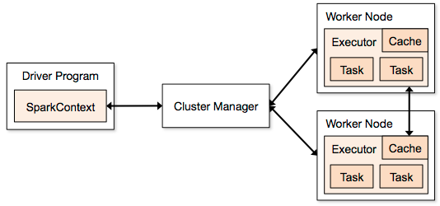
Spark Architecture
Node
Client
Standalone
Yarn
Mesos

Slide 12
Spark Architecture
Multiple ‘applications’ can run at the same time
Driver (or ‘main’) launches an application
Each application gets its own ‘executor’
Isolated (runs in different JVMs)
Also means data can not be shared across applications
Cluster Managers:
multiple cluster managers are supported
1) Standalone : simple to setup
2) YARN : on top of Hadoop
3) Mesos : General cluster manager (AMP lab)

Slide 13
Lab : First Look at Spark
Login to your Spark nodes Instructor will provide details
1) TODO : untar spark distribution
Tar xvf spark….
Mv spark…. Spark # ease of use
From now on, ~/spark will be the SPARK_INSTALL_DIR

Slide 14
Lab : First Look At Spark
Explore spark directory structure
cd ~/spark # where spark is installed
Inspect these directories
ls conf/
bin/ : shells (spark-shell) and submission programs (spark-submit)
sbin/ : start / stop cluster, management
conf/ : configuration files
examples/ : samples
lib/ : jar files
logs/ : logs

Slide 15
Lab : First look at Spark
Start spark on a single node
cd ~/spark
./sbin/start-all.sh
Use JPS to inspect the process

Slide 16
Spark Data Model : RDD
Resilient Distributed Dataset (RDD)
Can live in
Memory (best case scenario)
Or on disk (FS, HDFS, S3 …etc)
Each RDD is split into multiple partitions
Partitions may live on different nodes
Partitions can be computed in parallel on different nodes

Slide 17
RDD : Loading
Use Spark context to load RDDs from disk / external storage
sc.textFile(“/data/input1.txt”) // single file
Sc.textFile(“/data/”) // load all files under dir
Sc.textFile(“/data/*.log”) // wild card matching

Slide 18
RDD Operations
Two kinds of operations on RDDs
1) Transformations
Create a new RDD from existing ones (e.g. Map)
2) Actions
E.g. Returns the results to clients (e.g. Reduce)
Transformations are lazy.. Actions force transformations

Slide 19
Transformations / Actions
RDD 1
RDD 2
RDD 3
Transformation 1
(map)
Client
Action1
(collect)

Slide 20
RDD Transformations
Transformation | Description | Example
filter | Filters through each record (aka grep) | f.filter( line => line.contains(“ERROR”))
union | Merges two RDDs | rdd1.union(rdd2)
…see docs …

Slide 21
RDD Actions
Action | Description | Example
count() | Counts all records in an rdd | f.count()
first() | Extract the first record | f.first ()
take(n) | Take first N lines | f.take(10)
collect() | Gathers all records for RDD. All data has to fit in memory of ONE machine (don’t use for big data sets) | f.collect()
…. See documentation ..

Slide 22
Partitions Explained
1G file
32M
32M
32M
32M
Task
Task
Task
Task
Result

Slide 23
RDD : Saving
saveAsTextFile () and saveAsSequenceFile()
f.saveAsTextFile(“/output/directory”) // a directory
Output usually is a directory
RDDs will be saved as multiple files in the dir
Each partition → one output file

Slide 24
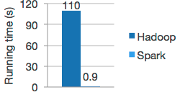
Caching of RDDs
RDDs can be loaded from disk and computed
Hadoop mapreduce model
Also RDDs can be cached in memory
Subsequent operations are much faster
f.persist() // on disk or memory
f.cache() // memory only
In memory RDDs are great for iterative workloads
Machine learning algorithms

Slide 25

Lab Time !

Slide 26
Lab : Running Spark (est : 15-30 mins)
Login to Spark node
Instructor will provide details
Update spark-labs $ cd ~/spark-labs $ git pull
Do the first lab : 1.1-intro $ cd ~/spark-labs $ cd 1.1-intro
follow the README.txt file use less or nano to read the file (less README.txt or nano README.txt)

Slide 27
Lab : Spark-shell (est : 30 mins)
Location : ~/spark-labs/1.2-shell follow README.txt

Slide 28
Lab : RDD (est 30 mins)
Location : spark-labs/1.3-rdd
Follow README.txt

Slide 29
Lab : RDD Caching (30 mins)
Location : spark-labs/1.3-rdd
Follow : cache.txt

Slide 30
Spark : map / flatMap
map() and flatMap()
One input → map() → one output ( 1 → 1 )
One input → flatap() → multiple elements ( 1 → N)

Slide 31
Map vs Flatmap Example
val input = Array ("hello world", "goodbye world", "bye bye”) val r = sc.makeRDD(input)
r.map(line => line.split(" ")).collect() // Array[Array[String]] = // Array(Array(hello, world), // Array(goodbye, world), // Array(bye, bye))
r.flatmap(line => line.split(“ “)).collect() // Array[String] = // Array(hello, world, goodbye, world, bye, bye)

Slide 32
Aggregate Functions
Function | Description | example
reduce() | Input 2, input 1 | Val sum = rdd.reduce((x,y) => x+ y)
reduceByKey() | Reduce for each key
Fold()
…

Slide 33
Word Count Example
val input = Array ("hello world", "goodbye world", "bye bye”) val r = sc.makeRDD(input)
val counts = r.flatMap(line => line.split(“ “)). map(word => (word, 1)). reduceByKey(_+_)

Slide 34

Thanks !
Sujee Maniyam
sujee@elephantscale.com
http://elephantscale.com
Expert consulting & training in Big Data

Slide 35
Credits
http://spark.apache.org/
http://www.strategictechplanning.com

