Slide 1
Business intelligence for the hotel industry
(A CASE STUDY OF BOWEN GUEST HOUSE )
Project by Joshua Tamunokuro Blue-Jack
SUPERVISOR: Mr. Adeyemo.

Slide 2
introduction
The Hotel Industry is becoming more competitive and as the industry continues to grow, customers tend to drift to only hotels that offer better services, feel comfortable in and keep them in high esteem.
Thus, hotel managers need a tool to help gather data (.i.e. reviews) and that would effectively monitor what customers are saying about their services, derive useful insights and strategies to enhance their services in order to gain their loyalty

Slide 3
Statement of problem
Lack of a Business intelligence tool to collect and monitor customers data
Lack of a visibility tool for top level manager to gain real time insights to business operations

Slide 4
Objectives of the project
The objectives of this project are:
Gather the necessary requirements for the design
Develop a design using Unified Modeling Language (UML)
Implement the design
Test the developed web application using test data

Slide 5
Methodology
The design for this project was developed using the Unified Modeling Language (UML) diagrams.
Also, development of the web application was handled with:
Python, Django, Bootstrap, JavaScript, MySQL, Elasticsearch and Kibana.

Slide 6
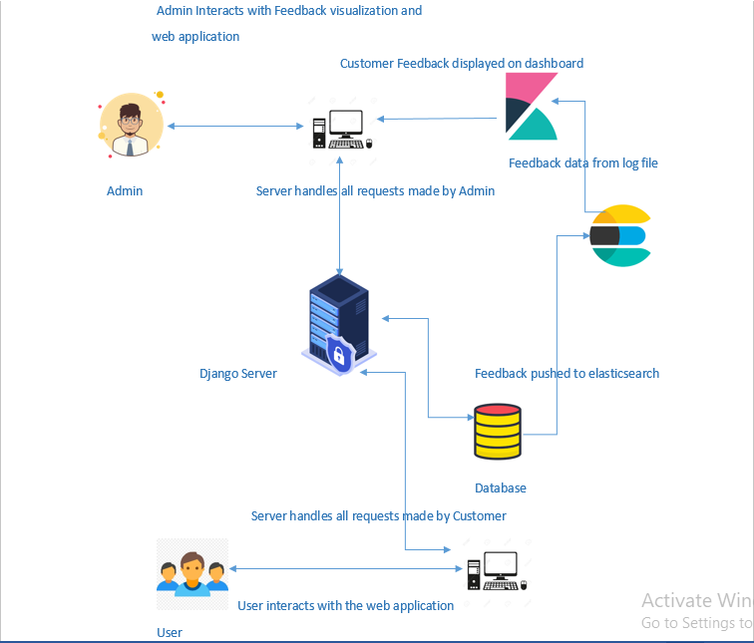
design

Slide 7
implementations
This project consists of two major parts:
The web application and Business Intelligence tool.
the web application was developed with Django, JavaScript and python.
the business intelligence tools used were:
Elastic search to store the data from the web application
Kibana Dashboard was used to create interactive visualizations

Slide 8
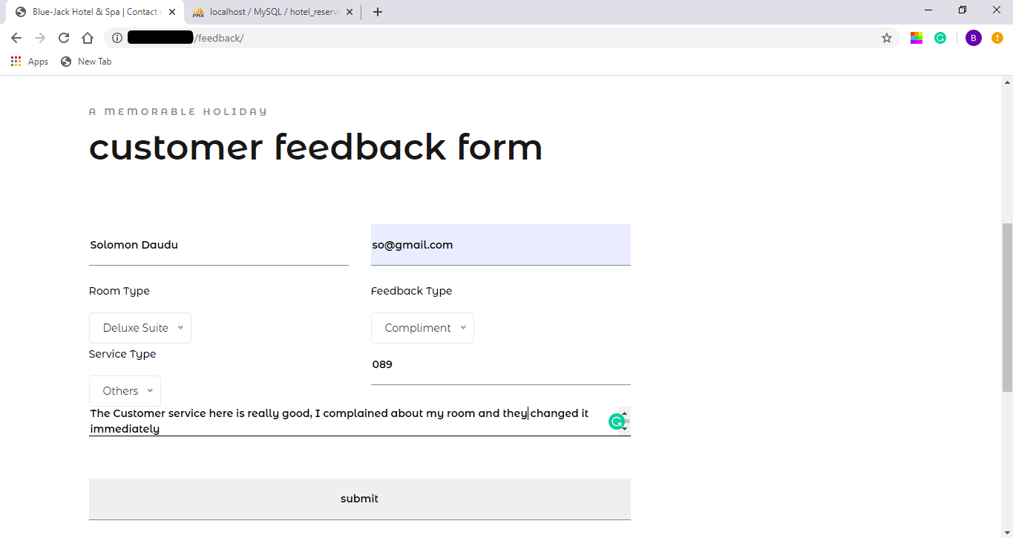
Results
(Feedback form)

Slide 9
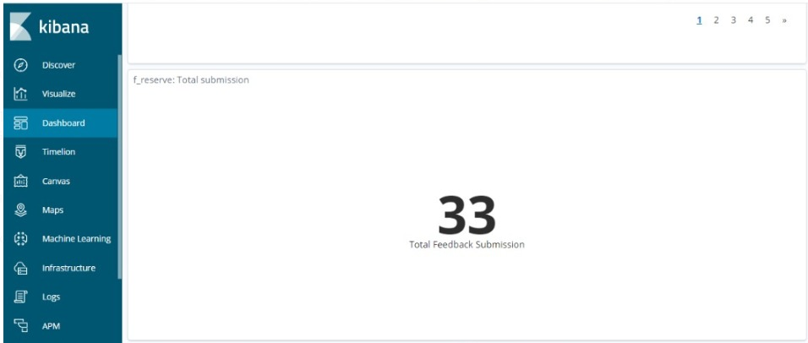
Results
(kibana dashboard)

Slide 10
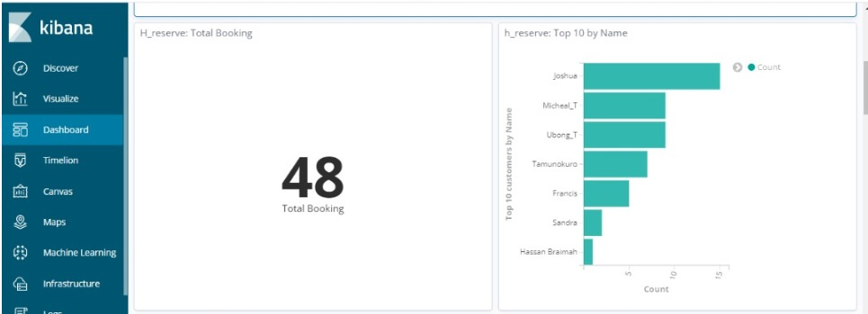

Slide 11
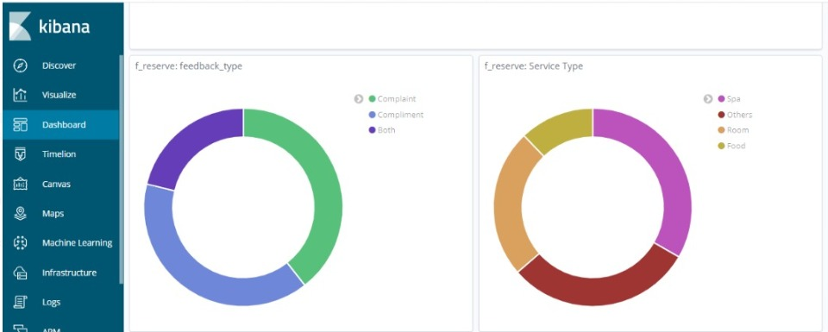

Slide 12
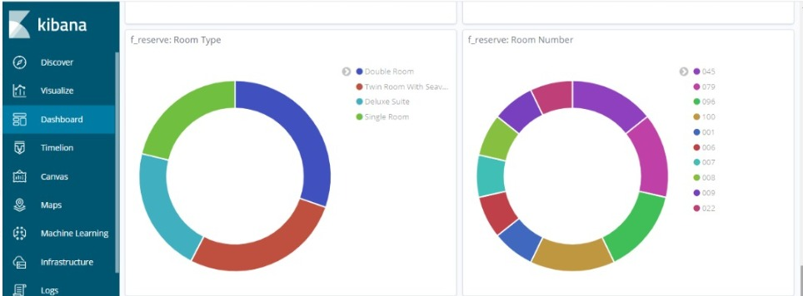

Slide 13
CONTRIBUTION TO KNOWLEDGE
In addition to prior research carried out, this project provides a model that aids in monitoring and visualizing hotel data in real time.

Slide 14
Conclusion
In conclusion, this project provides a quicker and easier means for hotel managers to generate intelligence from hotel data to influence business decisions.

Slide 15
S/N | AUTHOR(s) and DATE | PROBLEM ADDRESSED | METHODOLOGY EMPLYOYED | RESULT | REMARK
1 | Alabi Oluwaseun Faruq Babatunde Gideon Opeyemi (2014) | Development of a Hotel Information Management | The tools used were Visual Studio Code and Microsoft SQL server | The system developed was able to able to implement an accommodation module, catering module, finance and account module, front-desk module and personnel staff record module | They study was able to properly show designs used to develop the Hotel Information Management which made it easier to understand
2 | Akash et al (2018) | Development of a Faculty Feedback Management System | PHP and MySQL | The developed system was successful in establishing a good student-teacher relationship | This study showed the core benefits feedback system in a school setting.

Slide 16
references
Mavis Dah, Helen Dumenya, Arnold (2016). Investigating Customer Feedback Channels in the Hotel Industry: the Case of Ho – Ghana 12(26), pp 353
Mariani, M., Baggio, R., Fuchs, M., & Höepken, W. (2018). Business intelligence and big data in hospitality and tourism: a systematic literature review. International Journal of Contemporary Hospitality Management
Hien Dang (2014) Designing new feedback management system for Långvik hotels
Barlow, J. & Moller, C. 2010. A complaint is a gift: Recovering customer loyalty when things go wrong. 2nd edition. San Francisco: Berrett-Koehler publishers, Inc.
Nail, J. & Zabin, J. 2010. Customer feedback management. Illinois: Gleanster LLC.

