Slide 1
ADVOCACY ON ELECTRICITY CUSTOMERS’ RIGHTS AND RESPONSIBILITIES IN NIGERIAN ELECTRICITY MARKET
Presented by:
Handley Blue-Jack
Tel:08035892323

Slide 2

Introduction
Based on ESPR 2005, Nigerian Electricity Regulatory Commission (NERC) has established rules and regulations governing the provision of Electricity services in Nigeria.
The Purpose of the guidelines are to ensure standardization in the provision of Electricity services to Customers by Electricity Services Providers(Discos ).
The Nigerian Electricity Regulatory Commission has equally stipulated certain responsibilities electricity customers are to fulfill to service providers.

Slide 3
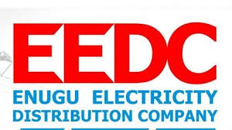
Introduction Cont’d
Evidence from pilot survey carried out on Electricity Consumers indicates high level of ignorance on Electricity Customers rights and responsibilities.
This presentation is aimed at ensuring a balancing act among these stakeholders notably the Regulator, Service Providers(DisCos), and Electricity Consumers.
Efficient and effective advocacy will shed more light on above balancing act among the stakeholders in Electricity Industry.

Slide 4
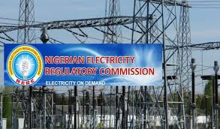
Objectives of the Presentation
To ensure that consumers know their rights and obligations.
To create pervasive awareness of Electricity Consumers rights and responsibilities in the Electricity Market.
To create a balancing act among stakeholders notably the Regulator, Service Providers and Electricity Customers.
To ensure effective market regulation, stability and profitability.
To create awareness among stakeholder to make electricity available on demand.

Slide 5

What is advocacy?
Advocacy is an activity by individual or group which aim to influence decision within the political , economic and social system and institution .
Advocacy also include many actitivities that a person or organization undertakes including media speaking, commissioning and publishing research.
Source : Wikipedia.

Slide 6

Purpose of our Advocacy
Advocacy in all its forms seek to ensure that people ,particularly those who are vulnerable in the society (ie Electricity Customers) are able to :
(a)Have their voice heard on issues that are important to them.
(b)Access information and services.
(c)Defend and safeguard their rights

Slide 7

Purpose of our advocacy Cont’d
(d) Have their views and wishes genuinely considered when decision are being made about their lives.
Express their views and rights
Explore choices and options available to them
Define their rights and responsibilities.

Slide 8
Why embarking on Advocacy Cont’d
“Information is power” “If you are not informed your deformed” –Anonymous
“Effective advocacy and information dissemination on extant regulatory laws by the regulator are essential ingredients for balance of power between Energy Providers and Customers in the Nigerian Electricity Market. - HD Blue-Jack.
Strangely, this public sensitization has being done, but more efforts are needed to inform unenlightened customers.

Slide 9

Channels of Advocacy
Town Hall Meeting
Print Media/ Electronic Media
Radio Jingles
Social Media/ Internet
Billboards etc
Retreat among Stakeholders

Slide 10
Stakeholders Responsibilities
The ESPR Act 2005 recognized three major actors namely:
(1) The Regulator ( NERC)/ Government.
(2) The Distribution Companies( DIsCos).
(3) The Customers/Consumers.
Each of these major actors have decisive roles to play as viz:
.

Slide 11
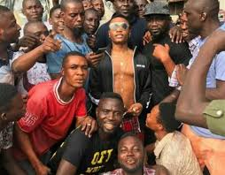
Nerc Responsibilities
The Nigerian Electricity Regulatory Commission (NERC) is empowered by the Electric Power Sector Reform (EPSR) Act, 2005 to ensure an efficiently managed electricity supply industry that meets the yearnings of Nigerians for stable, adequate and safe electricity supply ( Source : Nerc Website)
In light of the above NERC have the following roles
to play:
Sensitize members of the Public on Electricity Customer Bill of Rights by allocating more fund on publicity.
.

Slide 12

Nerc Responsibilities cont’d
Approve electricity prices based on economic indices.
Enforce regulatory laws to ensure adequate consumers protection.
Affordable pricing of electricity, products and services in order to recover investment.
)Right to protection of life and property through enforcement.

Slide 13
Create redress mechanism awareness for both Electricity Consumers and DisCOs.
Education and enlightenment of Electricity Customers on their Bill of Rights and Responsibilities.
Notes:
are

Slide 14
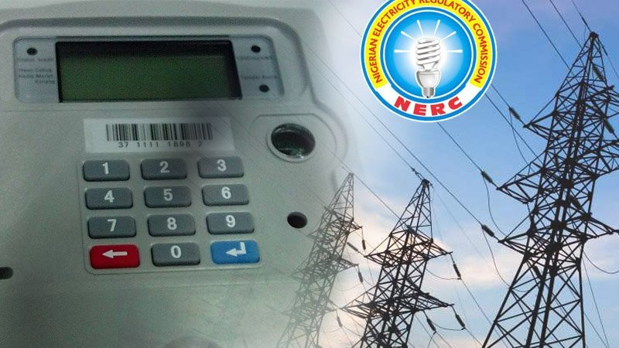
DisCos Responsibilities
DisCos must comply with bill of rights of customers as spelt out ESPR Act 2005.
Organise Town Hall Meeting, use radio , and other communication routes to empower customers to know their rights for efficient power sector delivery.

Slide 15
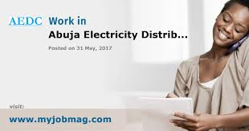
Under Education and enlightenment the DisCos owes the customers on the following responsibilities:
(1 (2) right to be heard
(3) right to seek redress
(4) right to education on products and services offered by DisCos
Right to steps in complaints resolution procedures.

Slide 16
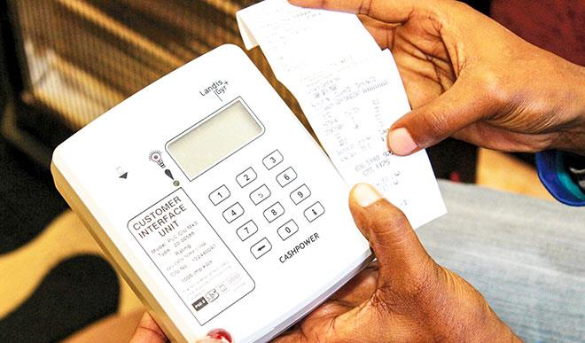
Customers Rights
All customers have right to properly install functional meter.
It is the customers right to be notified in writing ahead of any disconnection of electricity.
Customers need to be properly educated on how to seek redress ie From Customer Compliant Unit, Forum Office and NERC.

Slide 17
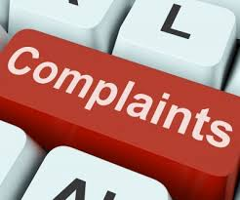
Customers Right Cont’d
.
It is the customers rights to context controversial electricity bill
All customer have the right to complaint and to prompt investigation of complaint.

Slide 18
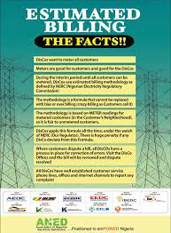
All customers have the rights to transparent billing.
All Customers have the right to refund when over billed

Slide 19
Customers Responsibilities
It is the customers Obligation to pay their bills when due and time.
It the customers responsibility to report of any electricity faults and hazards within the jurisdiction of the Electricity Provider (DisCos).
All customers aware to be aware that meter-bypass attract a huge penalty of (N100,000.00)Hundred Thousand Naira.
All customers are not to tamper with Discos' properties.

Slide 20
Why engaging an Advocacy Consultant ?
Consultant are hired to free up time to enable hired workers to concentrate on basic core business.
When problem appears to close for employees to understand it on all ramification, external consultant may make a difference by getting to the route of the problem.
External consultant will go extra mile in solving the problem as stated in terms of reference(TOR).
Specialist knowledge will minimize stress as well reduce time in proffering solution.

Slide 21
Conclusion
In conclusion, it is discernable from our presentation that the major problem in the Electricity Delivery Service Market is basically ignorance among the end-users.
The Regulator and DisCos are to do more in the above to close this gap of enlightenment caused by ignorance.
According to Mike Murduck,” the eyes that look are many, but the one that see are few”.
Our Advocacy Group have identified the need for robust and pervasive education , enlightenment and strong advocacy to address the issues of electricity customers rights and responsibilities.
We are prepared to collaborate with stakeholders to bring about the deserved service improvement and create a win – win situation for all stakeholder within the Nigerian Electricity Market Value Chain; to justify the objectives of the Power Sector Privatisation .

Slide 22
Thank you for listening

