Slide 1
FINAL YEAR PROJECT MINI DEFENCE
PROJECT TOPIC: DEVELOPMENT OF AN ONLINE RESERVATION SYSTEM
(A CASE STUDY OF BOWEN UNIVERSITY GUEST HOUSE, IWO)
BY
JOSHUA TAMUNOKURO BLUE-JACK
PROJECT SUPERVISOR:
MR. ADEYEMO
DEPARTMENT OF COMPUTER SCIENCE
COLLEGE OF COMPUTING AND COMMUNICATION STUDIES(COCCS)
BOWEN UNIVERSITY, IWO

Slide 2
DEVELOPMENT OF AN ONLINE
RESERVATION SYSTEM
(BOWEN UNIVERSITY AS CASE STUDY)

Slide 3
INTRODUCTION
The use of information technology has transformed the most sectors in the world today and the Hotel industry has not been left out.
Before now customers needed to contact agents to make bookings on their behalf, which was very slow and inefficient.
Computer Reservation Systems replaced the manual process in the early 1960s, first airline adopted it, causing the hotel and Tourism industry to incorporate it.
Technology made it easier.

Slide 4

STATEMENT OF RESEARCH PROBLEM
The Reservation of rooms in the university guest house is currently done manually which has proven to be inefficient and stressful.
To the visitors also, there is no platform accessible to make inquiries about the availability of rooms and possibly make reservation when planning a visit to the university. Making the inquiry process exhaustive and slow. This project aims at tackling that problem

Slide 5
AIMS
The aim of this project is to design and implement an online reservation system for the Bowen University Guest House.

Slide 6
OBJECTIVES
To use a few Research Methods to capture relevant data necessary for the development of a functional reservation system.
To design and represent the proposed system with Unified Modeling Language (UML) diagrams.
Apply the design developed to the proposed online reservation system.
To incorporate all information gathered to the online reservation system.

Slide 7
METHODOLOGY
The aims of this project will be achieved, using the following methods:
One-on-One Interviews with the Guest House Manager to derive the necessary requirements for the development of this reservation system.
Unified Modeling Languages (UML) diagrams for the designing of diagrammatic models for this application
Development of this application will be handled with Bootstrap, JavaScript for the front end and PHP(Hyper Text Preprocessor) will be used to handle the backend, WAMP server will be used to host the application locally and MySQL for designing of the database. Also all customer transactions will be stored in the database for easy retrieval and management. Visual Studio Code will be used as the IDE for this project.

Slide 8
LITERATURE REVIEW TABLE
S/N | AUTHOR(s) and DATE | PROBLEM ADDRESSED | METHODOLOGY EMPLOYED | RESULT | REMARK
1. | Williams (2018) | Design and Implementation of Reservation Management System Case Study: Grand View Hotels | Object Oriented Approach and Feasibility Study | Forms proved to be an efficient way of inputting user records into the reservation system | The research finding showed emphasized on the importance of implementing an accounting system and management information system to serve the need of the hotel
2 | Bemille (2014) | Development of an Online Hotel reservation system to replace the manual booking process | Macromedia dream weaver was used due to its user friendly features | Proper storing of customer records was achieved with the new system, now The hotel’s advertising effort is now accompanied by a virtual tour created on the system | The study did not show relevant diagrammatic models developed that were used to design the reservation system

Slide 9
S/N | AUTHOR(s) and DATE | PROBLEM ADDRESSED | METHODOLOGY EMPLYOYED | RESULT | REMARK
3 | Adams(2017) | Development of an Online Reservation System for Ta’al Hotel | Software Development Life Cycle was adopted, observations and Agile Software Development | Customers were able to make reservations successfully but were unable to make online payment | They study was able to properly show designs used to develop the reservation which made it easier to understand
4 | Anuar(2013) | Using Mobile Hotel Reservation System among 3-5 star City hotels in Malaysia | In-depth interviews were carried out to explore the mobile hotel benefits structure | More knowledge on the importance of Mobile Hotel reservation systems in aiding marketing strategies were explored | This study showed the core benefits of mobile hotel reservation system such as Convenient Access, Customer support center etc.

Slide 10
PROPOESD SYSTEM
As a replacement for the manual system currently used to make bookings in the Guest House. The proposed system is to develop an Online Reservation System to improve efficiency making bookings, manage customer details and also make it easier for future visitors to inquire for information when trying to book accommodation.

Slide 11

SYSTEM DESIGN
A system design stage states how the design of the system will be constructed with high emphasis on the model and approach through which the system would be developed. It describes the flow of processes to accomplish the logical design of the system which includes the architectural, the use case, flow charts and activity diagrams.
The following design are used for the project
Use case Design
System Architecture Design
Flow Chart Design for the User and System Admin

Slide 12
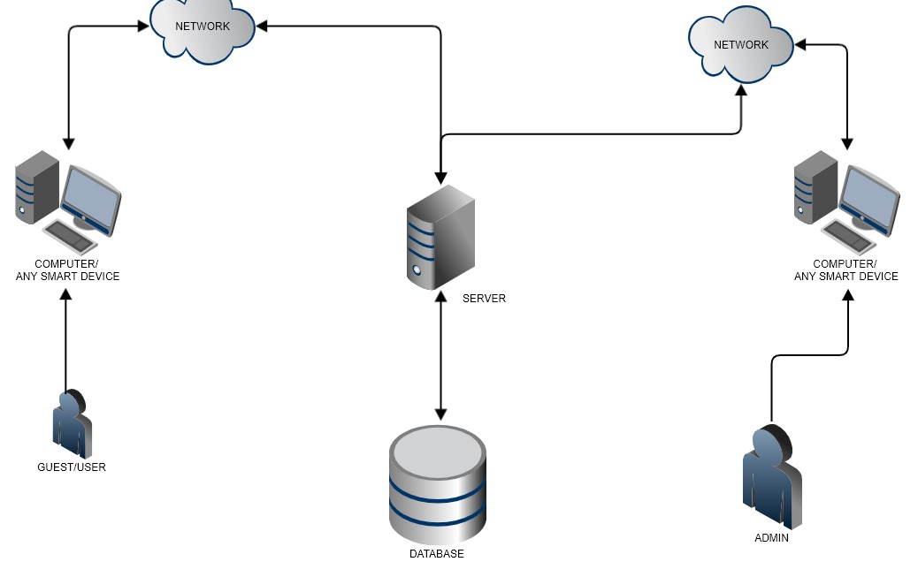
System Architecture

Slide 13
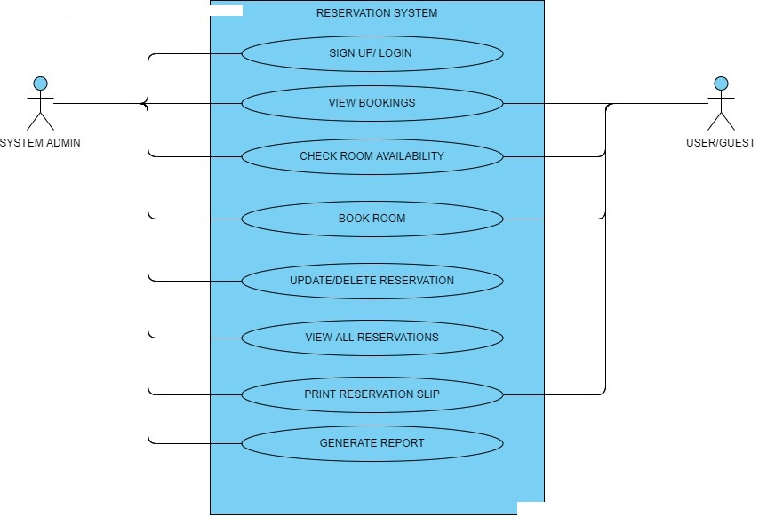
Use Case Diagram

Slide 14
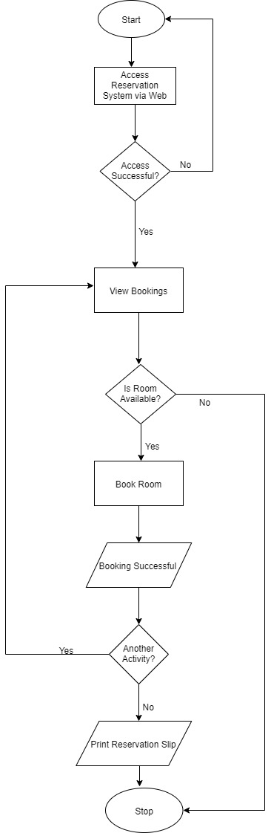
Flow Chart for Guest/User

Slide 15
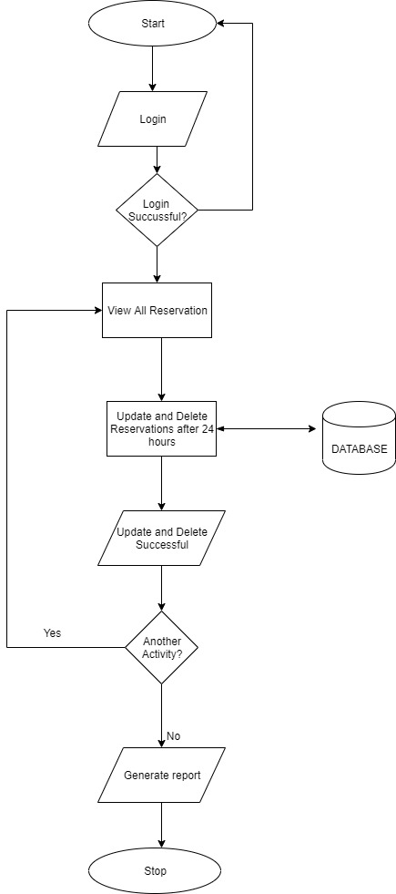
Flow Chart for System Admin

Slide 16
Expected Result
1. Eliminate manual reservation method.
2. Provide Online Access to the University Guest Reservation system to enable future Guest/users book rooms remotely.
3. Efficient management of User/Visitor Transactions.

Slide 17

Conclusion
Reservation systems has made the process of booking easier for both Guests and System Admins, the incorporation of reservation systems into the hotel industry has helped drastically in managing records efficiently and faster leading to increased productivity and comfort. This project will makie the booking process a lot easier for future visitors to the university.

Slide 18
THANK YOU FOR LISTENING!!

