Slide 1

Bowen University, Iwo
Faculty of Science and Science Education
Department of Computer Science
IT/SWIES REPORT

Slide 2
Presented By:
JOSHUA BLUE-JACK
SSE/016/16103

Slide 3
Brief SIWES History
The Student Industrial Work Experience Scheme (SIWES)was initiated in 1973 by Industrial Training Fund(ITF) to bridge the gap between theory and practical knowledge among the students in institutions of higher learning in Nigeria.

Slide 4
AIMS AND OBJECTIVES OF SIWES
It was aimed at bridging the gap between the theoretical knowledge acquired in class and the Practical knowledge in the Industries by providing students with the opportunities to apply their educational knowledge in real work situations.
Grooms student on how to have good human relation with their co-workers, therefore tolerating and being patient with them.
Prepares students for employment and makes the transition from school to the world of work easier after graduation.
SIWES will increase a student’s sense of responsibility.

Slide 5

Organization
OFFICE MACHINES NIGERIAN LIMITED
Location: 8 Nairobi Street, Off Parakou Cres, Wuse 2, Abuja

Slide 6
About Office Machines Nigerian Limited(OMNL)
Office Machines Nigerian Limited(OMNL) was incorporated on the 15th of January,2008. Office Machines Nigerian Limited (OMNL) is an Information Technology(IT) consulting company that provides innovative solutions to government, companies and people in West Africa. This organization handles development and deployment of applications, trainings and facility management solutions for organizations within Nigeria.

Slide 7
Office Machines Nigerian Limited Organogram
MD
Head Finance/Accounts
Technical Lead
Sales/Marketing Officer 2
Business Development Lead
Sales/Marketing Officer
Technical Consultant
Finance Consultant
Technical Consultant 2

Slide 8
Organization Structure
The various departments in the organization and their functions
I.T and Projects Department
Finance and Accounting Department
Marketing Department
I.T and Projects Department :
The I.T and Projects Department is responsible for the planning, development, support, management and follow-up of the company’s existing projects. They are also responsible for the assembling and testing of technological devices purchased, they work in teams in preparing reports for various projects. They help in assisting the members of staff with major or minor problems concerning the office facilities.
Finance and Accounting Department:
The finance and accounting department focuses on the following up of payments for work done, securing of contracts, managing the office accounts, preparing of repositions when necessary and makes sure that all necessary office needs are met.
Marketing Department:
The marketing department is solely responsible for biding of new contracts, preparation and submitting of documents necessary for bids and lastly, submission and follow-up of new business proposals

Slide 9
Industry Placement
IT and Projects Department:
The I.T and Projects Department is responsible for the planning, development of applications, support, management and follow-up of the company’s existing projects. They are also responsible for the assembling and testing of technological devices purchased, they work in teams in preparing reports for various projects. They help in assisting the members of staff with major or minor problems concerning the office facilities.

Slide 10
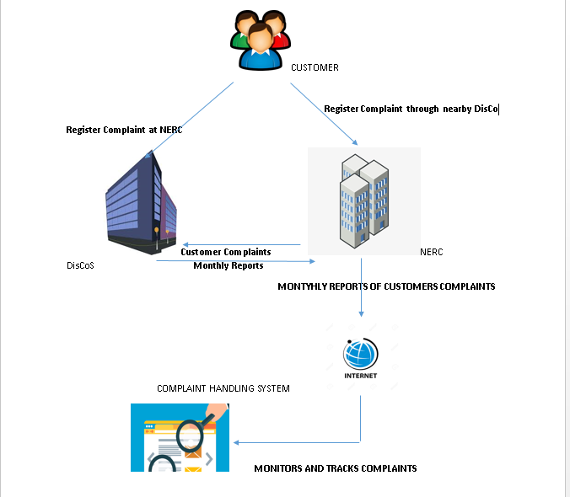
Contributions to the Organization
I was involved in the testing, review, documentations of user manuals and presentations made for the Customer Complaint Handling System(CHS) application for the Nigerian Electricity Regulatory Commission(NERC).
I helped in designing pictorial descriptions of the business process for the Customer Complaint Handling System(CHS)application for the Nigerian Electricity Regulatory Commission(NERC).
I worked with the four-man team in deploying an Education and Training Administration application for an aviation school.
I handled the installation process of the Central Call Data Record(CCDR) application for the National Communications Commission(NCC)

Slide 11
Recommendations
The company should have a detailed plan for what students are to achieve at the end of their SIWES programme.
Also I suggest that all IT/SIWES students should be assigned a major project before the termination of the SIWES program. As doing such will advance Student’s ability to Research and be productive.

Slide 12
Skills Acquired
Static Website Development (using bootstrap)
The advance use of Microsoft Office and Google Tools (Microsoft Word, PowerPoint, Excel, Gliphy diagrams).
Team spirit
Management skills

Slide 13
Conclusion
In conclusion, my six months SIWES program was a big eye opener to the real work situations in the technology industry. I was exposed to the practical application development lifecycle and good practices in managing clients. In all my SIWES programme was an informative and interesting period.

