Slide 1
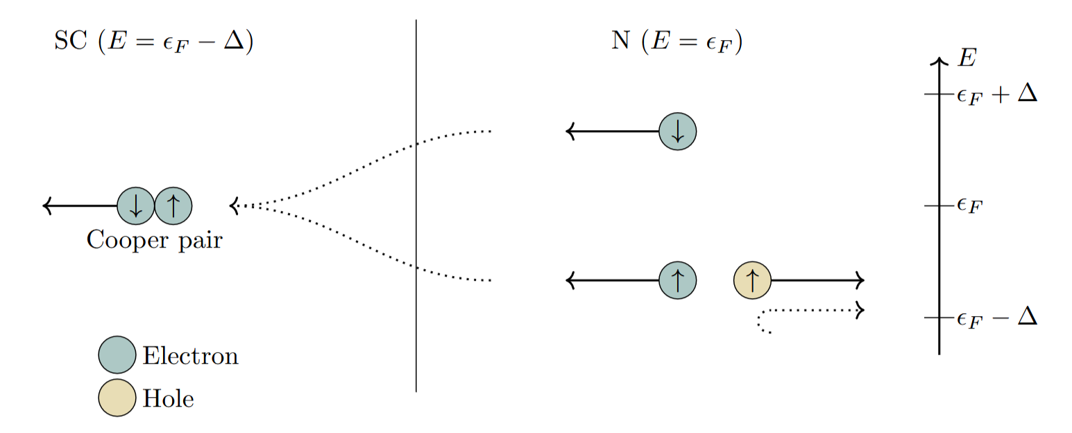
Proximity effects in altermagnetic systems

Slide 2
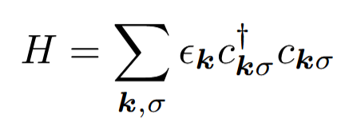






Fermi-liquids
We consider an inert Fermi-sea
$$q$$
Non-interacting case
Interacting case
$k$’
$$q$$
$$k$$

Slide 3



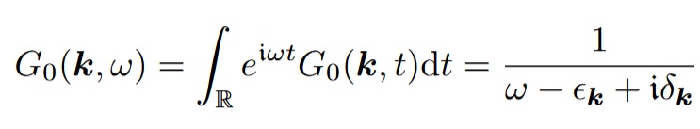






Fermi-liquids
Propagator and Dyson equation
Non-interacting case
$k$’
Probability
$$k$$
$k$’
$$t$$
$$t′$$
The particle should not scatter:

Slide 4


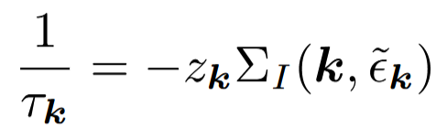
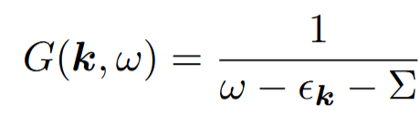




Fermi-liquids
Propagator and Dyson equation
Interacting case
Among other possibilities..
$$k$$
$k$’
Momentum transfert
$$t$$
$$t′$$
The particle can scatter:

Slide 5
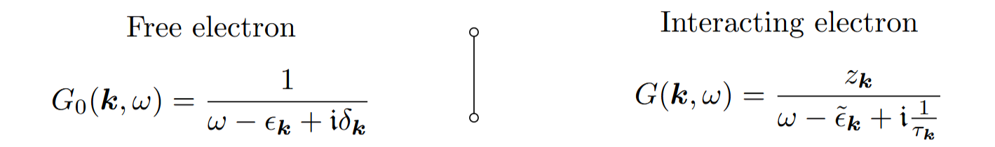
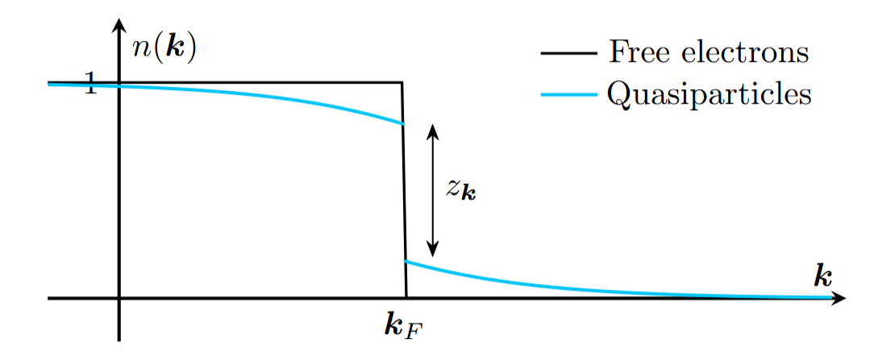
Fermi-liquids
Propagator and Dyson equation
Summary
$z_{k}>0$: We find a precise low energy single particle excitation. Not an exact eigenstate: a quasiparticle.
Fermi-liquid: interacting system of electrons and quasiparticles.

Slide 6
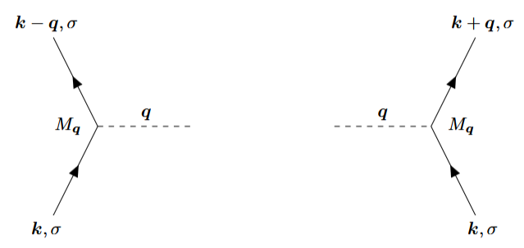
Stability of the liquid
Overview
To repulsive interactions
Coulomb potential > 0 and the accessible states are above the Fermi-surface. ”Stable”
To attractive interactions Attractive interactions lead to states bellow the Fermi-surface:
“destabilization”
Phonon exchange in a lattice A phonon is send by an electron.
Later another electron absorbes it,
leading to an effective e-e interaction.

Slide 7
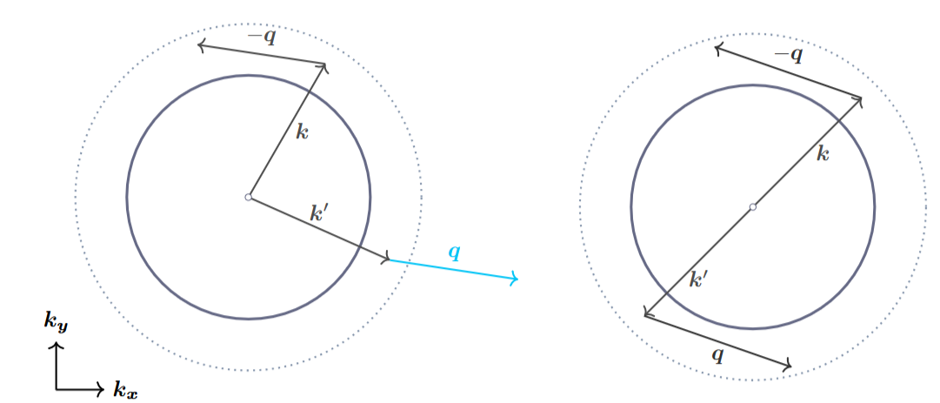


Stability of the liquid
Attractive interactions
The interactions takes place into a tiny shell (dotted line) around the Fermi-surface (solid circle).
Arbitrary $k$ and $k′$
$k=−k′$
Not a valid attractive interaction because the scattering makes the second electron leave the shell.
Scattering possibilities maximized.

Slide 8
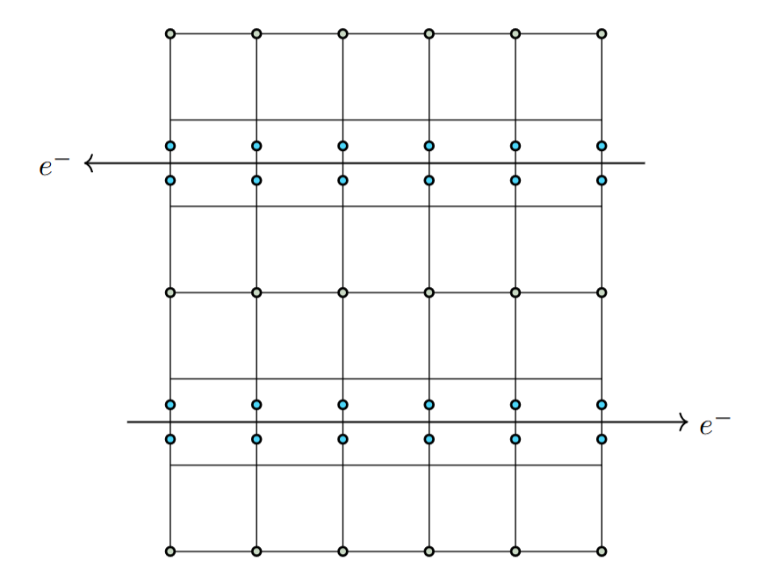
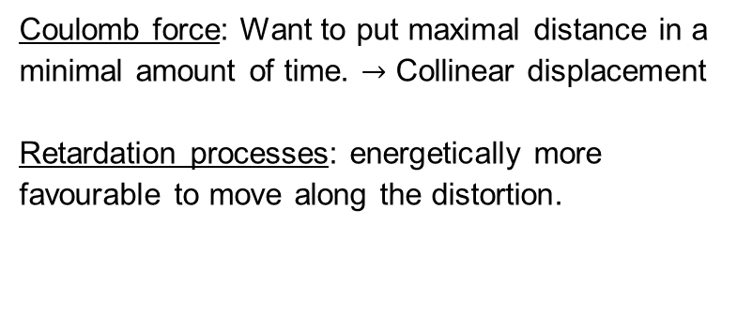
Stability of the liquid
Attractive interactions mediated by phonons
Retardation processes
An electron disforms the lattice. The ion moves slowly and comes back to its original position long after the electron left. A second electron experiences a dipole moment and is attracted towards the distortion.
And in real space?
Coulomb force: Want to put maximal distance in a minimal amount of time. $→$ Collinear displacement
Retardation processes: energetically more favourable to move along the distortion.

Slide 9
Stability of the liquid
Attractive interactions mediated by phonons
Pauli Principle
Electrons are very close to each other (recall the tiny shell). Due to the Pauli principle, they must have opposite spins to coexist.
Cooper-Pairing
Coupling of electrons in momentum space.
Requires electrons of opposite wave vectors and spins.
Behave like bosons and can therefore condensate.
“Superconductive condensate”.
Main source of superconductivity but also of principal origin of resistivity in clean materials.

Slide 10
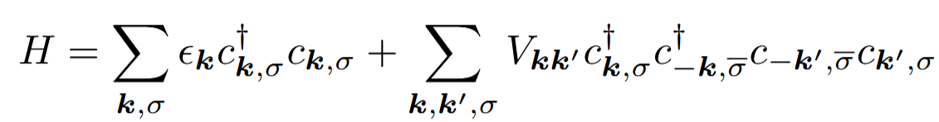

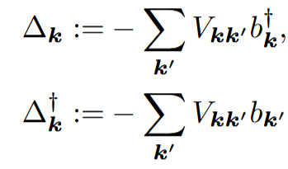


BCS superconductivity
Goal: present central concepts that follow from the mean field approach of the effective e-e interaction.
Effective e-e interaction:
Mean-field approach:
$→$ Energy gap:
Cumbersome result:

Slide 11
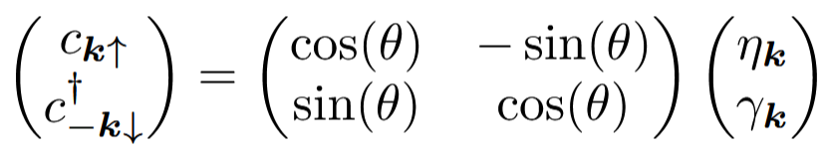
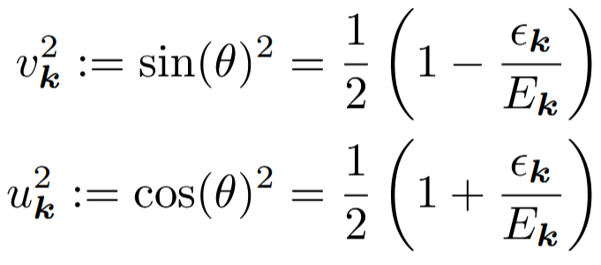
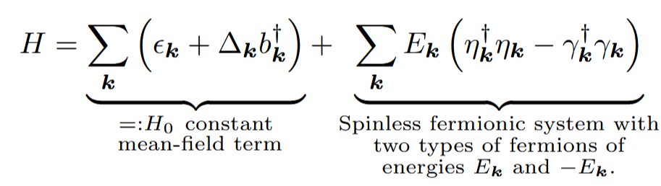

BCS superconductivity
Idea: rotate the basis to eliminate terms
The well-known coherence factors
Superconductivity in mean field:
And allows us to find a self consistent Eq. for the gap $∆_{k}$.

Slide 12

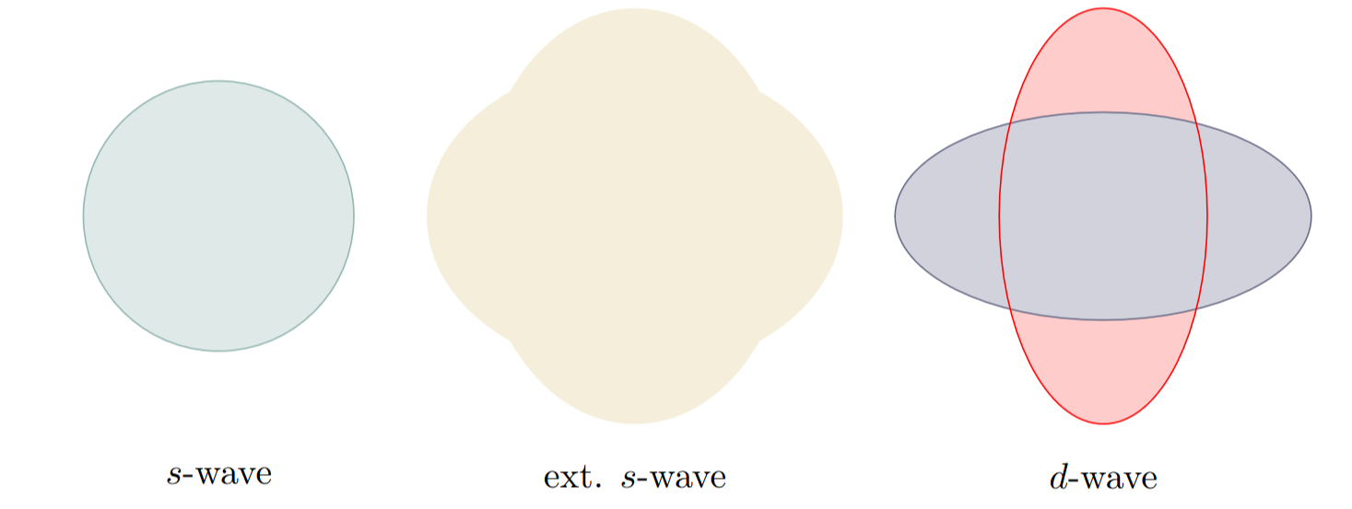
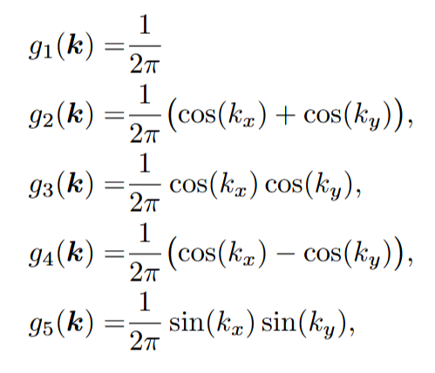
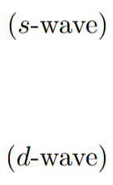
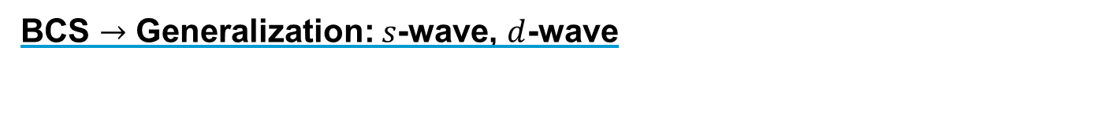
BCS $→$ Generalization: $s$-wave, $d$-wave
Because the states follow from the crystal periodicity, we can express the potential from the crystallographic basis.

Slide 13
Proximity effects

Slide 14
Freepik
okta

