Slide 1
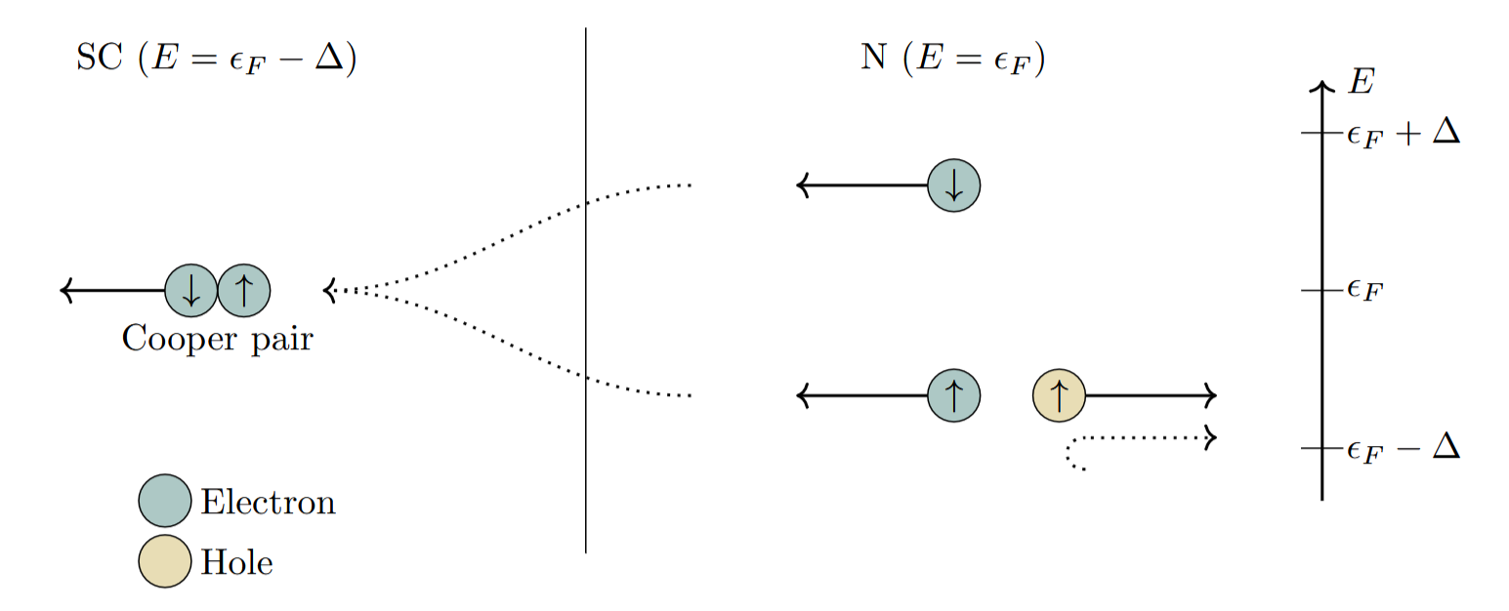
Proximity effects in altermagnetic systems
A bachelor thesis in theoretical physics.
Arto Steffan

Slide 2
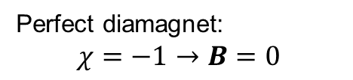
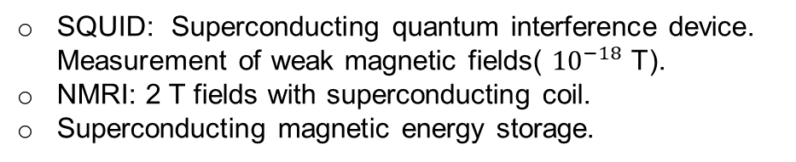

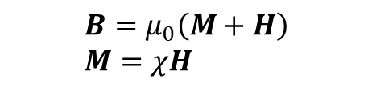

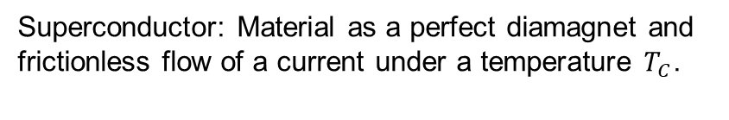





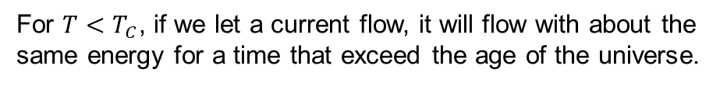
Superconductivity
Friction less flow of a current
An overview
For ${T<T}_{C}$, if we let a current flow, it will flow with about the same energy for a time that exceed the age of the universe.
Chapter based on [1].
$$ρ$$
Main characteristics
Superconductor: Material as a perfect diamagnet and frictionless flow of a current under a temperature $T_{C}$.
Perfect diamagnet: the Meissner state
$${ T}_{C}$$
$$T$$
Drop in the resistivity under the critical temperature.
$$B$$
$$B=0$$
Practical applications
$${T>T}_{C}$$
$${T<T}_{C}$$
SQUID: Superconducting quantum interference device. Measurement of weak magnetic fields( ${10}^{−18}$ T).
NMRI: 2 T fields with superconducting coil.
Superconducting magnetic energy storage.
$$B=μ_{0}\left(M+H\right) \\ M=χH$$
Perfect diamagnet: $$χ=−1→B=0$$

Slide 3
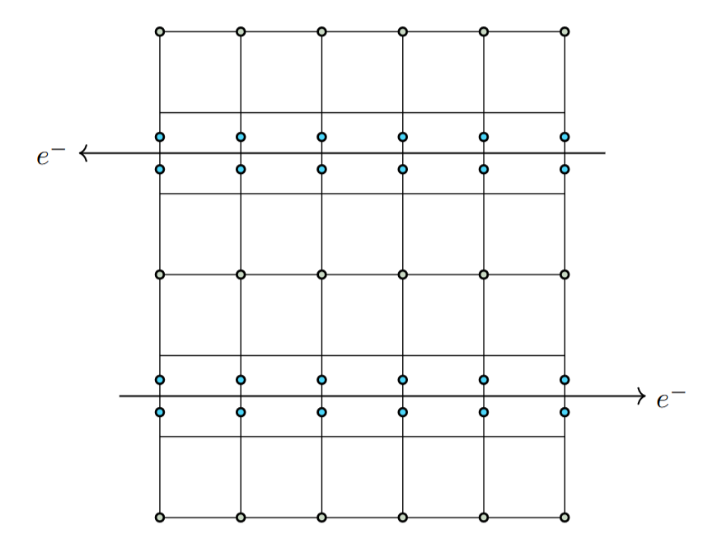
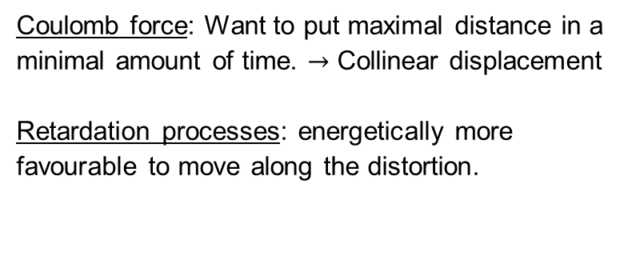
Superconductivity
An overview
Superconductivity with Cooper-pairs
A pair of electron couples in momentum space by exchanging a phonon.
The phonon exchange can lead to an attractive interaction.
This requires the electrons to have opposite momentums, and Pauli-principle force opposite spins.
It’s a Cooper pair and it acts like a boson, takes part to a condensate.
Cooper pairing in real space.
Retardation processes
An electron disforms the lattice. The ion moves slowly and comes back to its original position long after the electron left. A second electron experiences a dipole moment and is attracted towards the distortion.
And in real space?
Coulomb force: Want to put maximal distance in a minimal amount of time. $→$ Collinear displacement
Retardation processes: energetically more favourable to move along the distortion.

Slide 4
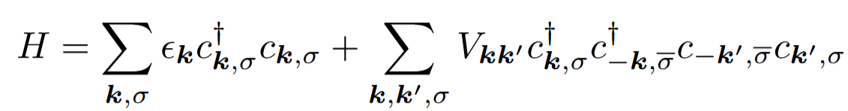

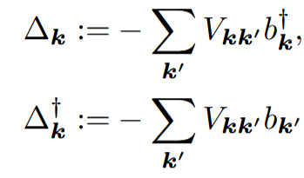


BCS superconductivity
Goal of the formulas: present central concepts that follow from the mean field approach of the effective e-e interaction.
Effective e-e interaction:
Mean-field approach:
$→$ Energy gap:
Cumbersome result:

Slide 5
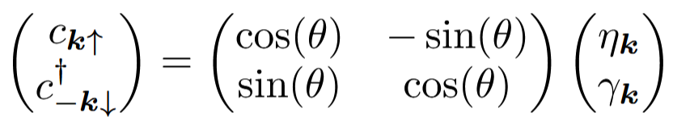
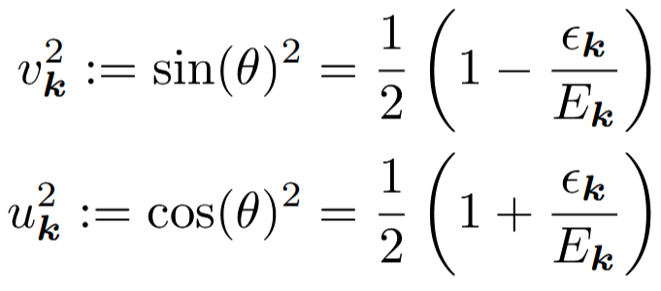
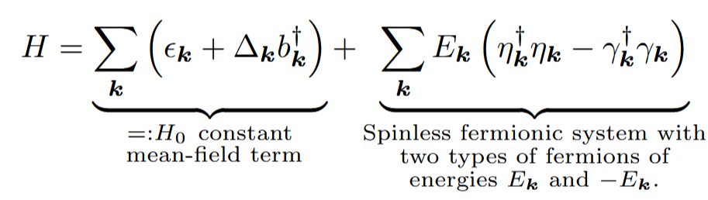

BCS superconductivity
Idea: rotate the basis to eliminate terms
The well-known coherence factors
Superconductivity in mean field:
And allows us to find a self consistent Eq. for the gap $∆_{k}$.

Slide 6

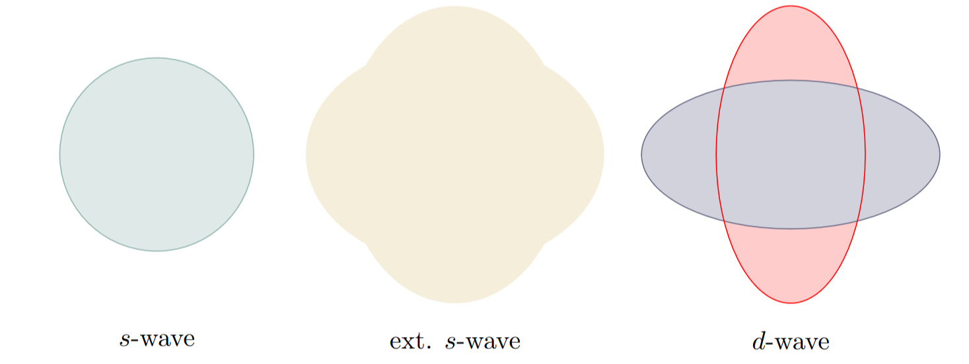
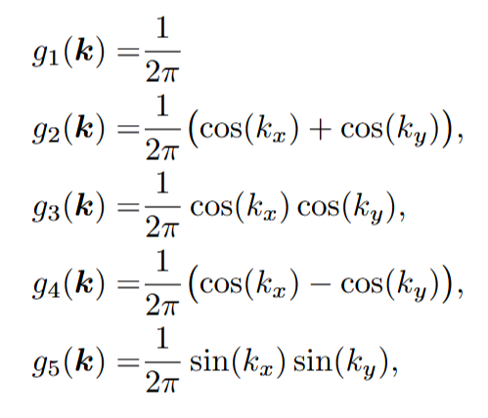
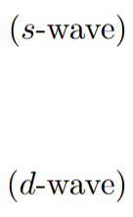
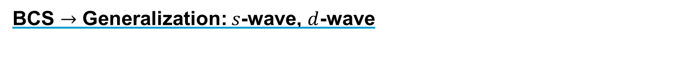
BCS $→$ Generalization: $s$-wave, $d$-wave
Because the states follow from the crystal periodicity, we can express the potential from the crystallographic basis.
Shape of the gap in the 1-st Brillouin zone.

Slide 7
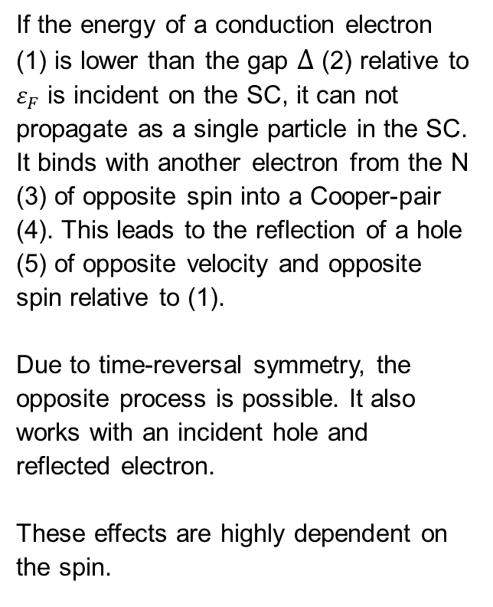
Proximity effects
In essence
Andreev reflection
If the energy of a conduction electron (1) is lower than the gap $∆$ (2) relative to $ε_{F}$ is incident on the SC, it can not propagate as a single particle in the SC. It binds with another electron from the N (3) of opposite spin into a Cooper-pair (4). This leads to the reflection of a hole (5) of opposite velocity and opposite spin relative to (1).
Due to time-reversal symmetry, the opposite process is possible. It also works with an incident hole and reflected electron.
These effects are highly dependent on the spin.
(2)
(4)
(1)
(3)
(5)
Andreev reflection and their inverse process: the Cooper pair leakage.
Leakage of Cooper pairs
It describes the leakage of Cooper pairs from the SC to the N. The pair breaks after a certain penetration depth. This is our focus.
[2] and [3]

Slide 8
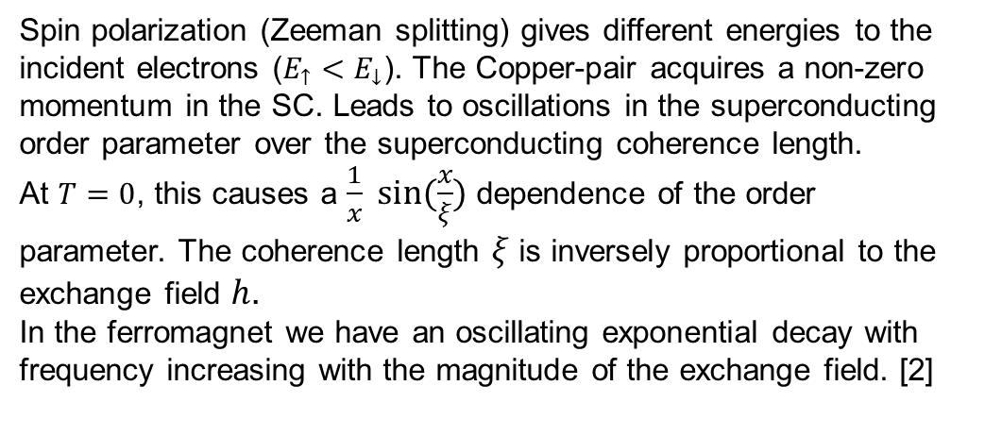
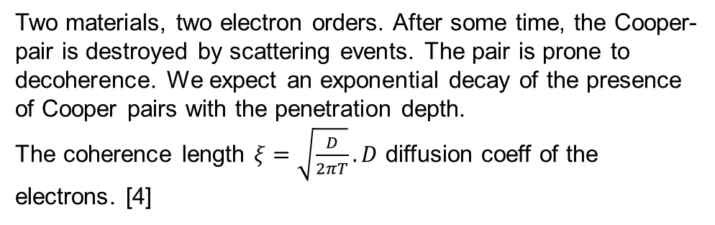
Proximity effects
Normal metals
Two materials, two electron orders. After some time, the Cooper-pair is destroyed by scattering events. The pair is prone to decoherence. We expect an exponential decay of the presence of Cooper pairs with the penetration depth.
The coherence length $ξ=\sqrt{\frac{D}{2πT}}.D$ diffusion coeff of the electrons. [4]
Antiferromagnets
Due to the two sublattices of opposite spins, the exchange field is cancelled out at larger scales but still locally destroys the Cooper-pairs.
We observe a decay of the singlet superconducting order parameter as well.
Coherence length longer because the exchange field is typically weaker.
On the other hand, unconventional spin-triplet Cooper-pairs emerge, and their pairing amplitude oscillates rapidly in space, like the AFM spins. They align with the spin structure and can therefore penetrate further than in the FM. [5]
Ferromagnets
Spin polarization (Zeeman splitting) gives different energies to the incident electrons ($E_{↑}<E_{↓}$). The Copper-pair acquires a non-zero momentum in the SC. Leads to oscillations in the superconducting order parameter over the superconducting coherence length.
At $T=0$, this causes a $\frac{1}{x} sin⁡(\frac{x}{ξ})$ dependence of the order parameter. The coherence length $ξ$ is inversely proportional to the exchange field $h$.
In the ferromagnet we have an oscillating exponential decay with frequency increasing with the magnitude of the exchange field. [2]

Slide 9
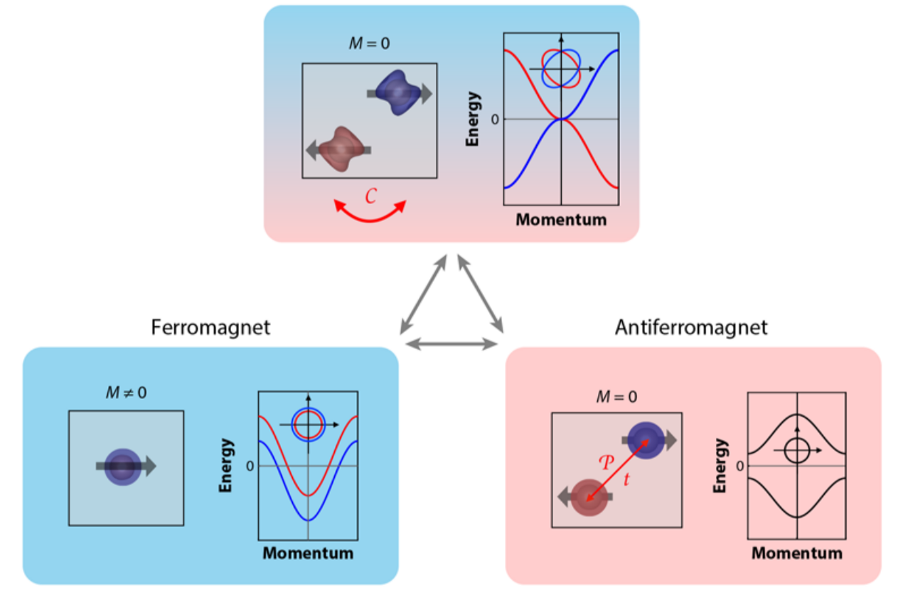
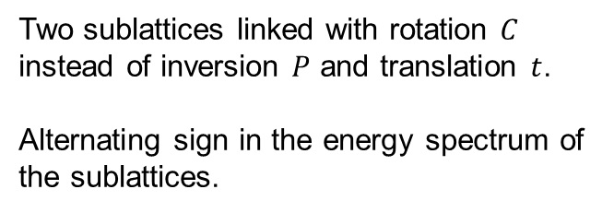
Altermagnet
Overview
In the landscape of magnetism
The altermagnet (AM) shares properties of the antiferromagnet (AFM) and the ferromagnet (FM).
Like the AFM: fully compensated magnetization due to two sublattices of opposite spins.
Like the FM: spin polarization. anomalous Hall effect, spin current, tunnelling magneto- resistance.
Symmetries and sublattices
Two sublattices linked with rotation $C$ instead of inversion $P$ and translation $t$.
Alternating sign in the energy spectrum of the sublattices.
Shape of the lattice and energy-momentum graphics of the anti-, ferromagnet and the altermagnet.
[6]

Slide 10
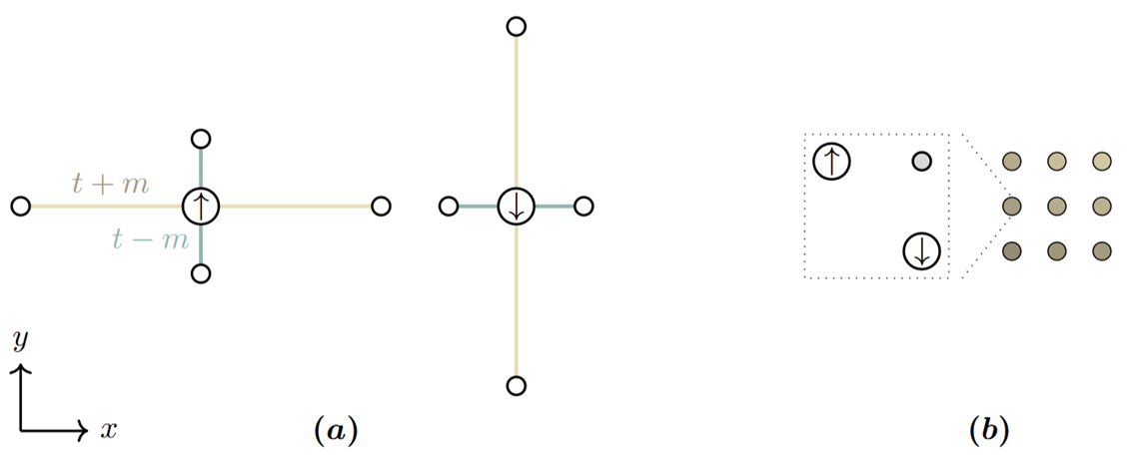
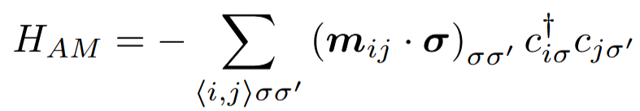


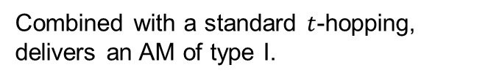

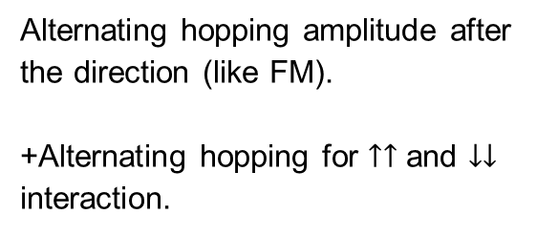

Altermagnet
Implementation
Type I (a)
Alternating hopping amplitude after the direction (like FM).
+Alternating hopping for $↑↑$ and $↓↓$ interaction.
Type II (b)
Non-magnetic particle in the unit cell.
Altermagnet of type I (a) and II (b).
Hamiltonian
$$e_{x}:$$
$$e_{y}:$$
Combined with a standard $t$-hopping, delivers an AM of type I.

Slide 11
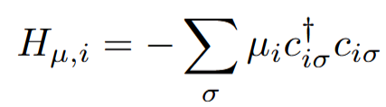
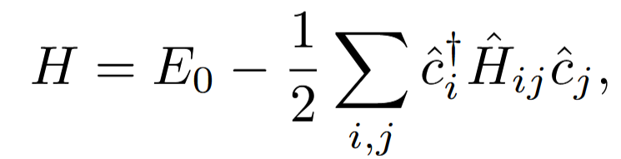
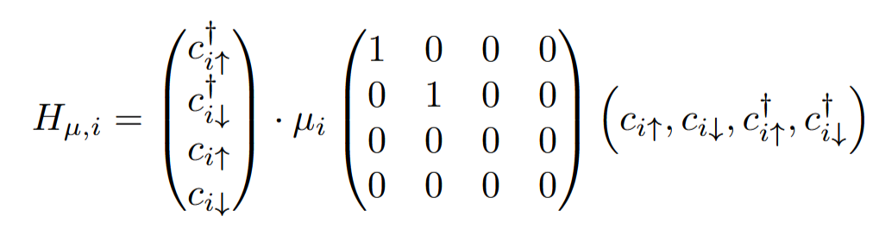
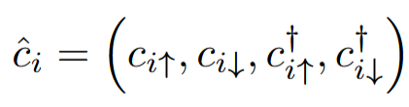
The Bogoliubov de-Gennes transformation
Overview
Key idea
Example
Transform the Hamiltonian in a vector-matrix-vector product.
Then by diagonalising the matrix we can find from the eigenvalues, -vectors an expression for the physical quantities we want to calculate.
The chemical potential is a simple term:
This makes the self consistent algorithm easier to solve. We need to diagonalize a matrix..

Slide 12




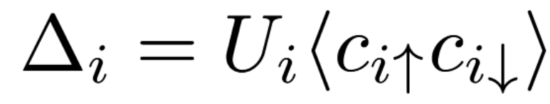
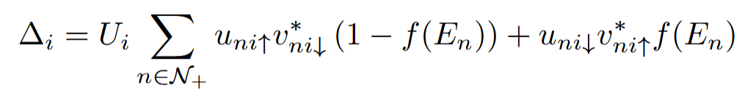


The Bogoliubov de-Gennes transformation
In action
Build the matrix
Transformation of the $c$-operators
Diagonalize
Compute $∆$
Converged since last update of $∆$?
Transformation of $∆$
No
Yes
Finished

Slide 13
The utility of quasiparticles
System excitations that arise when multiple fermions interact.
Not fundamental particle of the system.
Describe for ex. in a Cooper-pair, the excitation above the gap.
Whereas the Hamiltonian is not diagonal in term of the original fermionic operators, the Bogoliubov quasiparticle operators can give a solution.
These are linear combination of particle and hole operators: quasiparticles are superposition of particle and holes because of the interactions.

Slide 14
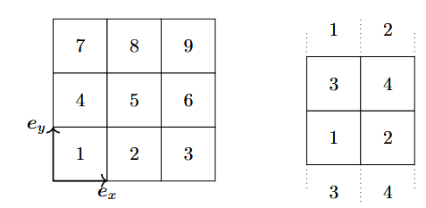

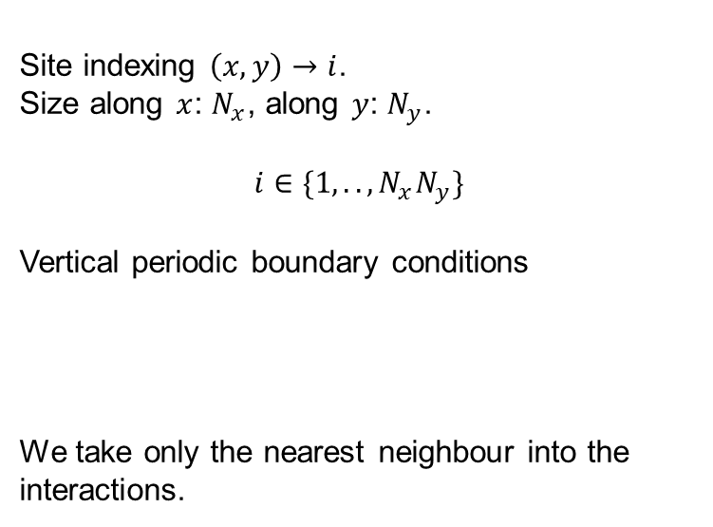



Simulated system
Rectangular system
Site indexing $\left(x,y\right)→i$.
Size along $x$: $N_{x}$, along $y$: $N_{y}$.
$$i∈\{1,..,N_{x}N_{y}\}$$
Vertical periodic boundary conditions
We take only the nearest neighbour into the interactions.
The indexing technique and the representation of vertical periodic boundary conditions.
SC
AM
$$N_{x}N_{y}$$
A 6x4 lattice with a superconductor SC and an altermagnet AM.
$$1$$
$$2$$
$$N_{x}$$

Slide 15



The Bogoliubov de-Gennes transformation
Shape of the matrix
Diagonalized matrix
On site: $i=j$
Chem. potential
Superconductive gap
Along $x$
Nearest neighbours $i,j$
Along $y$
Hopping $t$ and $t±m$
The matrix is unitary and very sparse.

Slide 16
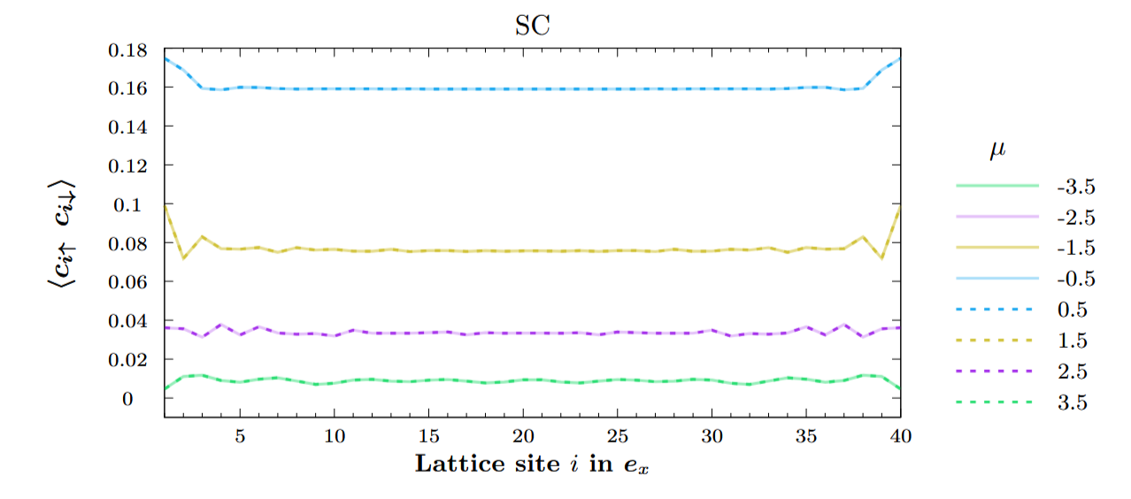
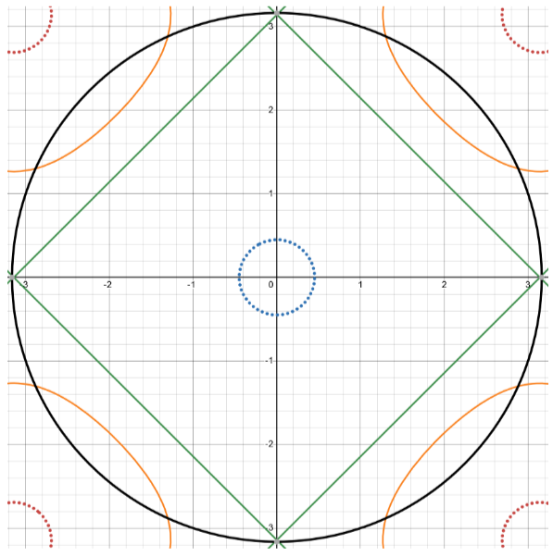

Results
Simple superconductor
$$Δ_{i}=U_{i}⟨c_{i↑}c_{i↓}⟩$$
1-st Brillouin zone. Fermi-surface and gap.
Superconductivity is the highest where the gap shares the most surface with the Fermi-surface.
Friedel oscillations

Slide 17
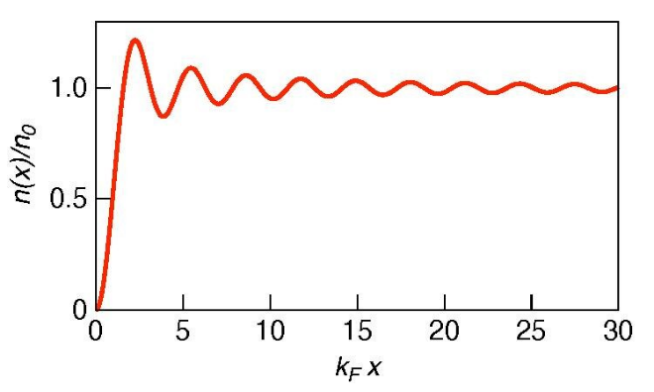
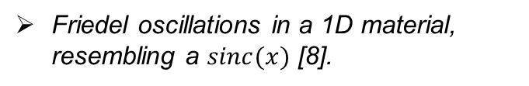
Friedel oscillations and Andreev bound states
Due to the open boundaries on the side (vacuum), the following process may emerge.
Andreev bound states
In inhomogeneous regions, multiples Andreev reflection can lead to Andreev bound states. These new states lies under the superconducting gap. They are therefore energetically more favourable, and we lose some candidates to form Cooper-pairs.
In the heterostructure, they may influence the DOS and therefore bring some modulations in the Friedel oscillations. [9]
Friedel oscillations
Similarly to electrical screening, the electron of the Fermi-liquid will arrange themselves around the impurity to screen it. The vacuum can be seen as a defect in the Fermi-liquid. We need a wavevector description and the electron arrange themselves in a periodic manner [7], influencing the Cooper-pair formation.
Friedel oscillations in a 1D material, resembling a $sinc(x)$ [8].

Slide 18
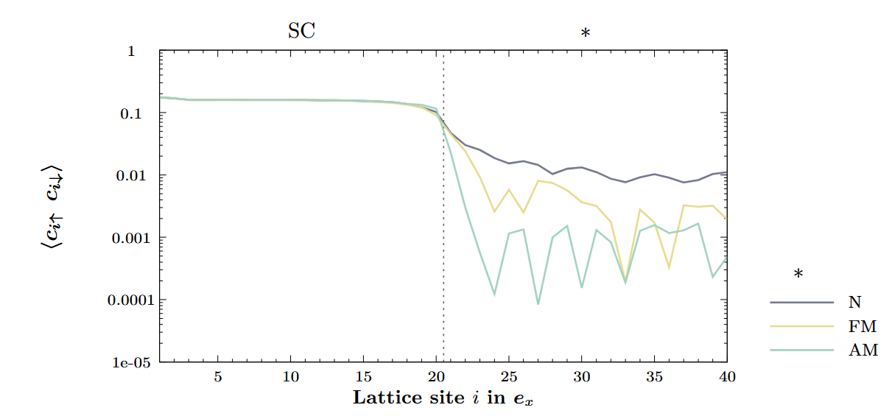

Results
Heterostructure: superconductor and N/FM/AM
Oscillations in AM.
Possibles Andreev bound states on the interface.
Penetration depth smaller in AM than FM and N. Greater oscillation amplitude.
$$Δ_{i}=U_{i}⟨c_{i↑}c_{i↓}⟩$$
$$μ=−0.5$$
$$U_{i}=2$$
$$U_{i}=0$$

Slide 19
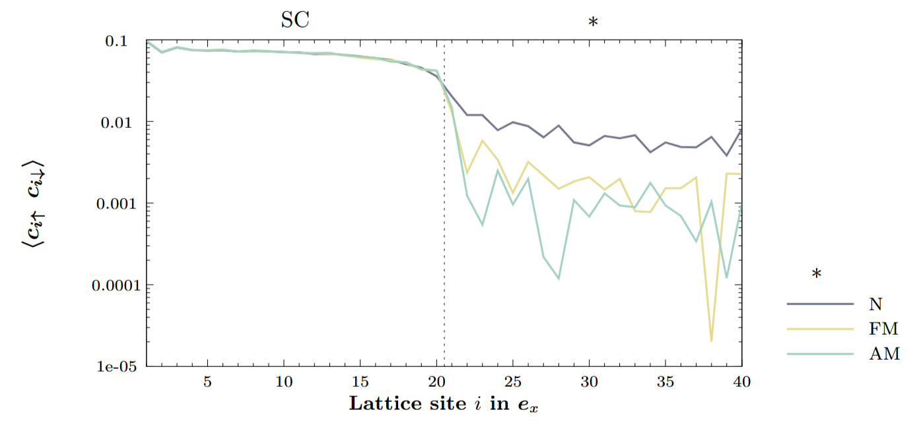

Results
Heterostructure: superconductor and N/FM/AM
$$μ=−1.5$$

Slide 20
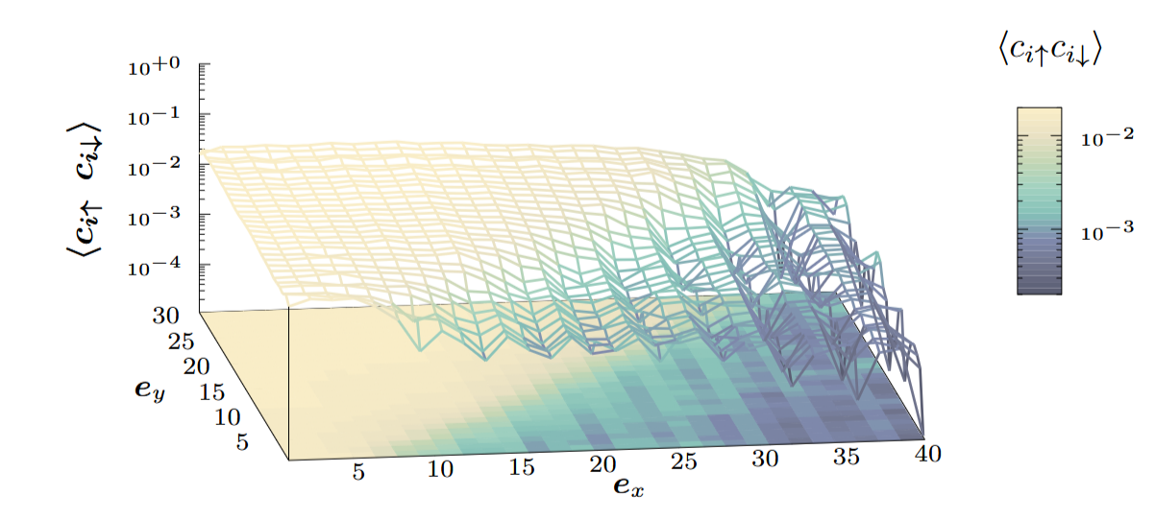
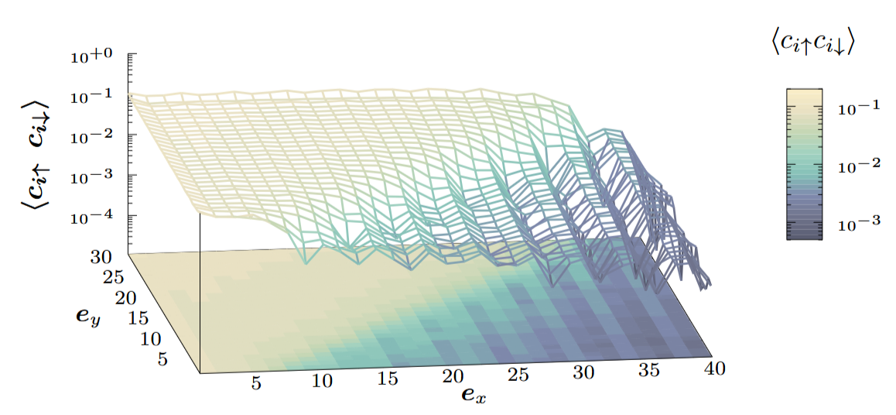
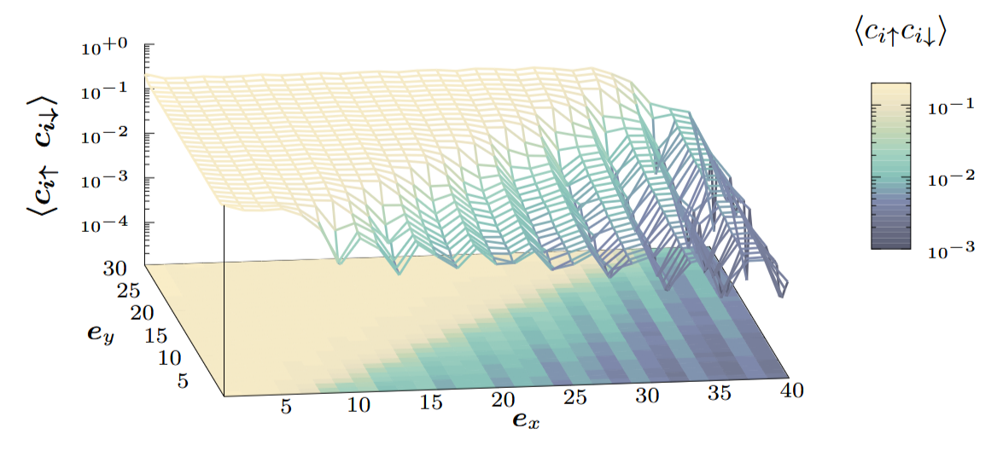
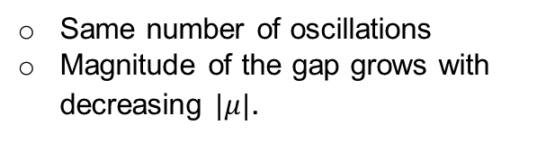



Results
Heterostructure: SC-AM and diagonal interface
$$μ=−2.5$$
$$μ=−1.5$$
Same number of oscillations
Magnitude of the gap grows with decreasing $|μ|$.
$$μ=−0.5$$

Slide 21
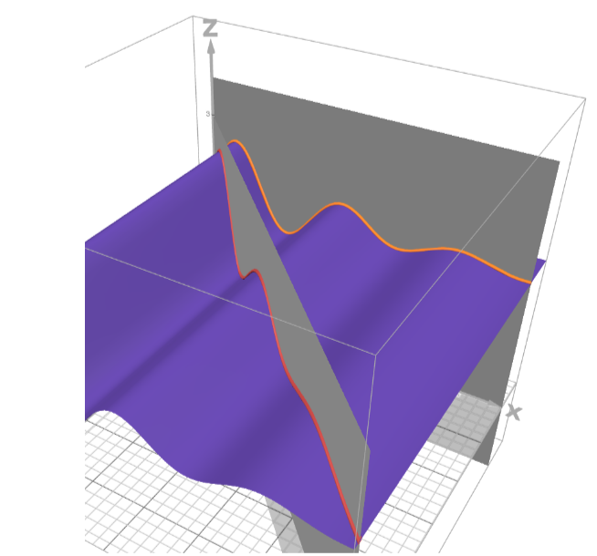
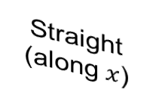

Results
Heterostructure: SC-AM and diagonal interface
Straight (along $x$)
The use of a diagonal interface results in less oscillations than in the straight interface
Diagonal
$$μ=−0.5$$

Slide 22
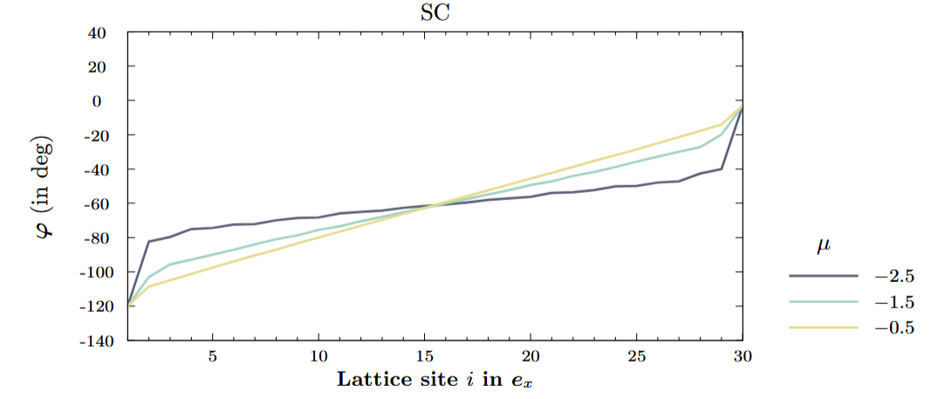
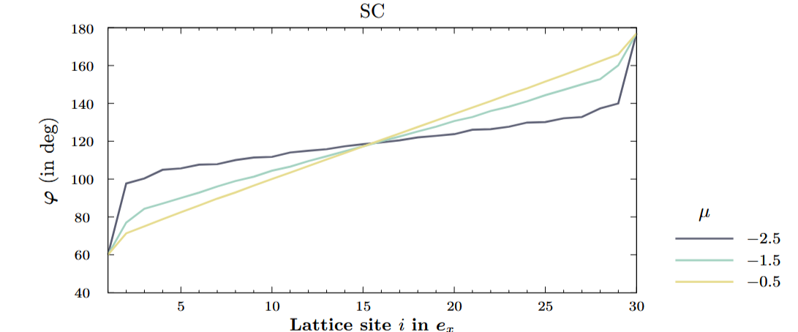
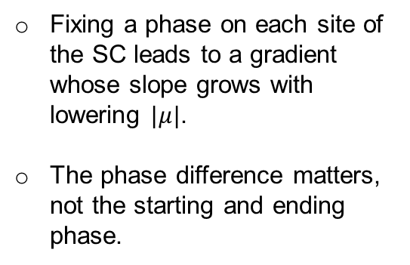
Results
Currents in SC
The superconducting current is expected to be proportional to the phase gradient of the gap. [10]
$$I∝∇φ$$
Fixing a phase on each site of the SC leads to a gradient whose slope grows with lowering $|μ|$.
The phase difference matters, not the starting and ending phase.

Slide 23
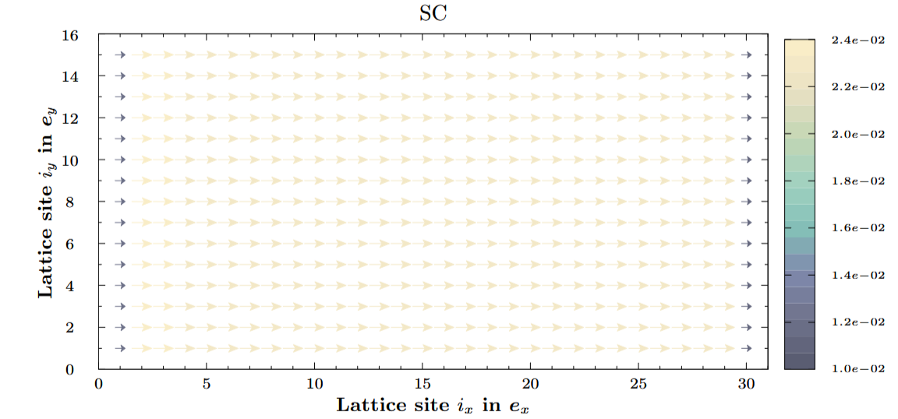



Results
Currents in SC: special distribution of the current
$I∝∇φ$ verified.
Bicolour: homogenous current in the bulk and discontinuity on the sides.
The current has the same shape for the different $μ$ and grows the more Cooper-pairs we have.

Slide 24

Results
Current continuity
Current conservation
$$∇I=0$$
Discrete derivative for lattice constant $a$
Current divergence is three orders of magnitude lower than the current. Assumed conserved.

Slide 25


Summary
Superconductors
Altermagnets
The ability of the system to form Cooper-pairs is the highest where the gap shares the most surface with the Fermi-surface.
BCS superconductivity is stronger with decreasing $|μ|$.
The phase gradient is stronger the more Cooper-pairs we have.
The supercurrent is proportional to the phase gradient of the gap and is conserved.
Exponential decrease of the pairing correlation function $⟨c_{i↑}c_{i↓}⟩$ modulated by oscillations.
Oscillations frequency is higher than in the FM.
Penetration depth is smaller than the FM.
In SC-AM junctions, the oscillations keep their shape regardless of the diagonal of straight interface, however the Cooper pair amplitude experiences oscillations of shorter frequency with the diagonal interface. Anisotropy of the pair-breaking, is due to the momentum dependence of the AM band structure.
Simulations
Friedel oscillations due to the open boundary conditions and possible presence of Andreev bound states.
Accuracy of the results can be increased with a higher lattice definition. Need of a better architecture.
AM
[6]

Slide 26



Outlook
+
The interest of $d$-wave superconductivity in AM
The spin polarized energy surface of the AM can have influence on the d-wave superconductivity. The d-wave superconductivity shows different energy surfaces for its positive and negative phase part (red and blue).
Due to this anisotropy, the case of study of a diagonal interface can be of particular interest.
-
AM
[6]
$$∆_{k}=∆_{0}(\cos\left(k_{x}\right)−\cos\left(k_{y}\right))$$
Along $k_{x}=±k_{y}$, the gap vanishes.
Shape of the conventional BCS gap and unconventional ext. $s$-wave and $d$-wave.
Momentum dependence band splitting of the AM

Slide 27


Acknowledgment
Jacob Linder
for his guidance, support and the scientific discussions we had.
Wolfgang Belzig
for correcting my work.
Timo Oppl
for his feedbacks.
Erasmus+ grant
for the ski excursion in the week-ends.

Slide 28
References
[1] Kristian Fossheim and Asle Sudbø. John Wiley & Sons, Ltd, 2004. isbn: 9780470020784.
doi: https://doi.org/10.1002/0470020784. eprint: https://onlinelibrary.wiley.
com/doi/pdf/10.1002/0470020784. url: https://onlinelibrary.wiley.com/doi/
abs/10.1002/0470020784.
[2] Andreas Halkjelsvik Mjøs and Jacob Linder. “Magnetism and Superconductivity in the
Hubbard Model”. In: NTNU Norwegian University of Science and Technology, Department of Physics (2019)
[3] https://en.wikipedia.org/wiki/Proximity_effect_(superconductivity)
[4] Mougel, Buhl, Li et. Al. “Strong effect of crystal structure on the proximity effect
between a superconductor and monolayer of cobalt” https://doi.org/10.1063/5.0130313
[5] Bobkov, G. A. and Bobkova, I. V. and Bobkov, A. M. and Kamra, Akashdeep ”N\'eel proximity effect at antiferromagnet/superconductor interfaces” https://journals.aps.org/prb/abstract/10.1103/PhysRevB.106.144512
[6] Libor ˇSmejkal, Jairo Sinova, and Tomas Jungwirth. “Emerging Research Landscape of
Altermagnetism”. In: Phys. Rev. X 12 (4 Dec. 2022), p. 040501. doi: 10.1103/PhysRevX.
12.040501. url: https://link.aps.org/doi/10.1103/PhysRevX.12.040501.
[7] “Friedel Oscillations: wherein we learn that the electron has a size” https://gravityandlevity.wordpress.com/2009/06/02/
[8] https://en.wikipedia.org/wiki/Friedel_oscillations
[9] J. A. Sauls “Andreev bound states and their signatures” https://arxiv.org/pdf/1805.11069
[10] Terry P. Orlando. 2003. url: https://web.mit.edu/6.763/www/FT03/Lectures/Lecture11.pdf (visited on 01/22/2025).

