Slide 1

E- School
A School Management System

Slide 2

Actor
Student
Course Teacher
Class Teacher
Parents
Headmaster
System Admin (Headmaster or someone assigned by Headmaster)

Slide 3
Subsystem
User Profile Subsystem
Student Profile Subsystem
Course Work Subsystem
Examination Subsystem
Result Subsystem
Notice Subsystem

Slide 4
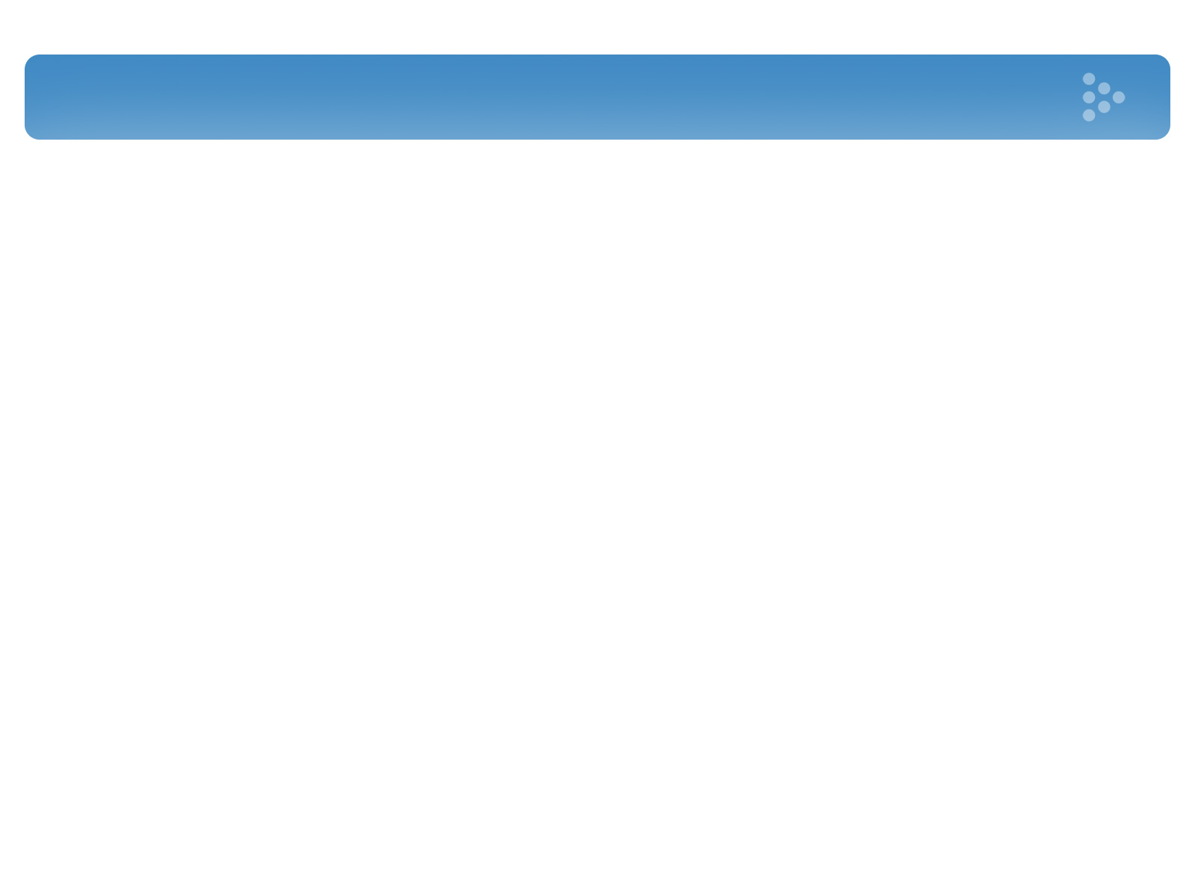
Use Case of User Profile Subsystem
Use Case Name | Actor
Add User | System Administrator, Class Teacher
Add User Details | Class Teacher, System Administrator
View User Details | Student, Parent, Class Teacher, Course Teacher, Headmaster, System Administrator
Login | Student, Parent, Class Teacher, Course Teacher, Headmaster, System Administrator
Update Details | Class Teacher, Course Teacher, Headmaster, System Administrator
Delete User | System Administrator

Slide 5
Use Case Diagram of User Profile Subsystem

Slide 6
Use Case of Student Profile Subsystem
Use Case Name | Actor
Pay Fee | Class Teacher
View Fee Status | Student, Parent, Headmaster
Insert Behaviour, Class Performance & Feedback | Class Teacher, Course Teacher
View Behaviour, Class Performance & Feedback | Student, Parent, Headmaster
Add Co- Curricular Activities | Class Teacher
View Co- Curricular Activities | Student, Parent
Add Attendance | Class Teacher
View Attendance | Student, Parent, Headmaster

Slide 7
Use Case of Course Work Subsystem
Use Case Name | Actor
Assign Course Teacher | System Administrator, Headmaster
Prepare Routine | Routine Committee, System Administrator, Headmaster
Send Routine | Routine Committee, System Administrator, Headmaster
View Routine | Student, Parent, Course Teacher, Headmaster
Add Class Test Schedule & Syllabus | Course Teacher
Update Class Test Mark | Course Teacher
View Class Test Mark | Student, Parent
Post Notice | Course Teacher
View Notice | Student, Parent

Slide 8
Use Case of Examination Subsystem
Use Case Name | Actor
Update Examination Schedule | System Administrator, Headmaster
View Examination Schedule | Student, Parent, Course Teacher
Prepare Examination Duty Roster | System Administrator, Headmaster
View Duty Roster | Course Teacher
Insert Marks of Exam Paper | Course Teacher
Issue Admit Card | Class Teacher
Print Admit Card | Class Teacher

Slide 9
Use Case of Result Subsystem
Use Case Name | Actor
Prepare Result | Class Teacher
View Result Summary and Approve | Headmaster
Update Result | Course Teacher, Class Teacher
Print Result | Class Teacher
View Result | Student, Parent, Class Teacher
Result Publication Notification | Parent, Student

Slide 10
Use Case of Notice Subsystem
Use Case Name | Actor
Input Vacation List | System Administrator, Headmaster
View Vacation List | Student, Parent, Course Teacher, Headmaster
Input Notice | System Administrator, Headmaster
View Notice | Student, Parent, Course Teacher, Headmaster

Slide 11

Thanking
Muhammad Sa’ad Naasik
1005092
Md. Tamzeed Islam
1005094
Bashima Islam
1005095
Shamim Hasnath
1005096
Akib Ibn Zahid
1005098

