Slide 1
COVID-19 Analysis
In the state of New Jersey
Tamzid Chowdhury

Slide 2

Required libraries:

Slide 3
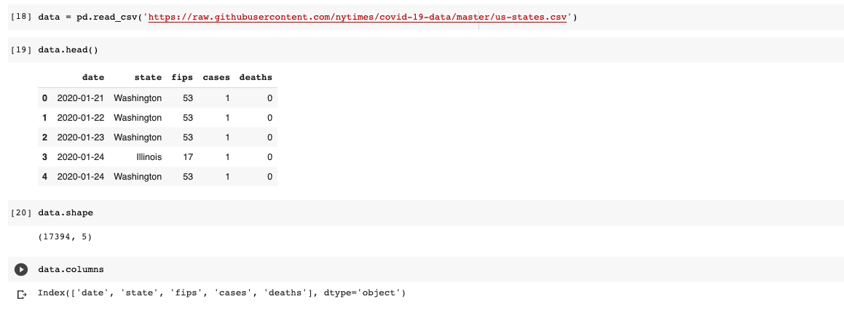
Data Collection:
The above link in red is the raw data from NYTimes on COVID-19 information on all the states in the country.
To help visualize the data in a data frame format, using data.head() allows us to see the first 5 cases in the list.
Data.shape shows the number of rows and columns being analized and data.columns() gives a clear idea of the topics being dealt with.

Slide 4
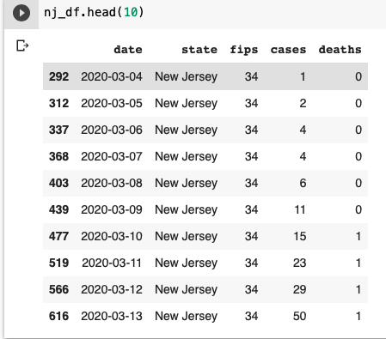
Data Wrangling and EDA (Exploratory Data Analysis):
In the chart we can see the first ten days of Covid cases recorded in the state of New Jersey. This helps us understand how fast the virus started to spread and the cases started to rise as more and more people started to get infected.

Slide 5
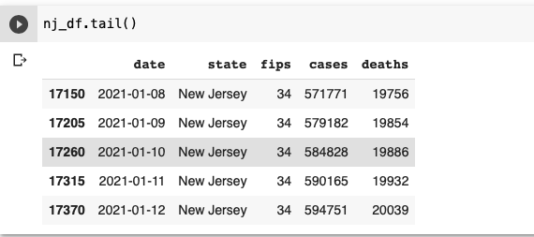
The chart above shows Covid cases recorded in the most recent days. As we can see from the previous slide, compared to the first week, the cases are increasing at an unbelievable and horrifying rate now. Compared to April 2nd of last year, exactly 1 month after the first reported case, to January 12th of this year, cases has increased almost 2324%.

Slide 6
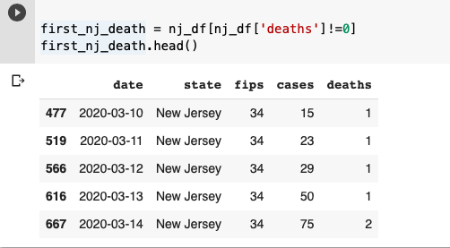
This chart shows the first death due to Covid in the state of New Jersey

Slide 7
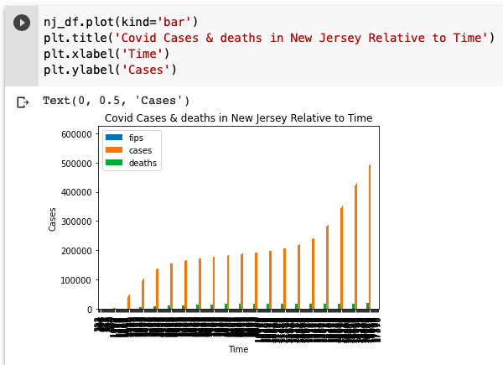
This bar graph shows the covid cases and deaths recorded relative to time in the state of New Jersey. Bar graph was a better choice to represent the data because we can see very easily how exponentially the cases grew as time passed since the first case.

Slide 8
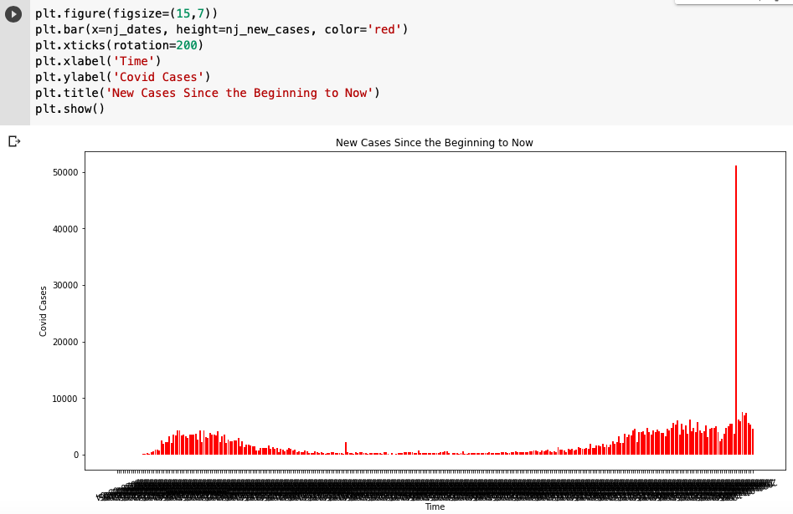
This chart shows the new cases recorded since the reporting of first case, to now. As we can see the cases started to slow down during the months of July - September, but it started to peak again since the last couple of months. And we’ve seen the highest case ever recorded in January of this year, when we see an abnormal spike in cases.

Slide 9

Understand NJ COVID-19 data in the last 30 days:
Consolidating the last 30 days of cases, deaths, and new cases in New Jersey.

Slide 10
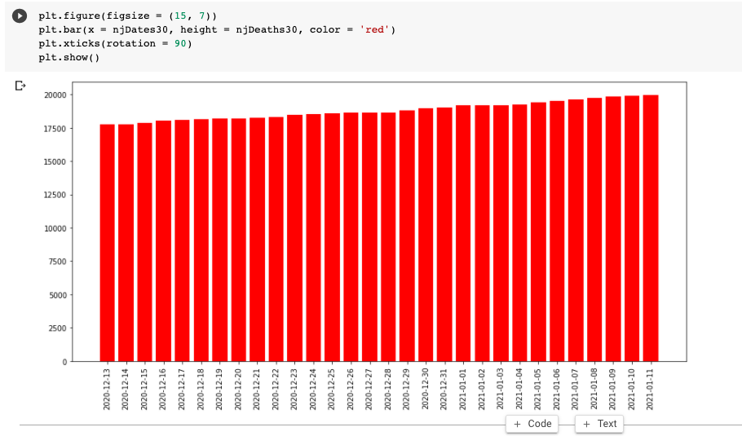
In this graph, we can see the number of deaths from last 30 dates in New Jersey.
The histogram shows that the number of deaths was ~17500 on the first date and increasing steadily.
As of Jan. 11, 2021, the number of deaths has not passed 20,000

Slide 11
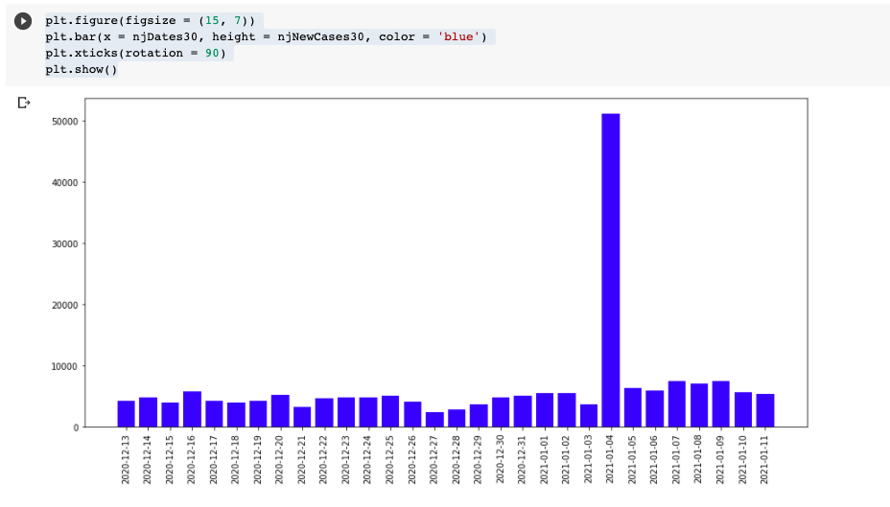
In this graph, a histogram was an appropriate choice because it makes it easier to visualize the number of new cases compared to the dates. As we can see, January 4, 2021, there was a spike of ~40,000 new cases on that day. Compared to Dec. 13, 2020 to jan 3, 2020, the numbers have been within ~< 10,000 new cases.

Slide 12
Conclusion:
Based on our findings on the state of New Jersey:
The number of cases has been growing on a steady pace in New Jersey.
It has over 594,751 cases.
On January 4, 2021, the number of new cases spiked over 40,000.
Although New York and New Jersey are closed neighboring states, New York surpasses New Jersey on total cases by ~210,000.
Covid cases started to slow down during the months of July-September, but started to peak again during the month of November and has been increasing ever since.
Compared to April 2nd of last year, exactly 1 month after the first reported case, to January 12th of this year, the number of cases has increased by almost 2324%.

Slide 13
Extra work: Analysis on the states with highest number of death.
Which five states have the highest number of deaths?
Calculate new cases(different approach) and visualize.
Calculate new deaths (different approach) and visualize.

Slide 14
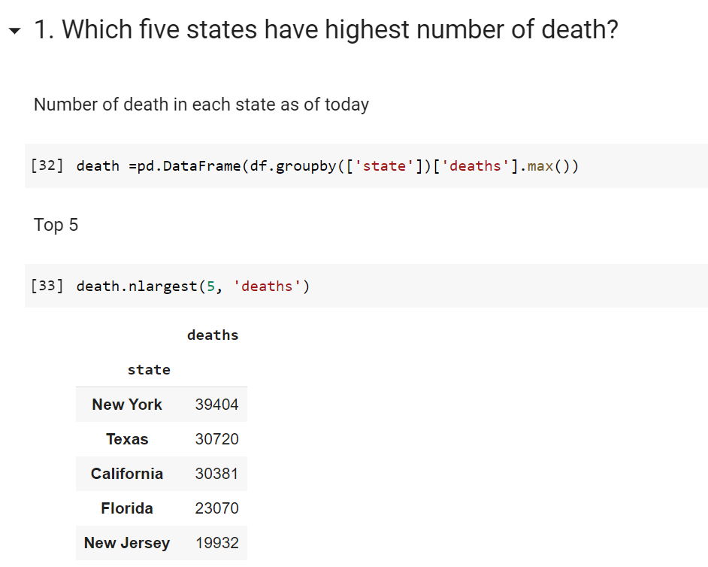

Slide 15
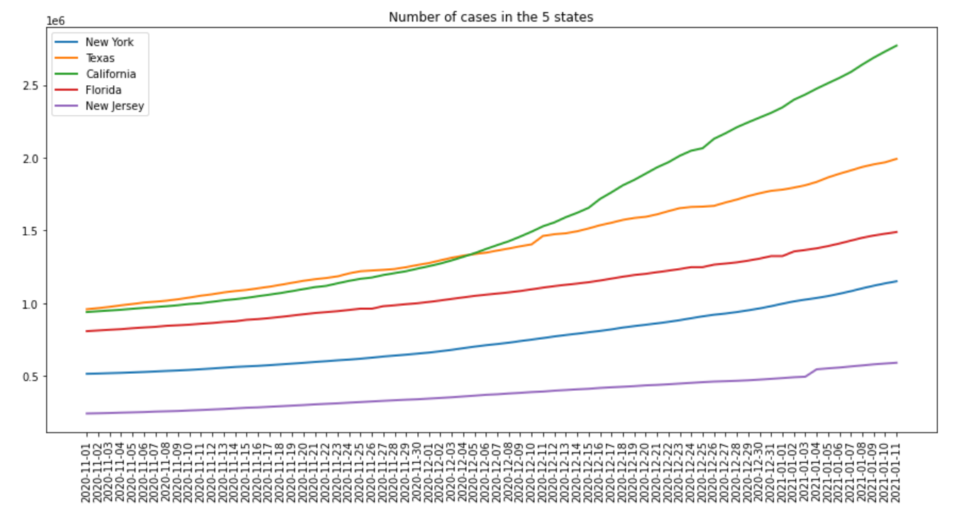
Visualization: Number of Cases in the Five States
1. California surpasses Texas in early December and become the worst in the nation.
2. The rate of increase was faster than the other states as well.

Slide 16
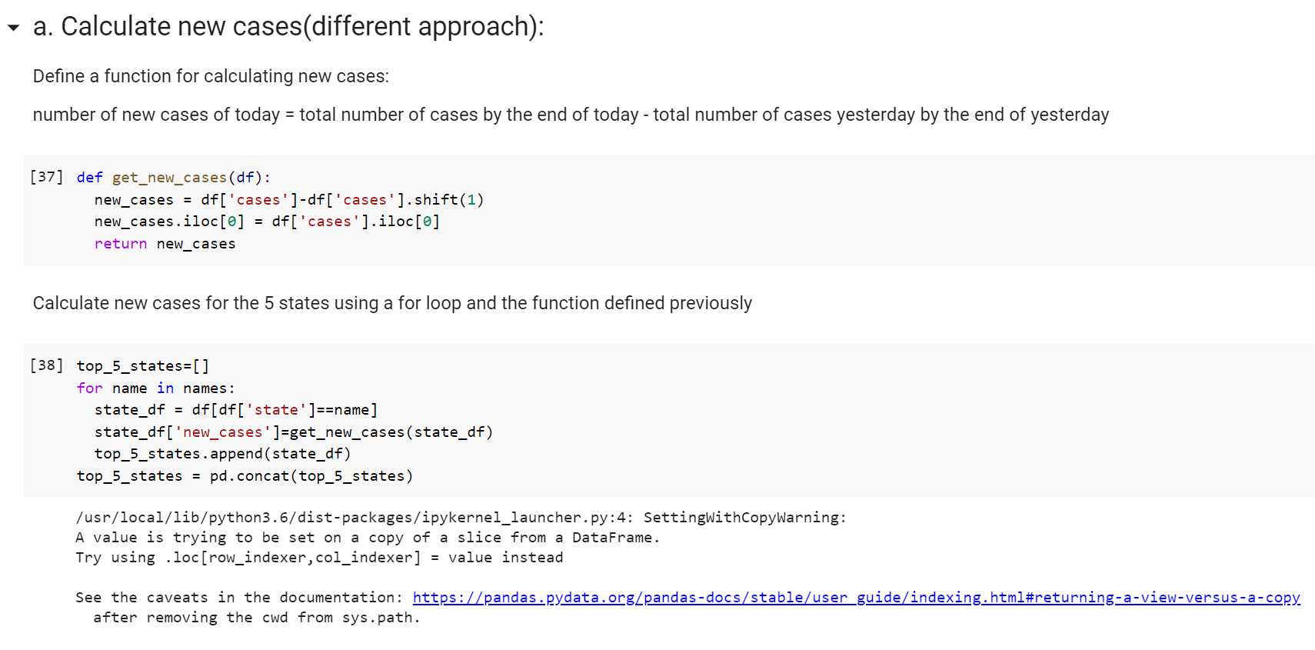

Slide 17
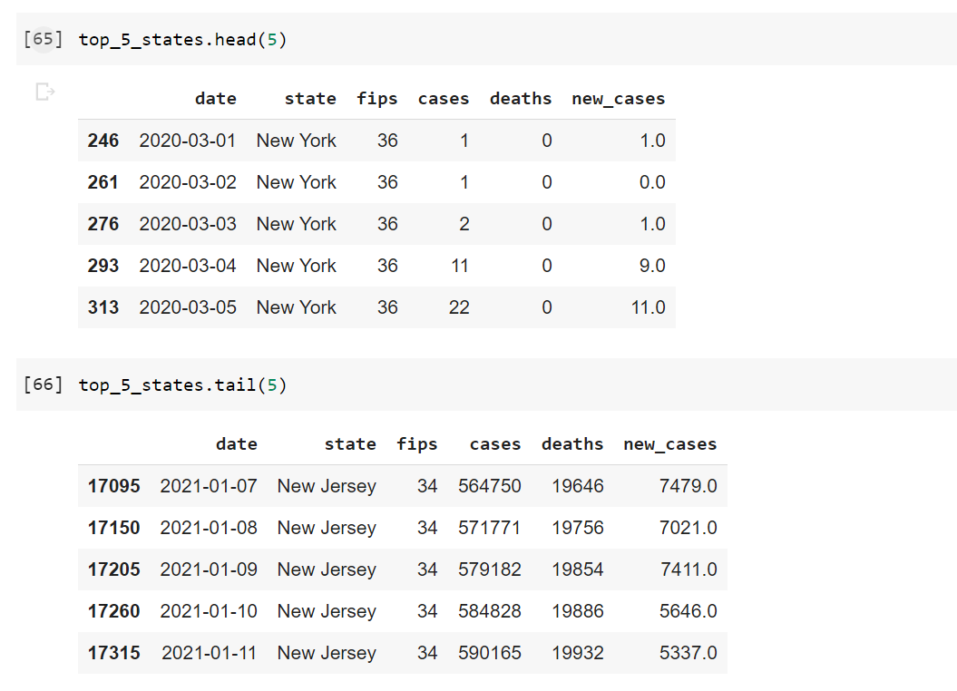

Slide 18
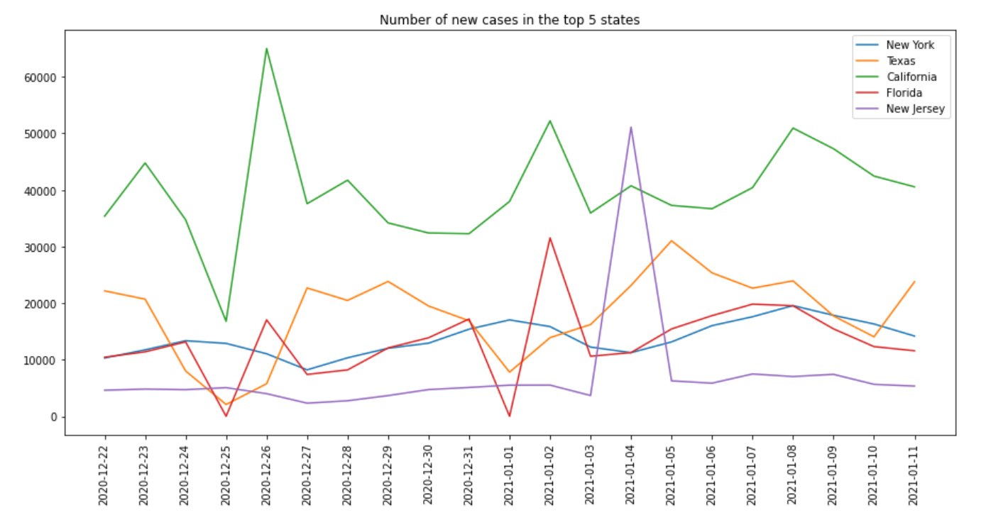
Visualization: number of new cases in the five states
California had the highest number of new cases almost all the days we investigated (on January 4th, New Jersey had the highest number of new cases).
For New York, we see that the curve is quite flat but with noticeable increment, from about 10000 new cases a day to 20000 new cases a day.

Slide 19
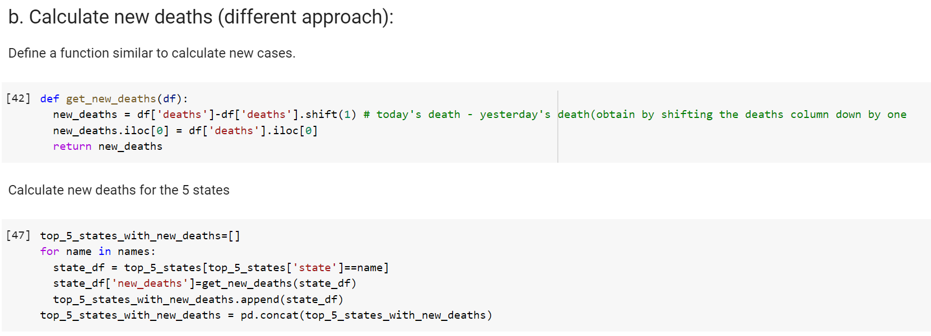

Slide 20
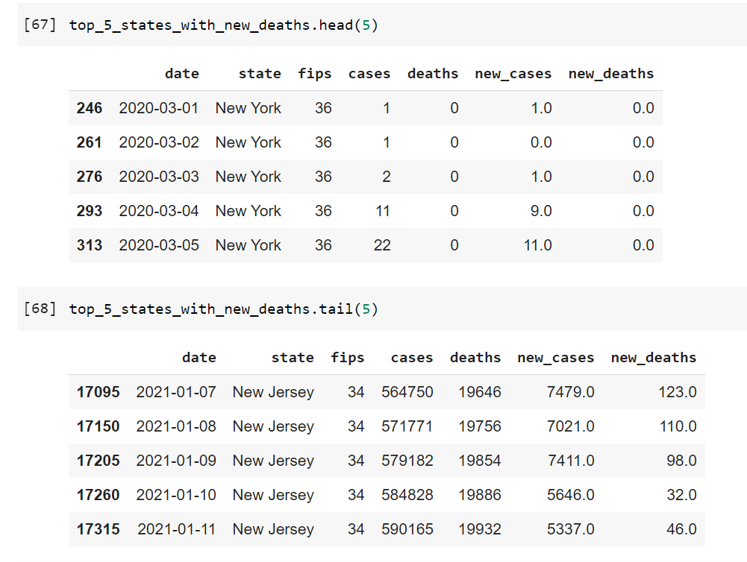

Slide 21
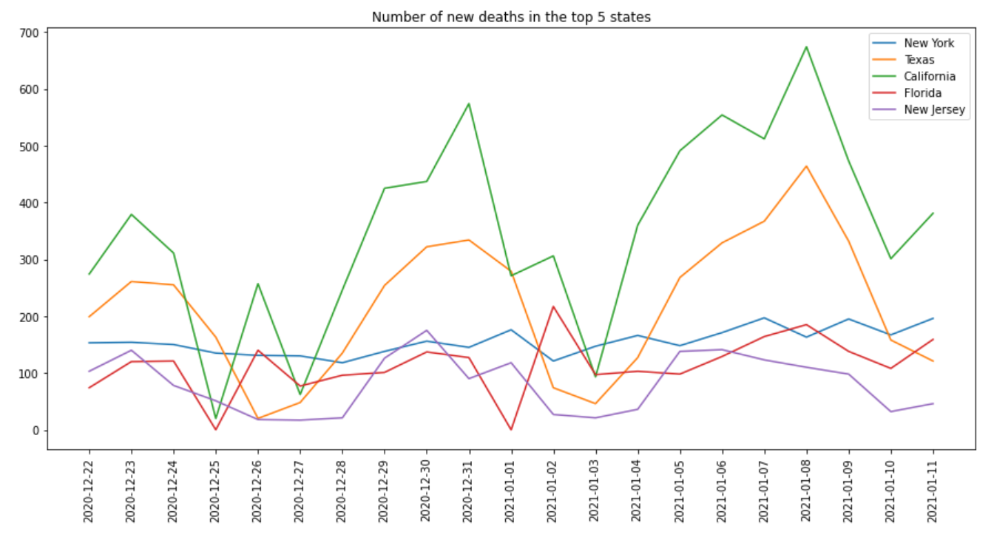
Visualize: number of new deaths in the five states
California had the highest number of deaths for most of the days we investigated. The maximum number of new deaths was 674 on 2021-01-08.
One person had died every two minutes in California on that day

