Slide 1

Self-introduction
Zeyuan Wei
学术背景：
  2025年12月获得悉尼大学Master of Computer Science硕士学位。Cybersecurity方向，毕业时均分达到 Distinction。
工作经历：
  澳洲：2025年3月开始在Link Cloud (Sydney)实习，岗位是Full Stack Programmer. 2026年1月正式入职（Part time）
  中国：从事过量化交易的数学模型构建。
Notes:
Our team comprises several skilled and passionate individuals.
Let me introduce them. hlz, which is me. and …
Each of them plays a vital role in the realization of this project.

Slide 2
Content
RSA简介
计算RSA公钥与私钥
利用RSA对数据进行加密
RSA Cheatsheet
RSA Example
Notes:
The aim of the project is to build an AI Shopping System.
Specifically, the project involves the production of recommendation algorithm by analyzing the consumer behavior data,
including online customer service that integrates AI components.
Project Cost 1.9 million Australian dollars and estimates 10 months of Project Time.

Slide 3
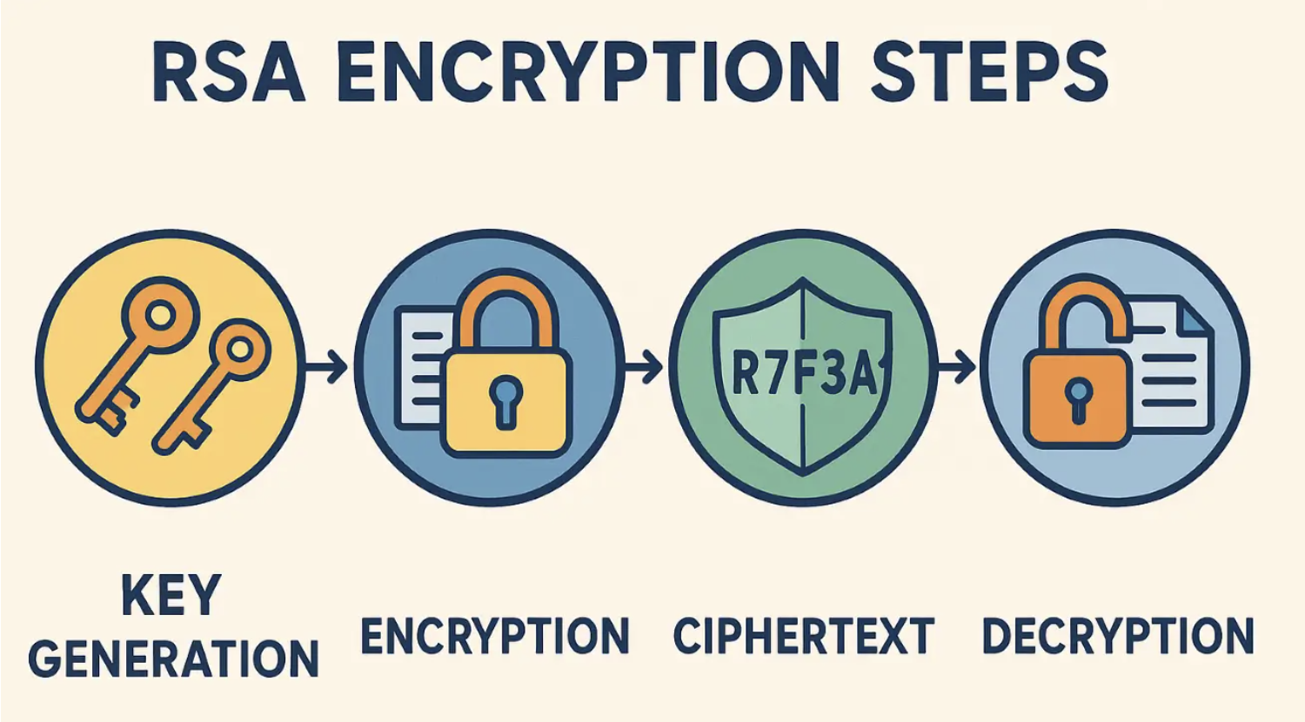
RSA Algorithm
一种非对称加密算法
  需要公钥（public key）和私钥（private key）
to encrypt m, we encrypt the corresponding number, which gives a new number c (the ciphertext).
  所谓的加密（encryption）与解密（decryption），就是通过比如＋，－，×，÷等方式对数字进行改变以及还原的过程。
  任何数据在计算机中以及传输过程中都会被转化成二进制数
  m= 10010001. This message is uniquely represented by the decimal number 145.
Notes:
The aim of the project is to build an AI Shopping System.
Specifically, the project involves the production of recommendation algorithm by analyzing the consumer behavior data,
including online customer service that integrates AI components.
Project Cost 1.9 million Australian dollars and estimates 10 months of Project Time.

Slide 4
RSA: Creating public/private key pair
1. choose two large prime numbers p, q.
选择两个质数，质数包括：2，3，5，7，11，13......
2. compute n = pq, z = (p-1)(q-1)
3. choose e (with e<n) that has no common factors
with z (e, z are “relatively prime”).
e需要和z互质
4. choose d such that ed-1 is exactly divisible by z.
(in other words: ed mod z = 1 ).
ed-1 = x*z -> d = (x*z+1)÷e
5. public key is (n,e). private key is (n,d).
+
-
K
K
B
B

Slide 5
RSA: encryption, decryption
0. given (n,e) and (n,d) as computed above
1. to encrypt message m (<n), compute
e
c = m mod n
2. to decrypt received bit pattern, c, compute
d
m = c mod n

Slide 6
RSA Cheatsheet
计算公钥 (n, e)，私钥 (n, d)
1. p,q需要自己选择，且为质数（2，3，5，7，11......）
2. n = pq, z = (p-1)(q-1)
3. e和z互质
4. ed-1是z的整数倍
加密
e
c = m mod n
解密
d
m = c mod n

Slide 7
RSA example:
Bob chooses p=5, q=7. Then n=35, z=24.
e=5 (so e, z relatively prime).
d=29 (so ed-1 exactly divisible by z).
public key: (35,5)
private key: (35,29)
encrypting 8-bit messages m.
m
e
e
bit pattern
m
c = m mod n
encrypt:
00001100
12
24832
17
d
d
c
c
m = c mod n
decrypt:
17
481968572106750915091411825223071697
12

Slide 8
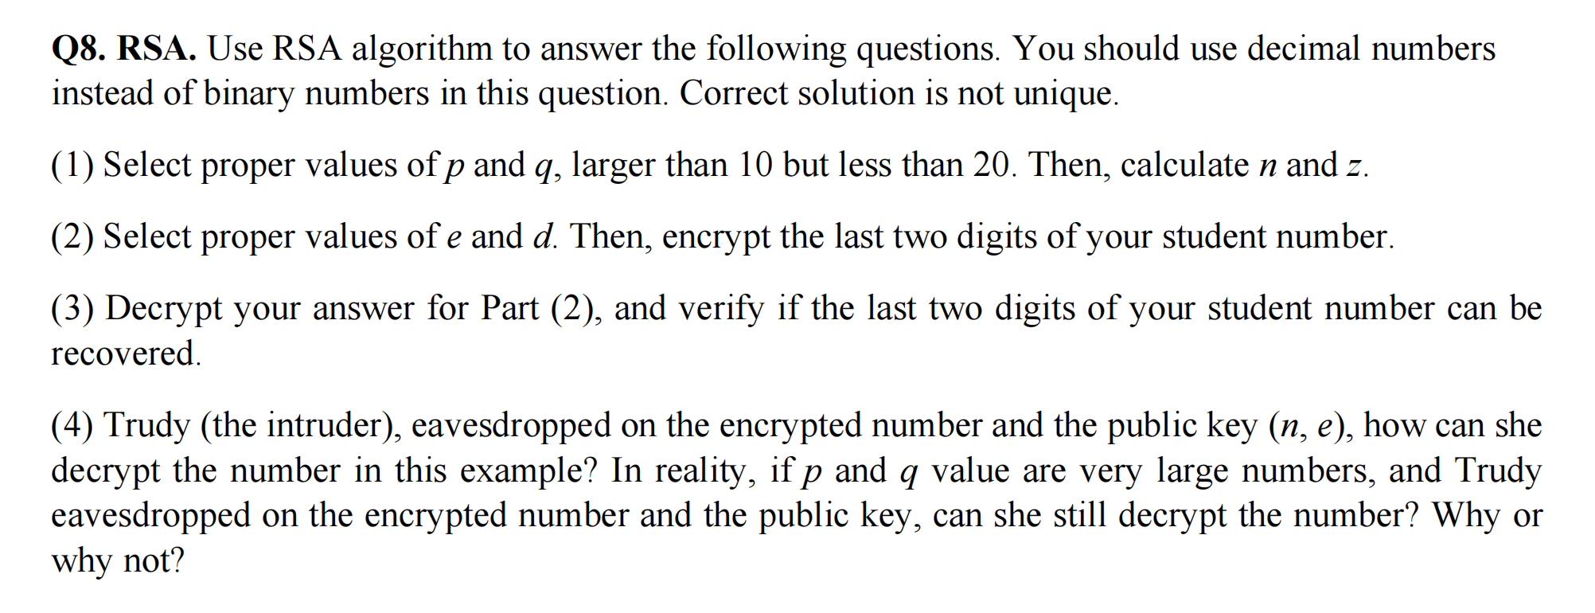
RSA in 2024 USYD COMP9121 Assignment

Slide 9
Thank You !

