Slide 1
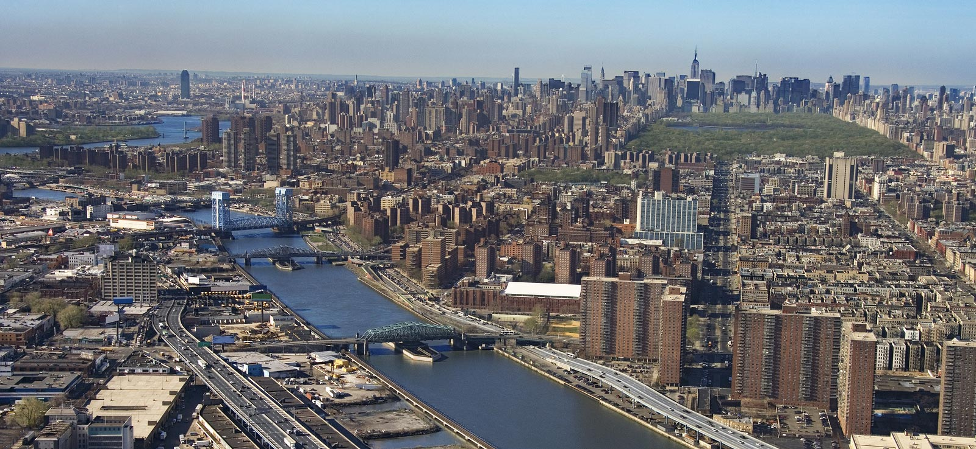
Introduction
People all around the world know the Bronx as the home of the New York Yankees, the Bronx Zoo and the New York Botanical Garden—not to mention as the birthplace of hip-hop. Look deeper and you’ll discover the quaint maritime village of City Island, the cultural attractions of Fordham and Belmont, aka the “real Little Italy,” centered on the restaurants and cafés of Arthur Avenue. Grand Concourse, in the South Bronx, is full of art deco marvels.

Slide 2
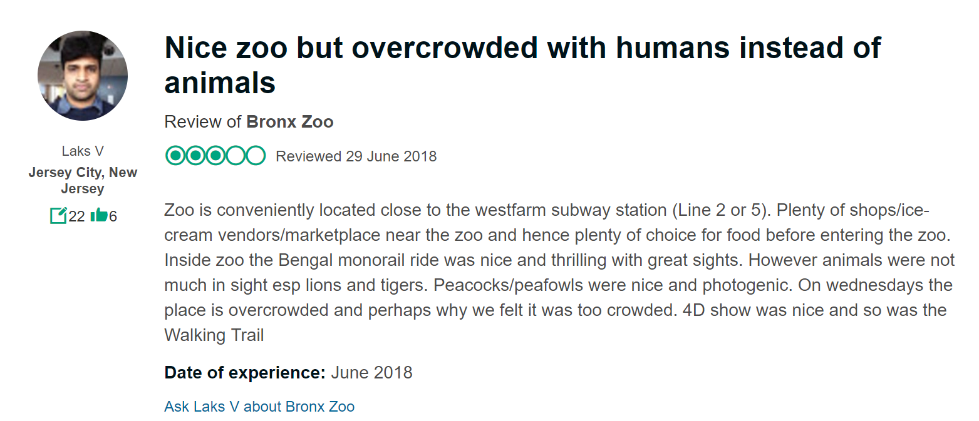
The Problem
The Bronx Zoo is a zoo located within Bronx Park in the Bronx, a borough of New York City. It is one of the largest zoos in the United States by area, comprising 265 acres of park lands and naturalistic habitats separated by the Bronx River. On average, the zoo has 2.15 million visitors each year as of 2009. But occasionally, it can be overcrowded.

Slide 3
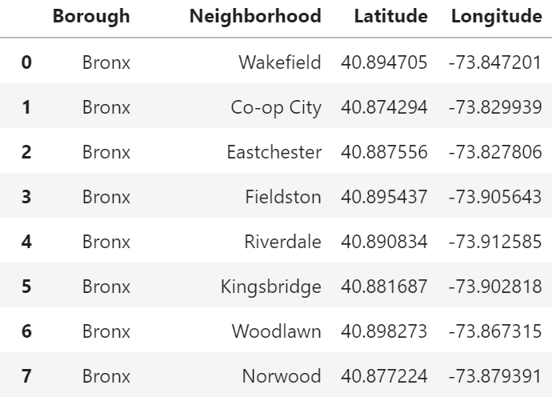
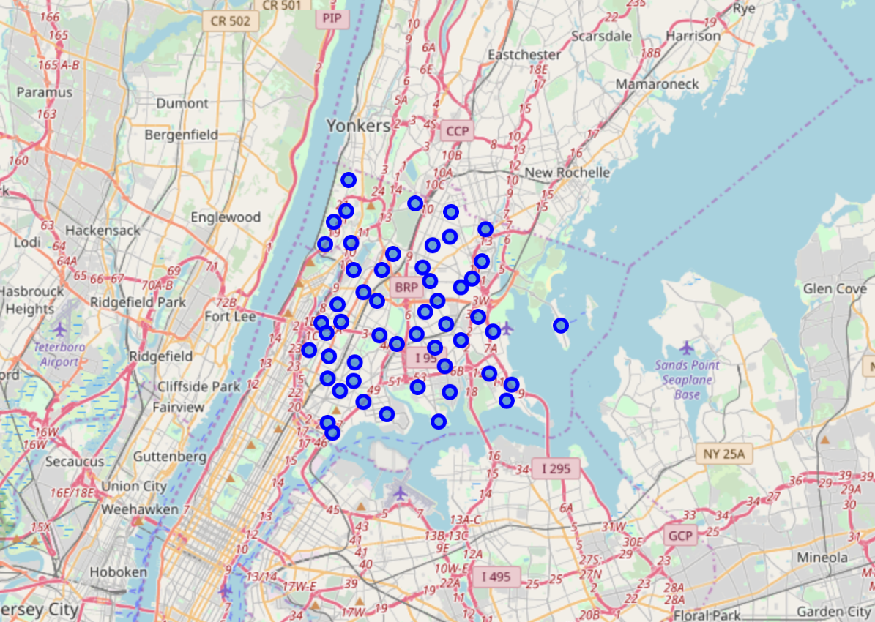
Load data
Sort and framed it
Used longitude & latitude to plot on map

Slide 4
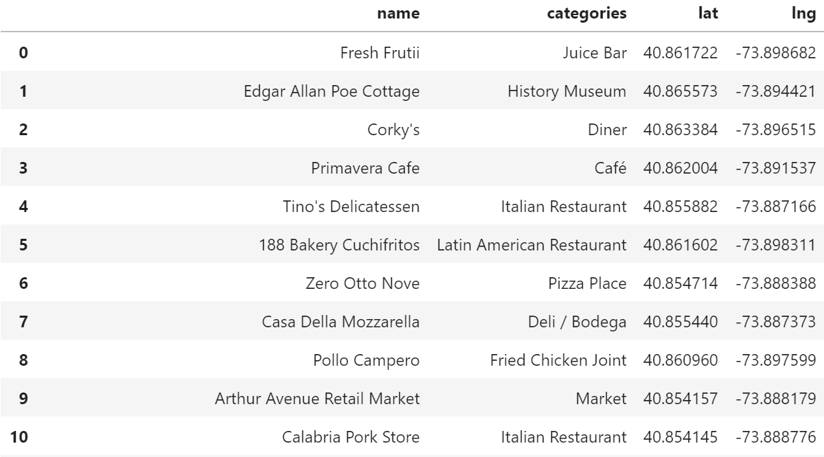
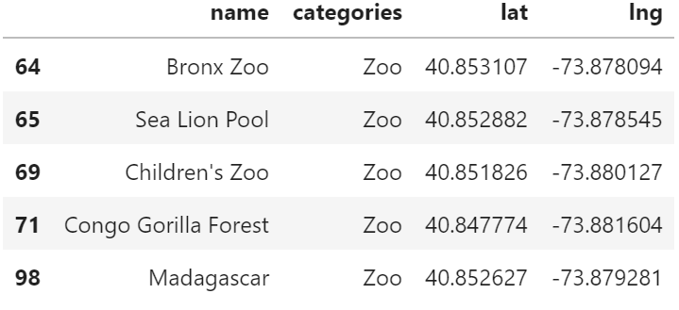
The above table shows top 10 venues closest to Fordham
Name and categories of the venues can be found
Visitor will know the available venues to visit in future
The below table shows the top 5 closest zoos to Fordham
This can help visitor to know the name of the zoo and location quickly

