Slide 1
Fifth Milestone or Event Here
April 1, 1995
First Milestone or Event Here
Seventh Milestone or Event Here
October 1, 1978
February 1, 2001
Third Milestone or Event Here
Ninth Milestone or Event Here
Today
November 22, 1985
November 9, 2007
January 15, 2015
1978
1978
1982
1986
1990
1994
1998
2002
2006
2010
2014
2015
July 14, 1982
February 4, 2011
Today
Second Milestone or Event Here
Tenth Milestone or Event Here
June 1, 2004
Eight Milestone or Event Here
July 1, 1997
Sixth Milestone or Event Here
March 1, 1994
Fourth Milestone or Event Here

Slide 2
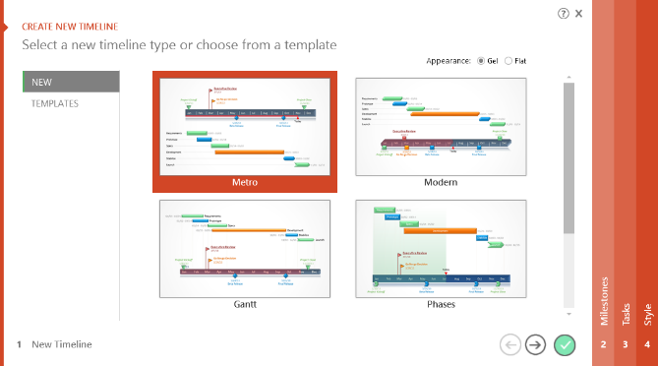

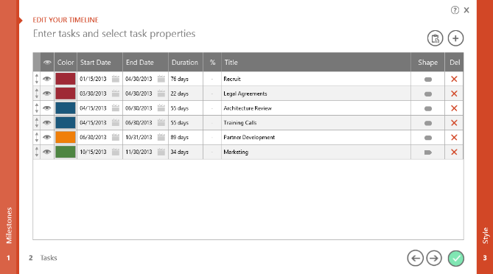
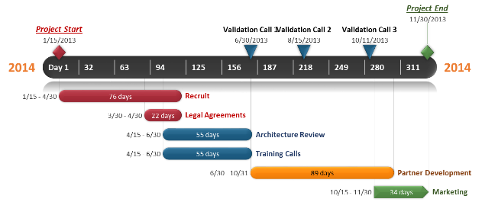
To change and update this template automatically,
download the free Office Timeline PowerPoint add-in!
Office Timeline is a free, award winning, timeline maker that's really easy to use.
Simple, easy-to-use wizards.
Professional, quick results.
Built directly into PowerPoint

