Slide 1
PS-5
Windows Event Logs: View and Query

Slide 2
Windows Event Logs
The logs that are available on Windows systems fall into two categories: Windows logs and applications and
services logs. The Windows logs are grouped into three primary categories: Application, Security, and System.
The windows events can be viewed using the windows event log
To access Event Viewer select the keyboard shortcut Win+R, type eventvwr.msc and press the ENTER key.
In Figure 9-3, you can see
Hardware Events, Internet Explorer, Key Management Service, ThinPrint Diagnostics, and Windows
PowerShell. Additionally, there is another folder you can see labeled Microsoft. Inside this folder are
all the various Windows applications and components. Each of them will have their own event log.
Four subtypes of logs are stored within the Applications and Services logs. These are Admin,
Operational, Analytic, and Debug.

Slide 3
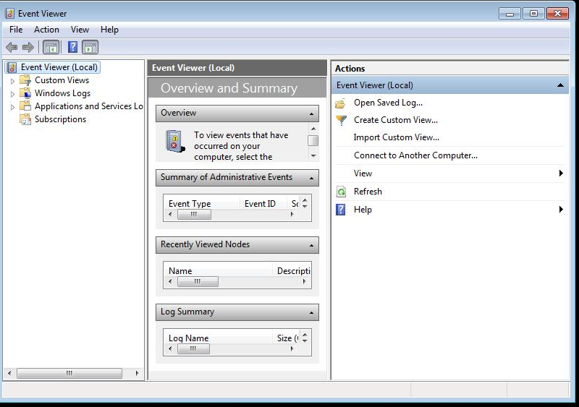
Windows Logs

Slide 4
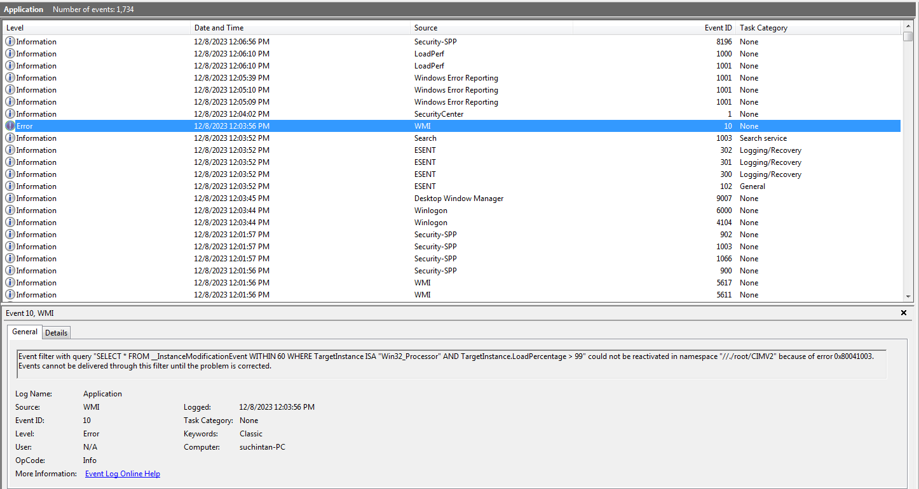
Application Logs

Slide 5
Questions
Open the windows log, click on windows log and fill the following table
Name | Type | Number of events | Size
Application
Security
Setup
System
Forwarded Events

Slide 6
Questions
Open the Applications log, click on application log what are the different types of levels that you can see.
Are there any errors, what is the description
Are there any warnings, can the system continue even if there is a warning.
What is the source for events with event Id 1, 10,1001.
For the event 1 what is the keyword.
Is there timestamp information about an event can you find the opcode of an event.

Slide 7
Questions
Open the security logs and find the latest event to be registered in the security events log.
What is the eventId, opcode, source and keyword for the last security event.
Can you find the account that logged into the system last.

Slide 8
Questions
From the system log find out the eventID for the kernel-general event. Is it the first event.
Is the windows update client running, what was the time when this system was last updated. Who was the last user who updated the system.
Is the DHCP client running, if yes what is the eventID, opcode, keyword of the dhcp client event.

Slide 9
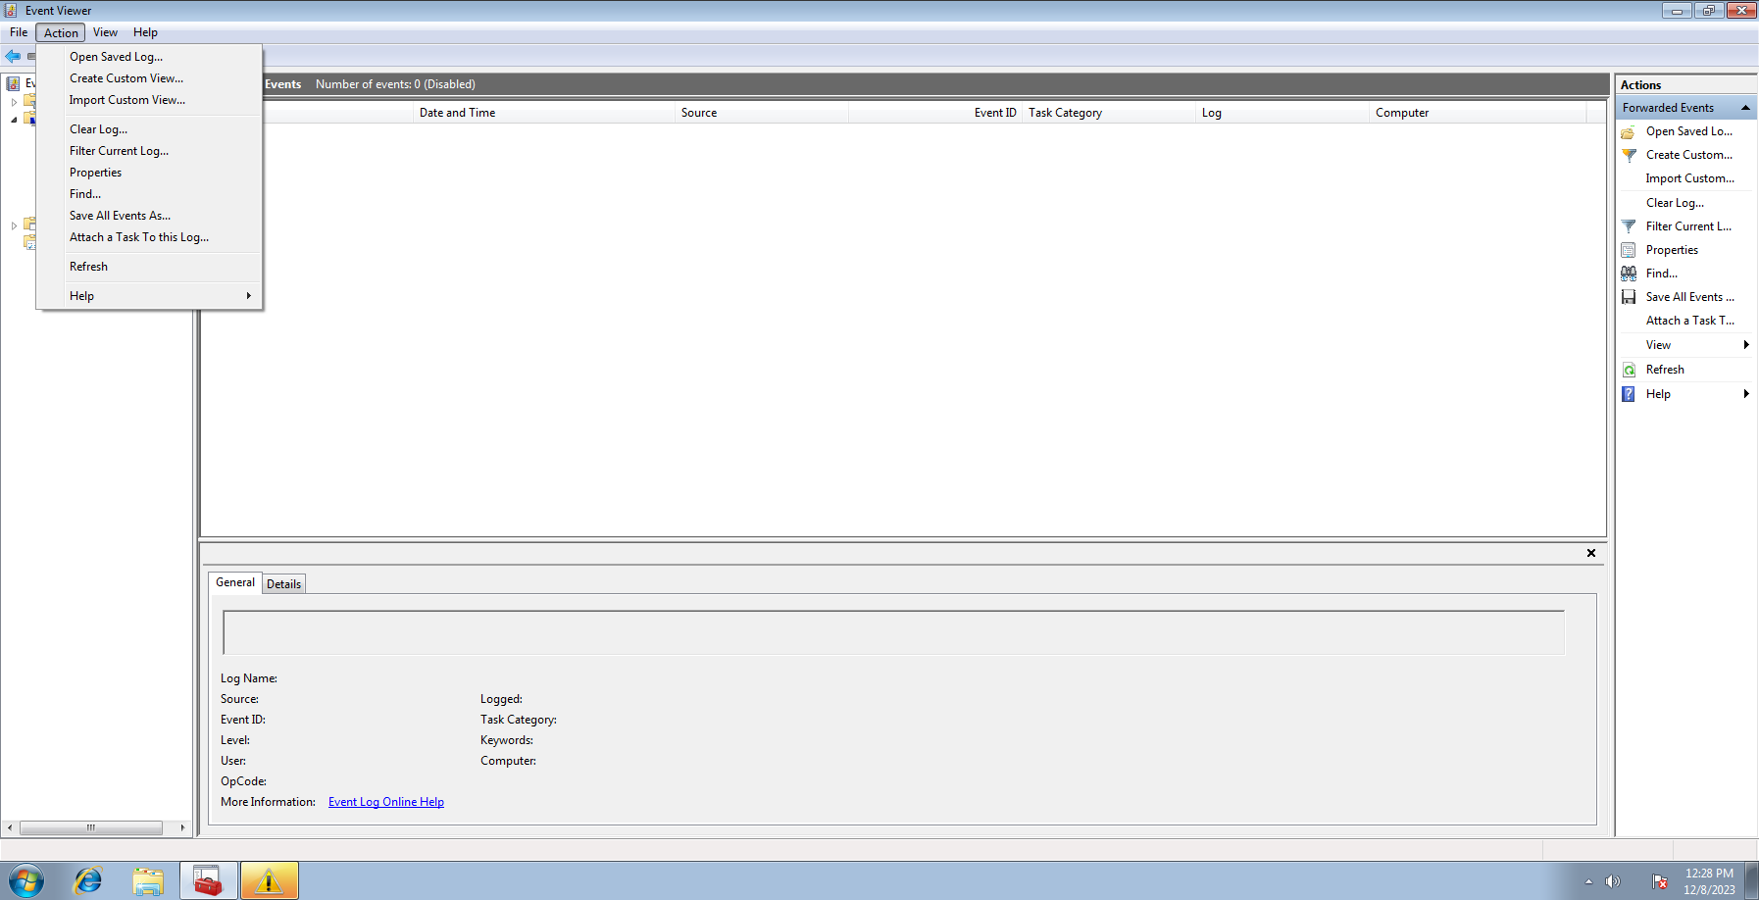
Querying Event Logs
Unlike the raw text files that syslog uses, Microsoft’s log files are stored in such a way that they can
be filtered and queried.
Once you have your log files open, you can use the Create Custom View feature to essentially query
the database and show only what you believe may be relevant. Figure below shows the Create Custom
View dialog box.
Once you have selected which logs you want to query from the pulldown menu, you
can select keywords from a second pulldown. This is not a freeform set of keywords. Instead,
you are presented with keywords from the logs themselves.

Slide 10
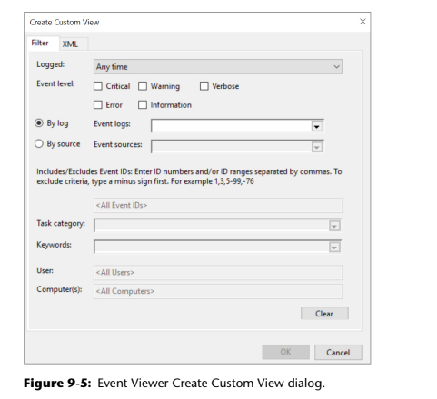
Create a Custom View

Slide 11
Questions
Using Custom Viewer filter logs from the last 24 hours that have a level critical or error where the sources are any of the following:
Disk
DHCPClient
Firewall-service
Kernel-General
Kernel-Memory
Kernel-prefetch
Filter the results for keywords Audit-failure and Response-time. How many such events are there?

Slide 12
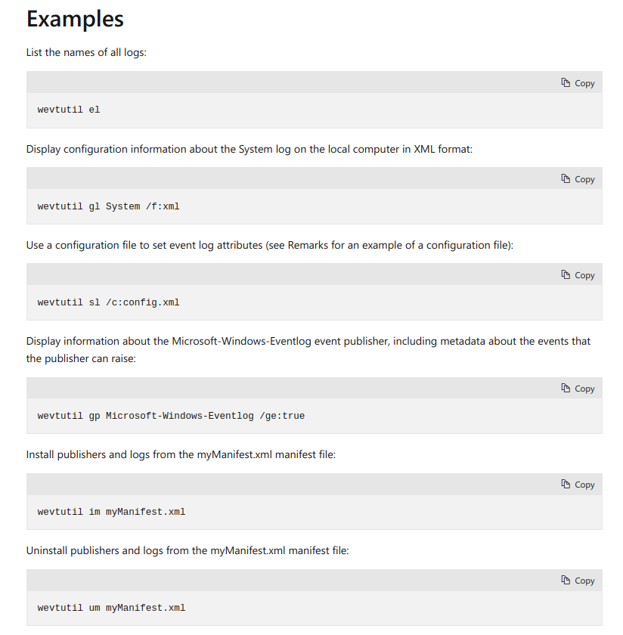
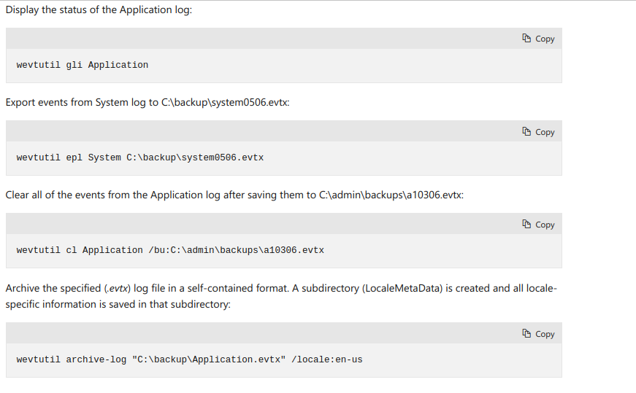
wevtutil
Enables you to retrieve information about event logs and publishers. You can also use this command to install and uninstall event manifests, to run queries, and to export, archive, and clear logs.

Slide 13
Questions
Using wevtutil list all logs in the system.
Using wevtutil Display the status of the Application log
Export events from System log to C:\backup\system0506.evtx:
Clear all of the events from the Application log after saving them to C:\admin\backups\a10306.evtx

