Slide 2

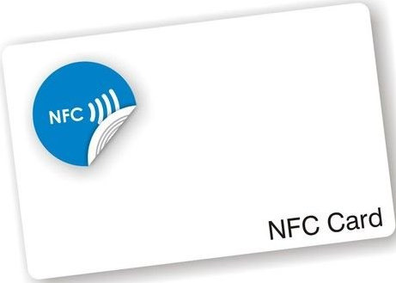
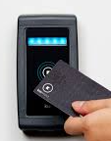
Real Card
Card Simulator
Card Reader
APDU request
Card Reader App
Card Simulator App
APDU request
APDU response
APDU response
save data
save/get data
(token, balance, transactions)
ENCRYPTED CARD DATA
- Card ID
- Card Balance
- Card Pin counter
- Transactions
---
Hardware storage
TEE (StrongBox)
encryption key
Part 1: read NFC card data
Part 1:perform card operator on card simulator

