Slide 1
Title: Data-Driven Pricing Strategy for Big Mountain Resort
Subtitle: A Case Study
Name: Tanvi Nandurkar

Slide 2
Introduction
Overview of Big Mountain Resort
Location: Whitefish, Montana
Recent operational cost increase: $1,540,000 due to new lift chair
Objective: Develop a competitive pricing strategy to cover operating expenses and boost revenue

Slide 3
Importance of Data in Pricing Strategy
Using data to inform pricing
Competitive pricing is crucial
Avoiding low/high pricing pitfalls
Key Data Sources
Competitor analysis
Customer behavior trends

Slide 4
Features Correlating with Ticket Price
Key Features Identified:
Fast Quads
Area of Snow Makers
Total Number of Runs
Night Skiing Ratio
Vertical Drop
Total Number of Chairs
Longest Run
Skiable Area

Slide 5
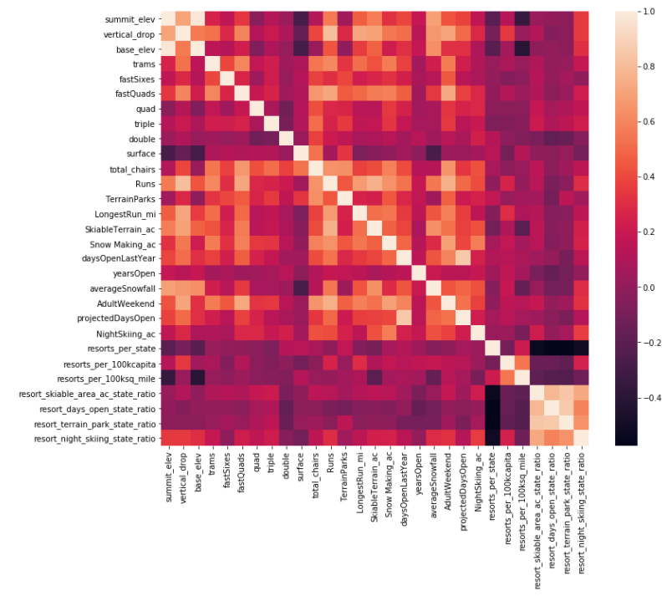
Heatmap Visualization

Slide 6
Modeling Approaches
Linear Regression Model:
Median and mean imputation
Mean Absolute Error (MAE): $9 (too high)
Random Forest Model:
Included all eight features
MAE: $1 (more accurate)
Cross-validation results

Slide 7
Findings and Recommendations
Ideal Ticket Price Determined: $94.22
Current price: $81
Recommendations:
Raise ticket price to $89.99
Close 4-6 runs daily to reduce operational costs

Slide 8
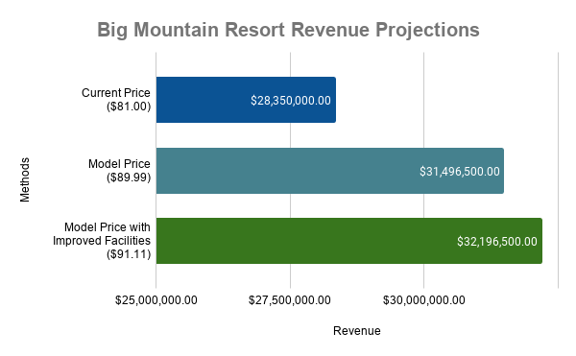

Slide 9
Facility Improvements and Revenue Potential
Proposed Enhancements:
Increase vertical drop by 150 ft
Add one new chair lift
Add one additional run
Expand snow cover by 2 acres
Projected Revenue Increase:
Estimated additional revenue of $700,000 with increased ticket price

Slide 10
Conclusion
Summary of Strategy:
Adjust ticket price and operational strategy to enhance profitability
Investments in facilities can justify higher prices
Anticipated Outcomes:
Increased revenue
Improved customer satisfaction and competitive standing

