Slide 1
<My Name>
Web Tech Summer 2025 Final Exams

Slide 2
<Your Name> is developing a data powered website to help <audience/customer/user/business> solve <problem>.

Slide 3
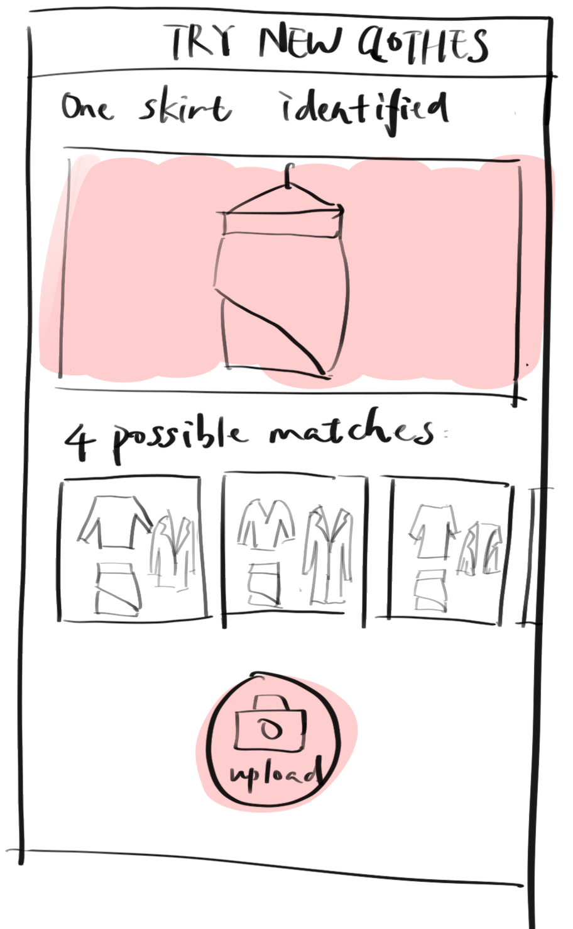
Project Title
ddd
PROBLEM:What is the problem the website will solve
PAYOFF: What is a simple drawn screen that is illustrative of something the website shows that helps solve the problem. It is likely a report or some results of data entered by the participants. This is the most important square
PERSONA(s) who are the people involved in using the website and what are their background
FINISH: Why are the users better off with the website than before.

Slide 4
User / Customer
describe the business, organization, or group of people that will use this website. If a business, describe its products or services and what its purpose is.
What are the roles of the users who will use the website. One sentence about what they do. For example, in the Attendance system the roles are “students”, “faculty” and “faculty interns”.

Slide 5
Main Functions of the Website
3- 4 functions that will be built to solve the problem.

Slide 6
Architecture
Image of 3 tier architecture and how they connect, programing languages for each tier and why, other technologies (frameworks, etc).

