Slide 1
Estimation of Obesity Based on Eating Habits and Physical Condition
By: Tommy Tan, Feb 2022

Slide 2
Introduction
Obesity is a condition defined by an excess amount of body fat, measure by BMI (Body Mass Index) of 30 and above. It is generally caused by eating too much and moving too little.
The amount of food we eat, were converted to energy and if not burn off the body through physical activities, it is stored as fat. This accumulation is not just a cosmetic concern but can be a medical problem that increases the risk for heart disease, diabetes, high blood pressure and certain cancers.

Slide 3
What are the…?
CAUSES:
EFFECTS:
Genetics
Metabolism Factors
Socioeconomic Factors
Lifestyle Choices
Medicines
Emotions
High Blood Pressure
Type 2 Diabetes
Heart Disease
Joint Problems
Sleep Apnea and respiratory Problems
Cancer
Psychosocial Effects

Slide 4
Why measure?
Obesity is serious because it is associated with poorer health outcome and reduces quality of life. It is also associated with leading cause of death worldwide.
By measuring the state of obesity and define its contributing factors, a person get to understand his/her current standing against potential life threatening conditions.
Correlating and predicting the results of obesity status vs. the contributing factors also allow us to confirm what course of actions is effective in achieving the ideal weight or, reversing the said conditions to improve our longevity with a healthier body.

Slide 5
How we did it?
The idea is to get all the datapoints available and create a prediction model what will intelligently predict a person’s obesity levels with these inputs.
Based on these data, we will determine how these factors are related and can influence obesity. Obesity Level is used to classify the outcome of the model.
The model should be able to correlate the datapoints using a selected model with high accuracy.

Slide 6
Our Data
The data we used in this research can be grouped in to 2 types:
Physical – Gender, age, height, weight and family history with Overweight
Behavioral or Habitual – Consumptions of alcohol, vegetables, water and meals. Physical activities, mode of transportation and time using technology devices.
There might be some constraints with the data considering it may not contain all the information we need and not equally distributed across all the sampling sets such as age and gender.

Slide 7
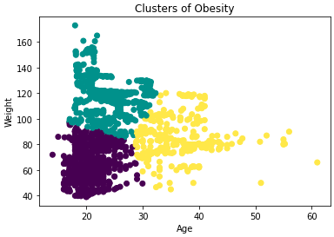
Visualizing the Data
Our data is not balanced in terms of age groups, this may skew the results and therefore age may not be considered here.
X-axis: Weight
Y-axis: Age
3 major groups presented in the clustering graph based on the weight and age distributions – taking other datapoints into considerations.
Although we see people with weight 140kgs mostly at the age between 18-23 as one cluster, it has very limited datapoints for ages 40 and above and it may affect the accuracy of our prediction model for those age groups

Slide 8
The Heatmap
We created a heatmap to correlate the available datapoints to seen how dependent are they on each other.
The data points may not show strong relationship based on the numbers but was enough to differentiate one data set to another.
Some categorized values were given weighting in order to be included in the correlations.

Slide 9
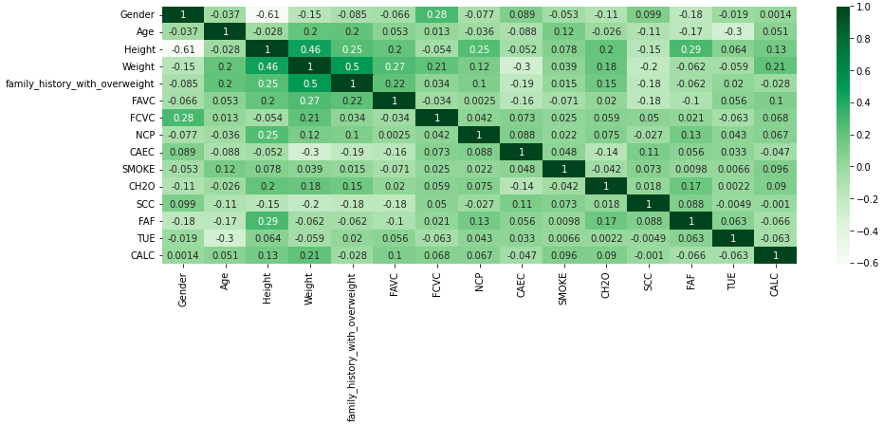
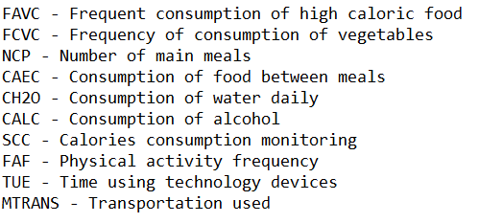
The Heatmap

Slide 10
The Data Model
Analysis were created using different machine learning model with the data presented earlier as input. And by analyzing these data points, the models were able to successfully classify the types of obesity based on the physical and behavioral data provided.
We also compared the metrics of these different models and came up with our choice that gives utmost prediction accuracy when given a test dataset.
The final choice is Logistic Regression as it is best for estimating relationships and determine the patterns among the datapoints provided. It allows us to use independent variables to determine categorical outcome and avoid overfitting problem like in Linear Regression.

Slide 11
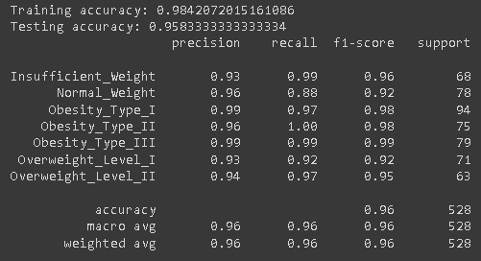
Results of Logistic Regression
We extracted a portion of the data to validate the selected model and was able to achieve more than 95% accuracy for all the classification types we are expecting.
Other models we tried has given us high accuracy but was too perfect for the test data compare to the validation data – overfitting

Slide 12
Conclusions
Based on the data, weight is always the primary indicator for obesity and the major contributing factors to this can be:
Family history of obesity
Frequent consumption of high calorie food
Consumption of alcohol
These should be taking into considerations to avoid obesity and further complications on health.
The model help us simplified the processing of the datapoints in generating the predictions we need.

Slide 13
Thank you!

Slide 14
References
https://libguides.cccneb.edu/obesity#:~:text=Obesity%20is%20a%20chronic%20condition,is%20about%2030%20pounds%20overweight
https://www.mayoclinic.org/diseases-conditions/obesity/symptoms-causes/syc-20375742
https://www.hopkinsmedicine.org/health/conditions-and-diseases/obesity/overview-of-obesity
https://towardsdatascience.com/the-perfect-recipe-for-classification-using-logistic-regression-f8648e267592#:~:text=Logistic%20regression%20is%20easier%20to,as%20indicators%20of%20feature%20importance

