Slide 1
delonix.cradlelogic.com/

Slide 2
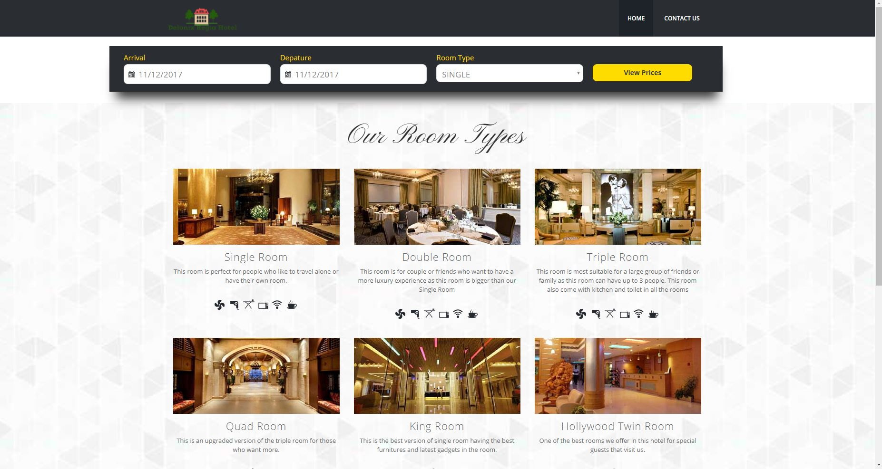
Home page

Slide 3
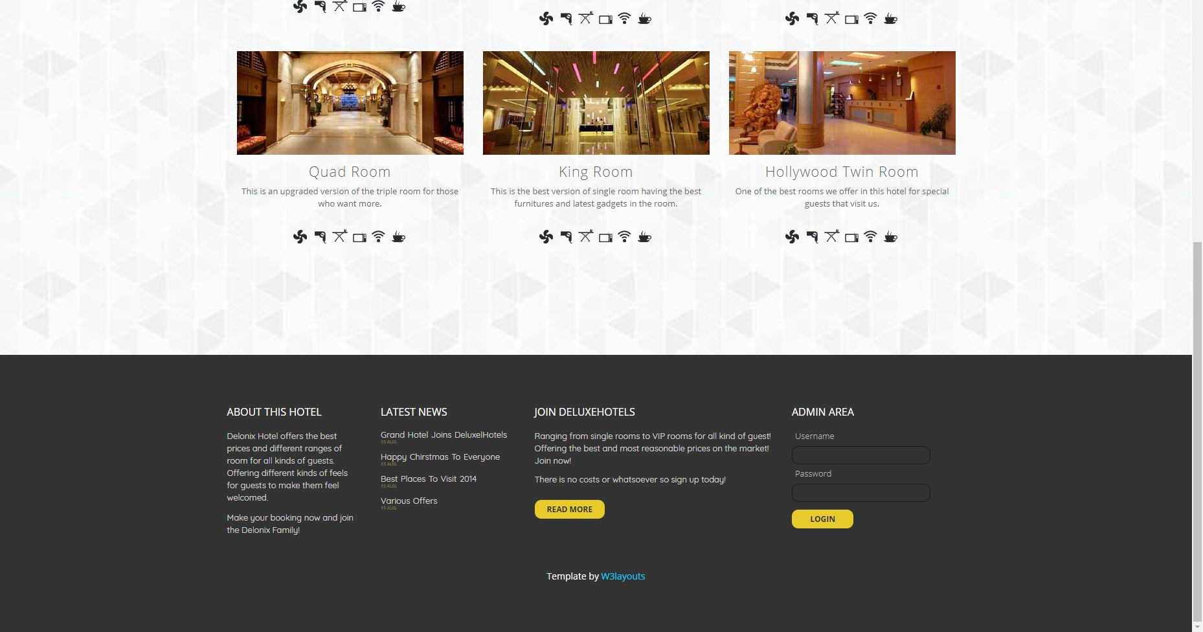
Home page

Slide 4
Admin account
Username : admin1
Password : admin1

Slide 5
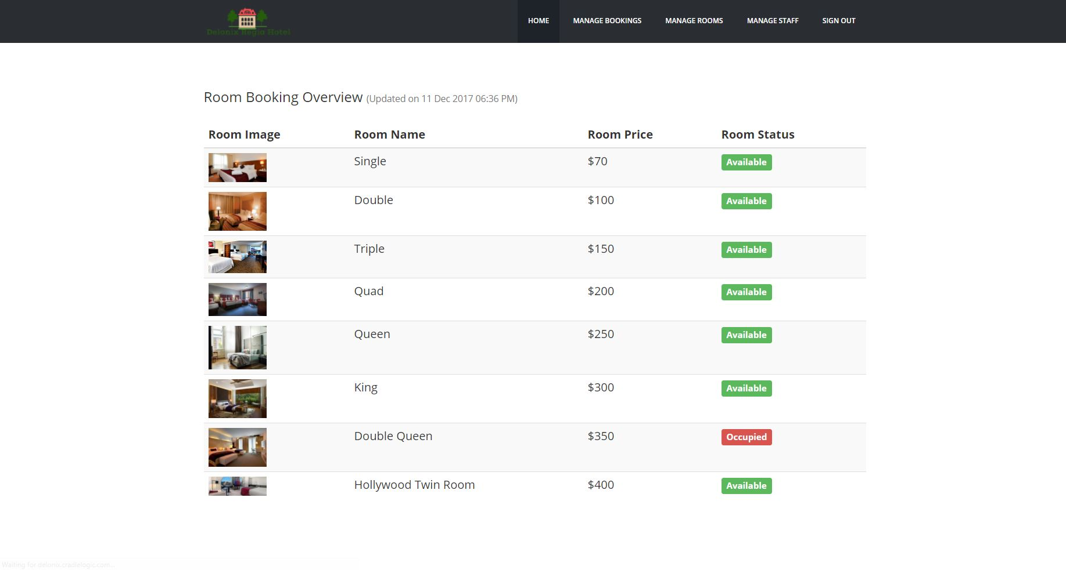
Room booking overview

Slide 6
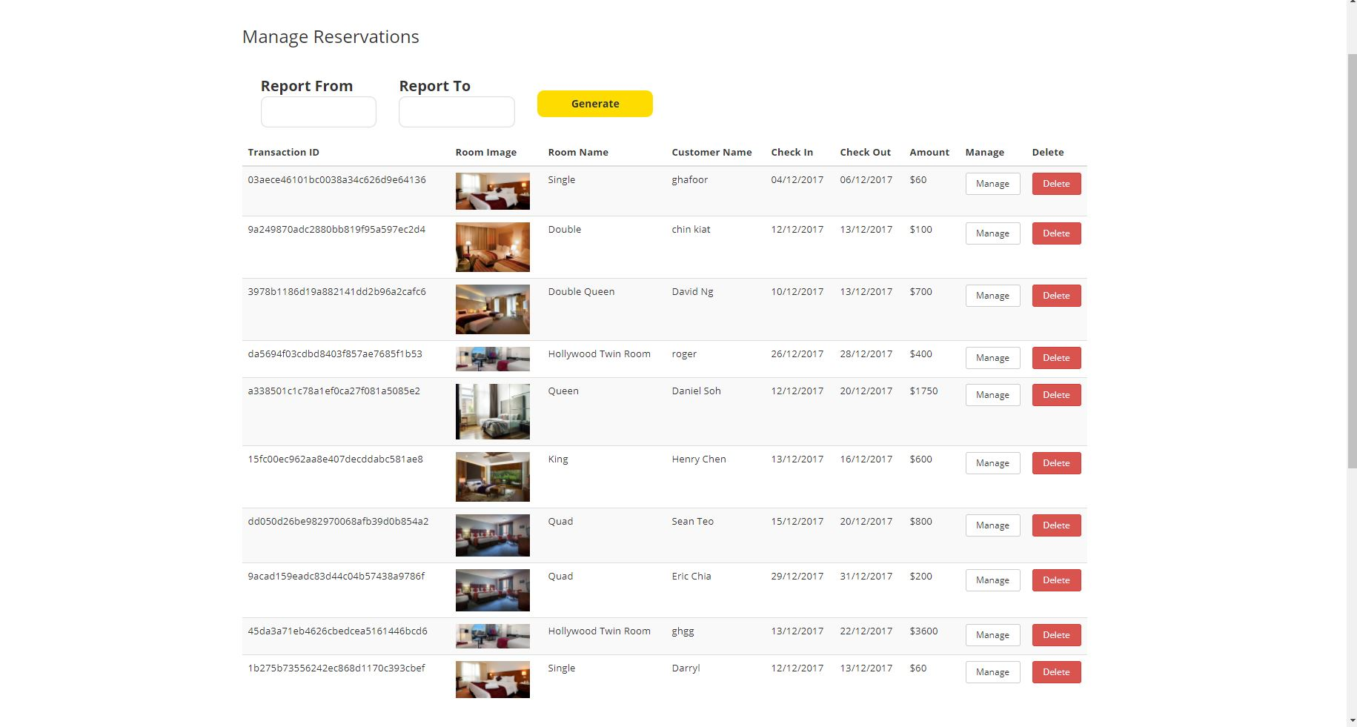
Manage reservation

Slide 7
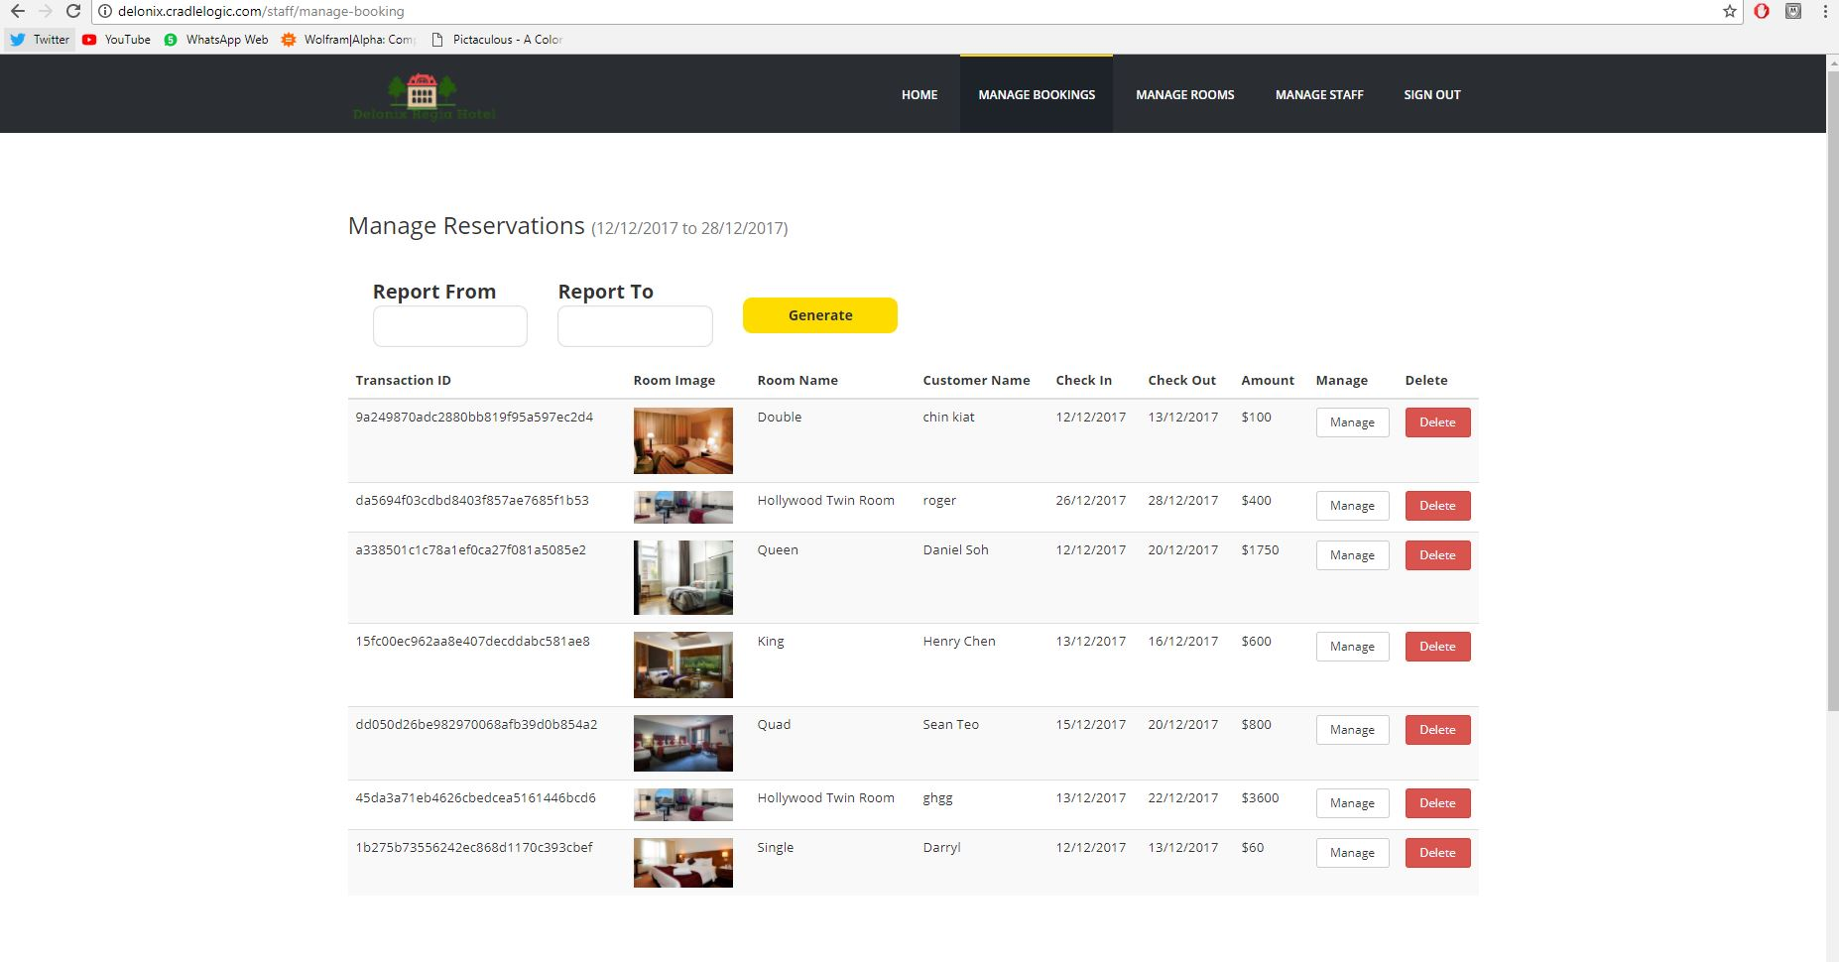
Viewing report

Slide 8
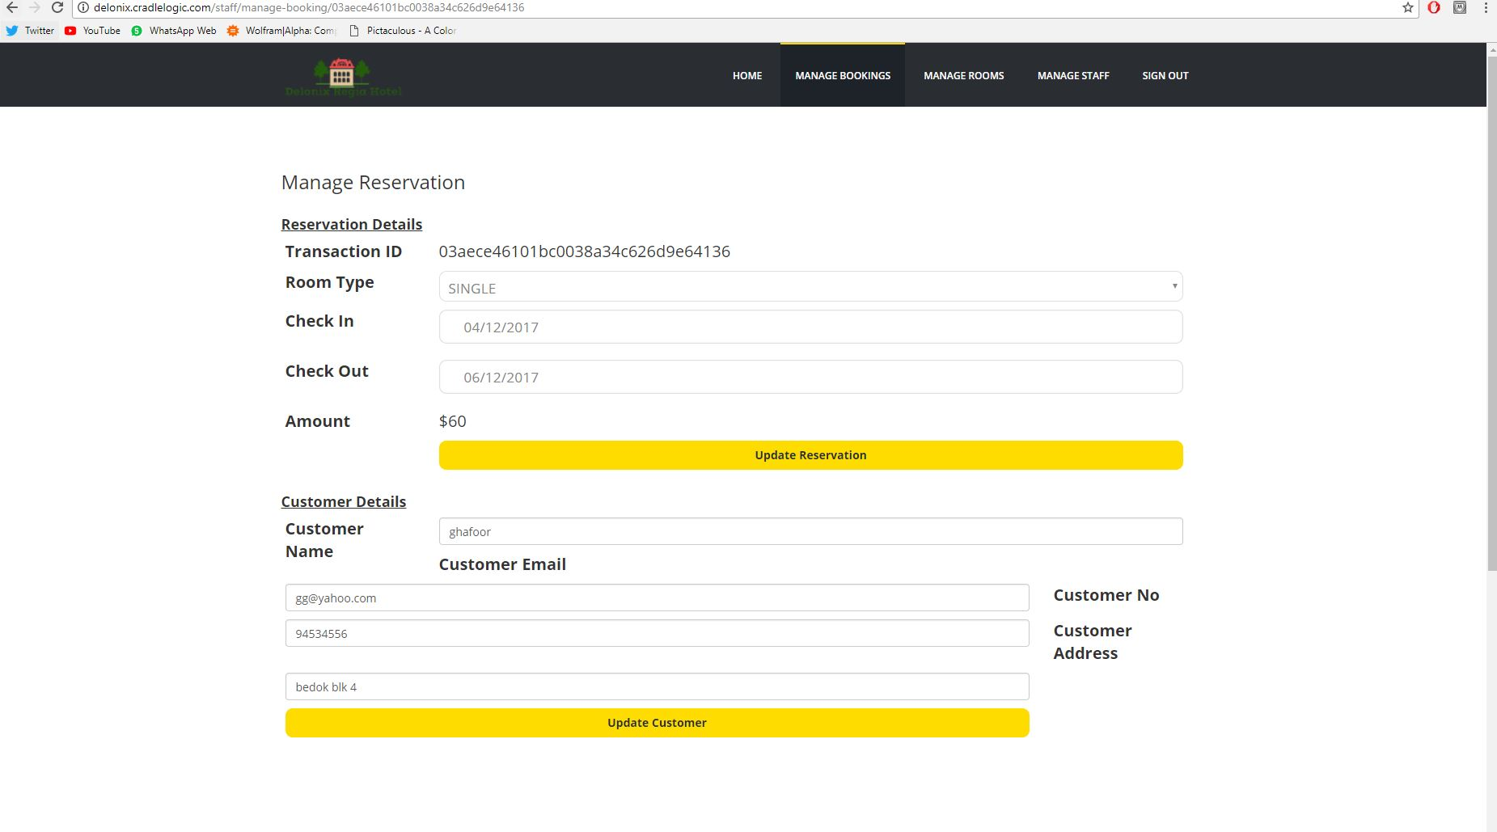
Manage reservation

Slide 9
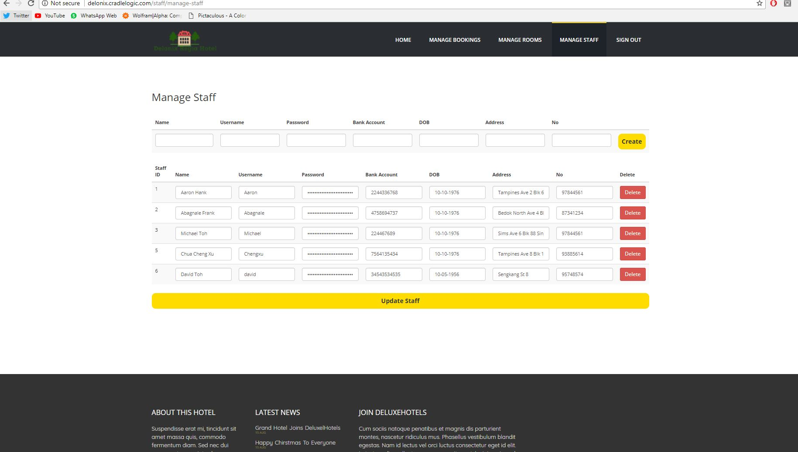
Manage staff

