Slide 1

Stable Diffusion on AWS
June 2024

Slide 2
Agenda
Proposed architecture for integration
Description product
Cost estimate

Slide 3
Proposed Architecture for Integration

Slide 4
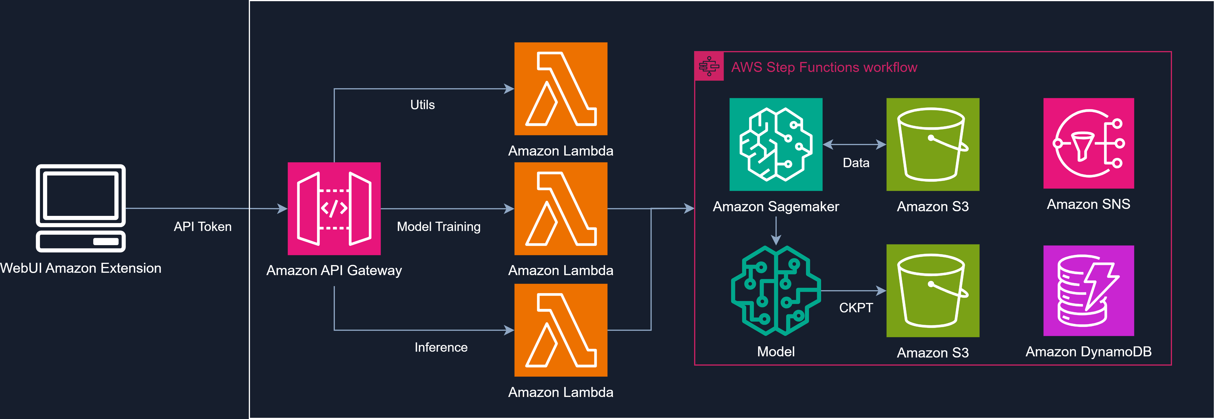
High Level Architecture

Slide 5
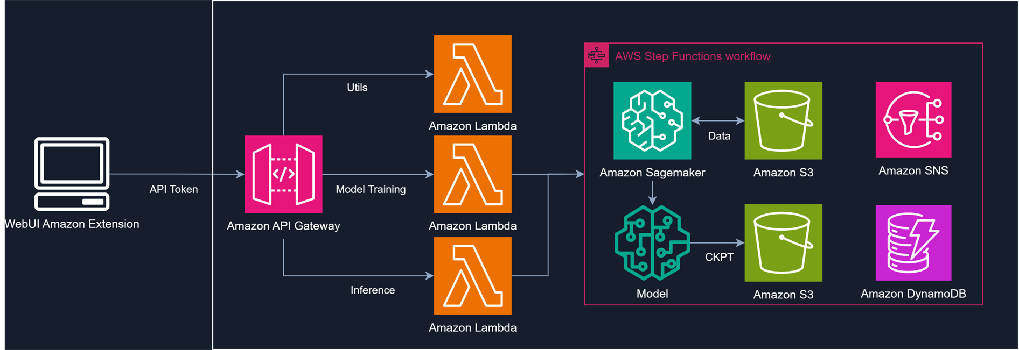
High Level Architecture
Reference: <link_of_the_diagram_show_here>

Slide 6
Description Product

Slide 7
Description Product
Amazon SageMaker is a fully managed machine learning service. With SageMaker, data scientists and developers can quickly and easily build and train machine learning models, and then directly deploy them into a production-ready hosted environment. In this workshop, we will build the Stable Diffusion WebUI on EC2 instance then utilize the Stable Diffusion AWS Extension to invoke Amazon SageMaker Endpoint to generate the images at scale.

Slide 8
AWS Infrastructure Cost Estimation

Slide 9
Assumptions
Region: N.Virginia (us-east-1)
Time: one month (30 days)

Slide 10
Cost for Infrastructure

