Slide 1
RGB LED Controlled Sensor

Slide 2
Objective and Purpose
Makes the LED lights follow with the surrounding environment
Let the user know that the room temperature is getting hotter or colder
It can use as a lamp
It mostly uses in places like in a small room, arcade or restaurant

Slide 3
Component
Sensor
Light Sensor, Temperature Sensor, and Touch Sensor
Output
Buzzer and RGB LED

Slide 4
Function
1. Touch sensor is used to activate and deactivate the LED Lights
2. Buzzer make generate a beep everything the touch sensor is used
3. LED Lights changes depending on the surrounding temperature
4. LED Lights brightness goes brighter when the surrounding environment is darker

Slide 5

CODE AND FUNCTIONS
Set the current touch state so when it restart the device, the LED will not be on

Slide 6

CODE AND FUNCTIONS
Toggle the touch sensor state and create buzz sound

Slide 7
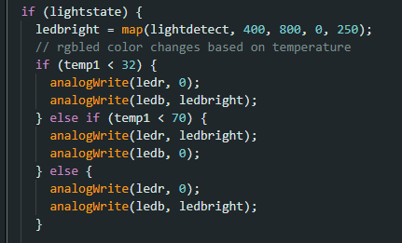
CODE AND FUNCTIONS
Control the LED color and brightness

Slide 8
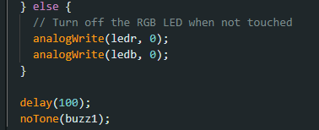
CODE AND FUNCTIONS
Turn off LED Light and Buzzer

Slide 9
End

