Slide 1
MATH CROSS

Slide 2
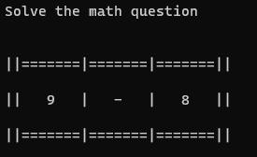
The Game functions
The main interface when you connected to the game

Slide 3
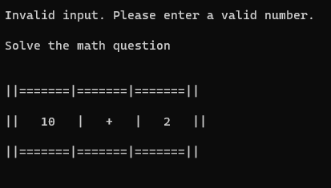
The Game functions
Server response Invalid Input for not using numeric input

Slide 4
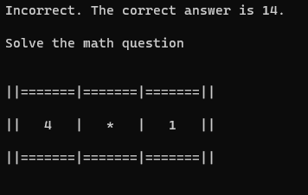
The Game functions
Server response Incorrect if the given answer is not the right one.

Slide 5
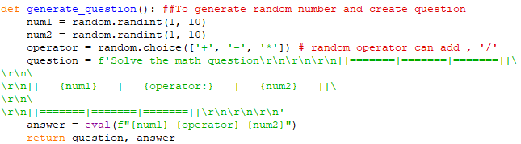
CODE AND FUNCTION
To generate the interface and add random operator into the question to the clients for each question

Slide 6
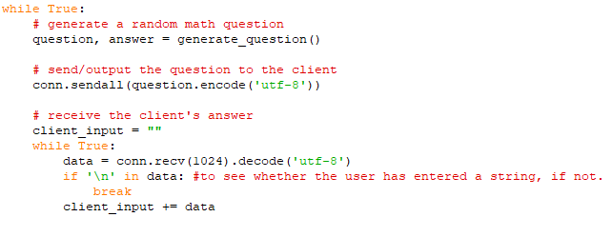
CODE AND FUNCTION
Generate the question and send to the clients
Receive the input from the clients

Slide 7
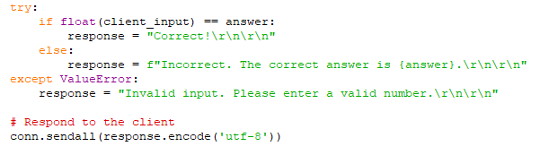
CODE AND FUNCTION
Ensure the clients input is a numeric answer and response whether the user has answer correctly or not

Slide 8
End

