Slide 1
CZ1015 DSAI
Mini Project
Done by:
Chan Si Min, Rachel
Isaac Soh Wei Yang
Lim Yi Keong
Tan Jun Hong

Slide 2
Content
Problem statement
Objective
Data Cleansing
Exploratory Data Analysis
Machine Learning
Learning Outcome

Slide 3
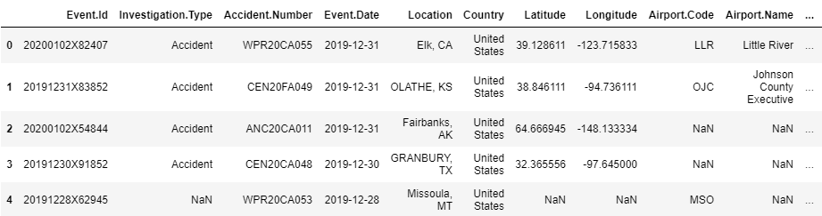
Finding A Problem
Dataset: Aviation Accident Database & Synopses
1

Slide 4
Problem Statement
Which factors are the biggest contribution that leads to aircraft accidents?

Slide 5
Objective
To create a model to accurately predict if an accident is fatal or not
To create a model to predict the number of injuries in an accident
Use various visualization methods to analyse the data

Slide 6
Data Cleansing
Done By: Isaac
2

Slide 7
Data Cleansing
Null Values
With Existing Data or Fill in with Unknowns
Event Date
Split into Year, Month and Date
Data Types
Changed data types to match corresponding data
Injuries
Sum of Number of Injuries with NANs replaced by 0
Notes:
Unable to clean latitude and longitude as the data is very specific and thus hard to give a rough gauge

Slide 8
Exploratory Data Analysis
Done By: Yi Keong & Rachel
3

Slide 9
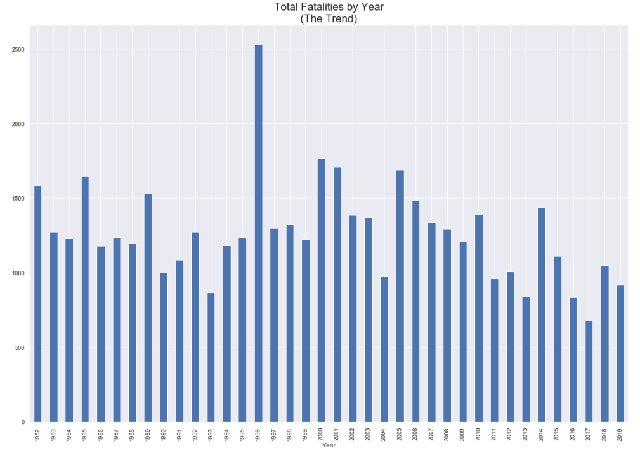

Slide 10
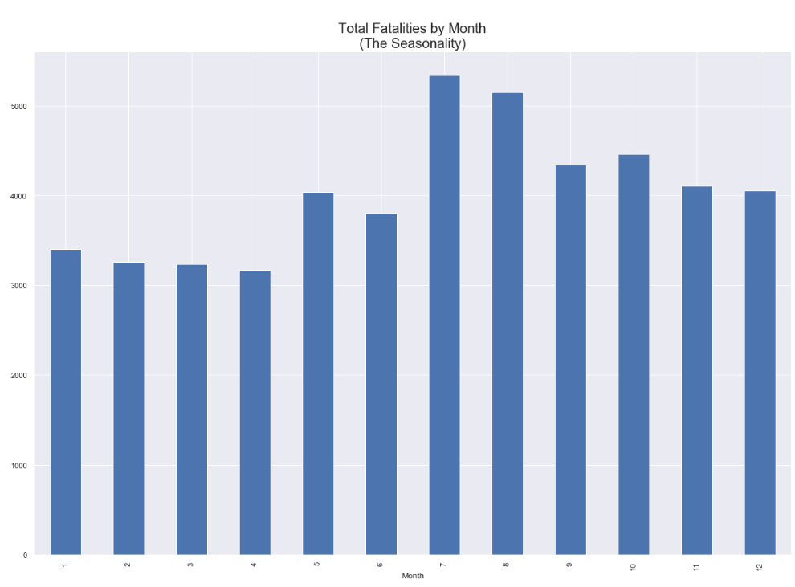

Slide 11
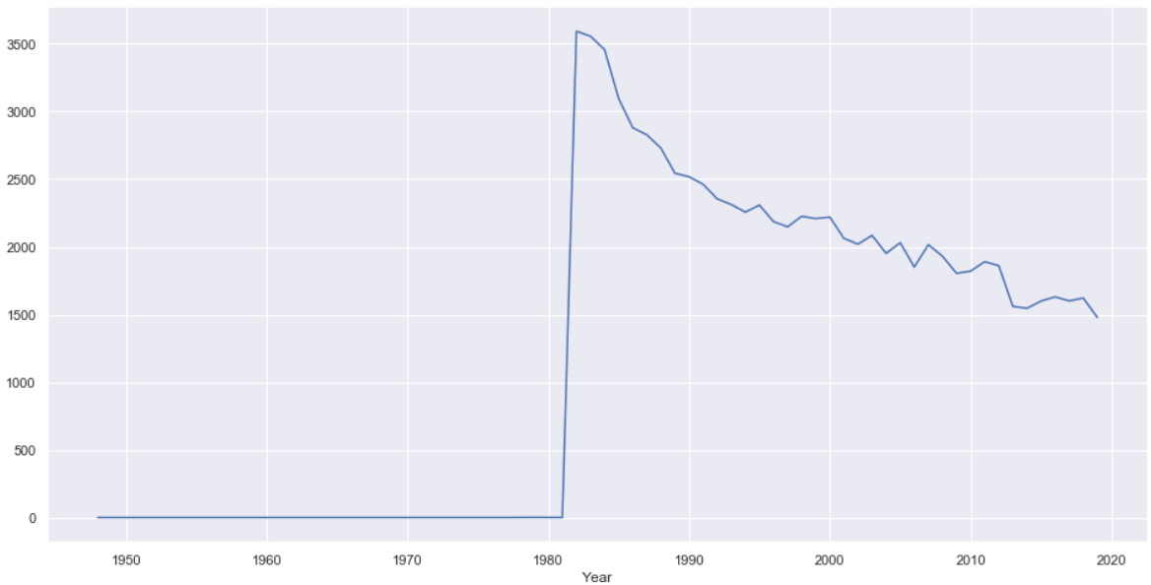
Accident over the years (for cleansing of data)

Slide 12
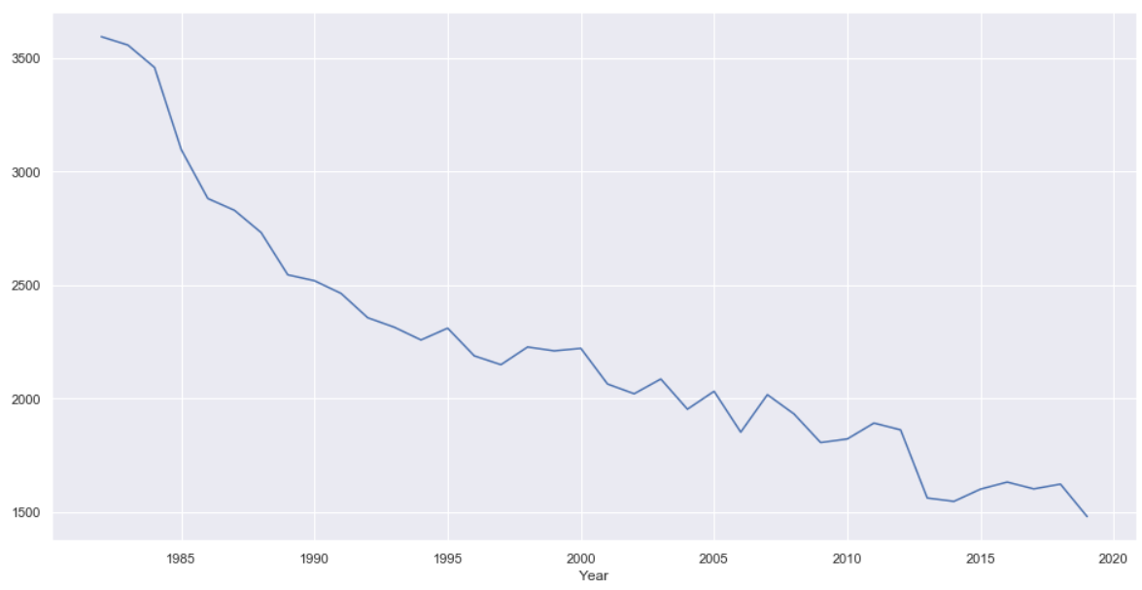
Accident over the years from 1982 onwards

Slide 13
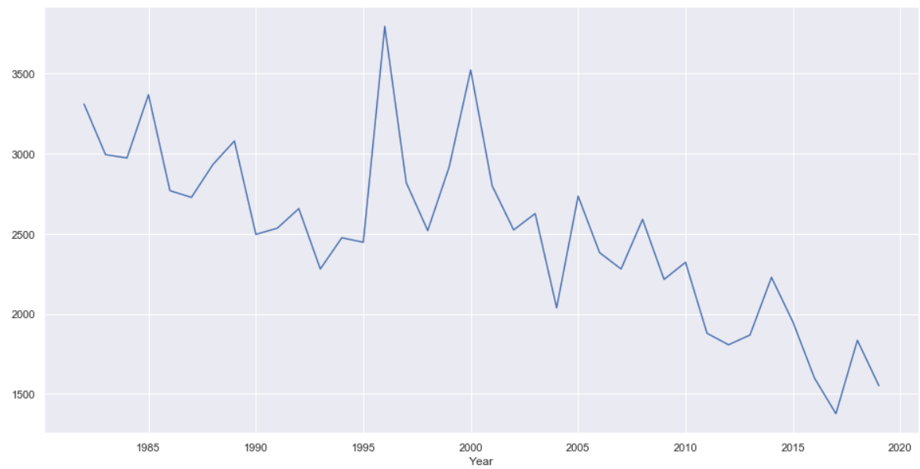
Injuries over the years
Notes:
Sharp peak at 1996, it was the year where alot of accidents relating to paranormal activities were reported

Slide 14
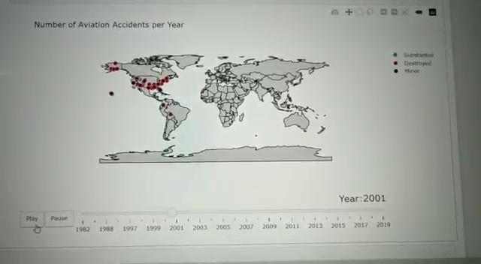
Animated Map (Rachel)
Most Aircraft Damage: Substantial
In America:
Alaska: Substantial
United States: Destroyed

Slide 15
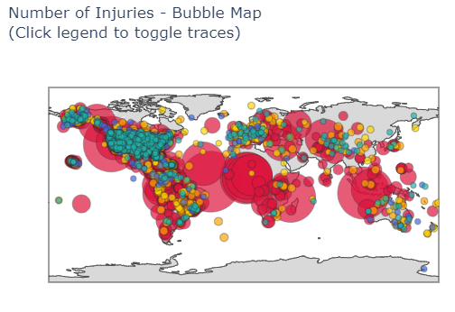
Bubble Map (Rachel)
Colors based on Injuries Count
Least: Green
Most: Red
Notes:
Infer that most datas are in the United States

Slide 16
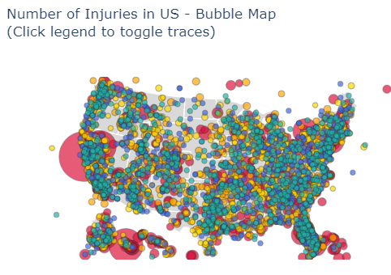
United States Bubble Map
Most Injuries: San Francisco
Most Accidents in: East of United States
Notes:
Color refers to the number of injuries.
Red has more compared to green

Slide 17
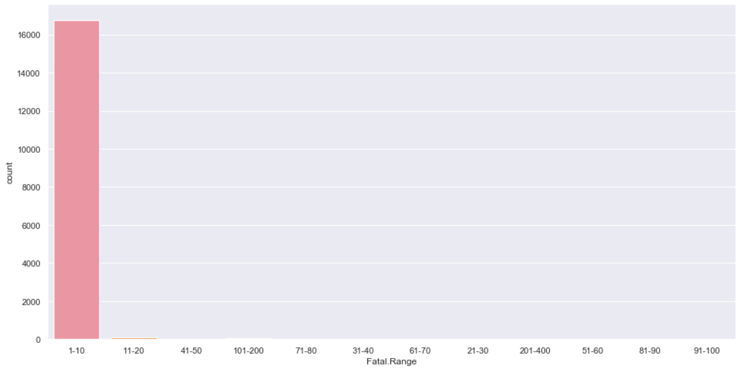
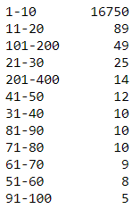
Fatalities per group (Yi Keong)

Slide 18
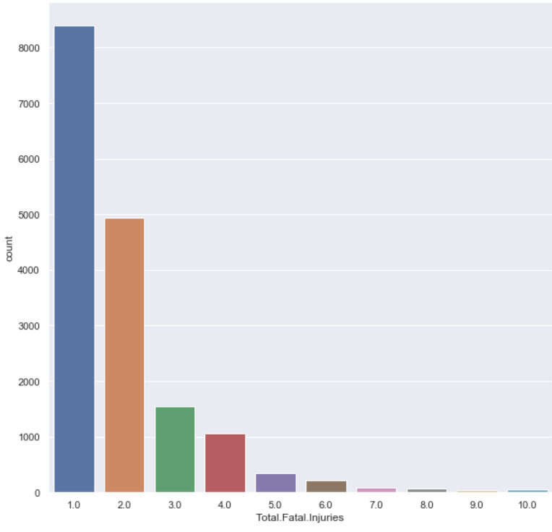
No. of Fatalities by group

Slide 19
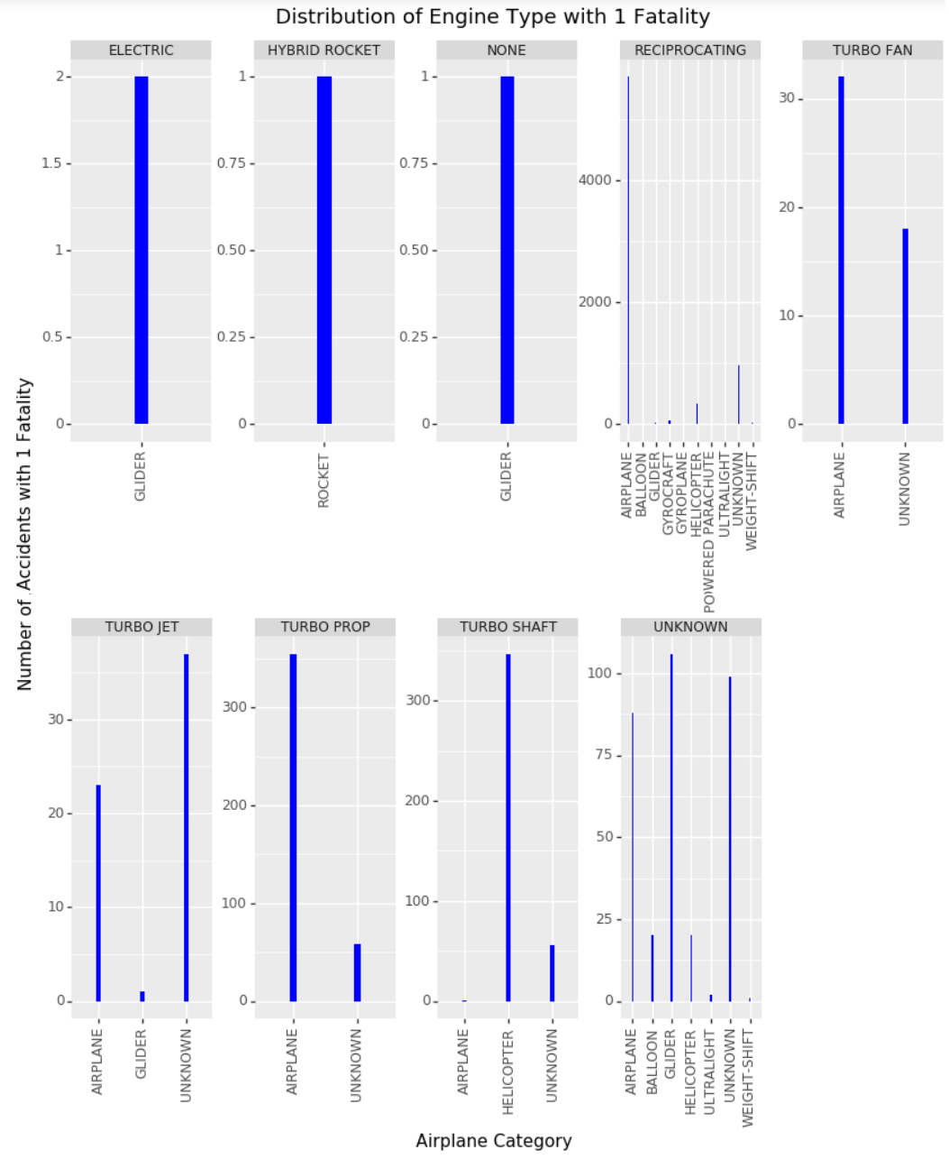

Slide 20
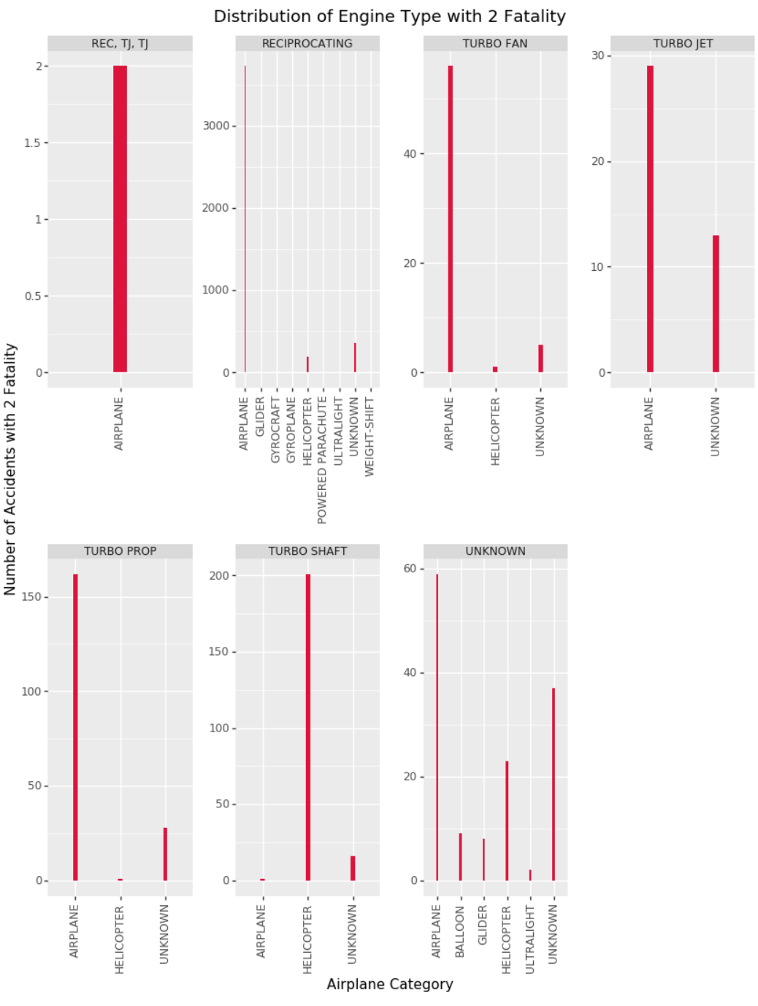

Slide 21
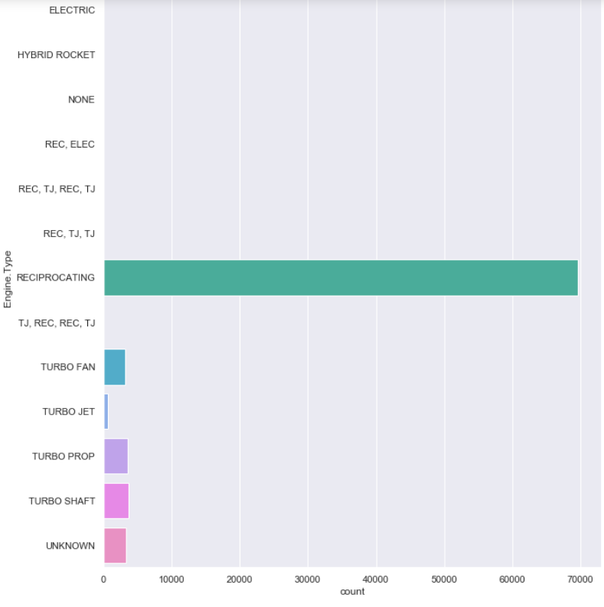
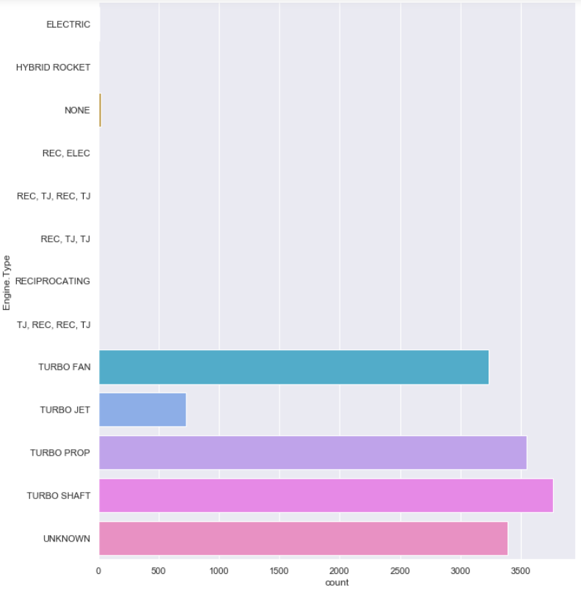
Type of engine with highest accidents
Notes:
Right side without reciprocating

Slide 22
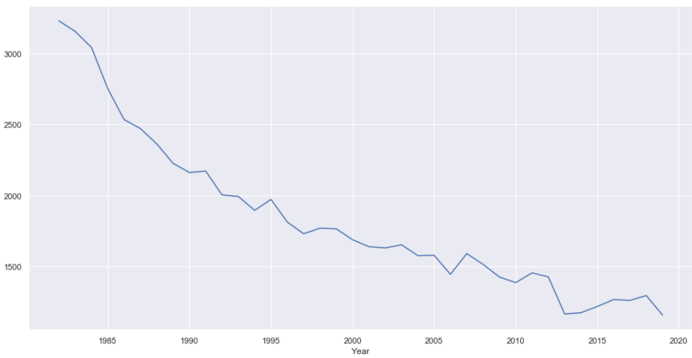
Engine (Reciprocating) over the years

Slide 23
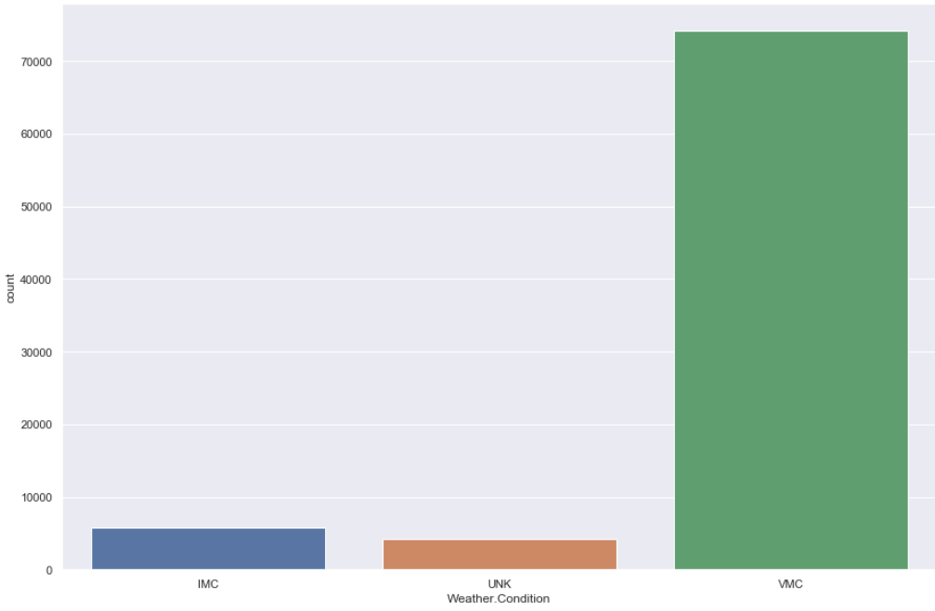
Type of weather with highest accidents

Slide 24
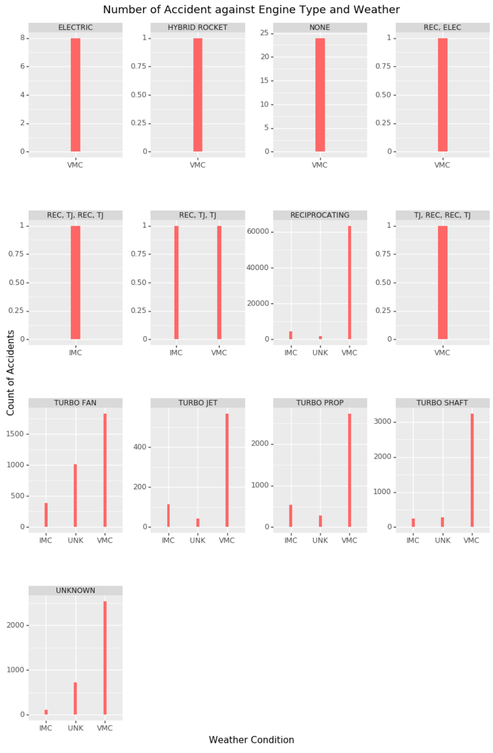

Slide 25
Machine Learning
Done By: Jun Hong
4

Slide 26
Things we did
Linear Regression using Scikit-Learn
Predictor: Year, Response: Number of accidents
Linear Regression using Keras
Classification Neural-Network using Keras
Classification using Decision Tree
Same predictors and response used as classification using Keras
Clustering using DBSCAN
Check where accidents are
Anomaly Detection using IsolationForest
Check what the weird location of accidents are

Slide 27
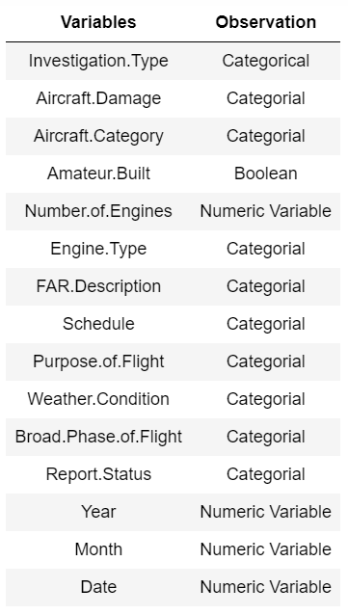
Keras (Jun Hong)
Model to predict the number of injuries for accidents
Model to predict if accident is fatal or not

Slide 28
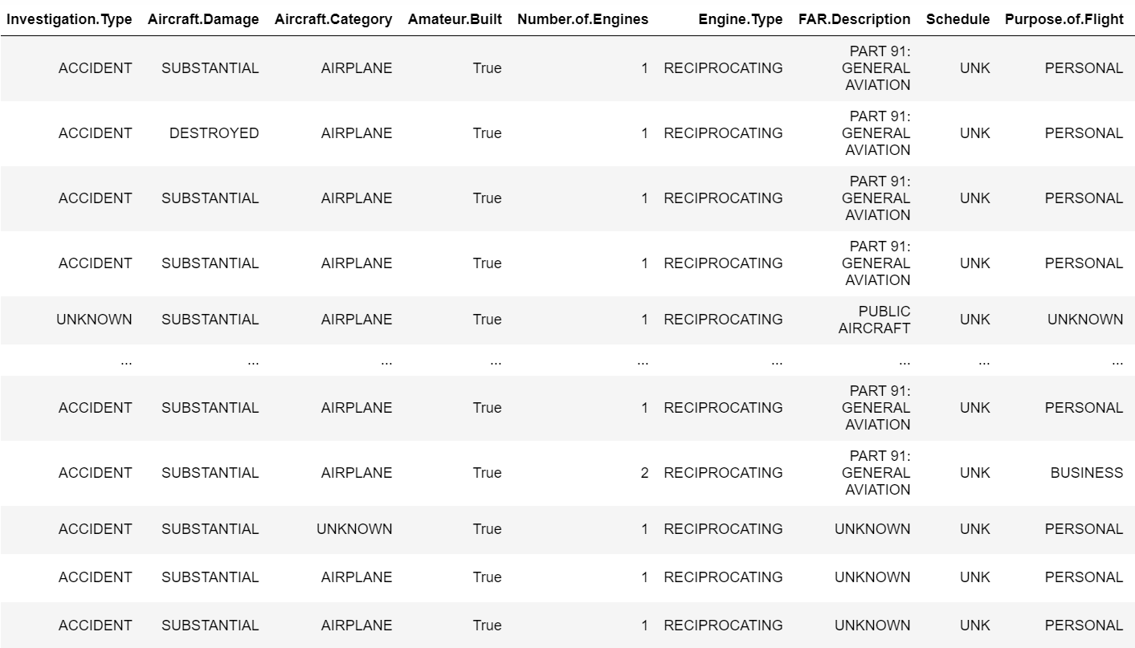
Preparing Data

Slide 29
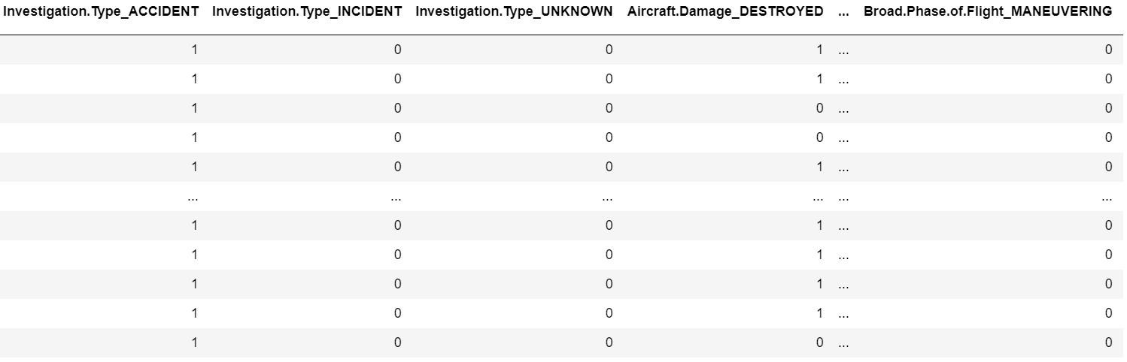
Preparing Data
One Hot Encoding
*We did standard scaling as well

Slide 30
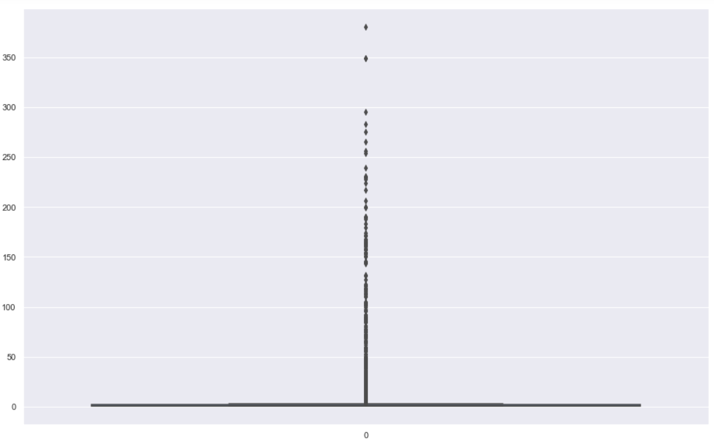
Model to predict the number of injuries for accidents
Data distribution
Too skewed!
Much of the data is between 1 to 20

Slide 31
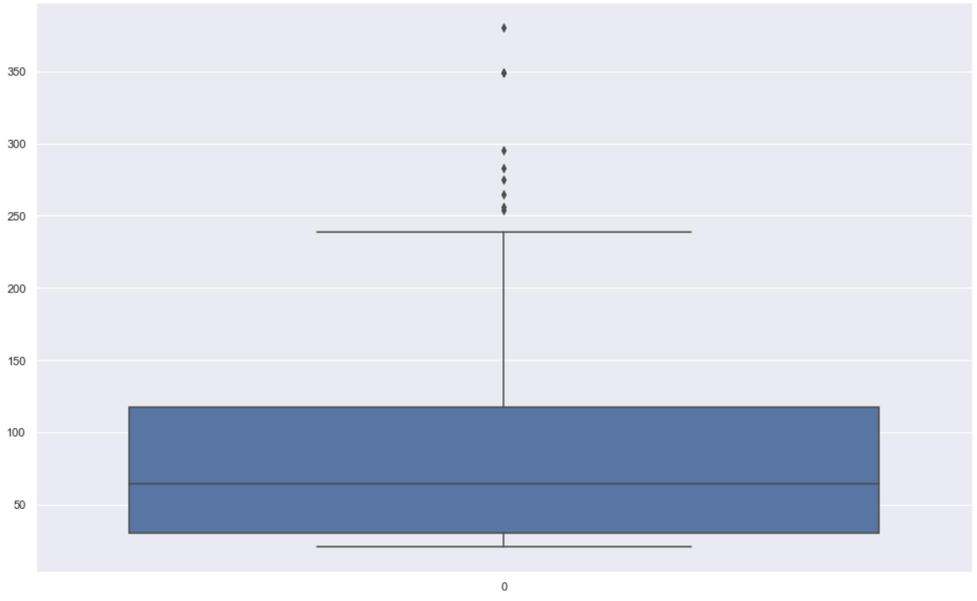
Model to predict the number of injuries for accidents
Data distribution
(>20)
Much better!

Slide 32
Model to predict the number of injuries for accidents
Randomly split into 75% Train, 25% Test
We defined a keras model
2 layers
Adam optimizer, and mean squared error loss function
Epoch of 200 and batch size of 1

Slide 33
Results
 | Train | Test
Explained Variance (R^2) | 0.7471219691410051 | 0.9332693694940938
Mean Squared Error (MSE) | 1179.1644753938235 | 370.8683178897451
Root Mean Squared Error (RMSE) | 34.33896439023494 | 19.257941683620945

Slide 34
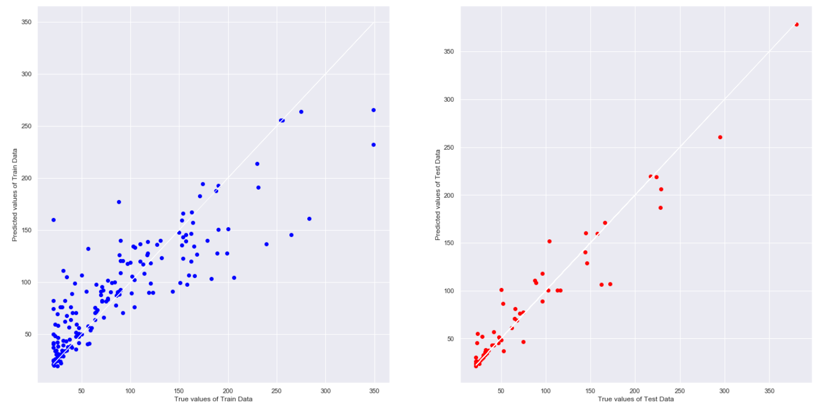
Results

Slide 35
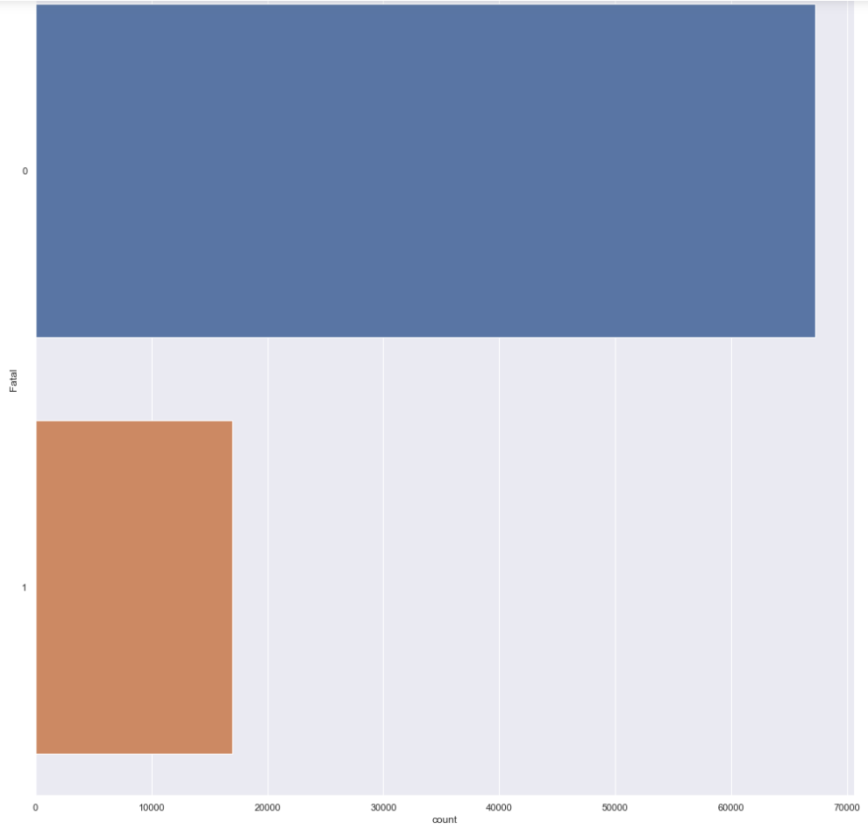
Model to predict if accident is fatal
Data distribution
Too skewed!
Most of the accidents are not fatal

Slide 36
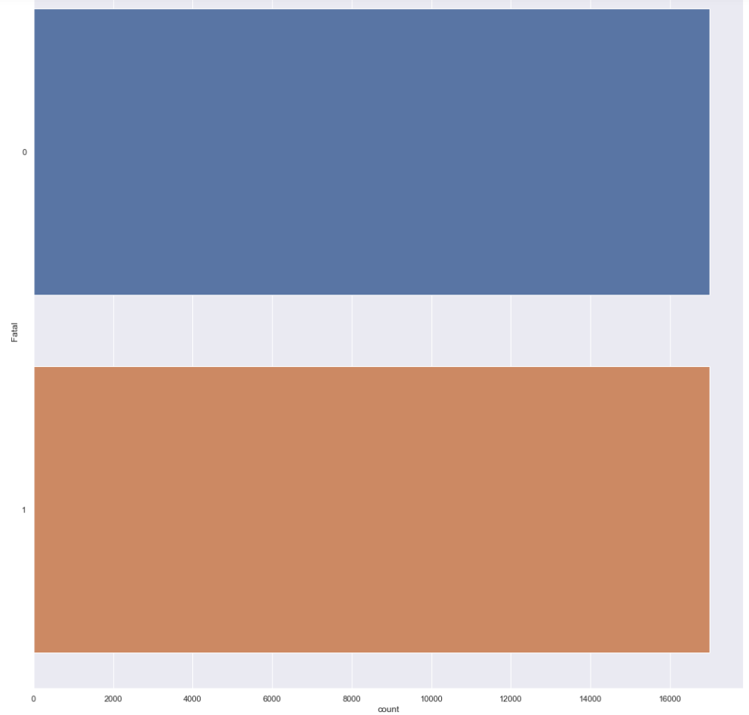
Model to predict if accident is fatal
Undersampling
Make sure the algorithm does not favour non-fatal

Slide 37
Model to predict if accident is fatal
Randomly split into 75% Train, 25% Test
We defined a keras model as well
3 layers
Adam optimizer, and binary cross entrophy loss function
Epoch of 200 and batch size of 1

Slide 38
Results
 | Train | Test
Classification Accuracy | 0.8441497292631248 | 0.838512241054614
True Positive Rate | 0.8481519265479086 | 0.842984934086629
True Negative Rate | 0.840147531978341 | 0.8340395480225988
False Positive Rate | 0.15985246802165895 | 0.16596045197740114
False Negative Rate | 0.15184807345209134 | 0.157015065913371
F1 Score | 0.8447709863998749 | 0.8392313100539021

Slide 39
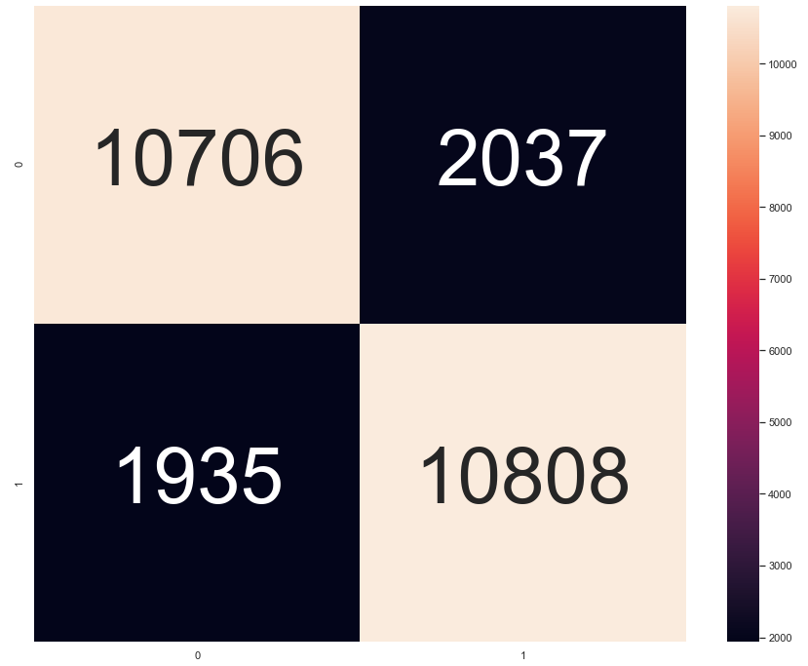
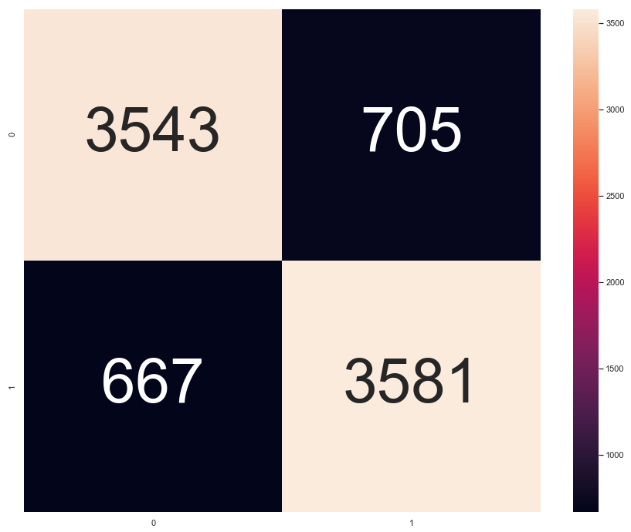
Results
Train Data
Test Data

Slide 40
What we learned beyond the course?
Animated Map
Bubble Map
Ggplot from plotnine
Keras Neural Network Model
One-hot encoding, under sampling etc.

Slide 41
Learning Outcome
We learned how to prepare our data
Data Cleansing, Undersampling, Random Sampling
We learned how to improve our model
By configuring with epoch, batch size etc.
We learned the different visualization methods
We gained useful insights from the data

Slide 42
Contributions
Problem Statement: All
Data Cleansing: Isaac
Exploratory Data Analysis: Rachel & Yi Keong
Machine Learning: Jun Hong

