Slide 1
CE2001/CZ2001
Lab Project 1
Team members:
Woon Yoke Min
Tan Yap Siang
Gordon Tan
Tey Yi Heng
Tan Jun Hong

Slide 2
Significance
Brute force (Naive) Algorithm:
Average time complexity = O(m*n), where n is the size of sequence string and m is size of query string
Check each character in the sequence. If there is a mismatch, go to next index of the sequence, go to index 0 of query and check again. Therefore, The time complexity for best case is O(n), worst case is O(m*n)

Slide 3
Significance
Brute force (Naive) Algorithm:
Average time complexity = O(m*n), where n is the size of sequence string and m is size of query string
KMP (Knuth-Morris-Pratt) Algorithm:
Average time complexity = O(m+n), where n is the size of sequence string and m is size of query string
Optimized KMP:
Same average time complexity as KMP

Slide 4
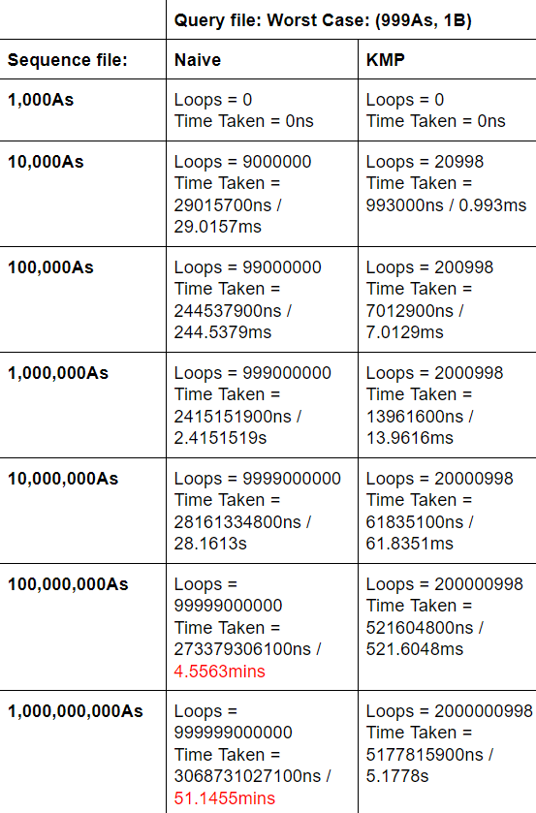
Significance

Slide 5
Example:
Sequence: c a b a b a b c a b a b a c a a
Query: a b a b a c a

Slide 6
KMP Algorithm (Preprocessing Step)
Query: a b a b a c a
variable matchedLength = 0;
First index should be 0 (first character not repeated)
3 possible cases:
(1) If the same
(2) If not the same & matchedLength = 0
(3) If not the same & matchedLength != 0
a | b | a | b | a | c | a
0

Slide 7
KMP Algorithm (Preprocessing Step)
Query: a b a b a c a
variable matchedLength = 0;
Compare next index with matchedLength’s index
(2) If not the same & matchedLength = 0:
Append matchedLength to array at that index
a | b | a | b | a | c | a
0 | 0

Slide 8
KMP Algorithm (Preprocessing Step)
Query: a b a b a c a
variable matchedLength = 0 -> 1;
Compare next index with matchedLength’s index
(1) If the same:
matchLength increments by one
Append matchedLength to array at that index
a | b | a | b | a | c | a
0 | 0 | 1

Slide 9
KMP Algorithm (Preprocessing Step)
Query: a b a b a c a
variable matchedLength = 1 -> 2;
Compare next index with matchedLength’s index
(1) If the same:
matchLength increments by one
Append matchedLength to array at that index
a | b | a | b | a | c | a
0 | 0 | 1 | 2

Slide 10
KMP Algorithm (Preprocessing Step)
Query: a b a b a c a
variable matchedLength = 2 -> 3;
Compare next index with matchedLength’s index
(1) If the same:
matchLength increments by one
Append matchedLength to array at that index
a | b | a | b | a | c | a
0 | 0 | 1 | 2 | 3

Slide 11
KMP Algorithm (Preprocessing Step)
Query: a b a b a c a
variable matchedLength = 3 -> 2;
Compare next index with matchedLength’s index
(3) If not the same & matchedLength != 0:
Use previous index as matchLength
Compare the same index again!
a | b | a | b | a | c | a
0 | 0 | 1 | 2 | 3

Slide 12
KMP Algorithm (Preprocessing Step)
Query: a b a b a c a
variable matchedLength = 2 ->1;
Compare the same index with matchedLength’s index
(3) If not the same & matchedLength != 0:
Use previous index as matchLength
Compare the same index again!
a | b | a | b | a | c | a
0 | 0 | 1 | 2 | 3

Slide 13
KMP Algorithm (Preprocessing Step)
Query: a b a b a c a
variable matchedLength = 1 -> 0;
Compare the same index with matchedLength’s index
(3) If not the same & matchedLength != 0:
Use previous index as matchLength
Compare the same index again!
a | b | a | b | a | c | a
0 | 0 | 1 | 2 | 3

Slide 14
KMP Algorithm (Preprocessing Step)
Query: a b a b a c a
variable matchedLength = 0;
Compare the same index with matchedLength’s index
(2) If not the same & matchedLength = 0:
Append matchedLength to array at that index
a | b | a | b | a | c | a
0 | 0 | 1 | 2 | 3 | 0

Slide 15
KMP Algorithm (Preprocessing Step)
Query: a b a b a c a
variable matchedLength = 0 -> 1;
Compare next index with matchedLength’s index
(1) If the same:
matchLength increments by one
Append matchedLength to array at that index
a | b | a | b | a | c | a
0 | 0 | 1 | 2 | 3 | 0 | 1

Slide 16
KMP Algorithm (Searching Step)
Sequence: c a b a b a b c a b a b a c a a
Query: a b a b a c a
Initialize:
Do the preprocessing step to create the failureFunction[]
Add a null character in the front of the failureFunction[]
i = 0, index of character in the sequence we want to search
j =0, index of character in the query we are looking at
j | 0 | 1 | 2 | 3 | 4 | 5 | 6 | 7
Query | \0 | a | b | a | b | a | c | a
failureFunction[] | 0 | 0 | 0 | 1 | 2 | 3 | 0 | 1

Slide 17
KMP Algorithm (Searching Step)
Index i | 0 | 1 | 2 | 3 | 4 | 5 | 6 | 7 | 8 | 9 | 10 | 11 | 12 | 13 | 14 | 15
sequence | c | a | b | a | b | a | b | c | a | b | a | b | a | c | a | a
Check if the character at i is the same as the next character at j (i.e. character at j+1)
3 possible comparison cases:
(1) If the same
(2) If not the same & failureFunction[] = 0
(3) If not the same & failureFunction[] != 0
Index j | 0 | 1 | 2 | 3 | 4 | 5 | 6 | 7
Query | \0 | a | b | a | b | a | c | a
failureFunction[] | 0 | 0 | 0 | 1 | 2 | 3 | 0 | 1
i | 0
j | 0

Slide 18
KMP Algorithm (Searching Step)
Index i | 0 | 1 | 2 | 3 | 4 | 5 | 6 | 7 | 8 | 9 | 10 | 11 | 12 | 13 | 14 | 15
sequence | c | a | b | a | b | a | b | c | a | b | a | b | a | c | a | a
Check if the character at i is the same as the next character at j (i.e. character at j+1)
2 possible search cases:
(1) If j = length of the query: Query is found at (i-j+1) index of sequence string
(2) If i = length of the sequence - 1: Search ends
Index j | 0 | 1 | 2 | 3 | 4 | 5 | 6 | 7
Query | \0 | a | b | a | b | a | c | a
failureFunction[] | 0 | 0 | 0 | 1 | 2 | 3 | 0 | 1
i | 0
j | 0

Slide 19
KMP Algorithm (Searching Step)
Index i | 0 | 1 | 2 | 3 | 4 | 5 | 6 | 7 | 8 | 9 | 10 | 11 | 12 | 13 | 14 | 15
sequence | c | a | b | a | b | a | b | c | a | b | a | b | a | c | a | a
Check if the character at i is the same as the next character at j (i.e. character at j+1)
(2) If not the same & failureFunction[] = 0
Change index j to 0
i ++
Index j | 0 | 1 | 2 | 3 | 4 | 5 | 6 | 7
Query | \0 | a | b | a | b | a | c | a
failureFunction[] | 0 | 0 | 0 | 1 | 2 | 3 | 0 | 1
i | 0 -> 1
j | 0

Slide 20
KMP Algorithm (Searching Step)
Index i | 0 | 1 | 2 | 3 | 4 | 5 | 6 | 7 | 8 | 9 | 10 | 11 | 12 | 13 | 14 | 15
sequence | c | a | b | a | b | a | b | c | a | b | a | b | a | c | a | a
Check if the character at i is the same as the next character at j (i.e. character at j+1)
(1) If the same
i ++
j ++
Index j | 0 | 1 | 2 | 3 | 4 | 5 | 6 | 7
Query | \0 | a | b | a | b | a | c | a
failureFunction[] | 0 | 0 | 0 | 1 | 2 | 3 | 0 | 1
i | 1 -> 2
j | 0 -> 1

Slide 21
KMP Algorithm (Searching Step)
Index i | 0 | 1 | 2 | 3 | 4 | 5 | 6 | 7 | 8 | 9 | 10 | 11 | 12 | 13 | 14 | 15
sequence | c | a | b | a | b | a | b | c | a | b | a | b | a | c | a | a
Check if the character at i is the same as the next character at j (i.e. character at j+1)
(1) If the same
i ++
j ++
Index j | 0 | 1 | 2 | 3 | 4 | 5 | 6 | 7
Query | \0 | a | b | a | b | a | c | a
failureFunction[] | 0 | 0 | 0 | 1 | 2 | 3 | 0 | 1
i | 2 -> 3
j | 1 -> 2

Slide 22
KMP Algorithm (Searching Step)
Index i | 0 | 1 | 2 | 3 | 4 | 5 | 6 | 7 | 8 | 9 | 10 | 11 | 12 | 13 | 14 | 15
sequence | c | a | b | a | b | a | b | c | a | b | a | b | a | c | a | a
Check if the character at i is the same as the next character at j (i.e. character at j+1)
(1) If the same
i ++
j ++
Index j | 0 | 1 | 2 | 3 | 4 | 5 | 6 | 7
Query | \0 | a | b | a | b | a | c | a
failureFunction[] | 0 | 0 | 0 | 1 | 2 | 3 | 0 | 1
i | 3 -> 4
j | 2 -> 3

Slide 23
KMP Algorithm (Searching Step)
Index i | 0 | 1 | 2 | 3 | 4 | 5 | 6 | 7 | 8 | 9 | 10 | 11 | 12 | 13 | 14 | 15
sequence | c | a | b | a | b | a | b | c | a | b | a | b | a | c | a | a
Check if the character at i is the same as the next character at j (i.e. character at j+1)
(1) If the same
i ++
j ++
Index j | 0 | 1 | 2 | 3 | 4 | 5 | 6 | 7
Query | \0 | a | b | a | b | a | c | a
failureFunction[] | 0 | 0 | 0 | 1 | 2 | 3 | 0 | 1
i | 4 -> 5
j | 3 -> 4

Slide 24
KMP Algorithm (Searching Step)
Index i | 0 | 1 | 2 | 3 | 4 | 5 | 6 | 7 | 8 | 9 | 10 | 11 | 12 | 13 | 14 | 15
sequence | c | a | b | a | b | a | b | c | a | b | a | b | a | c | a | a
Check if the character at i is the same as the next character at j (i.e. character at j+1)
(1) If the same
i ++
j ++
Index j | 0 | 1 | 2 | 3 | 4 | 5 | 6 | 7
Query | \0 | a | b | a | b | a | c | a
failureFunction[] | 0 | 0 | 0 | 1 | 2 | 3 | 0 | 1
i | 5 -> 6
j | 4 -> 5

Slide 25
KMP Algorithm (Searching Step)
Index i | 0 | 1 | 2 | 3 | 4 | 5 | 6 | 7 | 8 | 9 | 10 | 11 | 12 | 13 | 14 | 15
sequence | c | a | b | a | b | a | b | c | a | b | a | b | a | c | a | a
Check if the character at i is the same as the next character at j (i.e. character at j+1)
(3) If not the same & failureFunction[] != 0
Change index j to the value of failureFunction[] at j
Index j | 0 | 1 | 2 | 3 | 4 | 5 | 6 | 7
Query | \0 | a | b | a | b | a | c | a
failureFunction[] | 0 | 0 | 0 | 1 | 2 | 3 | 0 | 1
i | 6
j | 5 -> 3

Slide 26
KMP Algorithm (Searching Step)
Index i | 0 | 1 | 2 | 3 | 4 | 5 | 6 | 7 | 8 | 9 | 10 | 11 | 12 | 13 | 14 | 15
sequence | c | a | b | a | b | a | b | c | a | b | a | b | a | c | a | a
Check if the character at i is the same as the next character at j (i.e. character at j+1)
(1) If the same
i ++
j ++
Index j | 0 | 1 | 2 | 3 | 4 | 5 | 6 | 7
Query | \0 | a | b | a | b | a | c | a
failureFunction[] | 0 | 0 | 0 | 1 | 2 | 3 | 0 | 1
i | 6 -> 7
j | 3 -> 4

Slide 27
KMP Algorithm (Searching Step)
Index i | 0 | 1 | 2 | 3 | 4 | 5 | 6 | 7 | 8 | 9 | 10 | 11 | 12 | 13 | 14 | 15
sequence | c | a | b | a | b | a | b | c | a | b | a | b | a | c | a | a
Check if the character at i is the same as the next character at j (i.e. character at j+1)
(3) If not the same & failureFunction[] != 0
Change index j to the value of failureFunction[] at j
Index j | 0 | 1 | 2 | 3 | 4 | 5 | 6 | 7
Query | \0 | a | b | a | b | a | c | a
failureFunction[] | 0 | 0 | 0 | 1 | 2 | 3 | 0 | 1
i | 7
j | 4 -> 2

Slide 28
KMP Algorithm (Searching Step)
Index i | 0 | 1 | 2 | 3 | 4 | 5 | 6 | 7 | 8 | 9 | 10 | 11 | 12 | 13 | 14 | 15
sequence | c | a | b | a | b | a | b | c | a | b | a | b | a | c | a | a
Check if the character at i is the same as the next character at j (i.e. character at j+1)
(3) If not the same & failureFunction[] != 0
Change index j to the value of failureFunction[] at j
Index j | 0 | 1 | 2 | 3 | 4 | 5 | 6 | 7
Query | \0 | a | b | a | b | a | c | a
failureFunction[] | 0 | 0 | 0 | 1 | 2 | 3 | 0 | 1
i | 7
j | 2 -> 0

Slide 29
KMP Algorithm (Searching Step)
Index i | 0 | 1 | 2 | 3 | 4 | 5 | 6 | 7 | 8 | 9 | 10 | 11 | 12 | 13 | 14 | 15
sequence | c | a | b | a | b | a | b | c | a | b | a | b | a | c | a | a
Check if the character at i is the same as the next character at j (i.e. character at j+1)
(2) If not the same & failureFunction[] = 0
Change index j to 0
i ++
Index j | 0 | 1 | 2 | 3 | 4 | 5 | 6 | 7
Query | \0 | a | b | a | b | a | c | a
failureFunction[] | 0 | 0 | 0 | 1 | 2 | 3 | 0 | 1
i | 7 -> 8
j | 0

Slide 30
KMP Algorithm (Searching Step)
Index i | 0 | 1 | 2 | 3 | 4 | 5 | 6 | 7 | 8 | 9 | 10 | 11 | 12 | 13 | 14 | 15
sequence | c | a | b | a | b | a | b | c | a | b | a | b | a | c | a | a
Check if the character at i is the same as the next character at j (i.e. character at j+1)
(1) If the same
i ++
j ++
Index j | 0 | 1 | 2 | 3 | 4 | 5 | 6 | 7
Query | \0 | a | b | a | b | a | c | a
failureFunction[] | 0 | 0 | 0 | 1 | 2 | 3 | 0 | 1
i | 8 -> 9
j | 0 -> 1

Slide 31
KMP Algorithm (Searching Step)
Index i | 0 | 1 | 2 | 3 | 4 | 5 | 6 | 7 | 8 | 9 | 10 | 11 | 12 | 13 | 14 | 15
sequence | c | a | b | a | b | a | b | c | a | b | a | b | a | c | a | a
Check if the character at i is the same as the next character at j (i.e. character at j+1)
(1) If the same
i ++
j ++
Index j | 0 | 1 | 2 | 3 | 4 | 5 | 6 | 7
Query | \0 | a | b | a | b | a | c | a
failureFunction[] | 0 | 0 | 0 | 1 | 2 | 3 | 0 | 1
i | 9 -> 10
j | 1 -> 2

Slide 32
KMP Algorithm (Searching Step)
Index i | 0 | 1 | 2 | 3 | 4 | 5 | 6 | 7 | 8 | 9 | 10 | 11 | 12 | 13 | 14 | 15
sequence | c | a | b | a | b | a | b | c | a | b | a | b | a | c | a | a
Check if the character at i is the same as the next character at j (i.e. character at j+1)
(1) If the same
i ++
j ++
Index j | 0 | 1 | 2 | 3 | 4 | 5 | 6 | 7
Query | \0 | a | b | a | b | a | c | a
failureFunction[] | 0 | 0 | 0 | 1 | 2 | 3 | 0 | 1
i | 10 -> 11
j | 2 -> 3

Slide 33
KMP Algorithm (Searching Step)
Index i | 0 | 1 | 2 | 3 | 4 | 5 | 6 | 7 | 8 | 9 | 10 | 11 | 12 | 13 | 14 | 15
sequence | c | a | b | a | b | a | b | c | a | b | a | b | a | c | a | a
Check if the character at i is the same as the next character at j (i.e. character at j+1)
(1) If the same
i ++
j ++
Index j | 0 | 1 | 2 | 3 | 4 | 5 | 6 | 7
Query | \0 | a | b | a | b | a | c | a
failureFunction[] | 0 | 0 | 0 | 1 | 2 | 3 | 0 | 1
i | 11 -> 12
j | 3 -> 4

Slide 34
KMP Algorithm (Searching Step)
Index i | 0 | 1 | 2 | 3 | 4 | 5 | 6 | 7 | 8 | 9 | 10 | 11 | 12 | 13 | 14 | 15
sequence | c | a | b | a | b | a | b | c | a | b | a | b | a | c | a | a
Check if the character at i is the same as the next character at j (i.e. character at j+1)
(1) If the same
i ++
j ++
Index j | 0 | 1 | 2 | 3 | 4 | 5 | 6 | 7
Query | \0 | a | b | a | b | a | c | a
failureFunction[] | 0 | 0 | 0 | 1 | 2 | 3 | 0 | 1
i | 12 -> 13
j | 4 -> 5

Slide 35
KMP Algorithm (Searching Step)
Index i | 0 | 1 | 2 | 3 | 4 | 5 | 6 | 7 | 8 | 9 | 10 | 11 | 12 | 13 | 14 | 15
sequence | c | a | b | a | b | a | b | c | a | b | a | b | a | c | a | a
Check if the character at i is the same as the next character at j (i.e. character at j+1)
(1) If the same
i ++
j ++
Index j | 0 | 1 | 2 | 3 | 4 | 5 | 6 | 7
Query | \0 | a | b | a | b | a | c | a
failureFunction[] | 0 | 0 | 0 | 1 | 2 | 3 | 0 | 1
i | 13 -> 14
j | 5 -> 6

Slide 36
KMP Algorithm (Searching Step)
Index i | 0 | 1 | 2 | 3 | 4 | 5 | 6 | 7 | 8 | 9 | 10 | 11 | 12 | 13 | 14 | 15
sequence | c | a | b | a | b | a | b | c | a | b | a | b | a | c | a | a
Check if the character at i is the same as the next character at j (i.e. character at j+1)
(1) If the same
i ++
j ++
Index j | 0 | 1 | 2 | 3 | 4 | 5 | 6 | 7
Query | \0 | a | b | a | b | a | c | a
failureFunction[] | 0 | 0 | 0 | 1 | 2 | 3 | 0 | 1
i | 14 -> 15
j | 6 -> 7

Slide 37
KMP Algorithm (Searching Step)
Index i | 0 | 1 | 2 | 3 | 4 | 5 | 6 | 7 | 8 | 9 | 10 | 11 | 12 | 13 | 14 | 15
sequence | c | a | b | a | b | a | b | c | a | b | a | b | a | c | a | a
(Search case 1) If j = length of the query:
Query is found at (i-j+1) character of sequence string (14-7+1 = 8th character)
Index j | 0 | 1 | 2 | 3 | 4 | 5 | 6 | 7
Query | \0 | a | b | a | b | a | c | a
failureFunction[] | 0 | 0 | 0 | 1 | 2 | 3 | 0 | 1
i | 14 -> 15
j | 7 -> 1

Slide 38
KMP Algorithm (Searching Step)
Index i | 0 | 1 | 2 | 3 | 4 | 5 | 6 | 7 | 8 | 9 | 10 | 11 | 12 | 13 | 14 | 15
sequence | c | a | b | a | b | a | b | c | a | b | a | b | a | c | a | a
(Search case 2) If i = length of the sequence - 1:
Search ends
Index j | 0 | 1 | 2 | 3 | 4 | 5 | 6 | 7
Query | \0 | a | b | a | b | a | c | a
failureFunction[] | 0 | 0 | 0 | 1 | 2 | 3 | 0 | 1
i | 15
j | 1

Slide 39
Optimized KMP Algorithm (Preprocessing Step)
Query: a b a b a c a
Firstly, we create the failureFunction[] for the array (similar to KMP preprocessing step)
And, we take note of every unique character.
For every unique character, we create an array of the length of the query for the failureTable[][]:
a | b | a | b | a | c | a
0 | 0 | 1 | 2 | 3 | 0 | 1
‘a’
‘b’
‘c’

Slide 40
Optimized KMP Algorithm (Preprocessing Step)
Query(Q) : a b a b a c a
failureFunction[]:
Let t be the character where we mismatched
Let i = 0, index of character in the query we are looking at
Match Q[failureFunction[i]] and t for every unique character in query
3 possible cases for matching:
(1) If the same
(2) If not the same & failureFunction[i] = 0
(3) If not the same & failureFunction[i] != 0
a | b | a | b | a | c | a
0 | 0 | 1 | 2 | 3 | 0 | 1
t | ‘a’
i | 0

Slide 41
Optimized KMP Algorithm (Preprocessing Step)
Query(Q) : a b a b a c a
failureFunction[]:
failureTable[][]:
*Match Q[failureFunction[i]] and t* => match Q[0] and ‘a’ => match ‘a’ and ‘a’
(1) If the same:
*failureTable[t][i] = failureFunction[i] + 1*
failureTable[‘a’][0] = failureFunction[0] + 1 = 0 + 1 = 1
i++
a | b | a | b | a | c | a
0 | 0 | 1 | 2 | 3 | 0 | 1
t | ‘a’
i | 0 -> 1
‘a’
‘b’
‘c’
1

Slide 42
Optimized KMP Algorithm (Preprocessing Step)
Query(Q) : a b a b a c a
failureFunction[]:
failureTable[][]:
*Match Q[failureFunction[i]] and t* => match Q[0] and ‘a’ => match ‘a’ and ‘a’
(1) If the same:
*failureTable[t][i] = failureFunction[i] + 1*
failureTable[‘a’][1] = failureFunction[1] + 1 = 0 + 1 = 1
i++
a | b | a | b | a | c | a
0 | 0 | 1 | 2 | 3 | 0 | 1
t | ‘a’
i | 1 -> 2
‘a’
‘b’
‘c’
1 | 1

Slide 43
Optimized KMP Algorithm (Preprocessing Step)
Query(Q) : a b a b a c a
failureFunction[]:
failureTable[][]:
*Match Q[failureFunction[i]] and t* => match Q[1] and ‘a’ => match ‘b’ and ‘a’
(3) If not the same & failureFunction[i] != 0
*failureTable[t][i] = failureTable[t][failureFunction[i]-1]*
failureTable[‘a’][2] = failureTable[‘a’][failureFunction[2]-1] = failureTable[‘a’][1-1] = 1
i++
a | b | a | b | a | c | a
0 | 0 | 1 | 2 | 3 | 0 | 1
t | ‘a’
i | 2 -> 3
‘a’
‘b’
‘c’
1 | 1 | 1

Slide 44
Optimized KMP Algorithm (Preprocessing Step)
Query(Q) : a b a b a c a
failureFunction[]:
failureTable[][]:
*Match Q[failureFunction[i]] and t* => match Q[2] and ‘a’ => match ‘a’ and ‘a’
(1) If the same:
*failureTable[t][i] = failureFunction[i] +1*
failureTable[‘a’][3] = failureFunction[3] + 1 = 2 + 1 = 3
i++
a | b | a | b | a | c | a
0 | 0 | 1 | 2 | 3 | 0 | 1
t | ‘a’
i | 3 -> 4
‘a’
‘b’
‘c’
1 | 1 | 1 | 3

Slide 45
Optimized KMP Algorithm (Preprocessing Step)
Query(Q) : a b a b a c a
failureFunction[]:
failureTable[][]:
*Match Q[failureFunction[i]] and t* => match Q[3] and ‘a’ => match ‘b’ and ‘a’
(3) If not the same & failureFunction[i] != 0
*failureTable[t][i] = failureTable[t][failureFunction[i]-1]*
failureTable[‘a’][4] = failureTable[‘a’][failureFunction[4]-1] = failureTable[‘a’][3-1] = 1
i++
a | b | a | b | a | c | a
0 | 0 | 1 | 2 | 3 | 0 | 1
t | ‘a’
i | 4 -> 5
‘a’
‘b’
‘c’
1 | 1 | 1 | 3 | 1

Slide 46
Optimized KMP Algorithm (Preprocessing Step)
Query(Q) : a b a b a c a
failureFunction[]:
failureTable[][]:
*Match Q[failureFunction[i]] and t* => match Q[5] and ‘a’ => match ‘a’ and ‘a’
(1) If the same:
*failureTable[t][i] = failureFunction[i] +1*
failureTable[‘a’][5] = failureFunction[5] + 1 = 0 + 1 = 1
i++
a | b | a | b | a | c | a
0 | 0 | 1 | 2 | 3 | 0 | 1
t | ‘a’
i | 5 -> 6
‘a’
‘b’
‘c’
1 | 1 | 1 | 3 | 1 | 1

Slide 47
Optimized KMP Algorithm (Preprocessing Step)
Query(Q) : a b a b a c a
failureFunction[]:
failureTable[][]:
*Match Q[failureFunction[i]] and t* => match Q[6] and ‘a’ => match ‘b’ and ‘a’
(3) If not the same & failureFunction[i] != 0
*failureTable[t][i] = failureTable[t][failureFunction[i]-1]*
failureTable[‘a’][6] = failureTable[‘a’][failureFunction[6]-1] = failureTable[‘a’][1-1] = 1
(reach end of query length -> repeat for next unique character)
a | b | a | b | a | c | a
0 | 0 | 1 | 2 | 3 | 0 | 1
t | ‘a’
i | 6
‘a’
‘b’
‘c’
1 | 1 | 1 | 3 | 1 | 1 | 1

Slide 48
Optimized KMP Algorithm (Preprocessing Step)
Query(Q) : a b a b a c a
failureFunction[]:
failureTable[][]:
*Match Q[failureFunction[i]] and t* => match Q[0] and ‘b’ => match ‘a’ and ‘b’
(2) If not the same & failureFunction[i] = 0
*failureTable[t][i] = 0*
failureTable[‘b’][0] = 0
i++
a | b | a | b | a | c | a
0 | 0 | 1 | 2 | 3 | 0 | 1
t | ‘b’
i | 0 -> 1
‘a’
‘b’
‘c’
1 | 1 | 1 | 3 | 1 | 1 | 1
0

Slide 49
Optimized KMP Algorithm (Preprocessing Step)
Query(Q) : a b a b a c a
failureFunction[]:
failureTable[][]:
Applying the same principles for the remaining characters and cases , we end up
with this failureTable[][].
a | b | a | b | a | c | a
0 | 0 | 1 | 2 | 3 | 0 | 1
t
i
‘a’
‘b’
‘c’
1 | 1 | 1 | 3 | 1 | 1 | 1
0 | 0 | 2 | 0 | 4 | 0 | 2
0 | 0 | 0 | 0 | 0 | 0 | 0

Slide 50
Optimized KMP Algorithm (Searching Step)
j | 0 | 1 | 2 | 3 | 4 | 5 | 6
Query | a | b | a | b | a | c | a
failureFunction[] ‘a’ | 1 | 1 | 1 | 3 | 1 | 1 | 1
failureFunction[] ‘b’ | 0 | 0 | 2 | 0 | 4 | 0 | 2
failureFunction[] ‘c’ | 0 | 0 | 0 | 0 | 0 | 0 | 0
Sequence: c a b a b a b c a b a b a c a a
Query: a b a b a c a
Initialize:
Do the preprocessing step to create the failureFunction[]
Add a null character in the front of the failureFunction[]
i = 0, index of character in the sequence we want to search
j =0, index of character in the query we are looking at

Slide 51
Optimized KMP Algorithm (Searching Step)
Index i | 0 | 1 | 2 | 3 | 4 | 5 | 6 | 7 | 8 | 9 | 10 | 11 | 12 | 13 | 14 | 15
sequence | c | a | b | a | b | a | b | c | a | b | a | b | a | c | a | a
j | 0 | 1 | 2 | 3 | 4 | 5 | 6
Query | a | b | a | b | a | c | a
failureFunction[] ‘a’ | 1 | 1 | 1 | 3 | 1 | 1 | 1
failureFunction[] ‘b’ | 0 | 0 | 2 | 0 | 4 | 0 | 2
failureFunction[] ‘c’ | 0 | 0 | 0 | 0 | 0 | 0 | 0
i | 0 ->1
j | 0 ->0

Slide 52
Optimized KMP Algorithm (Searching Step)
Index i | 0 | 1 | 2 | 3 | 4 | 5 | 6 | 7 | 8 | 9 | 10 | 11 | 12 | 13 | 14 | 15
sequence | c | a | b | a | b | a | b | c | a | b | a | b | a | c | a | a
j | 0 | 1 | 2 | 3 | 4 | 5 | 6
Query | a | b | a | b | a | c | a
failureFunction[] ‘a’ | 1 | 1 | 1 | 3 | 1 | 1 | 1
failureFunction[] ‘b’ | 0 | 0 | 2 | 0 | 4 | 0 | 2
failureFunction[] ‘c’ | 0 | 0 | 0 | 0 | 0 | 0 | 0
i | 1->2
j | 0->1

Slide 53
Optimized KMP Algorithm (Searching Step)
Index i | 0 | 1 | 2 | 3 | 4 | 5 | 6 | 7 | 8 | 9 | 10 | 11 | 12 | 13 | 14 | 15
sequence | c | a | b | a | b | a | b | c | a | b | a | b | a | c | a | a
j | 0 | 1 | 2 | 3 | 4 | 5 | 6
Query | a | b | a | b | a | c | a
failureFunction[] ‘a’ | 1 | 1 | 1 | 3 | 1 | 1 | 1
failureFunction[] ‘b’ | 0 | 0 | 2 | 0 | 4 | 0 | 2
failureFunction[] ‘c’ | 0 | 0 | 0 | 0 | 0 | 0 | 0
i | 2->3
j | 1->2

Slide 54
Optimized KMP Algorithm (Searching Step)
Index i | 0 | 1 | 2 | 3 | 4 | 5 | 6 | 7 | 8 | 9 | 10 | 11 | 12 | 13 | 14 | 15
sequence | c | a | b | a | b | a | b | c | a | b | a | b | a | c | a | a
j | 0 | 1 | 2 | 3 | 4 | 5 | 6
Query | a | b | a | b | a | c | a
failureFunction[] ‘a’ | 1 | 1 | 1 | 3 | 1 | 1 | 1
failureFunction[] ‘b’ | 0 | 0 | 2 | 0 | 4 | 0 | 2
failureFunction[] ‘c’ | 0 | 0 | 0 | 0 | 0 | 0 | 0
i | 3->4
j | 2->3

Slide 55
Optimized KMP Algorithm (Searching Step)
Index i | 0 | 1 | 2 | 3 | 4 | 5 | 6 | 7 | 8 | 9 | 10 | 11 | 12 | 13 | 14 | 15
sequence | c | a | b | a | b | a | b | c | a | b | a | b | a | c | a | a
j | 0 | 1 | 2 | 3 | 4 | 5 | 6
Query | a | b | a | b | a | c | a
failureFunction[] ‘a’ | 1 | 1 | 1 | 3 | 1 | 1 | 1
failureFunction[] ‘b’ | 0 | 0 | 2 | 0 | 4 | 0 | 2
failureFunction[] ‘c’ | 0 | 0 | 0 | 0 | 0 | 0 | 0
i | 4->5
j | 3->4

Slide 56
Optimized KMP Algorithm (Searching Step)
Index i | 0 | 1 | 2 | 3 | 4 | 5 | 6 | 7 | 8 | 9 | 10 | 11 | 12 | 13 | 14 | 15
sequence | c | a | b | a | b | a | b | c | a | b | a | b | a | c | a | a
j | 0 | 1 | 2 | 3 | 4 | 5 | 6
Query | a | b | a | b | a | c | a
failureFunction[] ‘a’ | 1 | 1 | 1 | 3 | 1 | 1 | 1
failureFunction[] ‘b’ | 0 | 0 | 2 | 0 | 4 | 0 | 2
failureFunction[] ‘c’ | 0 | 0 | 0 | 0 | 0 | 0 | 0
i | 5->6
j | 4->5

Slide 57
Optimized KMP Algorithm (Searching Step)
Index i | 0 | 1 | 2 | 3 | 4 | 5 | 6 | 7 | 8 | 9 | 10 | 11 | 12 | 13 | 14 | 15
sequence | c | a | b | a | b | a | b | c | a | b | a | b | a | c | a | a
j | 0 | 1 | 2 | 3 | 4 | 5 | 6
Query | a | b | a | b | a | c | a
failureFunction[] ‘a’ | 1 | 1 | 1 | 3 | 1 | 1 | 1
failureFunction[] ‘b’ | 0 | 0 | 2 | 0 | 4 | 0 | 2
failureFunction[] ‘c’ | 0 | 0 | 0 | 0 | 0 | 0 | 0
i | 6->7
j | 5->4

Slide 58
Optimized KMP Algorithm (Searching Step)
Index i | 0 | 1 | 2 | 3 | 4 | 5 | 6 | 7 | 8 | 9 | 10 | 11 | 12 | 13 | 14 | 15
sequence | c | a | b | a | b | a | b | c | a | b | a | b | a | c | a | a
j | 0 | 1 | 2 | 3 | 4 | 5 | 6
Query | a | b | a | b | a | c | a
failureFunction[] ‘a’ | 1 | 1 | 1 | 3 | 1 | 1 | 1
failureFunction[] ‘b’ | 0 | 0 | 2 | 0 | 4 | 0 | 2
failureFunction[] ‘c’ | 0 | 0 | 0 | 0 | 0 | 0 | 0
i | 7->8
j | 4->0

Slide 59
Optimized KMP Algorithm (Searching Step)
Index i | 0 | 1 | 2 | 3 | 4 | 5 | 6 | 7 | 8 | 9 | 10 | 11 | 12 | 13 | 14 | 15
sequence | c | a | b | a | b | a | b | c | a | b | a | b | a | c | a | a
j | 0 | 1 | 2 | 3 | 4 | 5 | 6
Query | a | b | a | b | a | c | a
failureFunction[] ‘a’ | 1 | 1 | 1 | 3 | 1 | 1 | 1
failureFunction[] ‘b’ | 0 | 0 | 2 | 0 | 4 | 0 | 2
failureFunction[] ‘c’ | 0 | 0 | 0 | 0 | 0 | 0 | 0
i | 8->9
j | 0->1

Slide 60
Optimized KMP Algorithm (Searching Step)
Index i | 0 | 1 | 2 | 3 | 4 | 5 | 6 | 7 | 8 | 9 | 10 | 11 | 12 | 13 | 14 | 15
sequence | c | a | b | a | b | a | b | c | a | b | a | b | a | c | a | a
j | 0 | 1 | 2 | 3 | 4 | 5 | 6
Query | a | b | a | b | a | c | a
failureFunction[] ‘a’ | 1 | 1 | 1 | 3 | 1 | 1 | 1
failureFunction[] ‘b’ | 0 | 0 | 2 | 0 | 4 | 0 | 2
failureFunction[] ‘c’ | 0 | 0 | 0 | 0 | 0 | 0 | 0
i | 9->10
j | 1->2

Slide 61
Optimized KMP Algorithm (Searching Step)
Index i | 0 | 1 | 2 | 3 | 4 | 5 | 6 | 7 | 8 | 9 | 10 | 11 | 12 | 13 | 14 | 15
sequence | c | a | b | a | b | a | b | c | a | b | a | b | a | c | a | a
j | 0 | 1 | 2 | 3 | 4 | 5 | 6
Query | a | b | a | b | a | c | a
failureFunction[] ‘a’ | 1 | 1 | 1 | 3 | 1 | 1 | 1
failureFunction[] ‘b’ | 0 | 0 | 2 | 0 | 4 | 0 | 2
failureFunction[] ‘c’ | 0 | 0 | 0 | 0 | 0 | 0 | 0
i | 10->11
j | 2->3

Slide 62
Optimized KMP Algorithm (Searching Step)
Index i | 0 | 1 | 2 | 3 | 4 | 5 | 6 | 7 | 8 | 9 | 10 | 11 | 12 | 13 | 14 | 15
sequence | c | a | b | a | b | a | b | c | a | b | a | b | a | c | a | a
j | 0 | 1 | 2 | 3 | 4 | 5 | 6
Query | a | b | a | b | a | c | a
failureFunction[] ‘a’ | 1 | 1 | 1 | 3 | 1 | 1 | 1
failureFunction[] ‘b’ | 0 | 0 | 2 | 0 | 4 | 0 | 2
failureFunction[] ‘c’ | 0 | 0 | 0 | 0 | 0 | 0 | 0
i | 11->12
j | 3->4

Slide 63
Optimized KMP Algorithm (Searching Step)
Index i | 0 | 1 | 2 | 3 | 4 | 5 | 6 | 7 | 8 | 9 | 10 | 11 | 12 | 13 | 14 | 15
sequence | c | a | b | a | b | a | b | c | a | b | a | b | a | c | a | a
j | 0 | 1 | 2 | 3 | 4 | 5 | 6
Query | a | b | a | b | a | c | a
failureFunction[] ‘a’ | 1 | 1 | 1 | 3 | 1 | 1 | 1
failureFunction[] ‘b’ | 0 | 0 | 2 | 0 | 4 | 0 | 2
failureFunction[] ‘c’ | 0 | 0 | 0 | 0 | 0 | 0 | 0
i | 12->13
j | 4->5

Slide 64
Optimized KMP Algorithm (Searching Step)
Index i | 0 | 1 | 2 | 3 | 4 | 5 | 6 | 7 | 8 | 9 | 10 | 11 | 12 | 13 | 14 | 15
sequence | c | a | b | a | b | a | b | c | a | b | a | b | a | c | a | a
j | 0 | 1 | 2 | 3 | 4 | 5 | 6
Query | a | b | a | b | a | c | a
failureFunction[] ‘a’ | 1 | 1 | 1 | 3 | 1 | 1 | 1
failureFunction[] ‘b’ | 0 | 0 | 2 | 0 | 4 | 0 | 2
failureFunction[] ‘c’ | 0 | 0 | 0 | 0 | 0 | 0 | 0
i | 13->14
j | 5->6

Slide 65
Optimized KMP Algorithm (Searching Step)
Index i | 0 | 1 | 2 | 3 | 4 | 5 | 6 | 7 | 8 | 9 | 10 | 11 | 12 | 13 | 14 | 15
sequence | c | a | b | a | b | a | b | c | a | b | a | b | a | c | a | a
j | 0 | 1 | 2 | 3 | 4 | 5 | 6
Query | a | b | a | b | a | c | a
failureFunction[] ‘a’ | 1 | 1 | 1 | 3 | 1 | 1 | 1
failureFunction[] ‘b’ | 0 | 0 | 2 | 0 | 4 | 0 | 2
failureFunction[] ‘c’ | 0 | 0 | 0 | 0 | 0 | 0 | 0
i | 14
j | 6

Slide 66
Optimized KMP Algorithm vs KMP Algorithm
Optimized KMP | KMP
Able to skip characters in sequence that are not in query | Conducts searching as per usual
When there is a mismatch, it is able to skip directly to correct starting index | When there is a mismatch, it might have to conduct multiple comparisons before ending up at the correct starting index

Slide 67
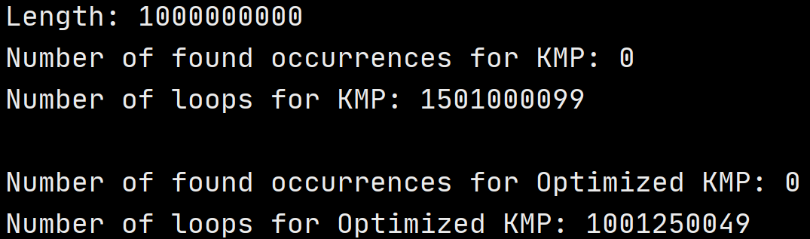
Optimized KMP Algorithm vs KMP Algorithm

Slide 68
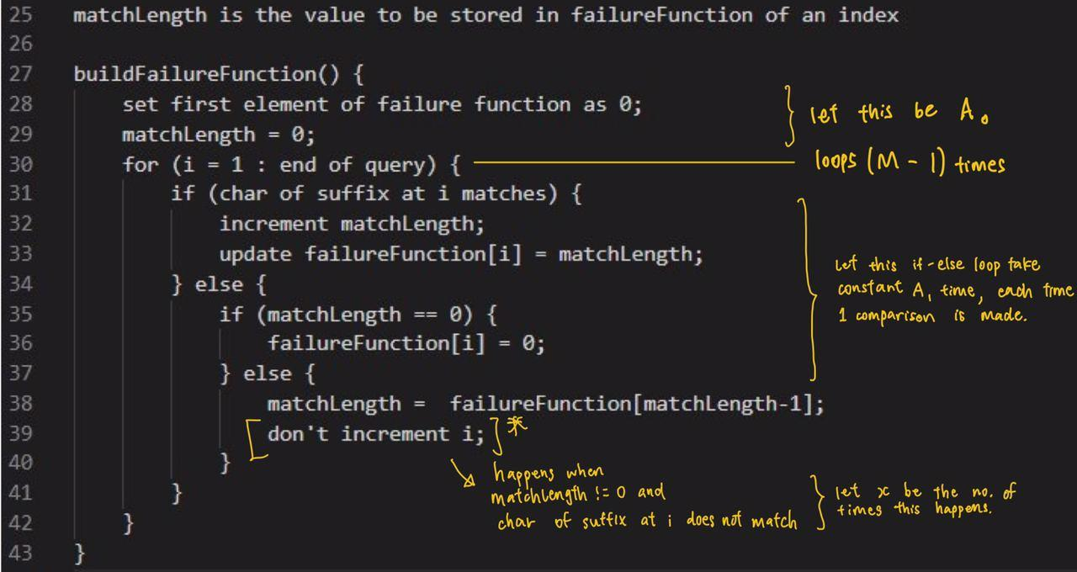
Time Complexity analysis
Preprocessing: construction failure function array
Loop (M-1) times, where M is size of the query string (what we want to find)

Slide 69
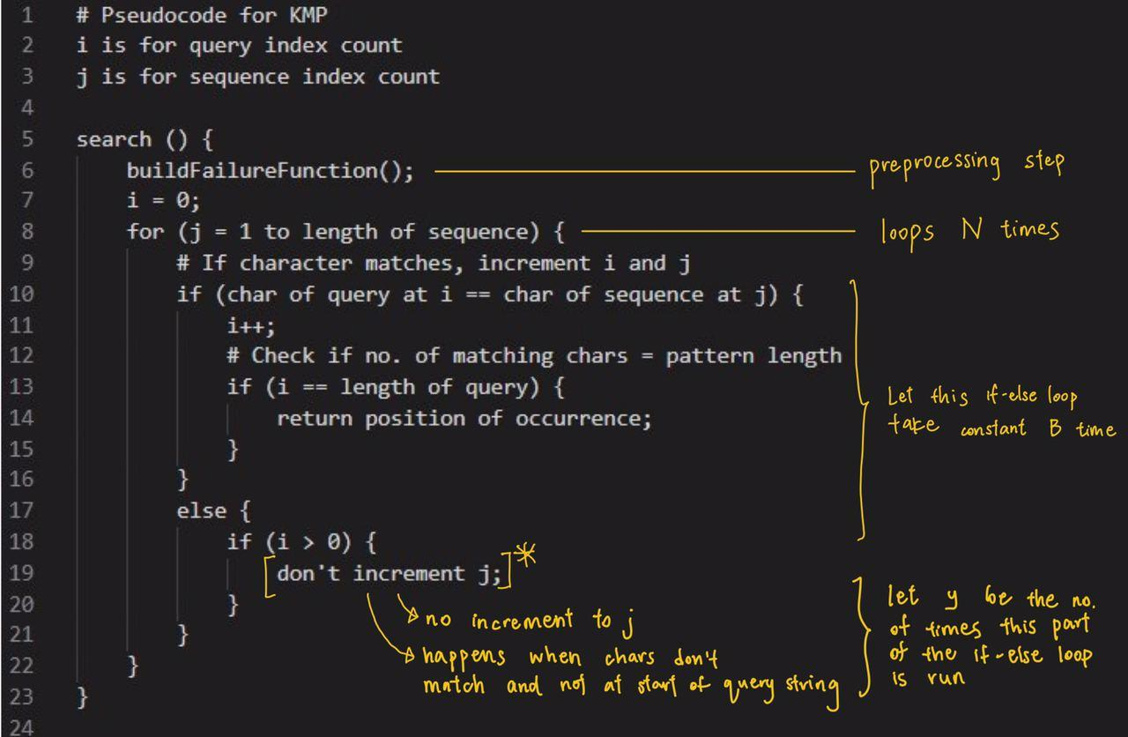
Time Complexity analysis
Searching:
Loop n times, where n is the size of the sequence string (the large text file we are opening to find)

Slide 70
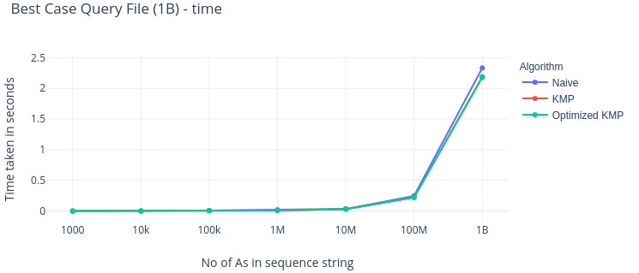
Best case scenario
Query(want to find): 1 alphabet “B”
Vs
Sequence: string containing many “A”s
* Note that x is on a logarithmic axis
** Notice that graphs for KMP and Optimized KMP overlaps each other → time complexity are almost the same.

Slide 71
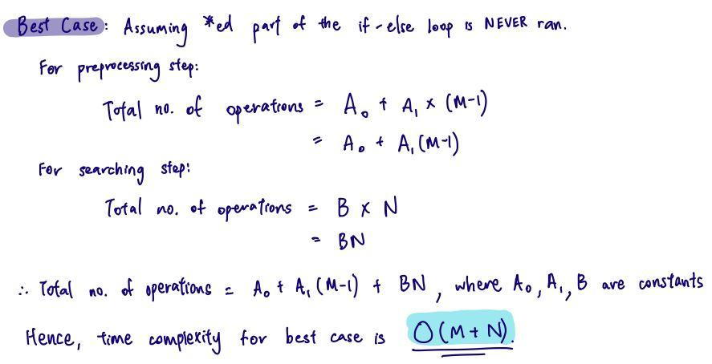
Best case scenario (KMP)

Slide 72
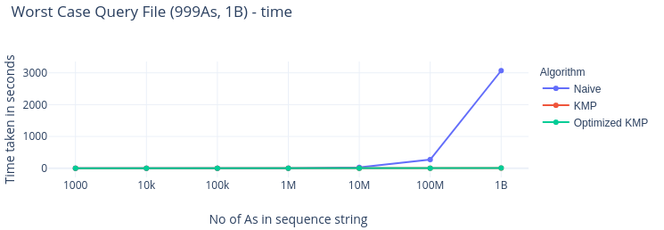
Worst Case (KMP)
Query(want to find): many “A” + 1 “B” at the end
VS
Sequence: all characters “A”
Eg. Query string: AAAAAAAAAB
Sequence String: AAAAAAAAAAA

Slide 73
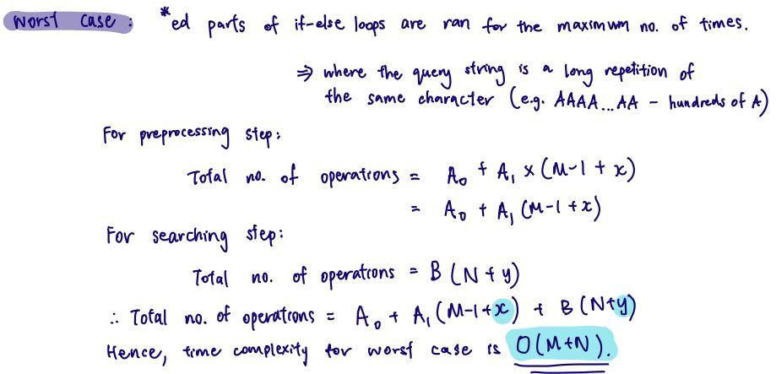
Worst Case (KMP)

Slide 74
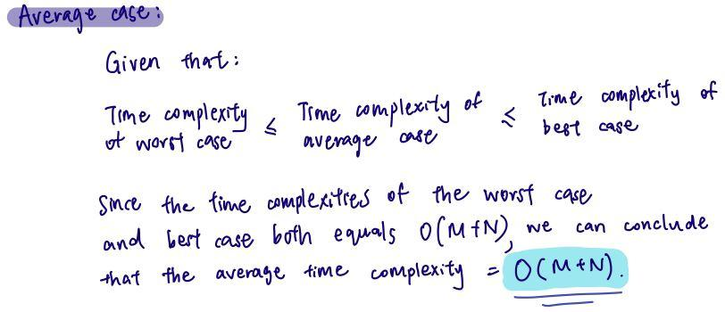
Average Case (KMP)

Slide 75
Time complexity for Optimized KMP
The main difference between KMP and optimized KMP algorithms is in the preparation of the failure function.
Such differences are minimal and barely affects time complexity. Hence, the time complexity for optimized KMP is also O(M+N).

Slide 76
Space Complexity Analysis
Preprocessing:
KMP Algorithm
Array created for failure function is dependent on size of query (M)
O(M)
Optimized KMP Algorithm
Array created for failure function is dependent on size of query (M) * no. of unique characters (4 for DNA sequences)
O(4M) = O(M)

Slide 77
Space Complexity Analysis
Searching:
Can assume no space taken if you ‘return’ the indexes of the occurrences using a print function
If indexes are stored in a separate array to be returned at the end of the search, it will depend on no. of occurrences.
Therefore, space complexity = O(M) for BOTH KMP and optimized KMP.
Naive only needs constant space (O(1)) as there is no pre-processed arrays.

Slide 78
Demo

