Slide 1
CE2001/CZ2001
Lab Project 2: Graphs
Team members:
Woon Yoke Min
Tan Yap Siang
Gordon Tan
Tey Yi Heng
Tan Jun Hong

Slide 2
Task A and B
Unweighted and undirected graph → Breadth First Search (BFS Search)
Expands each node at the present depth before moving to next node, total depth is distance
Marks every visited node that is explored and add unexplored neighbors to the queue
Repeats until every node is visited, then uses backtracking to obtain the shortest path

Slide 3
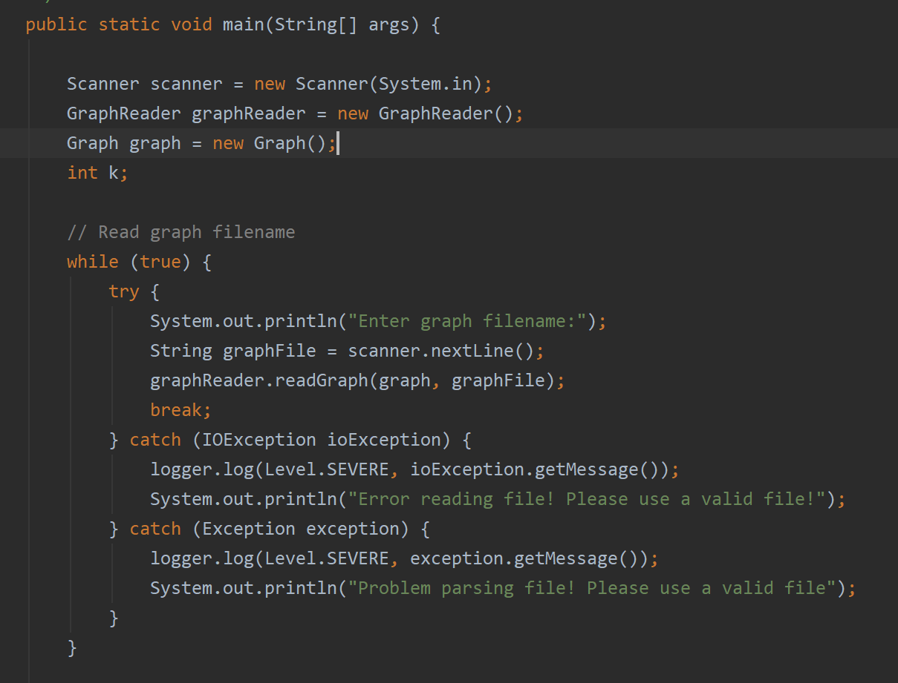
Implementation
Main.java
Will ask user for graph, hospital, node txt filename
Reading of these filenames will be done by different methods of GraphReader.java

Slide 4
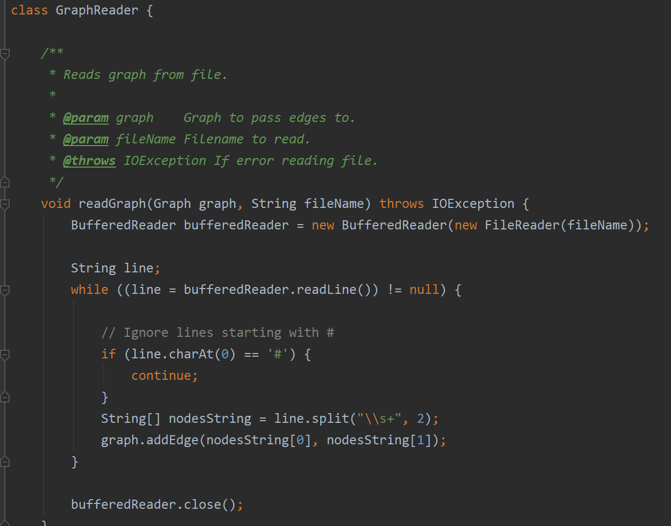
Implementation
GraphReader.java
Uses BufferedReader to efficient read the txt file
Storing of the edges, hospital nodes and normal nodes will be done by the Graph.java

Slide 5
Implementation
Graph.java
Initialize a hashmap called previousNodes to store key-value pairs where key is the current node and value is previous node
1
HashMap previousNodes
2
3
Hospital
Node
Hospital
Node
4
5
6
Key:Current nodes
Value: Previous nodes
7
8

Slide 6
Implementation
Graph.java
2. Initializes 2 array lists to store and get hospitals and nodes
ArrayList<Integers> Hospitals
6 | 7
ArrayList<Integers> Nodes
1 | 2 | 3 | 4 | 5 | 6 | 7 | 8

Slide 7
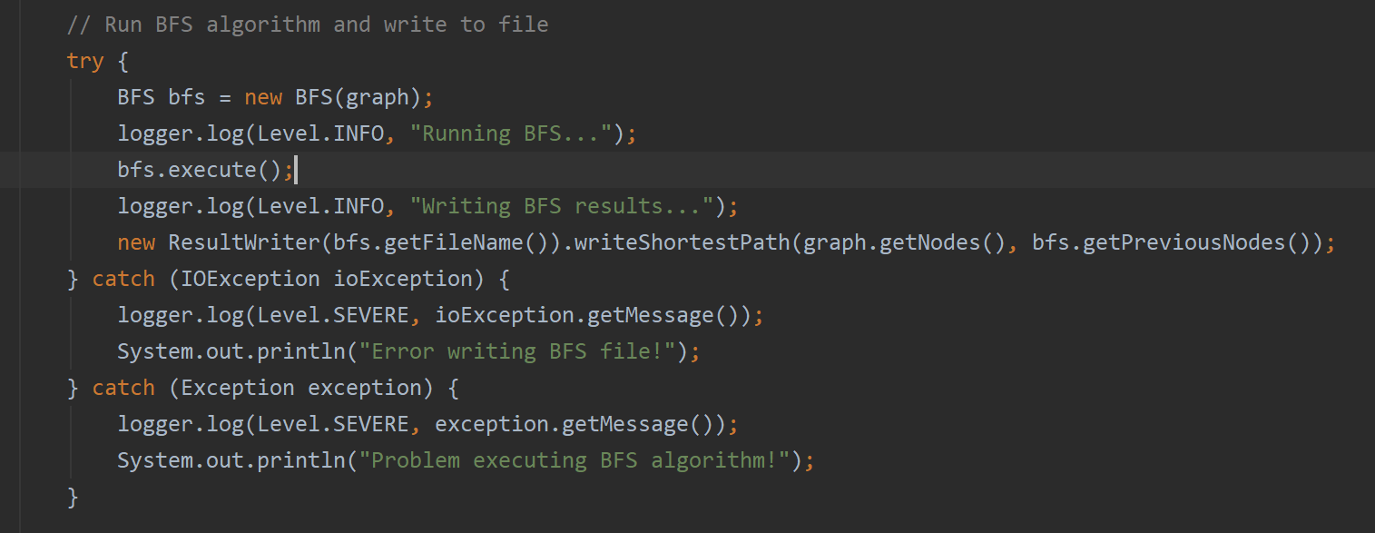
Implementation
Back to Main.java
Run the BFS algorithm in BFS.java

Slide 8
Implementation
BFS.java
Add hospitals as current and previous nodes
All hospitals are added to the queue from the ArrayList
HashMap previousNodes
6 | 6
7 | 7
Key value
Previous nodes
Queue
6 | 7
Check this first

Slide 9
Implementation
1
BFS.java
3. For first node in queue, check whether nearest neighbours have been visited before using the hash table previousNodes.
2
3
Hospital
Node
Hospital
Node
4
5
6
7
8
Queue
6 | 7
Check this first

Slide 10
Implementation
BFS.java
4. If the neighbour node is not visited, we will add to the previousNodes hash map and add to the queue as well.
Eg. In this case, the neighbour of hospital node 6, which is 3, is added to the hashmap and the queue.
HashMap previousNodes
Queue
6 | 6
7 | 7
6 | 7 | 3
Key:Current nodes
Value: Previous nodes

Slide 11
Implementation
BFS.java
4. If the neighbour node is not visited, we will add to the previousNodes hash map and add to the queue as well.
Eg. In this case, the neighbour of hospital node 6, which is 3, is added to the hashmap and the queue.
HashMap previousNodes
Queue
6 | 6
7 | 7
3 | 6
6 | 7 | 3
Key:Current nodes
Value: Previous nodes

Slide 12
Implementation
BFS.java
HashMap previousNodes
Queue
6 | 6
7 | 7
3 | 6
7 | 3
1
6 is done and left the queue, now for node 7
Visited Node
2
3
4
5
6
7
8

Slide 13
Implementation
BFS.java
HashMap previousNodes
Queue
6 | 6
7 | 7
3 | 6
4 | 7
8 | 7
7 | 3 | 4 | 8
1
2
3
4
5
6
7
8

Slide 14
Implementation
BFS.java
HashMap previousNodes
Queue
6 | 6
7 | 7
3 | 6
4 | 7
8 | 7
1 | 3
3 | 4 | 8 | 1
1
2
3
4
5
6
7
8

Slide 15
Implementation
BFS.java
5. If the neighbour node is visited, we ignore it and continue to the next neighbour if any.
1
Current node
2
3
HashMap previousNodes
Neighbour is visited, ignore
4
5
6
6 | 6
7 | 7
3 | 6
4 | 7
8 | 7
1 | 3
2 | 4
7
8
Queue
Already in queue
4 | 8 | 1 | 2

Slide 16
Implementation
HashMap previousNodes
BFS.java
6. This continues until the queue is empty, all nodes have been visited and we obtain the following hashmap.
6 | 6
7 | 7
3 | 6
4 | 7
8 | 7
1 | 3
2 | 4
5 | 8
1
2
3
4
5
6
Key:Current nodes
Value: Previous nodes
7
8

Slide 17
Implementation
HashMap previousNodes
6 | 6
7 | 7
3 | 6
4 | 7
8 | 7
1 | 3
2 | 4
5 | 8
ResultWriter.java
Once BFS is done, we will use backtracking to obtain previous nodes from hash table until we reach a hospital.
Eg. We will do for node 2 in this case and see the result
2 → 4
Key:Current nodes
Value: Previous nodes

Slide 18
Implementation
HashMap previousNodes
6 | 6
7 | 7
3 | 6
4 | 7
8 | 7
1 | 3
2 | 4
5 | 8
ResultWriter.java
2 → 4 → 7

Slide 19
Implementation
HashMap previousNodes
6 | 6
7 | 7
3 | 6
4 | 7
8 | 7
1 | 3
2 | 4
5 | 8
ResultWriter.java
Once key = value, hospital is reached.
2 → 4 → 7

Slide 20
Implementation
HashMap previousNodes
1
6 | 6
7 | 7
3 | 6
4 | 7
8 | 7
1 | 3
2 | 4
5 | 8
ResultWriter.java
2
3
Hospital
Node
Hospital
Node
4
5
6
7
8
2 → 4 → 7

Slide 21
Implementation
ResultWriter.java
Nodes visited will form the shortest path and distance will be computed in terms of number of edges and we will return the shortest distance.
Repeat for all nodes
Route 2→ 4 → 7
Distance: 2 edges

Slide 22
Analysis Of Time Complexity
Adjacency list executeBFS() → Worst case happens when there is path from any vertex to any other vertex: O( |V| + |E| ), where V is the number of vertices and E is the number of edges
Time complexity = O(|V| + |E|)

Slide 23
Analysis of Space Complexity
HashMap<Integer, ArrayList<Integer>>
To store nodes and its neighbours, using the concept of adjacency list
Total space complexity to store graph is O(|V| + |E|).
HashMap<Integer, Integer> previousNodes
To store the edges of paths that lead to a hospital.
Worst case space complexity is O(|E|), where every edge in the graph is part of a route to a hospital.
Queue is implemented with a linked list, with a maximum of |V| elements.
Total space complexity is O(|V| + |E|).

Slide 24
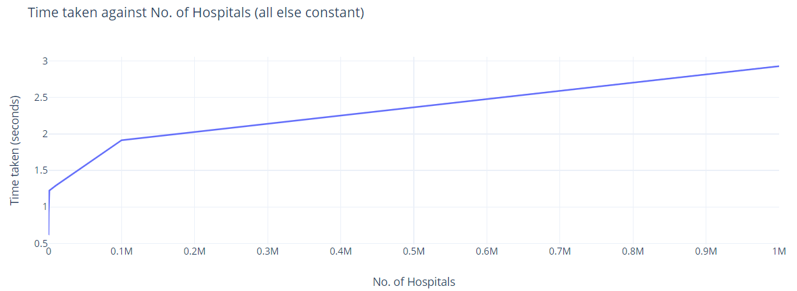
Empirical result
When number of hospital increase from 0.1M to 1M (10x), the time increase is only from 2 to 3 seconds (1.5x) which is negligible
Time taken does not depends on no. of hospitals → Results are consistent with our analysis

Slide 25
Task C and D
Similar to Task A and B, we still use BFS and backtracking but user can type in the k value to find top-k nearest hospital. The file used is ModifiedBFS.java
There are also differences in how we store the data
In our example, we will assume k = 2

Slide 26
Implementation
Storing data used
Queue that stores current node and hospital the node is from (using linked list of arrays of size 2 to store it)
Node #1
Hospital node that node #1 is from
Node #2
Hospital node that node #2 is from
Node #3
Hospital node that node #3 is from
Array
Queue (LinkedList)

Slide 27
Implementation
Storing data used
2. Partial Minimum Distance Spanning Tree (PMDST), hash table with hospital as key and another hash table as value. Nested hash table has node as a key and previous node as value, representing the individual edges to the hospital
PMDST
Key: Hospital
Value: Nested hash table
Key: Node
Value: Previous node

Slide 28
Implementation
Storing data used
3. Visited Order, hash table with node as key and linked list of hospitals visited as value.
Hashmap visitedOrder
Hospital 1
Hospital 2
Hospital 3
etc.
Key: Node
Value: Linked list of hospitals

Slide 29
Implementation
Initialization
Add [current hospital: current hospital] array to the queue
6
6
7
7

Slide 30
Implementation
Initialization
2. Create hashmap called previousNodes to be used as value for PMDST
Nested Hashmap previousNodes

Slide 31
Implementation
Initialization
3. Hospital will be added to visitedOrder as a key and an element inside the linked list
Hashmap visitedOrder
6 | 6
7 | 7
Key
LinkedList

Slide 32
Implementation
ModifiedBFS.java
Queue will indicate which node to visit.
1
6
6
7
7
2
3
Hospital
Node
Hospital
Node
4
5
6
7
8

Slide 33
Implementation
ModifiedBFS.java
2. Check if adjacent nodes have been visited before. If not, initialise a new linked list for the node and add it to the visitedOrder hash table.
1
Hashmap visitedOrder
6 | 6
7 | 7
3
2
3
4
5
6
7
8

Slide 34
Implementation
ModifiedBFS.java
3. Check if k hospitals have already visited this adjacent node and if current hospital already exist in adjacent nodes linked list. If not, add adjacent nodes and current hospital into visitedOrder hash table.
Hashmap visitedOrder
6 | 6
7 | 7
3 | 6
Add hospital node 6 to show 6 has visited 3

Slide 35
Implementation
ModifiedBFS.java
4. Adjacent nodes and current hospital will also be added to queue.
6
6
7
7
3
6
Node 6 leaves the queue, now do BFS for node 7

Slide 36
Implementation
ModifiedBFS.java
5. These edges will also be added to their PMDST of the respective hospital, with adjacent node as “current node” and current nodes as “previous node”.
6 | 6 | 6
 | 3 | 6
7
Key: Hospital
Value: Nested hash table

Slide 37
Implementation
6 | 6 | 6
 | 3 | 6
 | 1 | 3
 | 2 | 1
 | 4 | 2
 | 7 | 4
 | 8 | 4
 | 5 | 8
7 | 7 | 7
 | 4 | 7
 | 8 | 7
 | 2 | 4
 | 5 | 8
 | 1 | 2
 | 3 | 1
 | 6 | 3
ModifiedBFS.java
6. Repeat until the queue is empty and we get the following PMDST hashmap.
Each node will be visited k times, in this case 2 times.
Key: Hospital
Value: Nested hash table

Slide 38
Implementation
Hashmap visitedOrder
6 | 6
7 | 7
3 | 6
4 | 7
8 | 7
1 | 6
2 | 7
5 | 7
7
6
7
6
6
7
6
6
ModifiedBFS.java
7. The visitedOrder hashmap will look like this.
The hospital with the shortest path will be at the start of the linked list.
Key: Node
Value: Linked List of hospital

Slide 39
Implementation
Hashmap visitedOrder
6 | 6
7 | 7
3 | 6
4 | 7
8 | 7
1 | 6
2 | 7
5 | 7
7
6
7
6
6
7
6
6
ResultWriter.java
Using visitedOrder hashmap, we can find the top k hospitals.
Eg. If we want to find node 2, the closest hospital is 7 followed by 6.
Key: Node
Value: Linked List of hospital

Slide 40
Implementation
6 | 6 | 6
 | 3 | 6
 | 1 | 3
 | 2 | 1
 | 4 | 2
 | 7 | 4
 | 8 | 4
 | 5 | 8
7 | 7 | 7
 | 4 | 7
 | 8 | 7
 | 2 | 4
 | 5 | 8
 | 1 | 2
 | 3 | 1
 | 6 | 3
ResultWriter.java
2. Then, uses backtracking on PDMST and obtain distances to k-nearest hospitals for all nodes, similar to Task A and B
Eg. If we want to find node 2,
2 → 4
2 → 1
Key: Hospital
Value: Nested hash table

Slide 41
Implementation
6 | 6 | 6
 | 3 | 6
 | 1 | 3
 | 2 | 1
 | 4 | 2
 | 7 | 4
 | 8 | 4
 | 5 | 8
7 | 7 | 7
 | 4 | 7
 | 8 | 7
 | 2 | 4
 | 5 | 8
 | 1 | 2
 | 3 | 1
 | 6 | 3
ResultWriter.java
Eg. If we want to find node 2,
2 → 4 → 7
2 → 1 → 3
Key: Hospital
Value: Nested hash table

Slide 42
Implementation
6 | 6 | 6
 | 3 | 6
 | 1 | 3
 | 2 | 1
 | 4 | 2
 | 7 | 4
 | 8 | 4
 | 5 | 8
7 | 7 | 7
 | 4 | 7
 | 8 | 7
 | 2 | 4
 | 5 | 8
 | 1 | 2
 | 3 | 1
 | 6 | 3
ResultWriter.java
Eg. If we want to find node 2,
2 → 4 → 7 (hospital node 7 reached)
2 → 1 → 3 → 6
Key: Hospital
Value: Nested hash table

Slide 43
Implementation
6 | 6 | 6
 | 3 | 6
 | 1 | 3
 | 2 | 1
 | 4 | 2
 | 7 | 4
 | 8 | 4
 | 5 | 8
7 | 7 | 7
 | 4 | 7
 | 8 | 7
 | 2 | 4
 | 5 | 8
 | 1 | 2
 | 3 | 1
 | 6 | 3
ResultWriter.java
Eg. If we want to find node 2,
2 → 4 → 7 (hospital node 7 reached)
2 → 1 → 3 → 6 (hospital node 6 reached)
Key: Hospital
Value: Nested hash table

Slide 44
Analysis Of Time Complexity
Similar to part A and B, initialising and adding hospitals to the queue can be excluded in the time complexity analysis
In the worst case, k*|V| nodes will be added to the queue
Results in maximum of k*|E| times of running the for loop.
Hence, worst case time complexity of executeModifiedBFS: O(k*|V| + k*|E|)

Slide 45
Analysis Of Space Complexity
Adjacency list implemented with HashMap to store graph → O(|V| + |E|)
HashMap <Hospital #, HashMap<Node #, prevNode>> PMDST
Nested HashMap represents all edges that are part of a path to that particular hospital.
Requires O(k*|E|) in the worst case
HashMap <Node #, LinkedList<Integer>> visitedOrder
To store a linked list of the order in which each node visited the hospital(s).
Requires O(k*|V|) in the worst case.
Queue is implemented with a LinkedList<int[]> → O(k*|V|).
Hence, total space complexity is O(k*(|V| + |E|)).

Slide 46
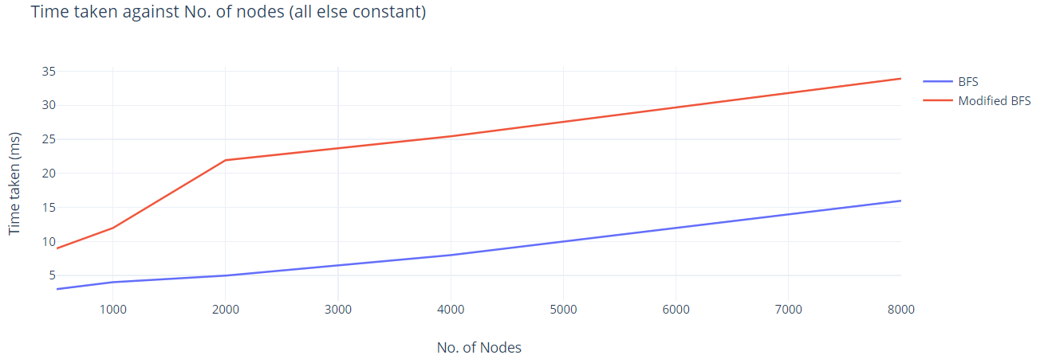
Empirical result
hospital = 5, k = 2, keeping no. of edges constant, changing no. of nodes
When number of nodes increase from 1000 to 2000, BFS has negligible increase in time taken. ModifiedBFS has an increase of 2 times the time taken previously, proportionate to k value.
Performance is consistent with our analysis

Slide 47
Demo

