Slide 1
515 Lab4 Report
The creation of magic and wand.

Slide 2
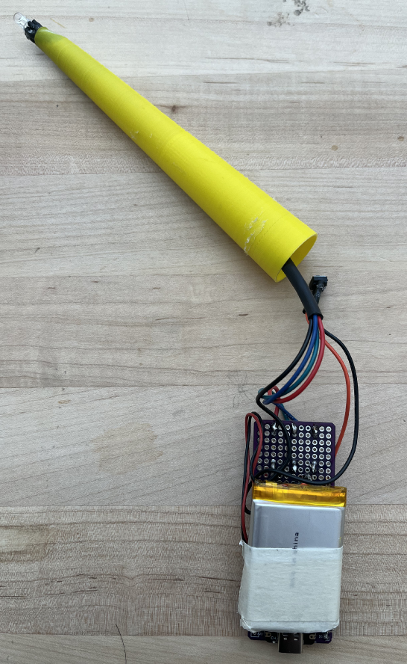
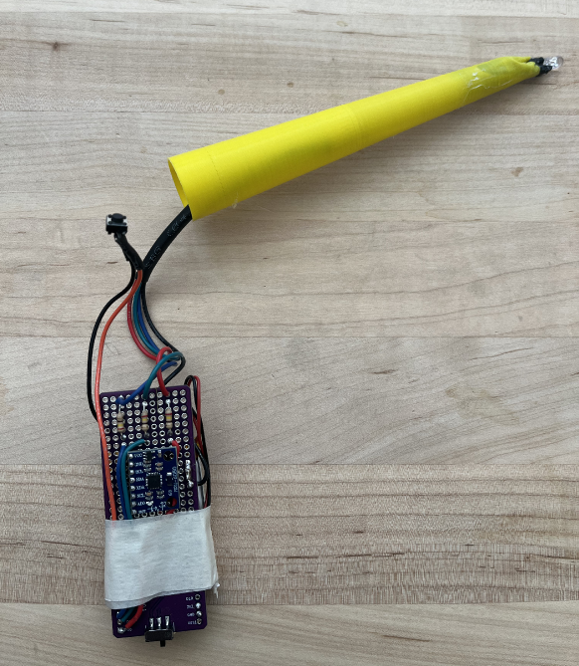


Hardware Setup
RBG LED
Pin connection:
RGB LED:
R - D0
G - D1
B - D2
(Each with one
240 Ohm resistor)
Button - D3
Button
240 Ohm resistors
MPU6050
3.7V 1100 mAh
LiPo Battery

Slide 3
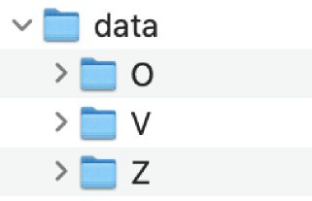
Data Collection
Process
Results
We have 6 people having the same MPU6050 orientation, so we decided to form a collective dataset. Each of us contributed around 100 data samples to each class (Each sample has a duration of 1 sec). Each class has data samples of varying range and speed.
(Compared to others’ models, using one person’s samples may be more effective.)
Dataset structure:
Three classes: O, V, Z
O: 638 samples
V: 620 samples
Z: 626 samples

Slide 4
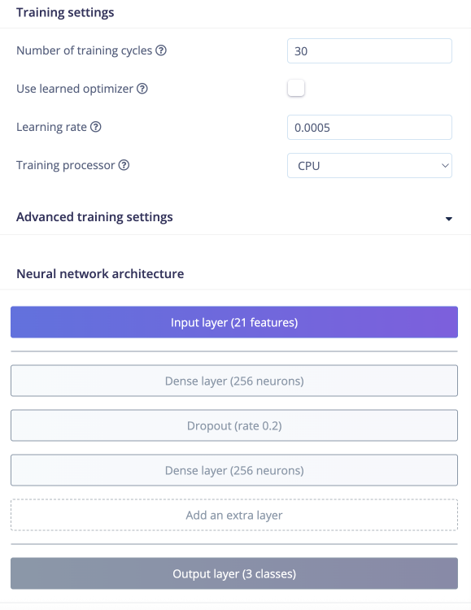
Edge Impulse Model Architecture
Architecture:
DSP - flatten
Output - classifier (3 class)
Neural network:
dense layer (256 neurons)
dropout (rate 0.2)
dense layer (256 neurons)
Training cycles: 30 epochs
Learning rate: 0.0005

Slide 5
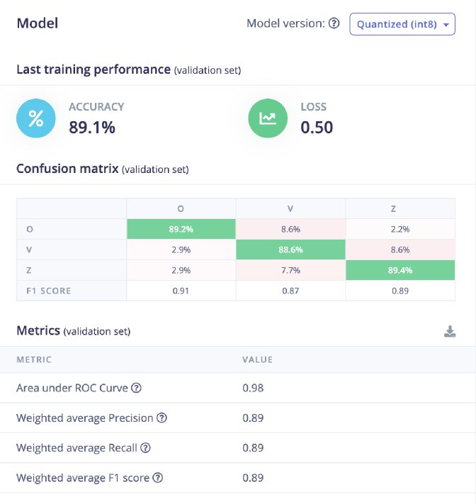
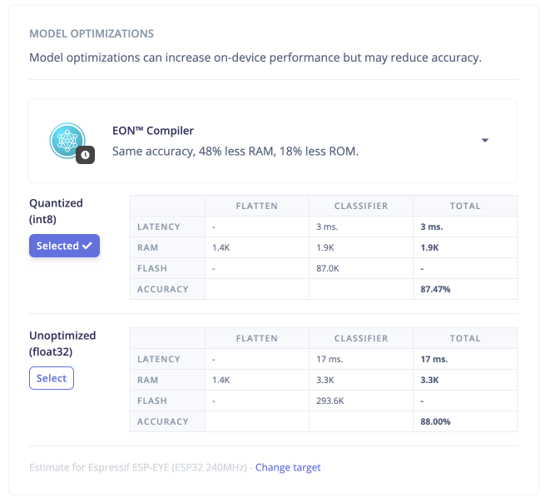
Performance analysis and optimization metrics
Performance
Optimization
Unoptimized model has a slightly higher accuracy. However, the quantized model has lower latency and takes fewer RAM.

Slide 6
Discussion (Data Collection)
Why should you use training data collected by multiple students rather than using your own collected data only? Think about the effectiveness and reliability of your wand.
Different students would have slightly different patterns when waving the gestures, at different ranges, speed, heights, even angles. Having data from multiple students would allow the system to adopt slight variations in patterns and make the wand more reliable when different people use it. With a large enough datasets, the recognition is actually more effective to fit more people.

Slide 7
Discussion (Edge Impulse Model Development)
Discuss the effect of window size.
Window size defines how long (in milliseconds) each segment of time-series data is. It affects the amount of context in each segment and the speed of the model to analyze.
Consider:
the number of samples generated:
Larger window size → fewer total samples are generated from a fixed-length dataset.
Smaller window size → more samples, since more windows can be created from the same time span.
the number of neurons in your input layer of neural network
The window size determines the dimensionality of the input to your model.
• At 100 Hz sampling and a 1,000 ms window → 100 data points per axis
• With 3 axes (x, y, z) → total of 300 input values per sample
effectiveness when capturing slow-changing patterns
With slow-changing patterns, the window size should be larger to capture full motion context.

Slide 8
Discussion (Edge Impulse Model Development)
Give at least two potential strategies to further enhance your model performance.
Include more data from more students to allow more adoption in learning patterns. (200 samples for one class, may need to monitor the gestures a bit more)
Potentially use overlapping windows to have more training data without collecting more. It also may create partial patterns for gesture recognition.

Slide 9
Demo video

Slide 10
Challenge faced & solution
The process actually went pretty well. The biggest challenge faced is when we have hardware done and trying to implement the final code.
We couldn’t figure out how to use the model.
We look up in web and ask ChatGPT how to use the library downloaded from Edge Impulse. It actually requires us to tell it that it is a .zip library. We then know we need to add the .zip folder as a whole to Arduino IDE and then include as usual.
After model is successfully used, the complete code (from ChatGPT) didn’t work on the first try.
We use code to confirm the functionality of each component and then start adding more function to the main function.

