Slide 1

AI-Based Fetal Health Monitoring
& Risk Prediction System
Machine Learning + Generative AI for Cardiotocography (CTG) Analysis
A full-stack healthcare application that classifies fetal condition — Normal, Suspect, or Pathological — from CTG parameters using a trained Machine Learning model, then uses Generative AI to turn that result into a clear, human-readable explanation. Built with React.js, FastAPI, PostgreSQL and Scikit-learn. Intended as an educational decision-support prototype, not a medical diagnosis tool.
Presented By • Tanish Sharma • Sahil Saurav • Piyush Sukhwani
1
Notes:
Open by stating the project name and the one-line pitch: this is a full-stack AI system that reads CTG (cardiotocography) data and predicts fetal health status, then explains that prediction in plain language using Generative AI. Mention the four pillars: Machine Learning (classification), Generative AI (explanation), a React/FastAPI/PostgreSQL full-stack app, and that this is an academic prototype, not a certified medical device — that disclaimer matters and should be said out loud early.

Slide 2




Problem Statement & Motivation
Why interpreting CTG data by eye is hard, and what this project sets out to fix
The Problem
CTG parameters read together
Fetal health monitoring relies on Cardiotocography (CTG) — a continuous trace of fetal heart rate and uterine activity. Reading it well means weighing several signals together at once, not just one number.
Fetal heart-rate baseline
Variability
Doing this consistently, at scale, and explaining the reasoning to a patient is where a software layer can genuinely help.
Accelerations
Motivation
Structure a multi-parameter read into one clear classification (Normal / Suspect / Pathological)
Back the prediction with confidence + the factors that drove it — not just a bare label
Explain the result in plain language via Generative AI, so it's actually understandable
Decelerations
Uterine contractions
Interpreting all five together — not just one — is what makes manual reads inconsistent.
2
Notes:
Explain CTG in one sentence: it's a trace of fetal heart rate and uterine contractions over time. The challenge is that a clinician has to weigh five different signals together — baseline heart rate, variability, accelerations, decelerations, and contractions — to reach one judgement. That's exactly the kind of multi-parameter pattern classification ML is good at. The motivation slide bridges into 'so we built a system that does this consistently and explains itself.'

Slide 3





Objectives & Key Features
What the system is built to achieve, and the capabilities that deliver it
Objectives
Authentication
Patient Management
JWT login, protected routes
Create & track patient records
Build an ML model that classifies fetal health from CTG parameters
Give clinicians a web interface to enter CTG data and get a result
Serve predictions through a FastAPI backend integrated with the model
Persist patients and assessment history in PostgreSQL
Surface confidence and the contributing parameters, not just a label
Turn the ML output into a plain-language explanation using Generative AI
Produce a downloadable PDF report per assessment
ML Prediction
Explainable Results
Normal / Suspect / Pathological
Key features behind each call
GenAI Explanation
PDF Report
Plain-language result summary
Shareable assessment report
3
Notes:
Walk the objectives as one continuous pipeline: model -> interface -> API -> storage -> confidence/factors -> GenAI explanation -> PDF report. That ordering is deliberate — it's the same order data moves through the app. For features, don't read all six — pick two to talk through: ML Prediction (the core) and GenAI Explanation (the differentiator), and just point at the rest.

Slide 4

Proposed System & Architecture
End-to-end request flow: browser to database/ML/GenAI and back to a report
User
(authenticated)
React Frontend
(Vite + Tailwind)
FastAPI Backend
(REST API)
PostgreSQL
ML Model
Gemini API
Patients & assessment records
Scikit-learn classifier
Generates the explanation
Assessment Result
(shown on result page)
PDF Report
How it works
The React frontend collects authenticated input and calls FastAPI. FastAPI validates and preprocesses the CTG data, runs it through the trained ML model, stores the record in PostgreSQL, and optionally calls Gemini to generate a plain-language explanation. The frontend then renders the result, contributing factors, history, and a report option.
4
Notes:
Trace the diagram top to bottom as you talk: user logs in through React, which calls FastAPI over REST. FastAPI is the hub — it talks to three things: PostgreSQL for storage, the trained ML model for the prediction, and the Gemini API for the explanation. Everything converges into one assessment result, which can also be exported as a PDF report. Emphasize that FastAPI, not the frontend, owns all the sensitive calls (DB, ML, Gemini key) — that's a deliberate security boundary.

Slide 5
Machine Learning Model & Prediction
Kaggle Fetal Health Classification dataset — three-class CTG classification
1 — Normal
Recommended Models
Evaluation Metrics
Logistic Regression — baseline
Decision Tree — interpretable comparison
Random Forest — strong candidate, gives feature importance
XGBoost — optional, if time permits
Accuracy
Precision
Recall
F1-score
Confusion Matrix
2 — Suspect
3 — Pathological
ML Pipeline
Data Cleaning
EDA
Preprocessing
Train/Test Split
Training & Evaluation
Best Model → FastAPI
5
Notes:
Name the three target classes and what they mean clinically at a glance: Normal is healthy, Suspect needs a closer look, Pathological is high-risk. Then explain the model choice logic: start simple with Logistic Regression as a baseline, use Decision Tree for interpretability, and land on Random Forest as the likely production model because it also yields feature importance — which feeds directly into the Explainable AI slide next. Mention XGBoost only as a stretch goal. Close with the pipeline row: this is the standard supervised-learning flow from raw Kaggle data to a serialized model FastAPI can load.

Slide 6

Generative AI & Explainable AI
Two layers of transparency: which features mattered, and what the result means in plain words
Explainable AI
Generative AI Explanation Flow
The system never shows a bare label — it also surfaces the parameters that drove the prediction
Feature importance from the chosen model (e.g. Random Forest) is visualized as a chart
Stretch goal: SHAP or LIME for per-prediction, more granular explanations
Builds trust — the presenter/clinician can see why, not just what
CTG Input
ML Model
Prediction + Confidence + Important Factors
Gemini API
AI-Generated Explanation
Gemini acts only as an explanation layer, not the medical decision engine — it receives structured classification data, not raw patient identifiers, and every explanation ships with a safety disclaimer.
6
Notes:
Two distinct techniques here, and it's easy for a viva panel to conflate them — keep them separate in your explanation. Explainable AI (left) is about the ML model itself: which input features (e.g. baseline heart rate, variability) pushed the prediction toward Pathological. Generative AI (right) is a separate, downstream step: it takes that already-computed prediction and factors and turns them into a sentence a non-technical reader can understand. Stress that Gemini never sees raw patient identity and never makes the classification itself — it only explains a decision the ML model already made.

Slide 7




Technology Stack & Implementation Workflow
What each layer is built with, and the steps a request takes through the app
Frontend
Backend
React.js, Vite, Tailwind CSS, Recharts
Python, FastAPI
Functional Workflow
1
User logs in (JWT session)
Machine Learning
Generative AI
2
Select or create a patient
Scikit-learn (+ XGBoost optional)
Gemini API
3
Start a new CTG assessment
4
Frontend validates & sends data to FastAPI
Database & ORM
Auth & Testing
PostgreSQL, SQLAlchemy
JWT auth, Postman
5
FastAPI preprocesses & runs the ML model
6
Result stored; Gemini explains it on request
Reporting
Version Control & Hosting
7
View result, history, or download PDF report
ReportLab (PDF)
Git/GitHub, Render (or equivalent)
7
Notes:
For the stack, don't read every cell — group it verbally into three layers: a React/Tailwind frontend, a FastAPI + PostgreSQL backend, and two AI layers (Scikit-learn for prediction, Gemini for explanation), plus JWT for security and ReportLab for the PDF output. For the workflow, walk it as the literal user journey during your live demo — login, pick a patient, fill the CTG form, get a prediction, then show the explanation and the PDF. This numbered list should mirror your demo script almost exactly.

Slide 8
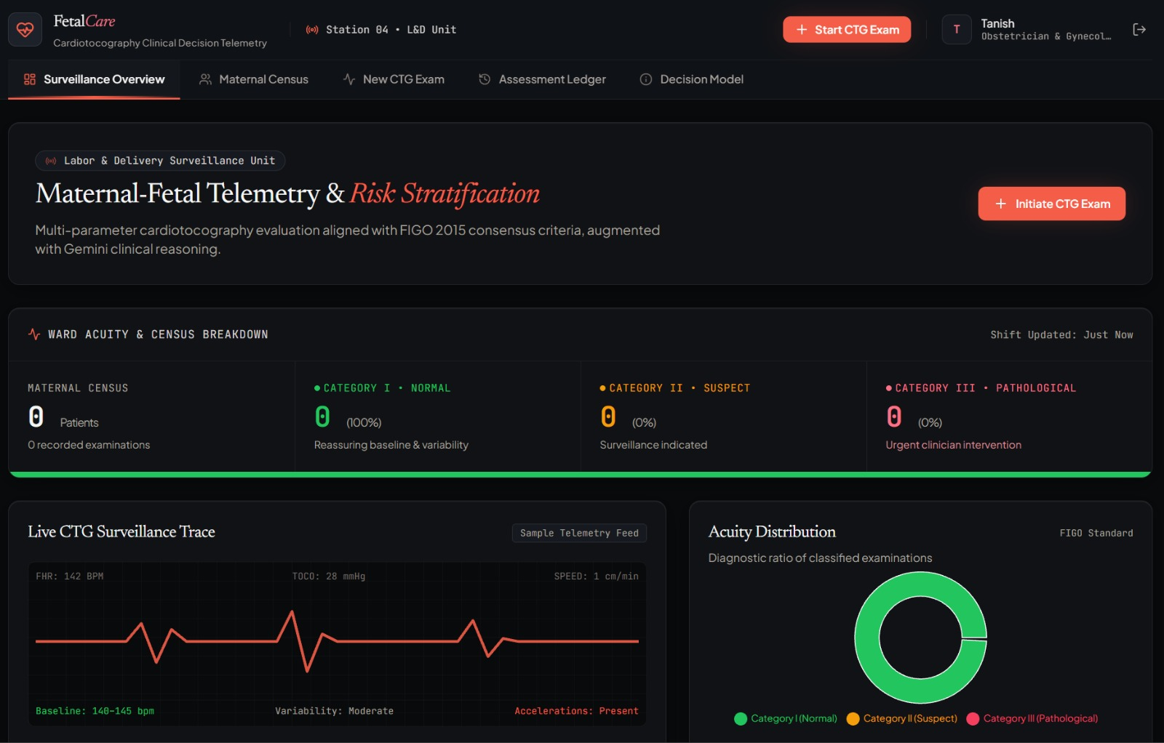
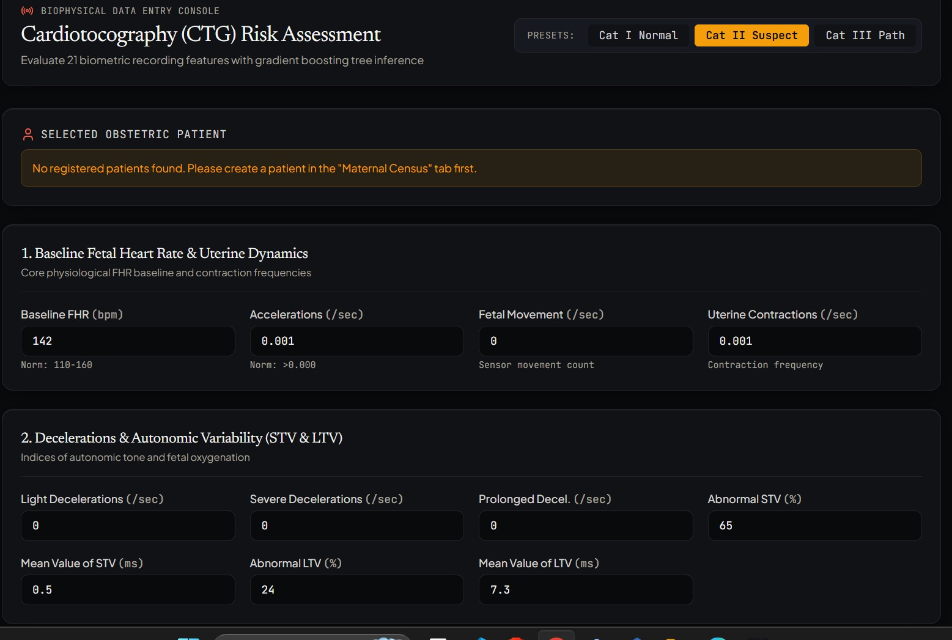
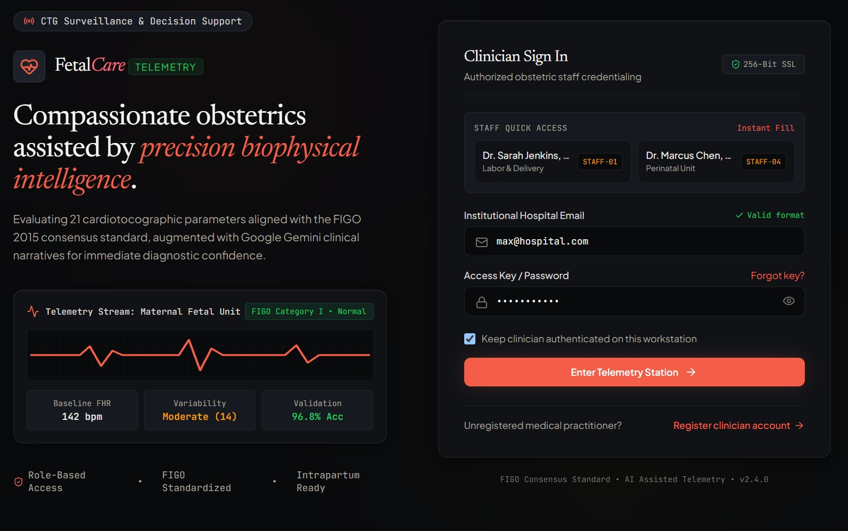
Application Demo — Walkthrough
FetalCare telemetry console: clinician sign-in, ward dashboard, and the CTG assessment form
Clinician Sign In
Surveillance Overview
CTG Risk Assessment Form
Authenticated clinicians sign in, land on a ward-level dashboard of assessment acuity, then open the 21-parameter CTG form to run a new fetal health assessment.
8
Notes:
These are live screenshots from our running application, not mockups. Walk through the actual user path: a clinician signs in with hospital-issued credentials (JWT-backed auth), lands on the Surveillance Overview dashboard showing ward-level acuity (how many patients fall in Category I/II/III), then opens New CTG Exam to enter the 21 biophysical parameters — baseline FHR, accelerations, decelerations, STV/LTV variability, and so on. If presenting live, this is the point to switch to the actual demo instead of the screenshot.

Slide 9
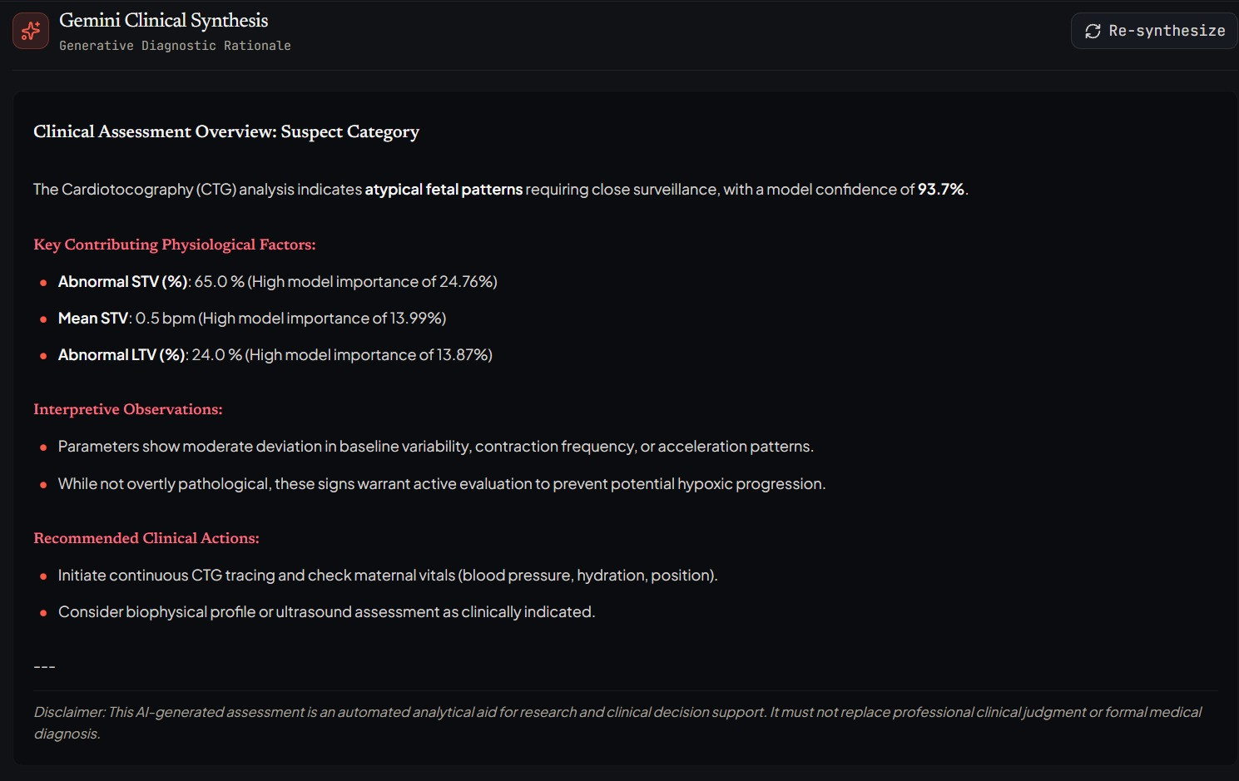
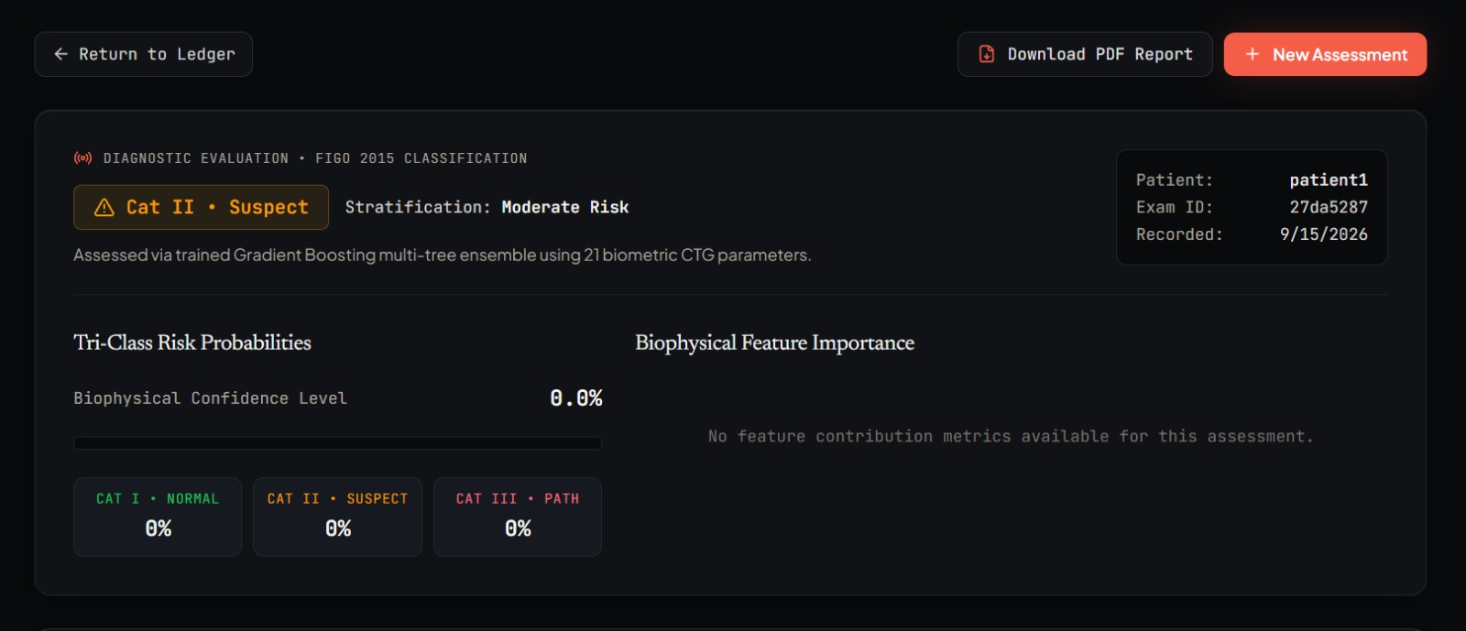
Application Demo — AI Output
From the trained model's classification to a Gemini-generated clinical explanation
Diagnostic Evaluation Result
Gemini Clinical Synthesis
The model returns a FIGO-aligned category with tri-class probabilities and feature importance; Gemini then converts that structured output into a readable clinical rationale with recommended next steps.
9
Notes:
This is the pay-off slide for the ML + GenAI story. Left: the raw diagnostic evaluation screen — Category II Suspect, moderate risk, tri-class probabilities, and which biophysical features (Abnormal STV, Mean STV, Abnormal LTV) drove the call. Right: the same result run through Gemini, turned into a structured, readable clinical synthesis — key contributing factors, interpretive observations, and recommended actions, closing with the safety disclaimer. Point out that the disclaimer is non-negotiable and always rendered — this is a decision-support aid, not an autonomous diagnosis.

Slide 10


Results, Limitations & Future Scope
Where the system stands today, its honest boundaries, and where it could go next
Results
Limitations
Future Scope
Model performance evaluated with accuracy, precision, recall, F1-score, and a confusion matrix across the three classes
Random Forest-style models expose feature importance for explainability
End-to-end flow verified: login → assessment → prediction → GenAI explanation → PDF report
Trained on a public dataset — may not generalize to every real-world population
Not clinically validated; predictions depend on input data quality
Generative AI explanations may contain inaccuracies and are not clinical advice
Real-time CTG monitoring with device integration
Deep Learning on raw CTG signals; SHAP/LIME explainability
Mobile app, real-time alerts, and hospital system integration
Academic prototype: the ML output is a pattern-based classification, not a clinical diagnosis, and the Generative AI explanation must not replace professional medical evaluation.
10
Notes:
Keep Results honest and specific: name the actual metrics you evaluated on (accuracy/precision/recall/F1/confusion matrix) rather than claiming a single headline number unless you have one to quote. Limitations should be delivered confidently, not apologetically — every academic prototype has them, and naming them well signals maturity to a viva panel. End on Future Scope to leave the presentation on a forward-looking note, then restate the closing disclaimer line verbatim since it's the one sentence you don't want to paraphrase loosely in front of examiners.

Slide 11
Thank You
AI-Based Fetal Health Monitoring & Risk Prediction System
Questions & Discussion
Major Project • B.Tech Computer Science
11
Notes:
Close by re-stating the one-line pitch and inviting questions: a full-stack ML + Generative AI system that classifies fetal health from CTG data and explains its own reasoning. Good anticipated questions to be ready for: how the model handles class imbalance in the dataset, why Random Forest over a deep model, how patient data privacy is handled end to end, and what clinical validation would be needed before any real-world use.

