Slide 1


Calculator Web App
An overview of HTML, CSS, and JavaScript code

Slide 2




About Me
z
Welcome to my calculator! I’m Tanish Sharma, a dedicated 2nd-year Computer Science student specializing in web development. This calculator showcases my design philosophy, technical skills, and a collection of projects that demonstrate my ability to craft engaging user interfaces using HTML, CSS and Js . As an aspiring web designer, I'm passionate about creating impactful digital solutions and constantly expanding my knowledge of new technologies.

Slide 3
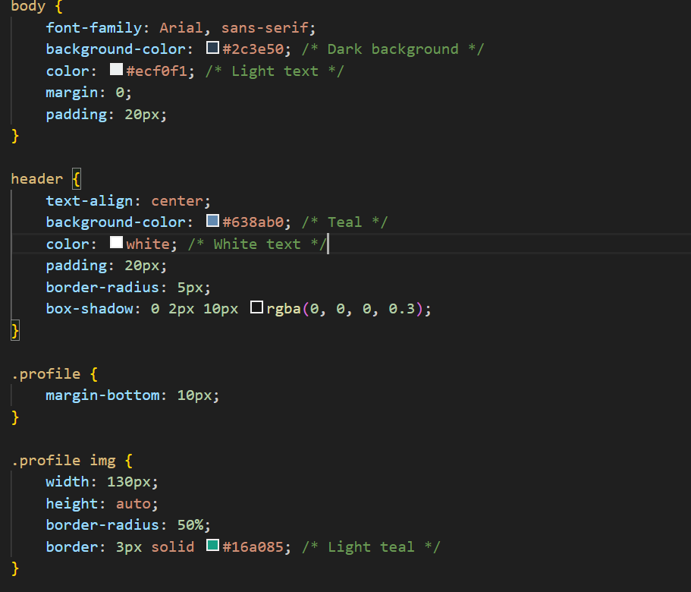
HTML Structure
z
The HTML code defines the structure of the calculator, including the input box and buttons for operations.

Slide 4
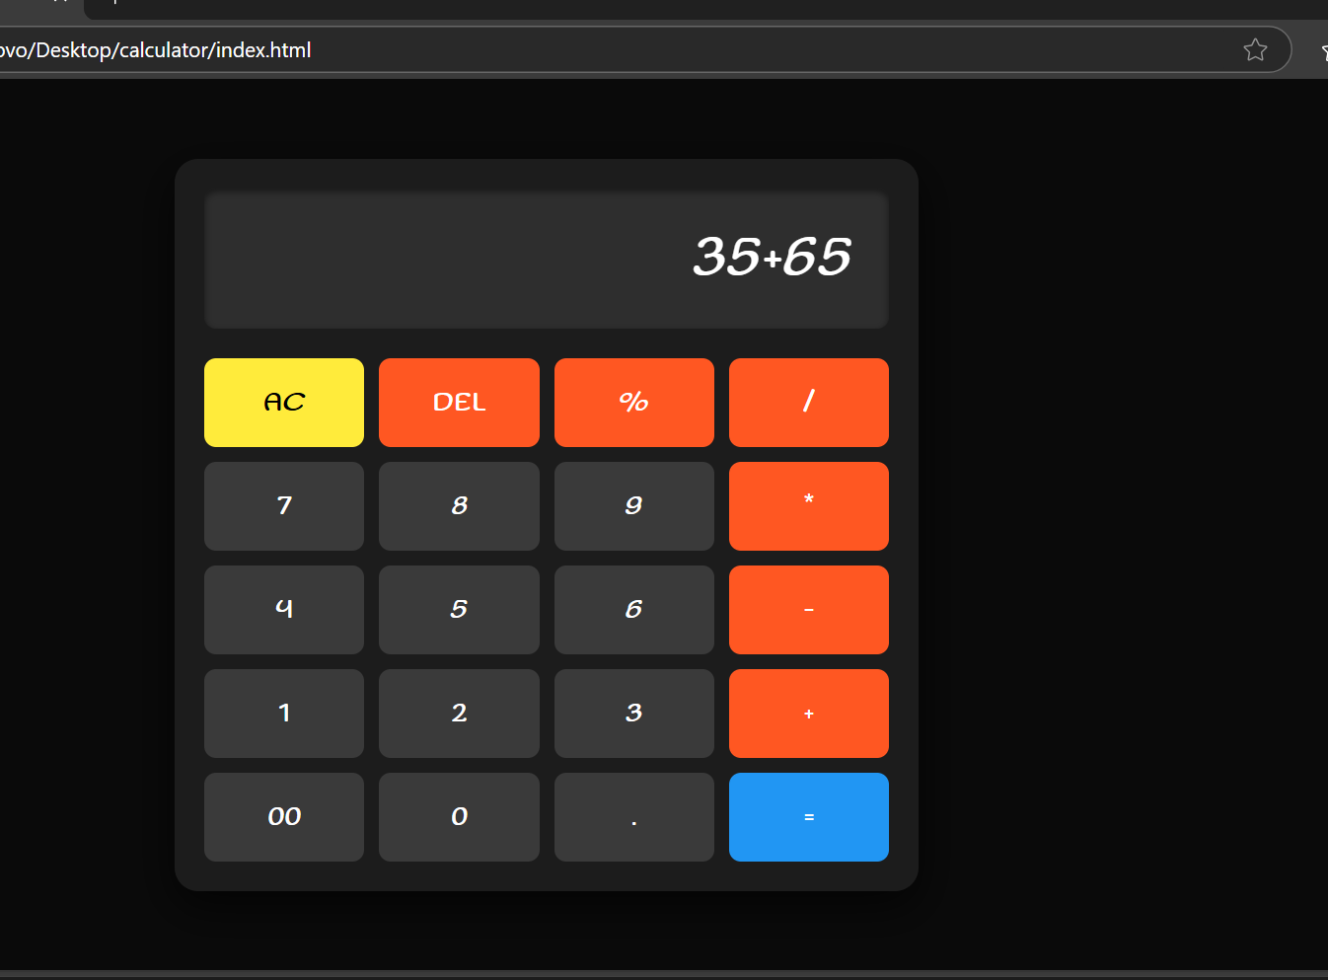
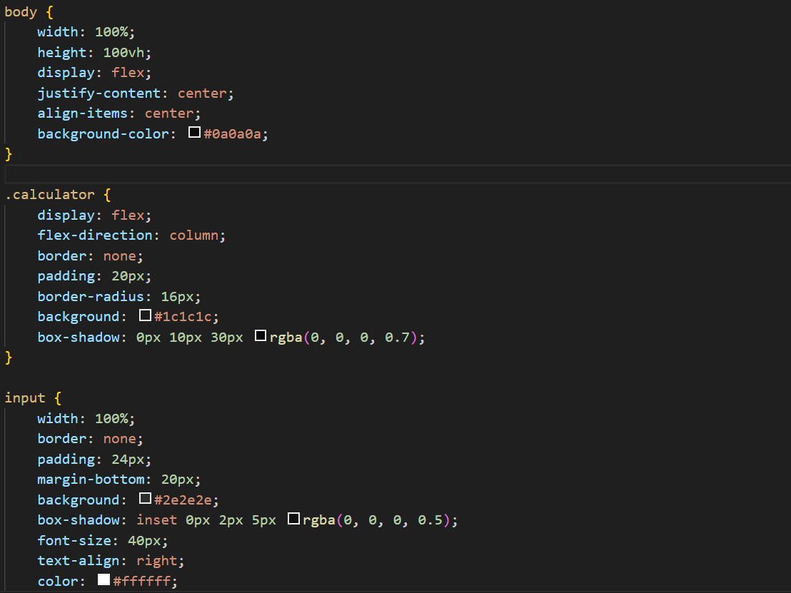
CSS Styling
z
The CSS code styles the calculator, making it visually appealing and responsive, using grid layout and hover effects.
All the tabular buttons, dark theme and placing is done using CSS to make it look appealing .

Slide 5
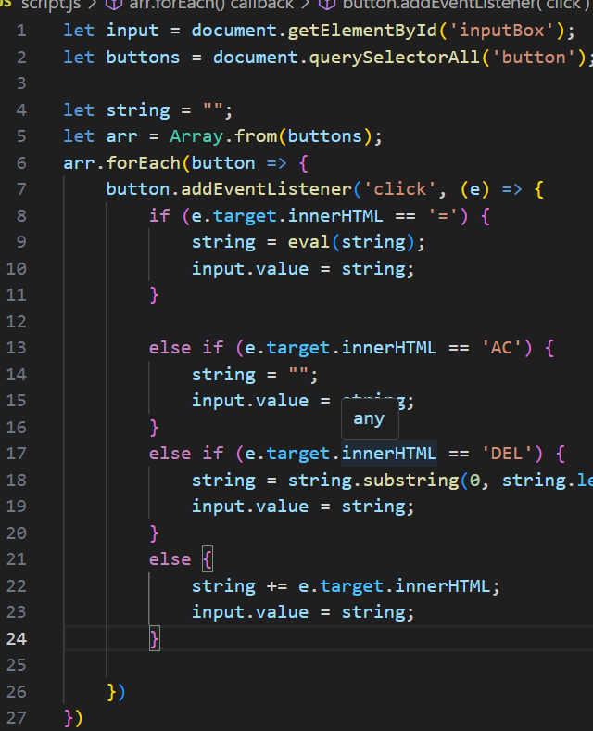
JavaScript Functionality
z
JavaScript adds interactivity, handling button clicks to perform calculations and manage input display.
With the help of it we make our calculations possible else no output will be generated.

Slide 6

Conclusion
z
This project demonstrates my ability to integrate HTML, CSS, and JavaScript to create a functional web application.
It also shows how we can link the files and make our website responsive

Slide 7

My Portfolio Project
Understanding My HTML and CSS Code

Slide 8

About Me:
Welcome to my portfolio! I'm Tanish Sharma, a dedicated 2nd-year Computer Science student specializing in web development. This portfolio showcases my design philosophy, technical skills, and a collection of projects that demonstrate my ability to craft engaging user interfaces using HTML and CSS. As an aspiring web designer, I'm passionate about creating impactful digital solutions and constantly expanding my knowledge of new technologies.

Slide 9
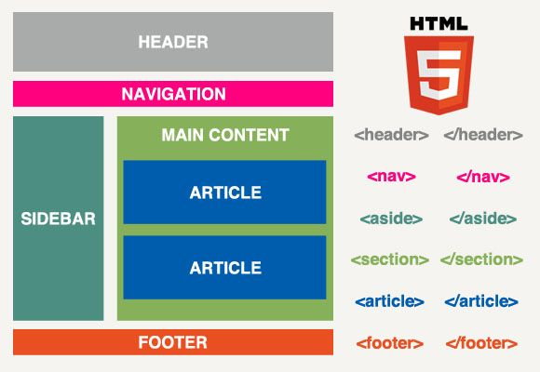
HTML Structure
Key Elements: <!DOCTYPE html>, <html>, <head> for meta info and styles.
The mostly used tag are <br>(to break the line) <hr>(to create the horizontal rule) and <section> (to style each individual part)
ThePhoto by PhotoAuthor is licensed under CCYYSA.

Slide 10
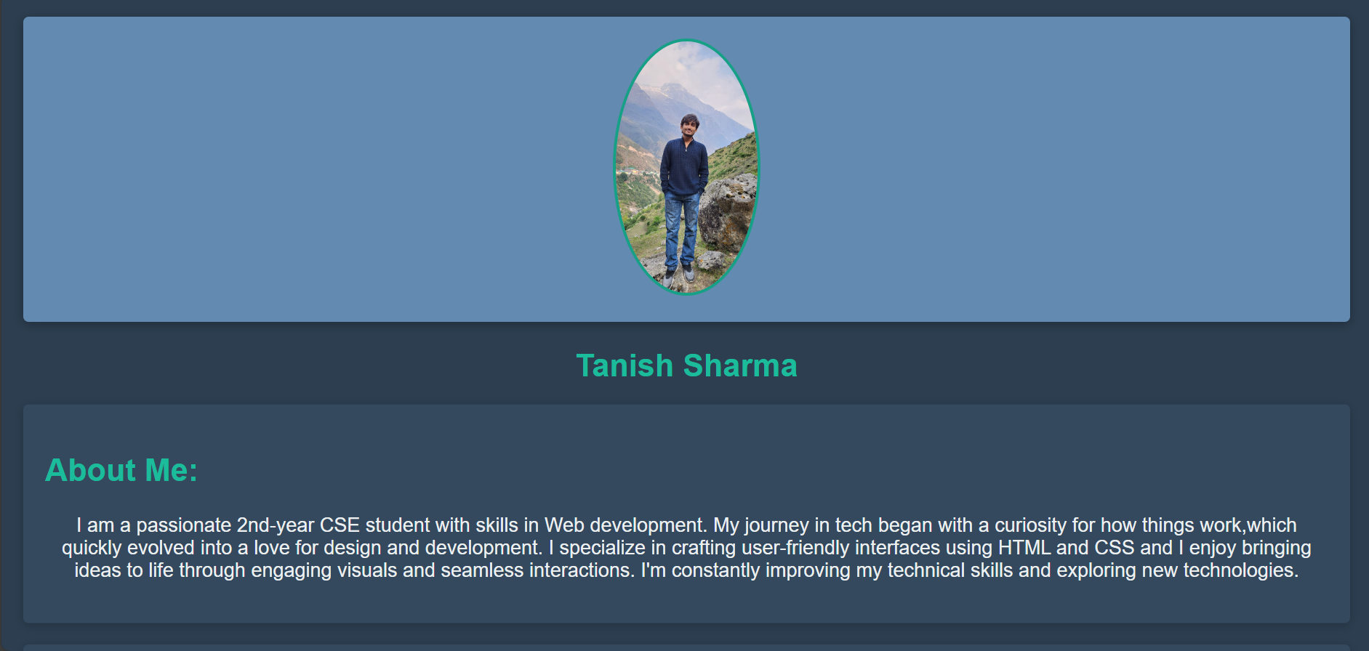
Profile Section
Uses <header> for profile image and <h2> for name, employing semantic HTML.

Slide 11
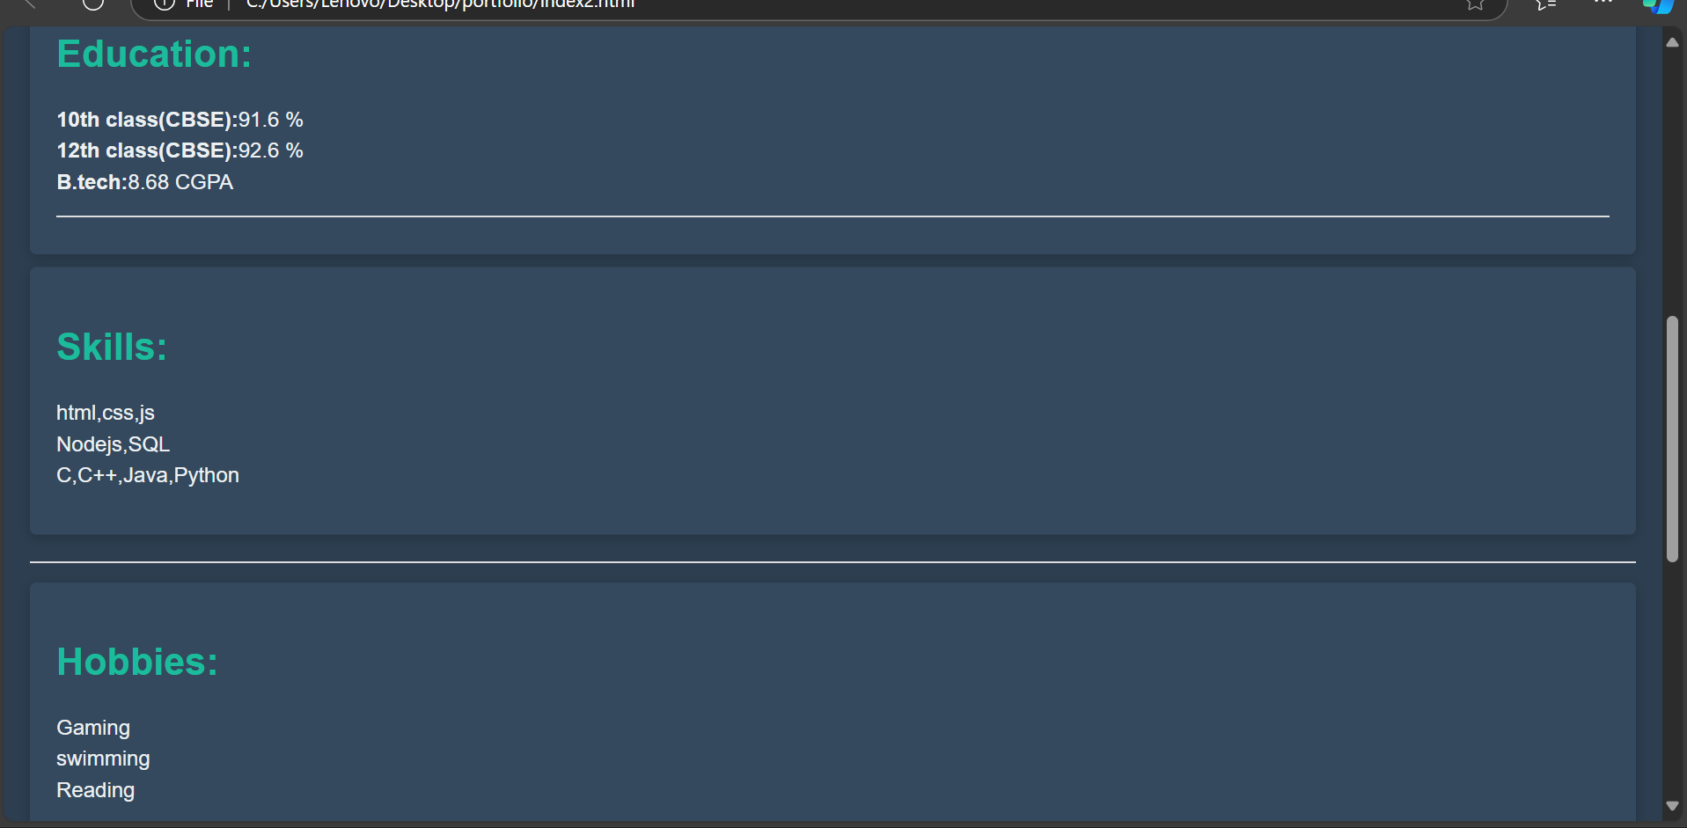
About Me & Education
Sections organize content, with lists for clarity and gave all the section relating some info about me a unique but same class name so can easily make changes in all of them

Slide 12

Skills & Hobbies
Highlights skills and hobbies using bullet points.
Can also use <hr> tag to show sepration and adjust the css accordingly

Slide 13
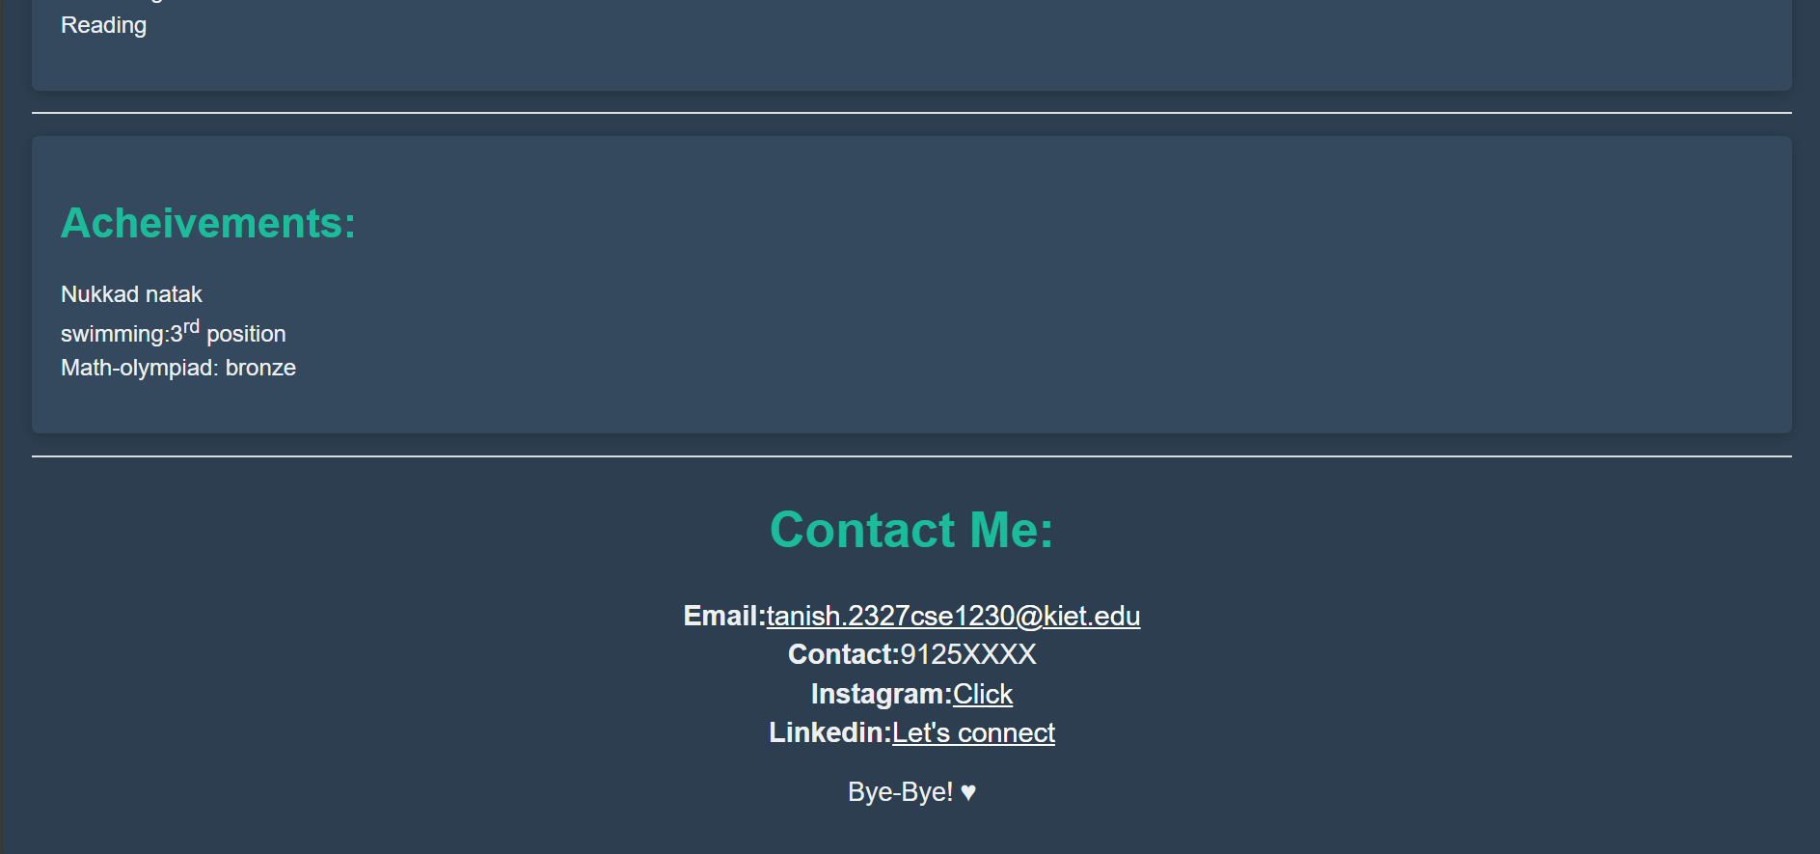
Achievements & Contact
Lists achievements and contact information with links.
Also use anchor tag to add hyperlink to all the contact information

Slide 14
Conclusion
Reflection on the project and invitation for feedback.
Mostly CSS was used to do all the styling html is only used to provide basic structure to our code.

