Slide 1
Over-assist mitigation in column EPS: assist map versus PID torque feedback
Progress report: method, model, results, code
Tran Minh Tan | Supervisor: Dr. Phung Thanh Huy | HCMUT | 2026-10-10
Notes:
Purpose: show the supervisor the method, model, results and code for the planned paper (Map vs PID).

Slide 2
Main message
Closed-loop torque feedback removes the over-assist that the map cannot; both are limited by sensor noise times high-frequency gain
-14.1 %
-0.09 %
32 x
Map: steady over-assist after mu 0.8 -> 0.3 while cornering (SLIP)
PID: same situation, error returns to about zero
high-frequency gain of the map (lead) relative to PID: why the map is the noisiest
Same plant, sensors, actuator, cases and gates for every controller, fixed before tuning
PID tracks best on the calibration case (R 24.4 % vs map 32.2 %); PI is the smoothest
Open issue: no controller passes all four gates; gate values and the calibration case need a final decision

Slide 3
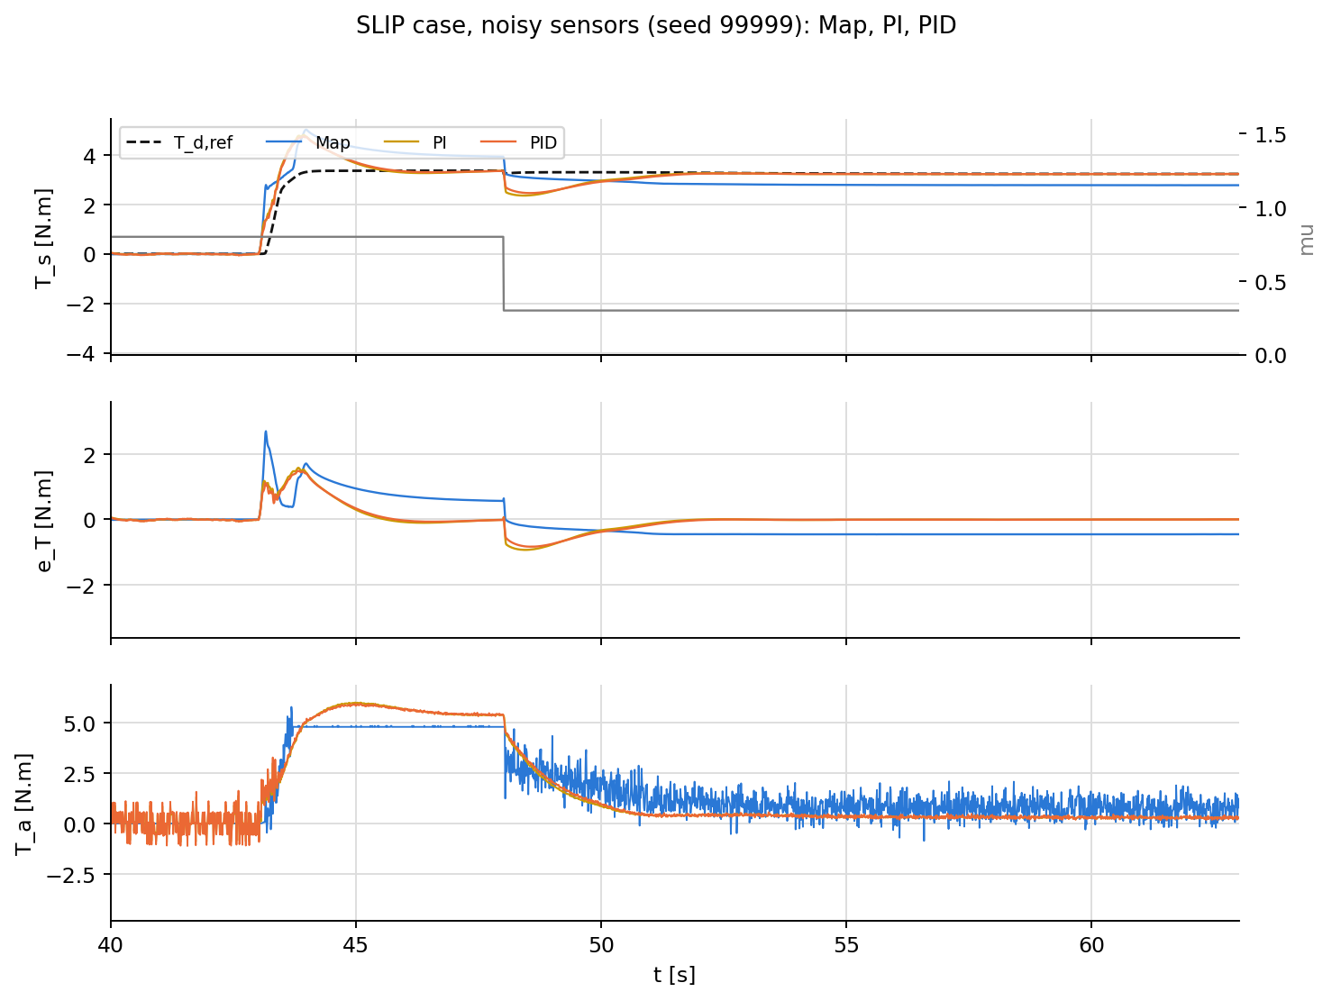
Problem: over-assist when grip drops
The map is calibrated on a dry road and does not know mu
Assist map: T_a = M(v, |T_s|), calibrated so that T_s = T_d,ref at mu = 0.8
When mu drops while cornering, the self-aligning torque T_r of the front tires collapses
Same assist + smaller T_r = lighter steering than intended, exactly near the grip limit
Feedback alternative: track T_d,ref(v, a_y) with T_a; it needs a_y and a reference, but no estimate of mu
SLIP, last scene: mu 0.8 -> 0.3 at 48 s (0.35 g, 100 km/h)

Slide 4
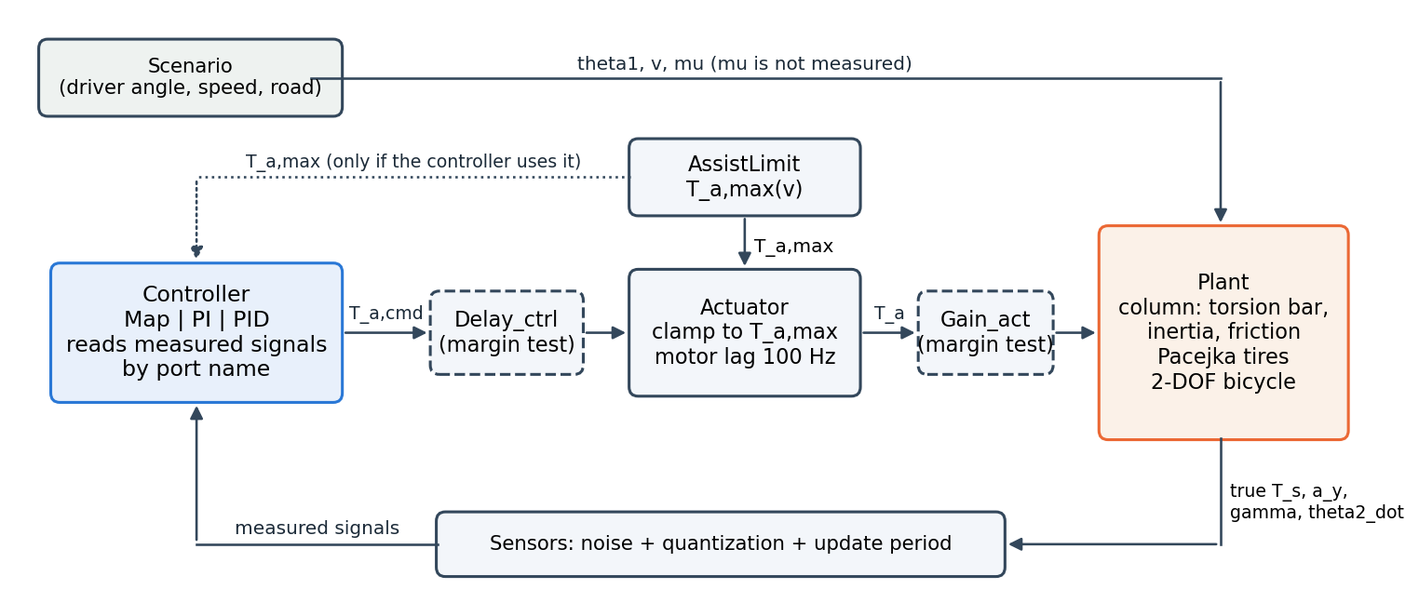
Model: closed loop shared by every controller
Plant - Sensors - controller - AssistLimit - Actuator, all at 1 ms; scoring on the true signals

Slide 5
Model: plant and environment
Four states (theta2, theta2_dot, beta, gamma), driver = steering-angle source
Column: T_s = K (theta1 - theta2); J_col theta2_ddot = T_a - T_r + T_s - T_f tanh(c theta2_dot) - C_col theta2_dot
Tires: Pacejka Magic Formula, D = mu F_zf; T_r = (pneumatic trail + caster) F_yf / n_st
Vehicle: 2-DOF bicycle (beta, gamma) at constant speed; a_y = (F_yf + F_yr)/m
T_d,ref(v, a_y): 17 x 17 table; T_a,max(v) = demand + F (F = T_f = 2 N.m)
Sensors: noise (1 resolution step), quantization, 1 ms (T_s) / 10 ms (v, a_y via CAN)
Motor: clamp to +-T_a,max and first-order lag 100 Hz
parameter | value
K | 143.24 N.m/rad
J_col / C_col | 0.11 / 1.35
T_f | 2.0 N.m
m / Iz | 1573 kg / 2873 kg.m2
C_alpha_f | 160000 N/rad
column resonance | 6.1 Hz

Slide 6
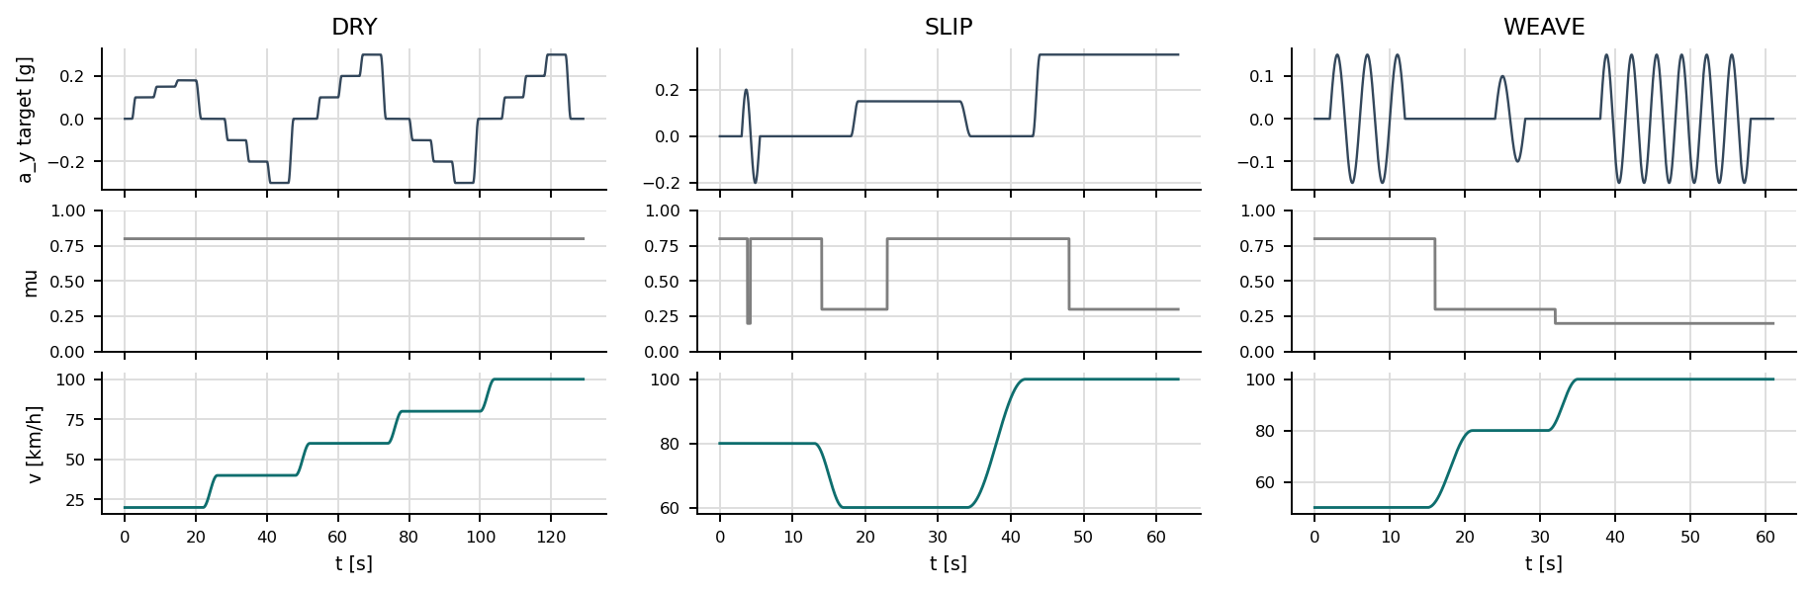
Method: one calibration case, three scoring cases
Tune on CALIB (local seed), score on DRY, SLIP, WEAVE (shared seed 99999)
CALIB 117 s
DRY 129 s
SLIP 63 s
WEAVE 61 s
Dry; 20, 60, 100 km/h; 0.1-0.4 g, sine, small corrections; mu step 0.8 -> 0.6. Tuning only.
Steady torque on the dry road (map design condition). Main metric: max |e_rel|.
Grip changes while cornering: puddle, mu rise, mu drop. Main metric: signed error after the change.
Continuous steering: slalom, lane change on mu 0.3, sine on mu 0.2. Main metric: RMS e_T, S, TV.

Slide 7
Method: metrics, gates and selection rule
Written before tuning; one function per metric, shared by all controllers
metric | definition
R [%] | RMS e_T / mean |T_d,ref| in four window groups, equal weights
S [N.m] | RMS of T_a after a 5 Hz high-pass (assist-torque noise)
TV [N.m/s] | total variation of T_a per second
e_rel [%] | mean e_T / mean |T_d,ref| per steady window; < 0 = over-assist
gate (priority order) | threshold
1 stability with margin | gain x2 and +1 ms keep R < 2x
2 reverse assist | <= 1 % of time
3 no bang-bang | <= 1 % extra time at T_a,max
4 steady accuracy | |e_rel| <= 3 % in all windows
Selection: R within 5 % of the controller's own best R, then smallest S
Conclusion = compare whole Pareto fronts (R, S), not single points
Fallback if nothing passes: drop the lowest gate, take the least violation

Slide 8
Controllers: assist map and PID
Map reads T_s and v only; PI/PID read T_s, v, a_y and the actuator clamp
Map (industrial baseline)
PI / PID (torque feedback)
T_a = sgn(T_s) M(v, |T_s|) + lead (s/z+1)/(s/p+1)
Dead zone 0.3 N.m, slope <= K_max
K_acc = 6.75 (accuracy), K_stab = 9.5 (PM 45 deg), bang-bang K <= 7.5
Selected: K_max 6.75, z 59.8, p 1666 rad/s
1 tuned parameter, 11 simulations
e_T = T_s - T_d,ref(v, a_y)
T_a = Kp e_T + Ki int e_T + Kd d/dt T_s,meas / (Tf s + 1)
Anti-windup on the clamp (Kaw = Ki/Kp)
PI: Kp 1.25, Ki 3.0 (103 simulations)
PID: Kp 1.50, Ki 3.0, Kd 0.015, Tf 3.5 ms (455 simulations)
 | Map | PI | PID
tuned parameters | 1 | 2 | 4
simulations on CALIB | 11 | 103 | 455
high-frequency gain | 188 | 1.25 | 5.8
signals read | T_s, v | T_s, v, a_y | T_s, v, a_y

Slide 9
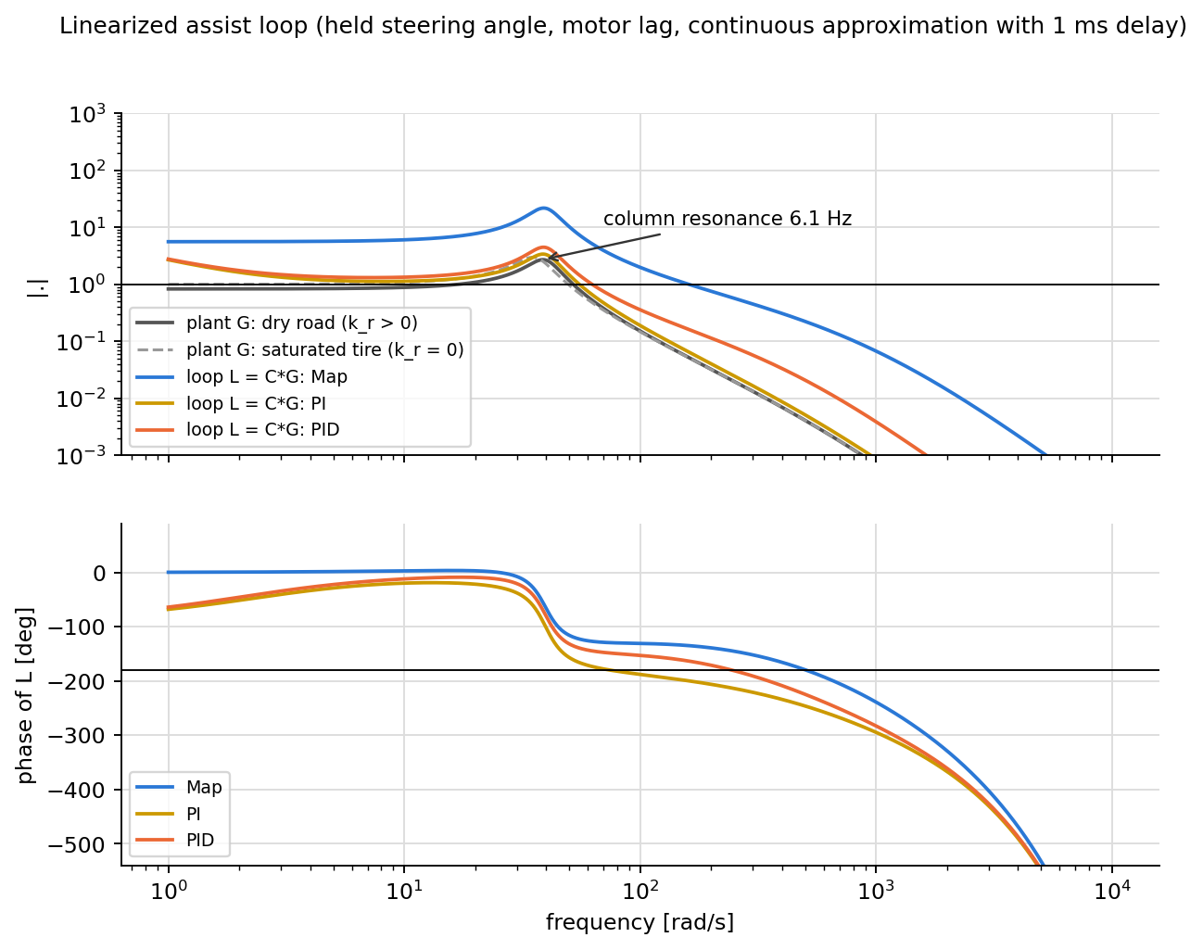
Result: column resonance and loop shape
The 6.1 Hz resonance caps the PI bandwidth; the map needs a large lead
Phase margin, discrete 1 ms model: Map 41, PI 12, PID 34 deg (Ms 1.8, 5.1, 1.9)
High-frequency gain: Map 188, PID 5.8, PI 1.25
Noise in T_a scales with this gain, not with the presence of a D term

Slide 10
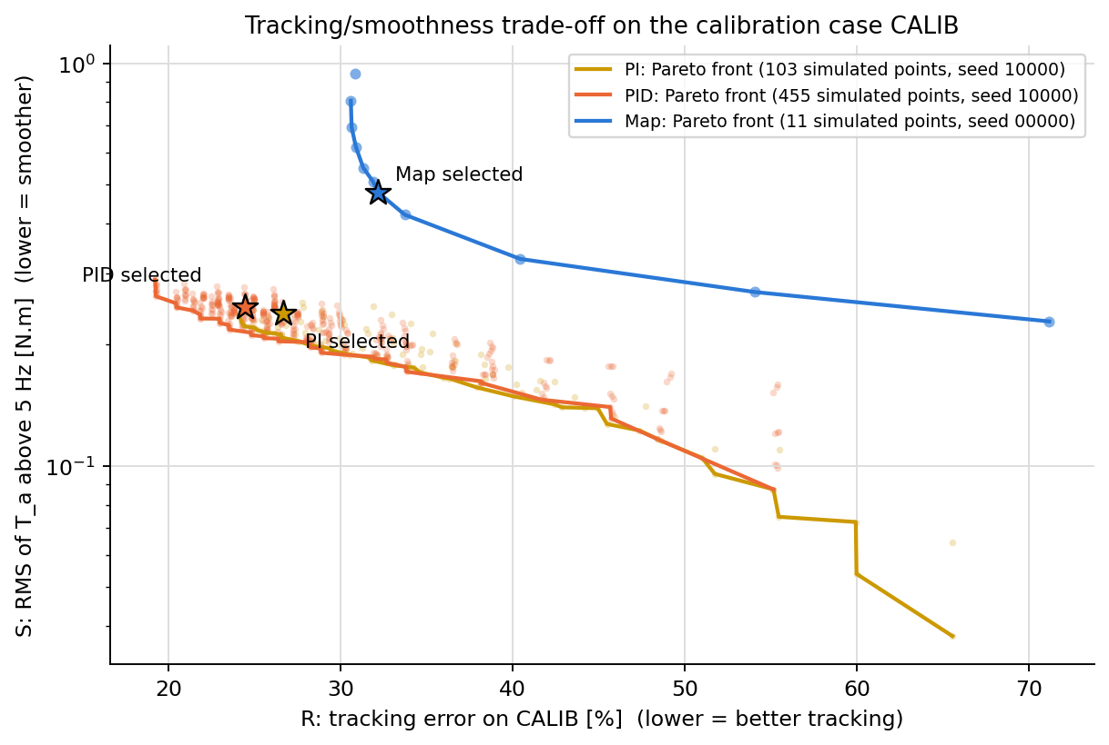
Result: tracking vs smoothness on CALIB
Whole Pareto fronts; stars are the selected points
 | R % | S N.m | TV
Map | 32.2 | 0.477 | 368
PI | 26.7 | 0.240 | 14
PID | 24.4 | 0.248 | 30
The map front lies to the right of the PI/PID fronts wherever S overlaps: the ranking does not depend on the choice of a single point.

Slide 11
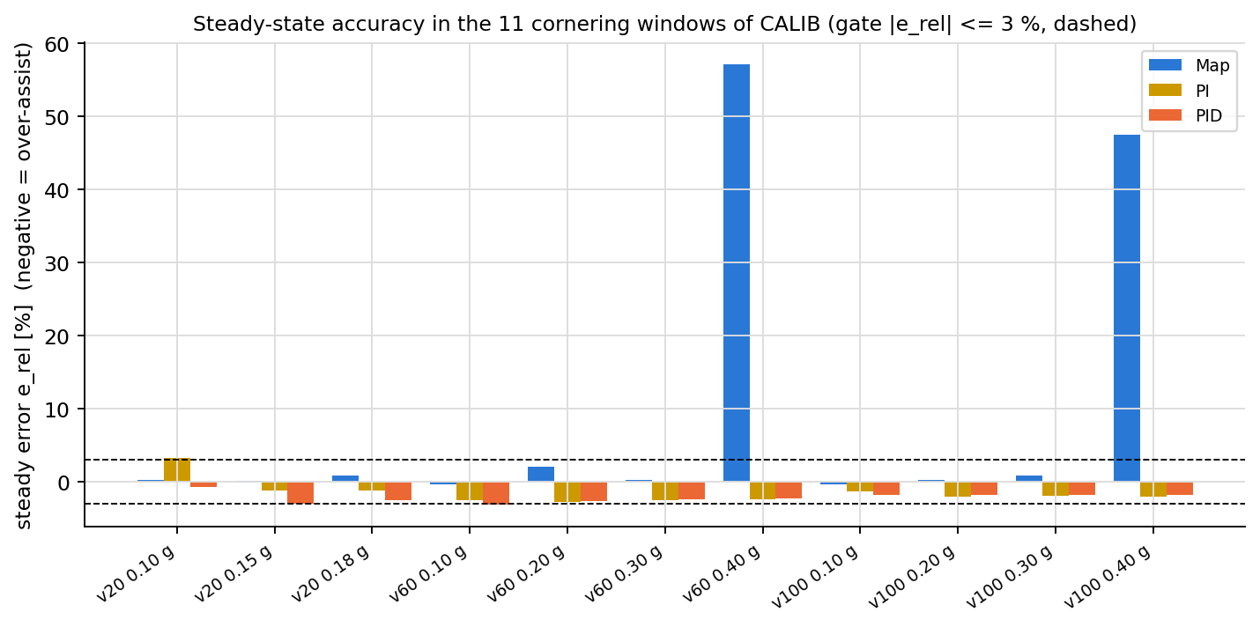
Result: steady accuracy on CALIB
Map meets the 3 % gate in 9 of 11 windows (fails at 0.4 g); PI/PID miss it only slightly at 0.1 g

Slide 12
Result: scoring cases (noisy sensors, seed 99999)
Whole-case RMS tracking error and total variation of the assist torque
TV of T_a [N.m/s] | Map | PI | PID
DRY | 325 | 19 | 36
SLIP | 330 | 24 | 41
WEAVE | 179 | 35 | 53
DRY max |e_rel| % | 2.75 | 1.58 | 1.90

Slide 13
Result: over-assist in the SLIP case
Mean error in % of T_d,ref (negative = steering too light)
Window | meaning | Map | PI | PID
pud_in | inside 0.4 s puddle (mu 0.2), 80 km/h | -83.5 | -56.4 | -50.3
up_post | after mu 0.3 -> 0.8, 60 km/h, 0.15 g | 0.6 | -0.1 | -0.1
down_pre | before mu drop, 100 km/h, 0.35 g | 17.4 | -1.2 | -1.1
down_post | after mu 0.8 -> 0.3, settled | -14.1 | -0.1 | -0.1
After the friction drop the map settles at a lighter steering; PI and PID return to the reference (integral action and a_y-based reference)
Inside the 0.4 s puddle nobody can react fully, but the map error is the largest
This gap is structural (feedback + reference vs open-loop map), and is reported as such

Slide 14
Open issues before freezing the method
Found while running all controllers under the same rules
Gates
Calibration case
Model limits
No controller passes all four gates (reverse assist 1-4 %, e_rel > 3 %): points chosen by the fallback rule. The simulated margin gate accepted a PI with PM 12 deg (Ms 5.1): too weak. Thresholds need a source or a sensitivity study.
The mu step 0.8 -> 0.6 hardly changes T_r, so tuning does not see over-assist; only the scoring case SLIP does. Deeper step (e.g. 0.35) planned.
Simulation only; open-loop driver (no recovery after a slide); motor as first-order lag; noise level assumed; plant not validated against vehicle data.
Gate (order) | Map | PI | PID
1 stable + margin (gain x2, +1 ms) | pass | pass | pass
2 reverse assist <= 1 % | fail (1.09) | fail (4.51) | fail (3.74)
3 no bang-bang (<= 1 % extra saturation) | pass | pass | pass
4 |e_rel| <= 3 % in all windows | fail (57.1) | fail (3.25) | fail (3.13)
linear PM / Ms (1 ms discrete model) | 41 deg / 1.8 | 12 deg / 5.1 | 34 deg / 1.9

Slide 15
Code: MATLAB/Simulink R2023a, generated models
Every model is built by a script and has one test; all code and comments in English
Model/setup_paths.m paths (single place)
Model/data/*.json single data source
Model/PRSM/<Plant|Ref|Sensors|
AssistLimit|Actuator>/ build_*.m, test_*.m
Model/Controllers/<Map|PI|PID>/
load_<ctrl>.m, <Ctrl>.mdl, Model_<Ctrl>.mdl,
script/ design, sweep, select, test
Model/Sim/script/ build_closed_loop, make_cases,
calib_run, run_cases, make_pair_comparisons
Result/ Design, Calib, Cases, Compare
tools/build_report_en.py this report and deck
Run: setup_paths; load_pid; build_closed_loop('PID'); run_cases('PID', 10000)
Compare: make_pair_comparisons({'Map','PID'}, 99999)
Tests: test_plant, test_map, test_pid, test_calib, test_gates (all pass)
Repository: github.com/TanTramM/Adaptive-EPS-using-Reinforcement-Learning

Slide 16
Planned paper and next steps
Paper: assist map vs PI/PID torque feedback; contributions: fair evaluation framework, resonance and high-frequency gain analysis, quantified over-assist
Next: settle gate values and the calibration mu step, freeze the method; sensitivity (gates, noise, seed); robustness to +-20 % plant errors; choose the venue. SMC/ISMC stay in the thesis.

