Slide 1
Anomaly Detection
Gyóni Ákos
Consultants: Dr. Ekler Péter, Dr. Forstner Bertalan

Slide 2
Network traffic anomalies
Credit card transaction datasets are usually anonymized and have very few outliers, which makes it difficult to get meaningful results, without access to un-anonymized data.
For these reasons I changed my focus to network traffic datasets, as these have lots of publicly available data and usually a higher anomaly percentage.
Specifically, I chose the CIC-UNSW-NB15 dataset, that has around 20% malicious traffic.

Slide 3
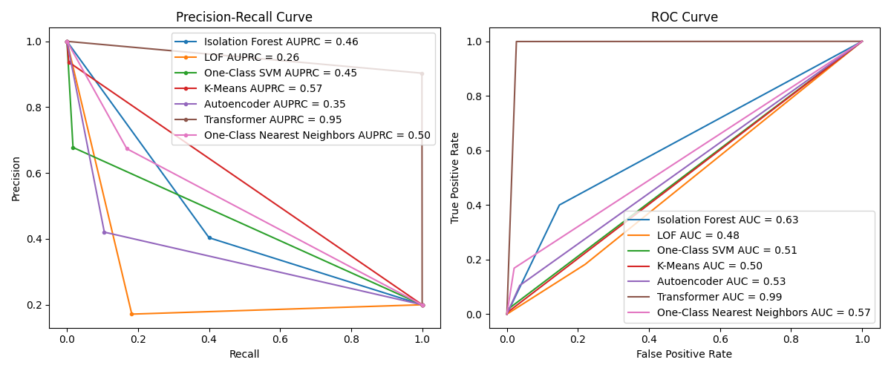
Challenges with Network Traffic datasets
The CIC-UNSW-NB15 dataset has many dimensions (76 columns), which makes it hard for most methods to find anomalies. This is reflected in the results I’ve found, where most models performed quite poorly on this dataset, except the Transformer model, which can work really well with high dimensional data.

Slide 4
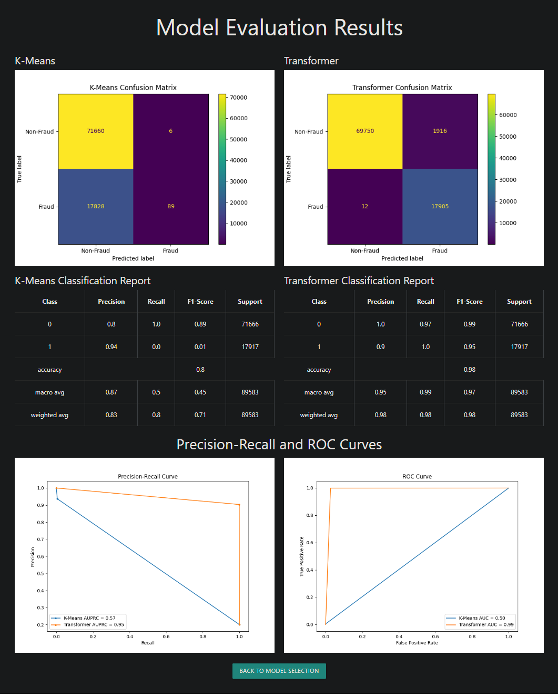
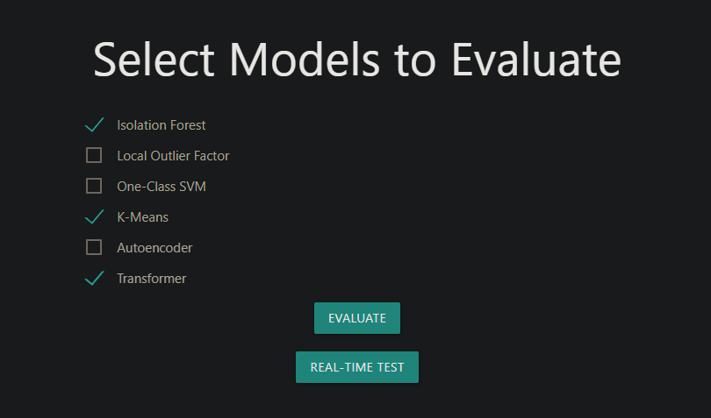
Flask based Frontend
I’ve also added a Flask based frontend page to the app, that can be used to compare models. It has 2 different pages, one that compares the selected models on a static test dataset, and another that uses simulated live data, to compare the models in a real time use case.

Slide 5
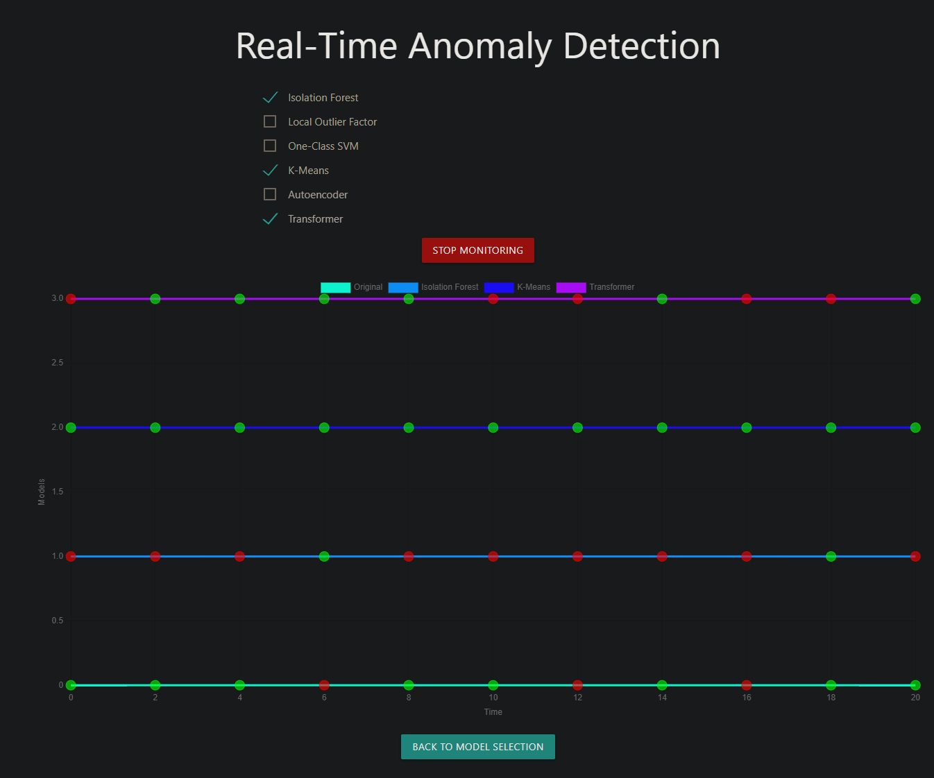
Simulated live data comparison
My frontend component also has a real time comparison page. For this I trained a CTGAN model on the original dataset, which can generate new data points that are similar to the original data.
This page calls this generator every 2 seconds and asks for a new data point. I then display a graph that shows if it was an anomaly or not and show each selected model’s prediction for it.

Slide 6
Bot detection dataset
I’ve also started working on predicting on another new dataset, that tracks the user agents of different websites and tries to identify bots.
This dataset is very large (larger than 500GB), so I can only use a small fraction of it for AI training, so that it finishes in a reasonable amount of time. It also has text-based columns, which don’t work with any of my previous models.
Potential models that could work with this dataset are:
Modified transformer model (my current one only works with numerical data)
K Nearest Neighbor model that uses a distance metric that works on text (like Gower’s distance)
Gradient Boosted Trees
Random Forest

