Slide 1
Anomaly Detection
Gyóni Ákos
Consultants: Dr. Ekler Péter, Dr. Forstner Bertalan

Slide 2
Introduction to Anomaly Detection
Anomaly detection is critical for identifying unusual patterns that don't conform to expected behavior. For example, fraudulent credit card transaction, network anomalies or health problems in patient.
In this project so far, I’ve compared different statistical, machine learning, and AI techniques for detecting anomalies in datasets.

Slide 3
Types of Anomaly Detection Techniques
Statistics-based: Ideal for well-defined datasets with known distributions (e.g., Z-score, Grubbs Test).
Machine Learning: Better suited for complex datasets, categorized into supervised, unsupervised, and semi-supervised learning. (e.g., K-nearest neighbors, Isolation Forests)
Deep Learning: Particularly effective for large and high-dimensional datasets. (e.g., Autoencoders, Transformers)
Time Series & Graph-based methods: For detecting anomalies in sequential data and relationships in graphs.

Slide 4
Supervised vs. Unsupervised Learning
In Unsupervised Learning the model doesn’t have access to labels, so it categorizes anomalies based on deviations from the norm. Most of the models I’ve tested so far use this method. In Supervised Learning the model has labels for which data points are considered anomalies and it uses them to establish its definition of outliers. The transformer model I’ve implemented works this way.

Slide 5
Comparison of different models
So far, I’ve compared 6 different types of anomaly detection models. I’ve used 2 datasets:
The pointe77 credit-card-transaction dataset
And the MLG ULB University’s Credit Card Fraud Detection dataset, that was used in many scientific papers
With the following models: Isolation Forest, Local Outlier Factor, One-Class SVM, K-Means, Autoencoder and a Transformer model.

Slide 6
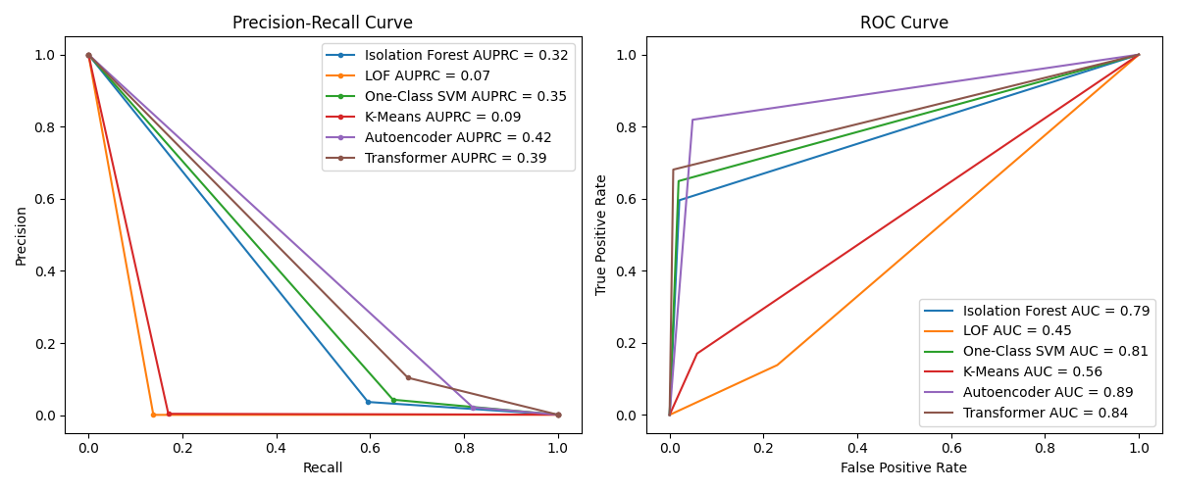
Performance Metrics: Precision-Recall & ROC Curves
Precision-Recall (PR) curves highlight the trade-off between precision and recall, especially useful for imbalanced datasets, like the credit card transaction datasets, that I’ve used for testing.
ROC (Receiver operating characteristic) curves measure the true positive rate vs. false positive rate, showing the model's ability to distinguish anomalies.
This graph shows the different models’ performance on the MLG ULB dataset

Slide 7
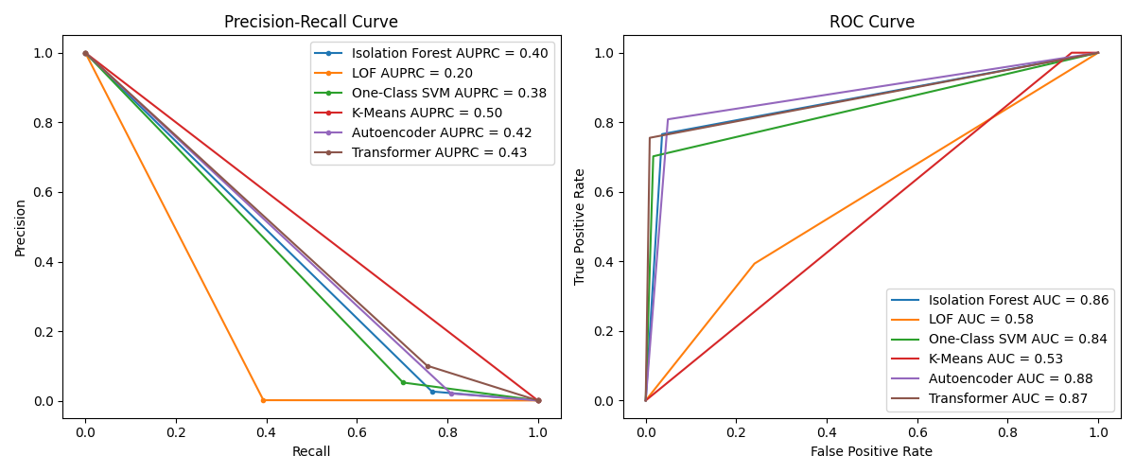
Data generation
A difficult part of working with credit card fraud datasets is that they are very imbalanced, as there are extremely few fraudulent cases.
To help models learn patterns better I’ve used different techniques to increase the ratio of fraudulent to legitimate transaction.
Of the different methods, SMOTE-ENN (Synthetic Minority Over-sampling Technique with Edited Nearest Neighbors) seems to be the best for my use case.
Results with no data generation
Results with SMOTE-ENN

Slide 8
Challenges in finding datasets
My biggest challenge in finding data for my project was that almost all the available datasets were anonymized, so I couldn’t add logic based on specific columns.
The only studies I’ve found with not anonymized data didn’t provide the used dataset, to protect customer rights.
For this reason, I am considering also using other types of datasets for anomaly detection (not just credit card data).

