Slide 1



TDT University
Natural Language Processing
Final Project
Natural Language Processing
Le Thanh Nhan

Slide 2




TDT University
Natural Language Processing
Final Project
TABLE OF CONTENTS
01
05
Attention in LSTM
Traditional Seq2Seq Model
02
06
Attention Mechanism
Attention in Transformer
03
07
Attention in GPT
Bahdanau Attention
04
08
Compare Model
Luong Attention

Slide 3
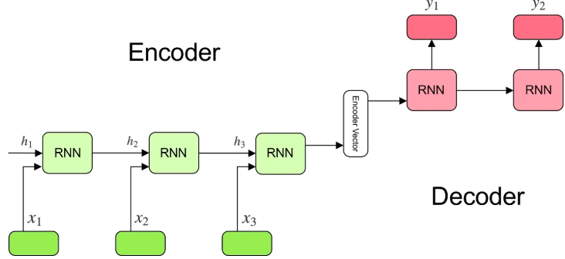
TDT University
Natural Language Processing
Final Project
1. Traditional Seq2Seq Model
We can use the Seq2Seq model for many problems such as Machine Translation (machine translation), Named Entity Recognition (Named Entity Recognition) or Sentiment Classification (Emotion Classification)...
The Encoder in a traditional Seq2Seq model processes the entire input sequence and converts it into a single vector, called the context vector. This vector is intended to encapsulate all the information the encoder extracts from the input. The context vector then acts as the initial hidden state for the Decoder, guiding it to generate the output sequence.

Slide 4
TDT University
Natural Language Processing
Final Project
1. Limitations in Seq2Seq
Vanishing Gradient
Exploding Gradient
Memory Compression
Gradient Problem is a significant issue in Recurrent Neural Networks (RNNs), particularly when dealing with long sequences. It occurs during the training process and severely limits the network's ability to learn dependencies between distant parts of the input sequence.
The exploding gradient problem occurs when the gradients during backpropagation become excessively large. This issue is particularly common in Recurrent Neural Networks (RNNs) when processing long sequences, as gradients accumulate excessively in the later layers or time steps.
Embedding the beginning of the string into a fixed vector size was successful. Through many experiments, it was found that this learning model with long sentences is very close while wasting memory with short sentences. This problem still appears in LSTM and GRU

Slide 5
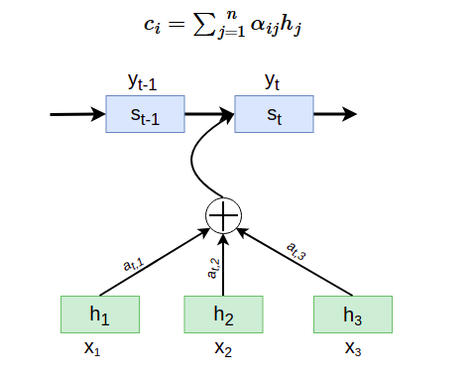
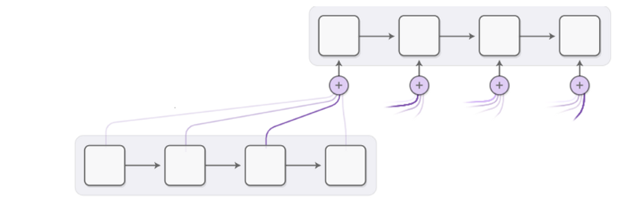
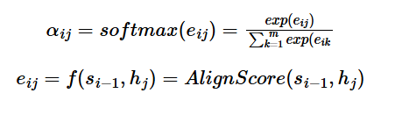
TDT University
Natural Language Processing
Final Project
2. Attention Mechanism In Seq2Seq Model
The Attention mechanism has become a pivotal innovation in sequence-to-sequence (Seq2Seq) models, especially for tasks such as machine translation, speech recognition, and text summarization. Its primary goal is to enhance the model's capacity to focus on different parts of the input sequence dynamically as it generates each token in the output sequence. Below, we'll explore more about the attention mechanism's workings, types, and implementations, along with its effect on model performance.

Slide 6
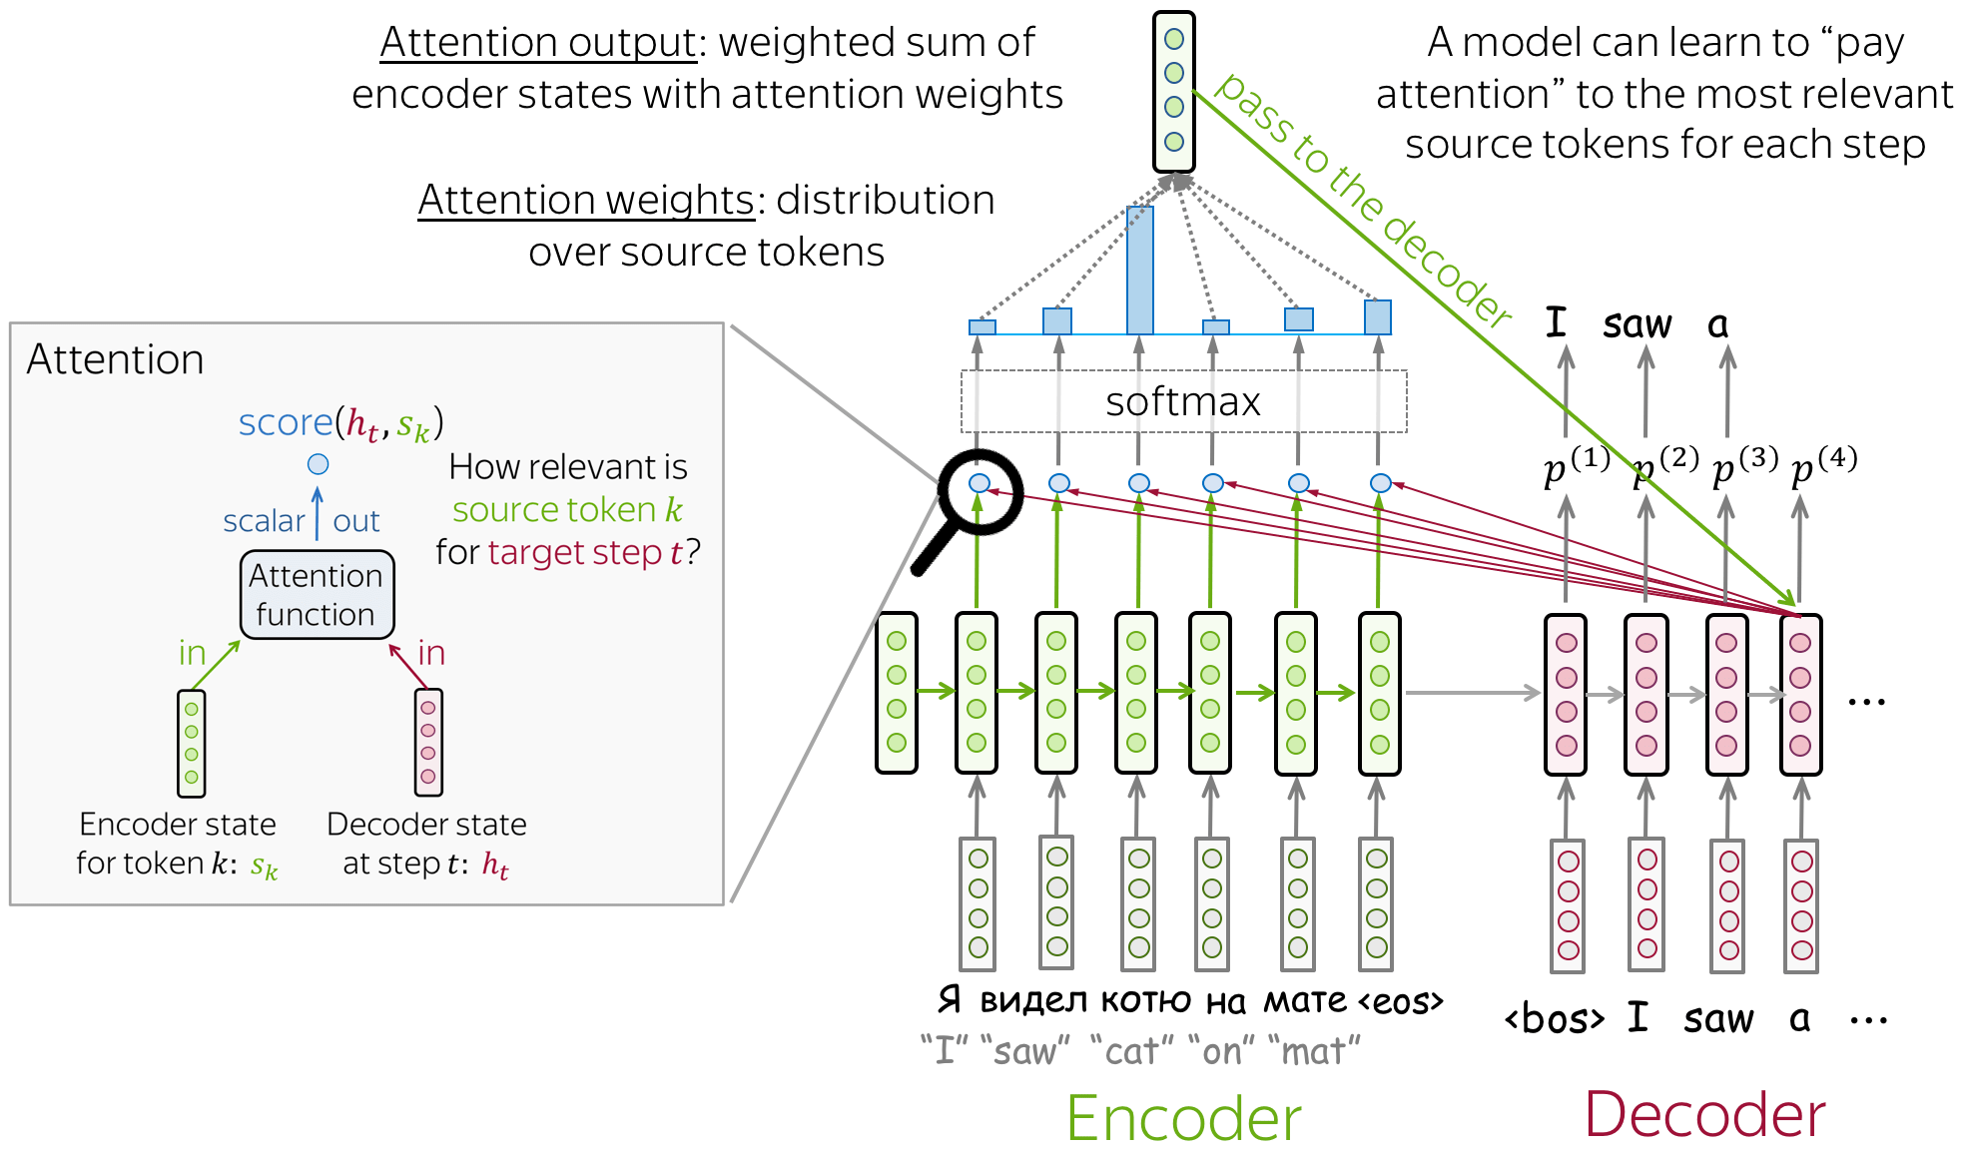
TDT University
Natural Language Processing
Final Project
How Attention Work

Slide 7
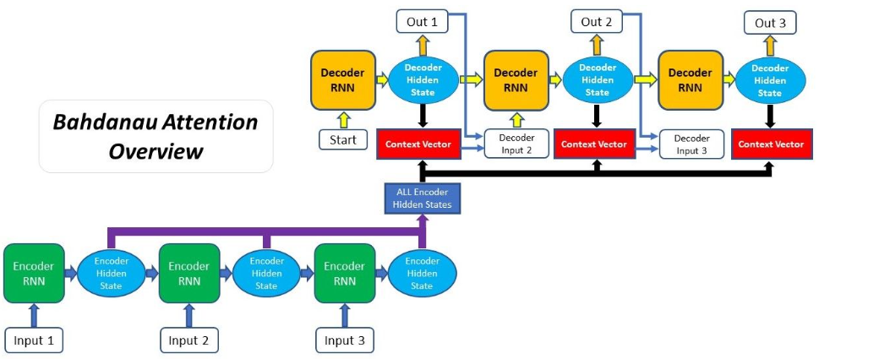
TDT University
Natural Language Processing
Final Project
Bahdanau Attention Mechanism
Bahdanau Attention is also known as Additional Attention, created by Dzmitry Bahdanau in paper in 2014. Its goal is to improve the performance of the Seq2Seq model by varying the Decoder input with information from Input String.

Slide 8
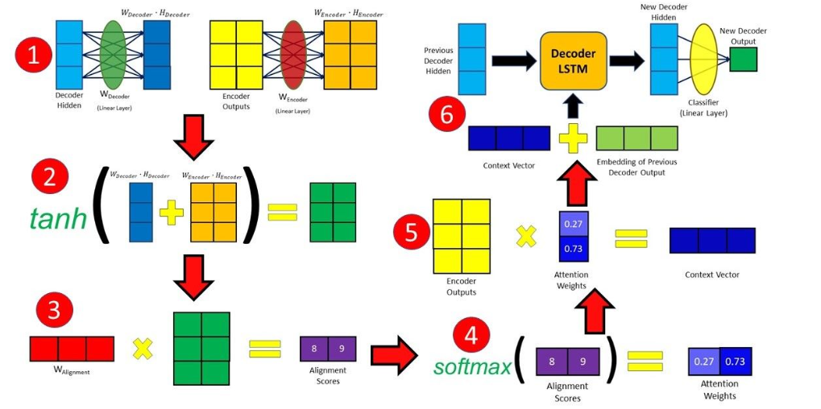
TDT University
Natural Language Processing
Final Project
Bahdanau Attention Mechanism
The image below describes the 6 steps to implement the model Bahdanau Attention

Slide 9
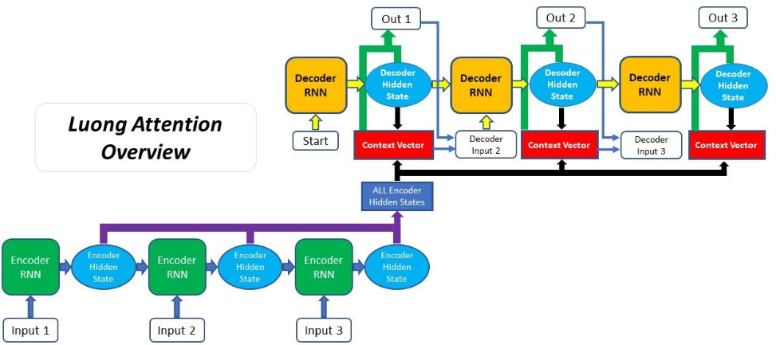
TDT University
Natural Language Processing
Final Project
Luong Attention
Luong Attention is a mechanism introduced in the context of neural machine translation (NMT) by Minh-Thang Luong et al. in their 2015 paper titled "Effective Approaches to Attention-based Neural Machine Translation". It enhances the ability of a model to focus on relevant parts of the input sequence when generating each word in the output sequence.

Slide 10


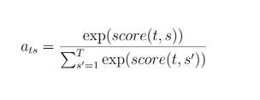
TDT University
Natural Language Processing
Final Project
Attention in LSTM
Define the LSTM: Let’s use an LSTM encoder-decoder structure. The encoder LSTM processes the input sequence and produces a sequence of hidden states. Each hidden state hₛ​ is typically the concatenation of the LSTM’s forward and backward cell states at time s.
Compute the Attention Scores: For each hidden state hₜ of the decoder LSTM, compute attention scores with all the encoder hidden states. One commonly used method is the dot-product scoring function:
Compute the Attention Weights: Normalize the scores to produce a probability distribution using the softmax function:
Compute the Context Vector: Calculate the context vector for the decoder time step t as a weighted sum of the encoder hidden states:

Slide 11
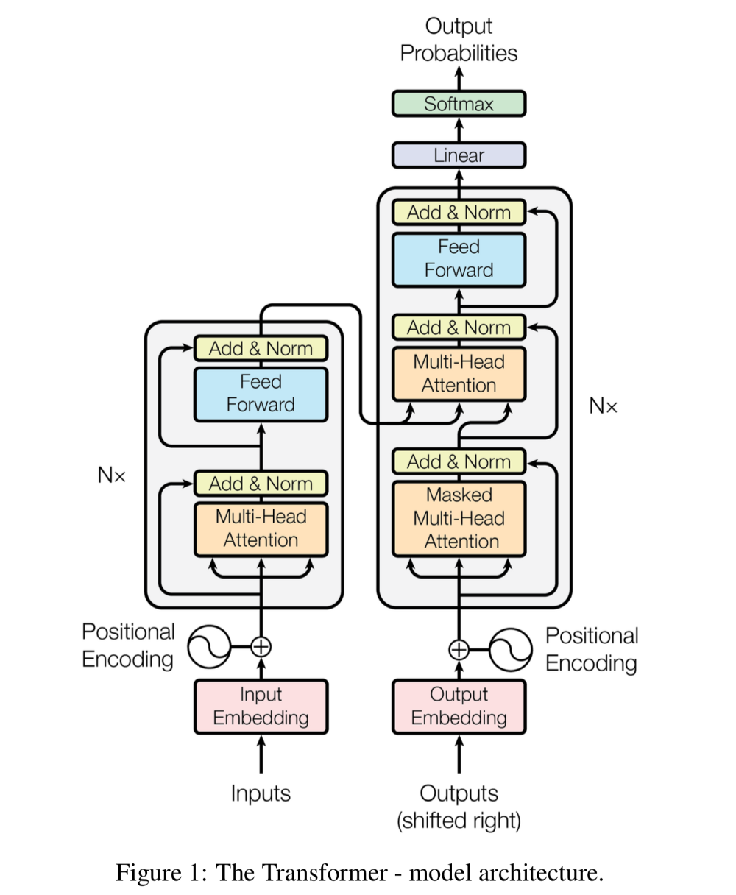
TDT University
Natural Language Processing
Final Project
Attention in Transformer
This structure includes two parts: the encoder on the left and the decoder on the right.
Encoder: is a stacked synthesis of 6 defined layers. Each layer includes 2 sub-layers within it. The first sub-layer is multi-head self-attention which we will learn about in a moment. The second layer is simply a fully-connected feed-forward layer.
Decoder: Decoder is also a stacked combination of 6 layers. The architecture is similar to the sub-layers in Encoder except that one more sub-layer represents the attention distribution in the first place.

Slide 12
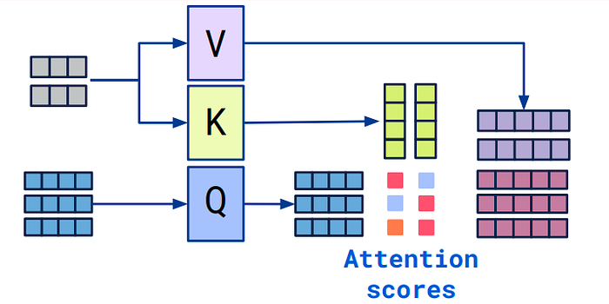

TDT University
Natural Language Processing
Final Project
Attention in Transformer
Self Attention: To build a self-attention mechanism, you need to pay attention to the behavior of the vector icon for each time as follows

Slide 13
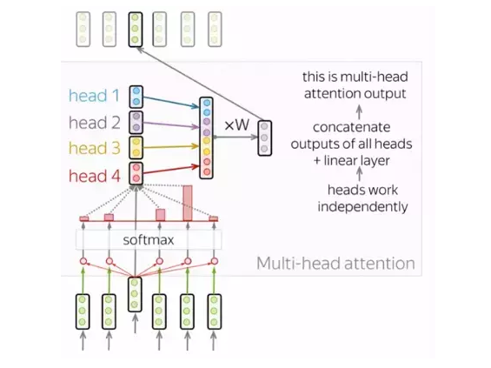
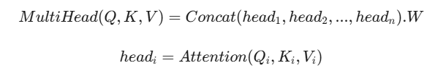
TDT University
Natural Language Processing
Final Project
Attention in Transformer
Multi-head Attention: the model obtain richer and more diverse information than conventional Self-Attention.

Slide 14
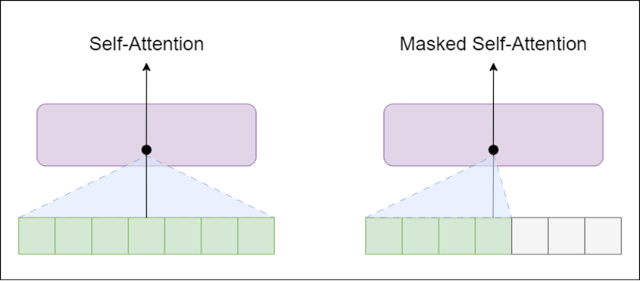
TDT University
Natural Language Processing
Final Project
Attention in GPT
GPT, which is based on an autoregressive approach, uses masked attention to ensure that the model generates tokens sequentially. Unlike self-attention, masked attention prevents a token from attending to future tokens in the sequence. This is crucial for tasks like text generation, where the model needs to predict the next word in the sequence without "cheating" by looking ahead at future tokens.

Slide 15
TDT University
Natural Language Processing
Final Project
The division of attention varies between these architectures
Feature | LSTM | Transformer | GPT
Making Use of Attention | Rarely employs attention mechanisms | Attention is the central component | Relies on attention mechanisms
Structure | Processes data sequentially, step by step | Processes the entire sequence in parallel | Based on the same architecture as Transformer
Access Scope | Restricted to nearby or sequential elements | Can focus on the full input sequence | Can focus on the full input sequence
Computational Speed | Slower for long sequences | Faster compared to LSTM | Matches Transformer performance

Slide 16
THANK YOU FOR WATCHING
TDT University
Natural Language Processing
Final Project

