Slide 1

Java Programming Cornerstone Project
Final Review
Student Attendance System
Presented by
B L V Surya Prakash (25B21CS066)
T Naga Sai Charan (25B21CS070)
Tanatswa Hilary Gendere (24B11CS529)
Blessed Zambezi (24B11CS537)
Department of Computer Science and Engineering

Slide 2

Presentation Outline
1. Abstract
2. Introduction
3. System Analysis
4. Database Design
5. System Design
6. System Implementation
7. Future Enhancements
8. References
9. Conclusion

Slide 3
ABSTRACT
The Student Attendance System (SAS) is a desktop-based application designed to efficiently manage student attendance records within an academic institution by replacing traditional manual methods with a digital solution.
The system enables faculty and administrators to mark attendance, view statistics, generate reports, and manage student information in a structured and secure manner using a relational database.
Developed using Core Java, Swing (GUI), JDBC, and SQLite (with MySQL compatibility), the application ensures data accuracy, reduces redundancy, and improves accessibility.
Features include role-based access control (Admin, Faculty, Student), SHA-256 password hashing, and a modern dark-themed UI for enhanced institutional productivity.

Slide 4
INTRODUCTION
In many institutions, student attendance is still recorded using manual registers or spreadsheet tools, which leads to data duplication, difficulty in generating reports, and increased chances of errors.
The Student Attendance System (SAS) provides a centralized platform to store, retrieve, update, and delete attendance records in a structured manner.
This project focuses on developing a Java desktop application supporting three distinct user roles: Admin, Faculty, and Student, each with dedicated dashboards.
The application is portable and ships as a standalone executable JAR file, making it easy to run on any Java-enabled machine without complex installation.

Slide 5
SYSTEM ANALYSIS
Functional Requirements:
Mark Attendance: Faculty marks each student PRESENT or ABSENT by subject and date; upsert logic prevents duplicates.
Edit Attendance: Modify existing records – change status from PRESENT to ABSENT or vice versa for any student, subject, and date.
Add / Manage Students: Admins can add student records (name, roll no., branch, year, section) and manage existing entries.
View Attendance Statistics: Subject-wise total classes, attended count, and percentage – visible to both students and faculty.
Generate Reports: Filterable by section, year, subject, and date range for administrative review.
Manage Announcements: Admins post announcements; all users can view them from their respective dashboards.

Slide 6
SYSTEM ANALYSIS
Hardware Requirements
Software Requirements
Processor: Intel i3 or above
RAM: Minimum 4 GB
Storage: 20 GB free space
Input Devices: Keyboard, Mouse
Output Device: Monitor
OS: Windows 10/11, macOS, or Linux
Language: Java (JDK 11 or above)
IDE: VS Code or IntelliJ IDEA
Database: SQLite (bundled) or MySQL 8.0+
Connectivity: JDBC with sqlite-jdbc / mysql-connector-j JAR

Slide 7
DATABASE DESIGN
The system uses a relational database to store student and attendance information in a structured manner.
The database consists of eight main tables: users, branches, faculty, subjects, students, attendance, marks, and announcements.
The users table stores login credentials and roles (Admin / Faculty / Student) for all system users.
The students table stores student profiles linked to users and branches tables via foreign keys.
The attendance table records daily attendance per student per subject with upsert-safe unique index.
Primary keys, foreign keys, and unique constraints ensure data integrity and prevent duplicate records.

Slide 8
DATABASE DESIGN
Users Table:
Stores login credentials and role information for all system users.
Field Name | Data Type | Constraint | Description
user_id | INTEGER | PK, AUTOINCREMENT | Unique user identifier
username | TEXT | NOT NULL, UNIQUE | Login username
password | TEXT | NOT NULL | SHA-256 hashed password
role | TEXT | NOT NULL | ADMIN / FACULTY / STUDENT
email | TEXT | — | Contact email address
phone | TEXT | — | Contact phone number

Slide 9
DATABASE DESIGN
Students Table:
Stores student profiles linked to user accounts and branches.
Field Name | Data Type | Constraint | Description
student_id | INTEGER | PK, AUTOINCREMENT | Unique student identifier
user_id | INTEGER | FK → users | Linked user account
student_name | TEXT | NOT NULL | Full name of student
roll_no | TEXT | NOT NULL, UNIQUE | Unique roll number
branch_id | INTEGER | FK → branches | Department / branch
year | INTEGER | — | Academic year (1–4)
section | TEXT | — | Class section (A, B, C…)

Slide 10
DATABASE DESIGN
Attendance Table:
Records daily attendance per student per subject with upsert-safe unique index.
Field Name | Data Type | Constraint | Description
attendance_id | INTEGER | PK, AUTOINCREMENT | Unique record identifier
student_roll | TEXT | FK → students | Student roll number
subject | TEXT | — | Subject name
date | DATE | — | Date of attendance
status | TEXT | — | PRESENT or ABSENT

Slide 11
SYSTEM DESIGN
Presentation Layer (UI)
Modules:
Java Swing • Role-specific Dashboards • Dark Theme
Authentication Module
Attendance Management Module
Student Management Module
Reports Module
Announcements Module
Database Connectivity Module
Application Layer (Business Logic)
Event Listeners • DAO Pattern • Operations
Data Layer (Database)
SQLite / MySQL • JDBC • DBConnection Utility

Slide 12
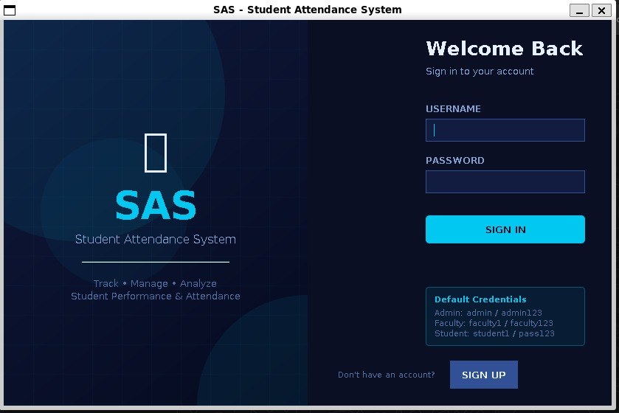
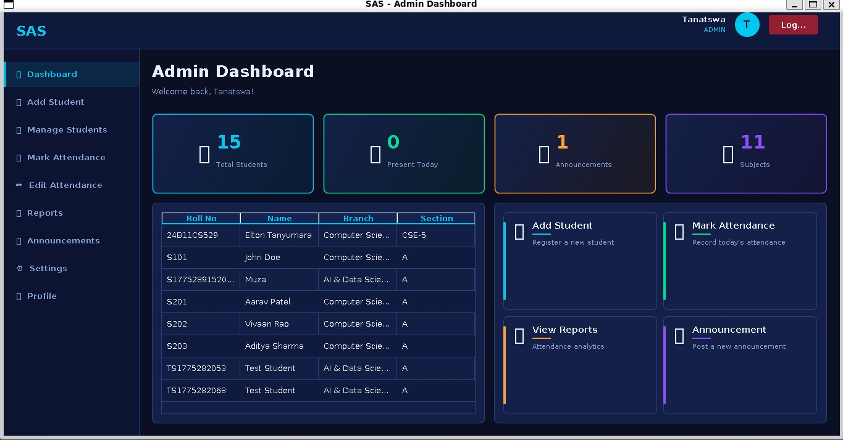
SYSTEM IMPLEMENTATION
Login Screen:
Admin Dashboard:
Allows users to enter username and password. Credentials are validated against the database using SHA-256 hashed password comparison and the user is routed to their role-based dashboard.
Navigation sidebar with options: Dashboard, Add Student, Manage Students, Mark Attendance, Edit Attendance, Reports, Announcements, Settings, and Profile. Home shows summary statistics.
[Login Screen Screenshot]
[Admin Dashboard Screenshot]

Slide 13
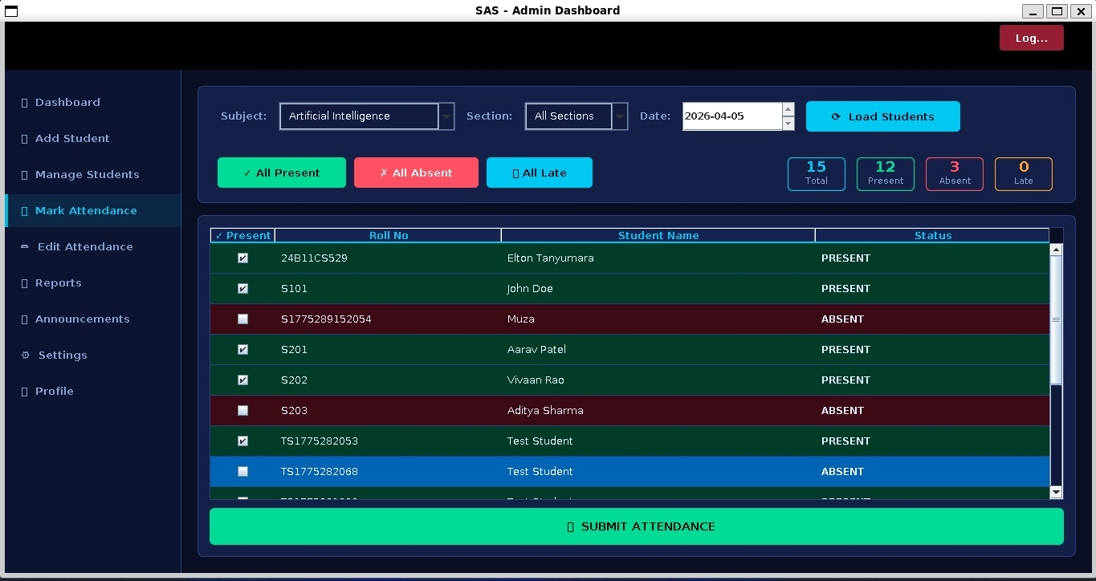
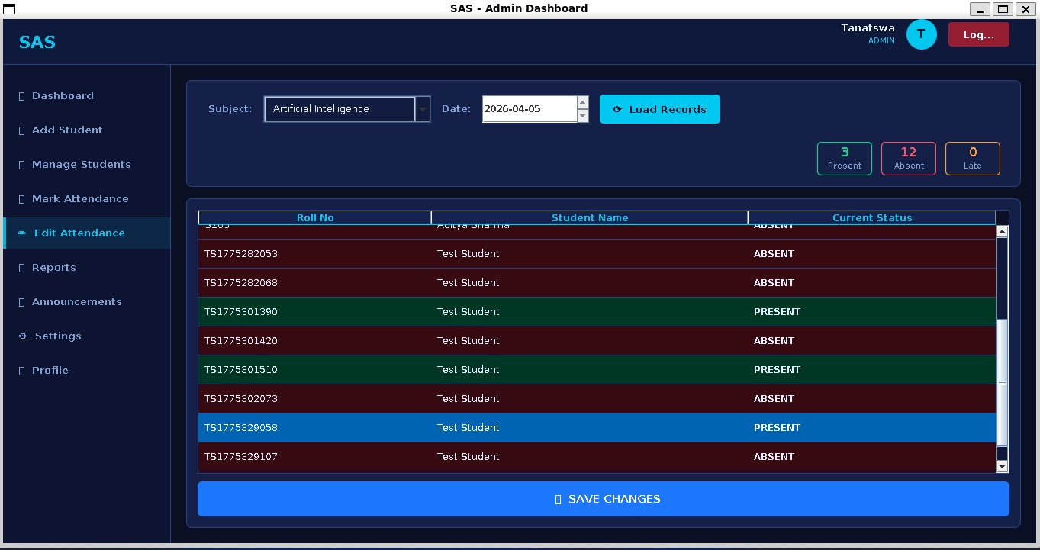
SYSTEM IMPLEMENTATION
Mark Attendance Screen:
Reports Screen:
Faculty selects a section, date, and subject, then marks each student PRESENT or ABSENT. Upsert logic prevents duplicate entries.
Displays subject-wise attendance statistics (total classes, attended count, percentage). Filterable by section, year, subject, and date range.
[Reports Screenshot]

Slide 14
FUTURE ENHANCEMENTS
Web-Based Application:
Convert the desktop app into a web-based system for remote access — faculty can mark attendance from any browser.
Automated Notifications:
Send email/SMS alerts to students and parents when attendance falls below the required threshold (e.g., below 75%).
Biometric / QR Code:
Integrate fingerprint scanners or QR code-based attendance marking to eliminate manual data entry errors.
Multi-User Network:
Upgrade to a dedicated MySQL server to allow multiple faculty members to mark attendance simultaneously.
Improved Analytics:
Add graphical charts and trend analysis for attendance patterns, exportable to PDF or Excel format.

Slide 15
REFERENCES
1. Herbert Schildt, Java: The Complete Reference, Oracle Press, 11th Edition.
2. E. Balagurusamy, Programming with Java, McGraw Hill Education.
3. Korth, Silberschatz, Sudarshan, Database System Concepts, McGraw Hill.
4. SQLite Documentation — https://www.sqlite.org/docs.html
5. Java Documentation (Oracle) — https://docs.oracle.com/javase
6. JDBC Tutorial – GeeksforGeeks — https://www.geeksforgeeks.org/jdbc/
7. Java Swing Tutorial – TutorialsPoint — https://www.tutorialspoint.com/java_swing
8. W3Schools Java Tutorial — https://www.w3schools.com/java/

Slide 16
CONCLUSION
The Student Attendance System was successfully developed as a portable Java desktop application.
It replaces manual attendance registers with an efficient, role-based digital solution for academic institutions.
Key functionalities — marking, editing, viewing attendance, generating reports, and managing students — are fully implemented.
Data security is ensured through SHA-256 password hashing and role-based access control (Admin, Faculty, Student).
Technologies: Core Java, Swing, JDBC, and SQLite provide reliable performance with MySQL scalability for institutional deployment.
The system improves faculty efficiency, reduces administrative workload, and provides a scalable platform for future enhancements.

Slide 17
THANK YOU
Student Attendance System | Java Cornerstone Project | Final Review

