Slide 1
Khmer Word Embeddings and Neural Language Modeling using Temples Corpus
NLP Mini Project 3 - Word Embeddings
Master of Data Science | Institute of Technology of Cambodia

Slide 2
Project Objective
Build Khmer word embeddings.
Visualize embeddings using PCA.
Build neural language models.
Compare n-gram, fixed embedding LM, and scratch LM.

Slide 3
Mini Project 3 Requirements
Embedding dimension = 50
Context window = +/-4
Negative sampling = 2
MIN_FREQ = 10
Neural LM: n=5, h=512
Scratch embedding comparison included

Slide 4
Dataset Overview
Dataset: temples.txt
Topic: Khmer temple Wikipedia text
Total useful tokens: 9,075
Vocabulary size: 175
Small domain-specific Khmer corpus

Slide 5
NLP Pipeline
Khmer Text -> Cleaning -> Tokenization -> EDA
Skip-gram -> PCA Visualization
Neural LM -> Model Evaluation

Slide 6
Text Preprocessing
Khmer tokenization is essential.
Punctuation, numbers, spaces, and noisy tokens removed.
MIN_FREQ = 10 applied.
Rare words mapped to <UNK>.

Slide 7
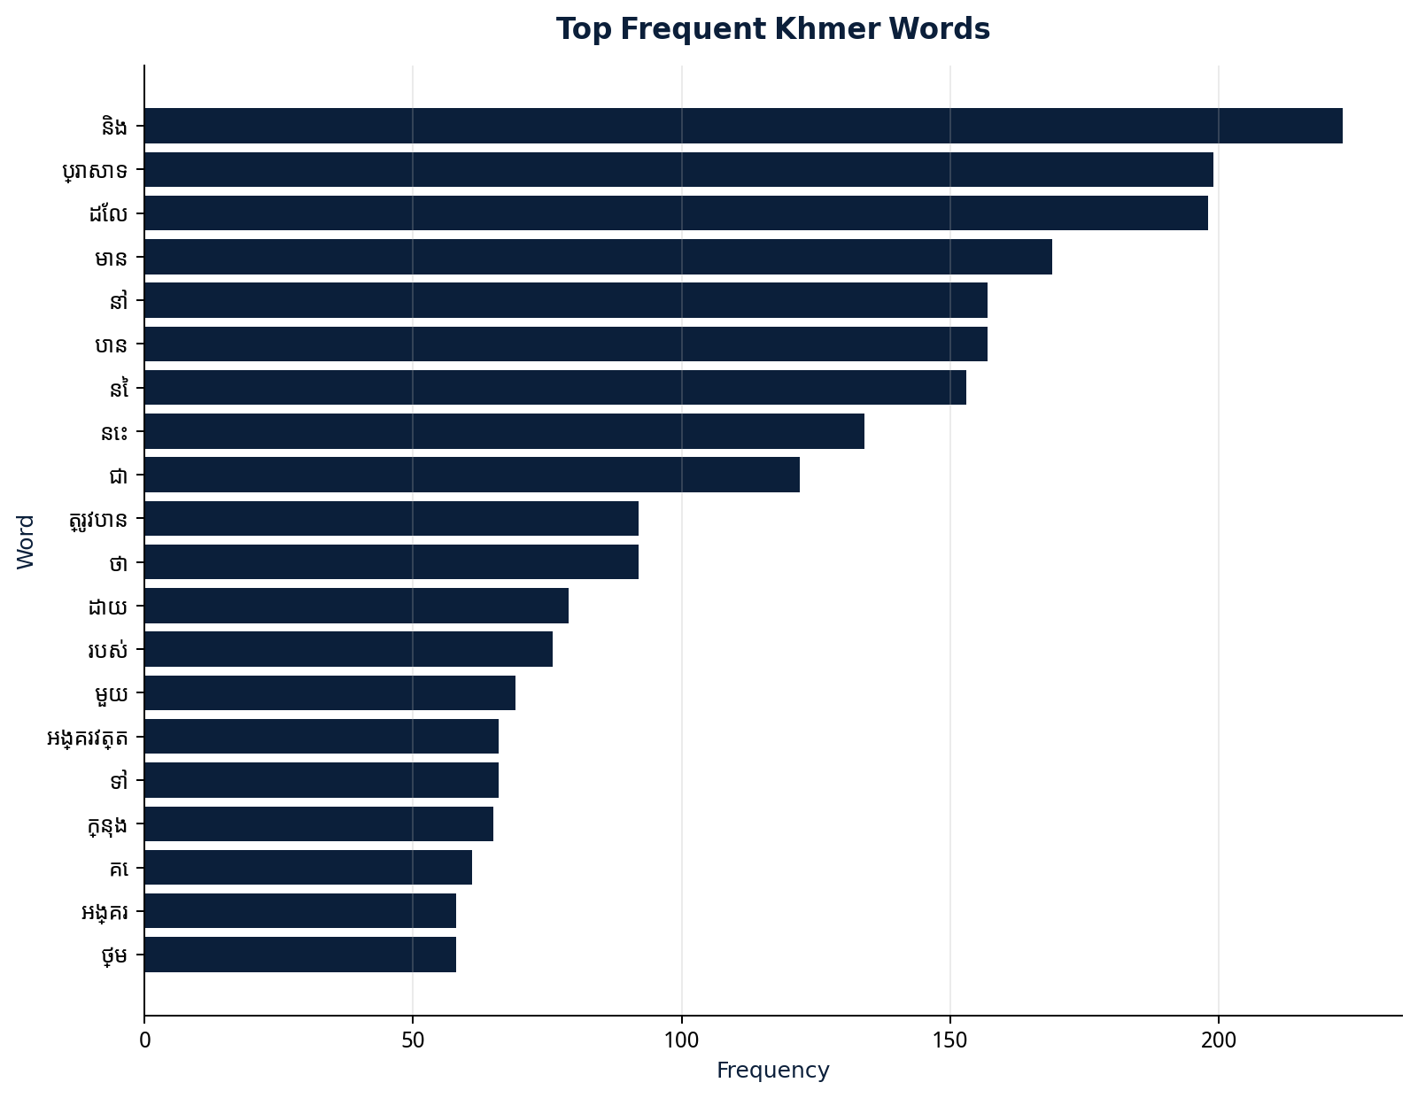
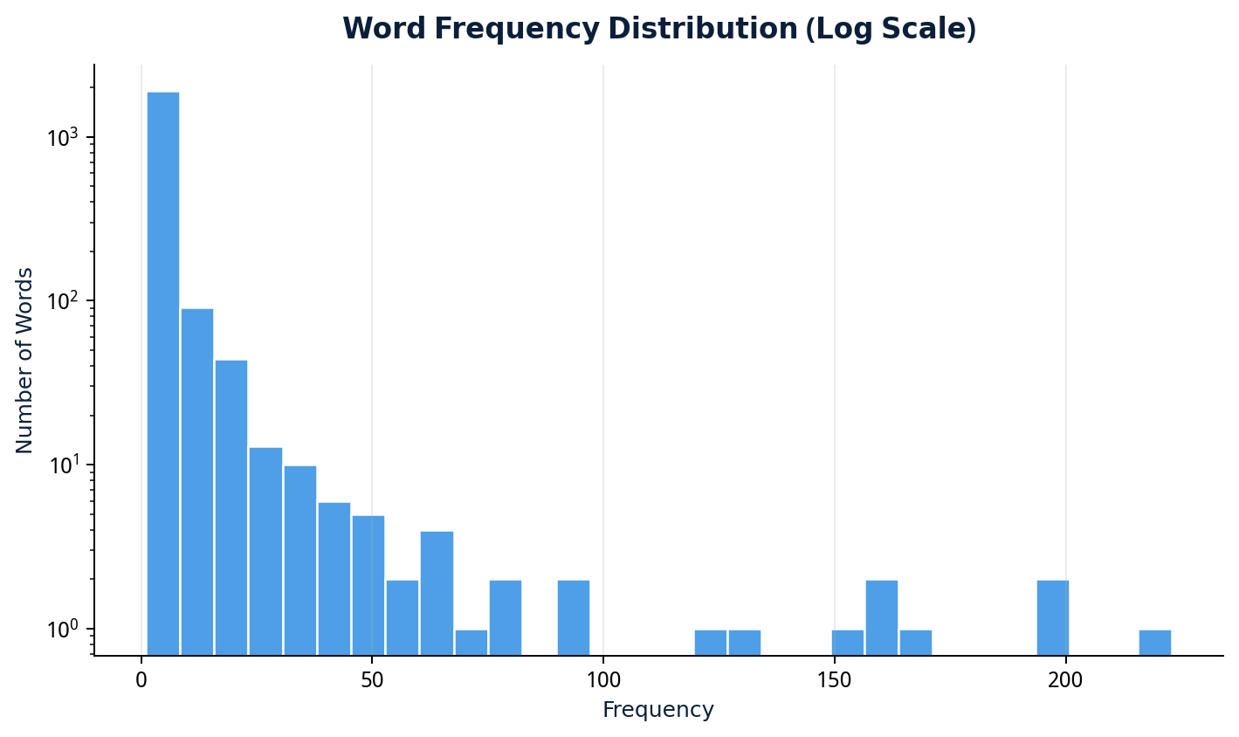
EDA Result

Slide 8
Skip-gram Model
Center word and context words from window +/-4.
Negative sampling k=2.
Embedding dimension = 50.
Binary classification: real vs negative pairs.

Slide 9
Word Embedding Analysis
Query | Similar Word | Freq. | Cosine
ប្រាសាទ | សតវត្ស | 17 | 0.5914
ប្រាសាទ | ប្រទេស | 17 | 0.5365
ប្រាសាទ | តំណាង | 13 | 0.5147
ប្រាសាទ | ផ្នែក | 18 | 0.4326
ប្រាសាទ | ខាងត្បូង | 12 | 0.4271
ប្រាសាទ | ខាងកើត | 16 | 0.4234
ប្រាសាទ | អង្គរ | 58 | 0.4173
ប្រាសាទ | ស្ថិត | 24 | 0.4151
Cosine similarity compares word vectors.
Nearest words show contextual association.
Display filtering hides <UNK> and common function words for clearer interpretation.

Slide 10
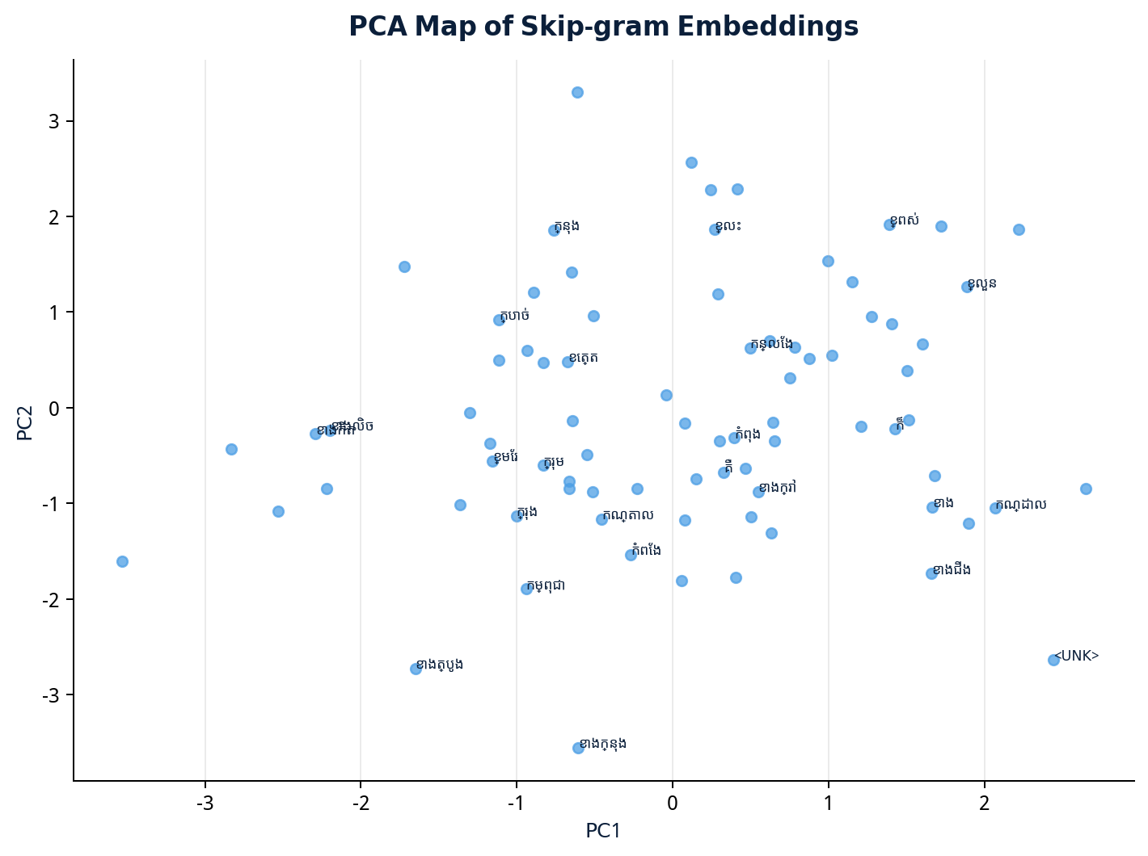
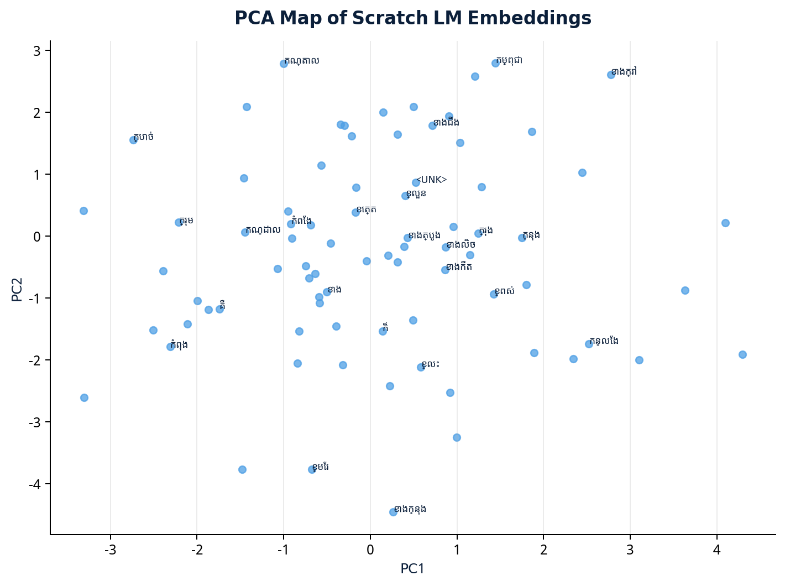
PCA Visualization

Slide 11
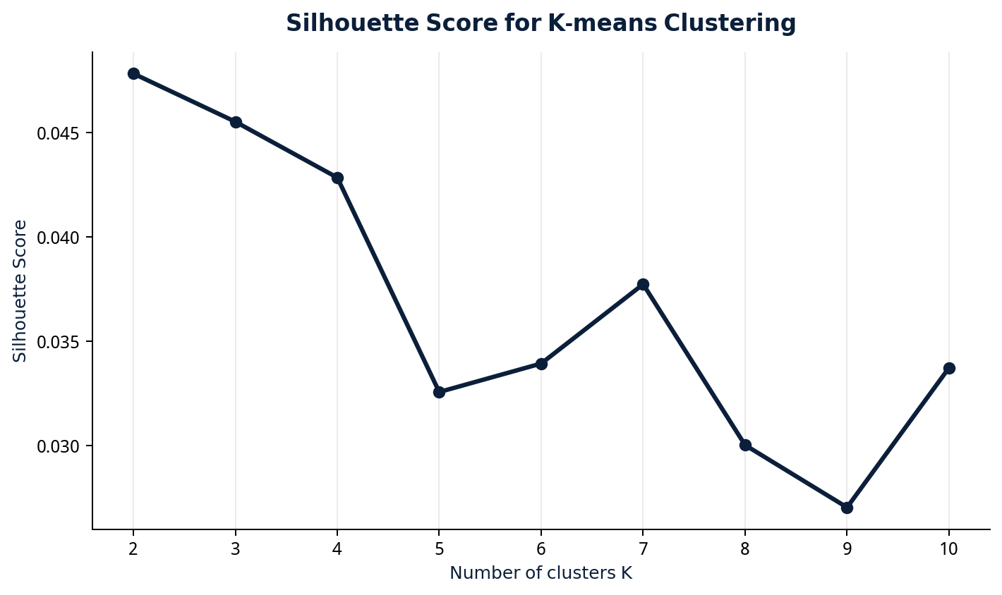
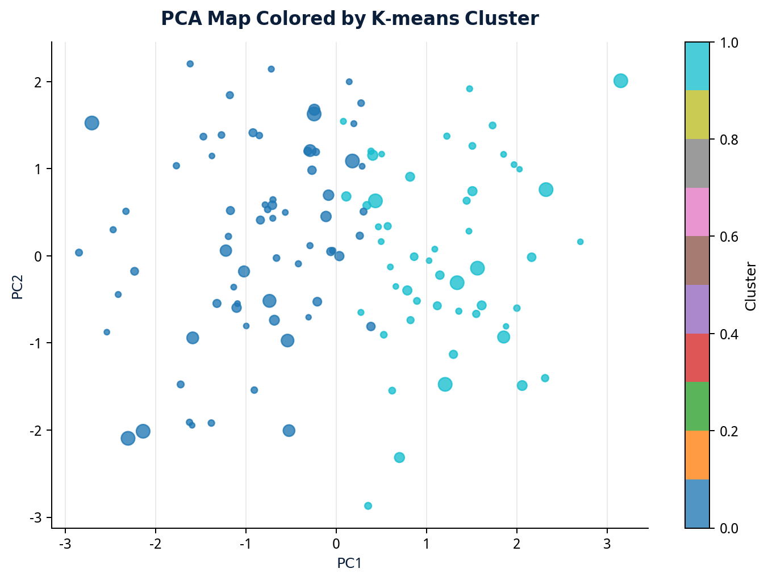
Advanced Embedding Clustering
K-means groups words with similar embedding patterns.
Silhouette score helps choose K.
PCA is used only for 2D visualization.

Slide 12
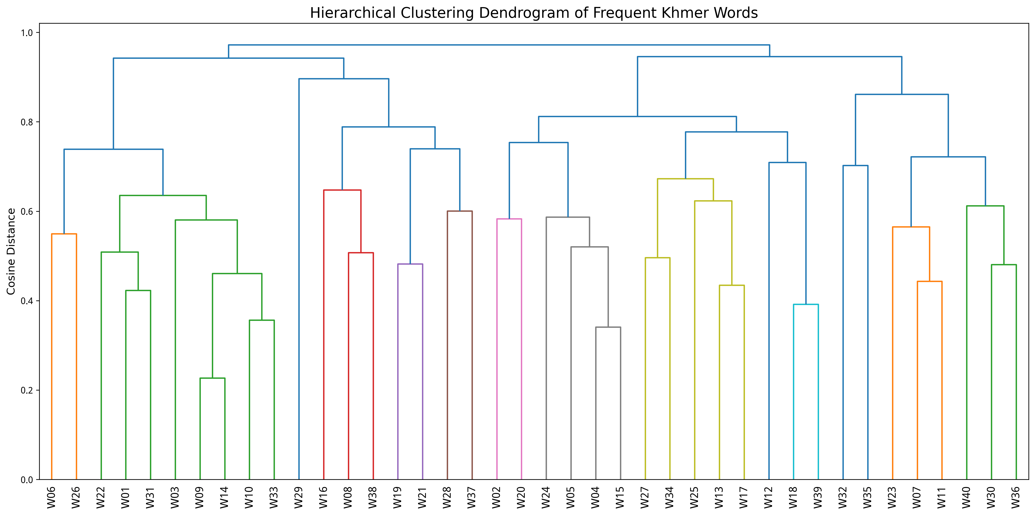
Hierarchical Clustering
ID | Khmer Word | Freq.
W01 | និង | 223.0
W02 | ប្រាសាទ | 199.0
W03 | ដែល | 198.0
W04 | មាន | 169.0
W05 | បាន | 157.0
W06 | នៅ | 157.0
W07 | នៃ | 153.0
W08 | នេះ | 134.0
W09 | ជា | 122.0
W10 | ថា | 92.0
Numbered labels improve slide readability.
Full mapping is included in the report.

Slide 13
Neural Language Model
Previous 5 words -> embeddings.
Concatenate embeddings.
Hidden layer size = 512.
Softmax predicts the next word.

Slide 14
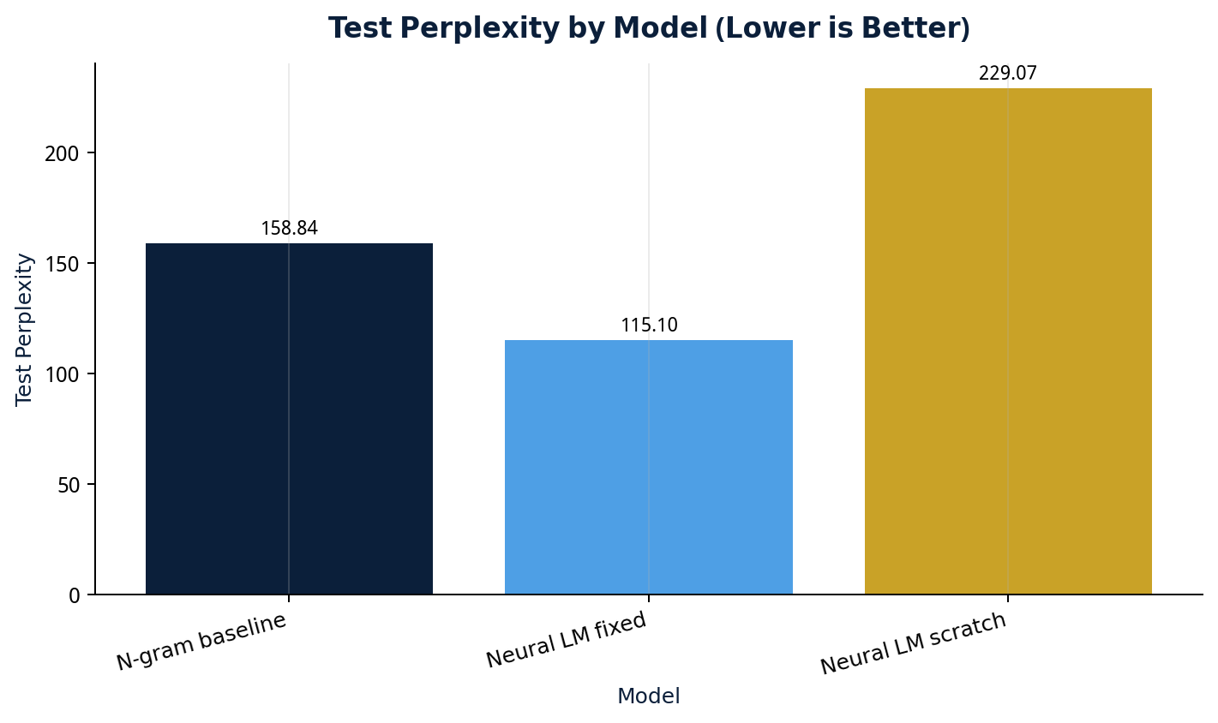
Model Comparison
Model | Test Perplexity
N-gram baseline | 158.84
Neural LM fixed | 115.10
Neural LM scratch | 229.07
Best model: Neural LM fixed skip-gram embeddings.
Perplexity around 115.10.
Lower perplexity is better.

Slide 15
Discussion and Limitations
Fixed skip-gram embeddings helped prediction.
Scratch LM can overfit on small data.
Khmer tokenization remains challenging.
PCA is approximate and loses information.

Slide 16
Streamlit Deployment
Khmer Temple NLP Explorer app.
Default temples.txt and upload .txt for EDA.
Embedding explorer, PCA map, and model comparison.
Ready for GitHub and Streamlit Cloud.

Slide 17
Conclusion
Project satisfies Mini Project 3 requirements.
Khmer skip-gram embeddings were learned.
PCA and neural LM were implemented.
Fixed embedding LM achieved best perplexity.
Future work: larger corpus and stronger tokenizer.

