Slide 1
Text Generation with 4-gram Language Models
19,681
tokens after Khmer segmentation
NLP Mini Project 1 | Khmer Wikipedia Corpus: Angkor Wat Domain
5
LM1 Backoff vs LM2 Interpolation + Add-k Smoothing
related Wikipedia articles
27.22
20-minute presentation
LM1 test perplexity
Data → Preprocessing → 4-gram models → Tuning → Perplexity → Generation demo
01

Slide 2
Presentation Roadmap
Designed for a 20-minute explanation
Problem
→
Corpus
→
Preprocess
→
LM1
→
LM2
→
Results
Vocab
→
Generation
→
Demo
→
Limitations
→
Conclusion
Suggested timing: 1-2 minutes per main concept
Spend more time on model differences and result interpretation
Use the demo near the end to make Part II concrete
02

Slide 3
Project Requirement Mapping
Corpus
Split
5 Khmer Wikipedia articles
70% training, 10% validation, 20% testing
Tokenize
Vocabulary
khmernltk.word_tokenize + split fallback
Cap = 500, remaining tokens → <UNK>
Models
Evaluation
LM1 Backoff, LM2 Interpolation + add-k
Test perplexity + generated examples
03

Slide 4
Corpus: Larger and Topic-Consistent
ប្រាសាទ អង្គរវត្ត
អង្គរធំ
ប្រាសាទបាយ័ន
ខេត្តសៀមរាប
ចក្រភពខ្មែរ
Why combine articles?
One article was too small for a language model. Related articles increase n-gram evidence while keeping the generated text on the Angkor/Khmer history domain.
96,199
19,681
13,776
corpus characters
tokens
training tokens
04

Slide 5
Preprocessing Pipeline
Scrape
→
Clean
→
Segment
→
Split
→
Limit vocab
→
Train
Cleaning choices
Khmer tokenization
Removed English-only lines, article markers, scripts/references, and separated Khmer sentence punctuation.
Used khmernltk.word_tokenize because Khmer word boundaries are not always separated by spaces.
Assignment alignment
Vocabulary is limited and rare/out-of-vocabulary tokens become <UNK>.
05

Slide 6
What Does 4-gram Mean?
A 4-gram model predicts the next token using the previous 3 tokens.
Example context
→
Possible next token
ប្រាសាទ អង្គរវត្ត ជា ___
ប្រាសាទ
The model learns from counted sequences in training data.
It does not understand meaning; it estimates probability from observed patterns.
06

Slide 7
LM1: Backoff 4-gram
Try 4-gram
→
If unseen
→
Try 3-gram
→
Try 2-gram
→
Unigram
Core idea
Why it worked well
Use the longest available context. Back off only when the higher-order n-gram was not observed.
With this corpus, exact local patterns are useful, and backoff avoids zero probability by moving to shorter histories.
07

Slide 8
LM2: Interpolation + Add-k
P = λ1P(unigram) + λ2P(bigram) + λ3P(trigram) + λ4P(4-gram)
Best lambdas
Best k
Interpretation
(0.4, 0.3, 0.2, 0.1) More weight on lower-order n-grams
0.001 Small smoothing for sparse n-grams
The validation set preferred stable lower-order probabilities because exact 4-grams are still sparse.
08

Slide 9
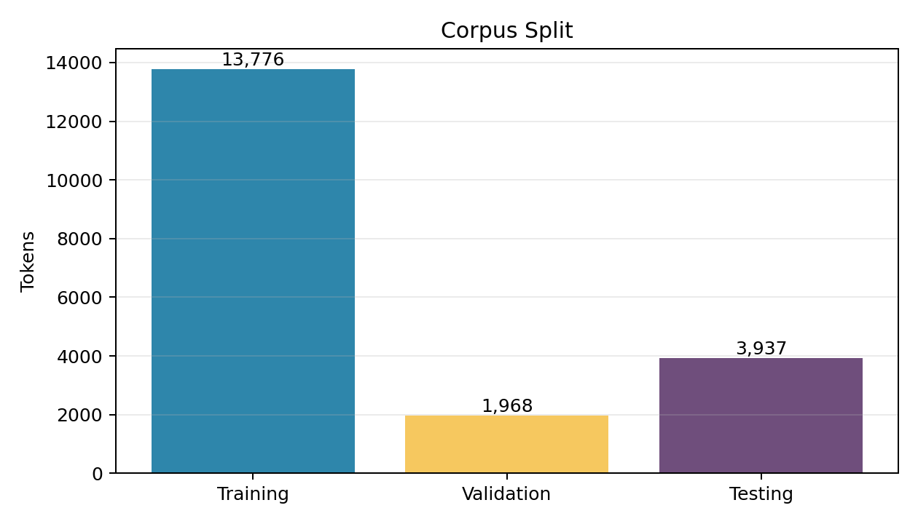
Dataset Split Visualization
Why this matters
Training learns counts. Validation tunes λ and k. Testing gives final unbiased evaluation.
09

Slide 10
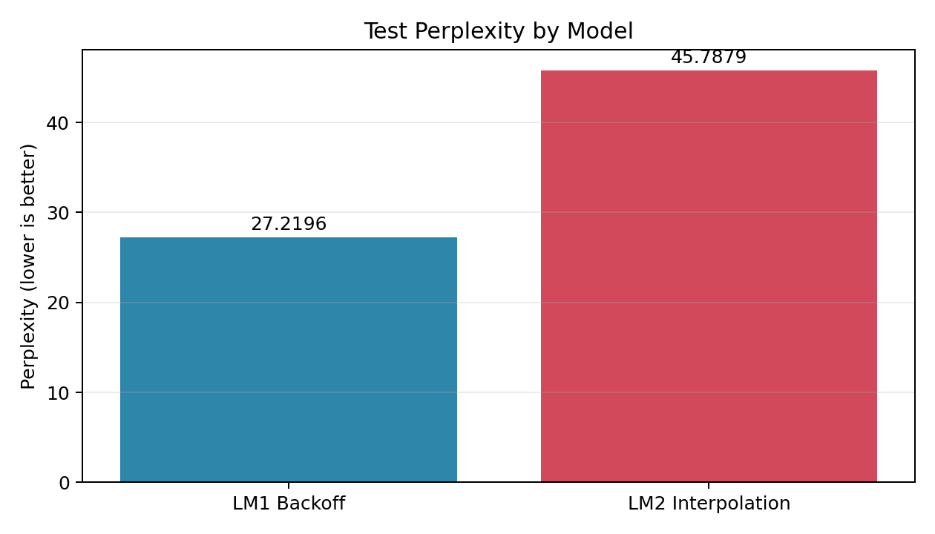
Final Perplexity Results
27.2196
45.7879
LM1 Backoff
LM2 Interpolation
Main finding
Lower perplexity is better. LM1 performs better on this corpus, although LM2 is smoother in theory.
10

Slide 11
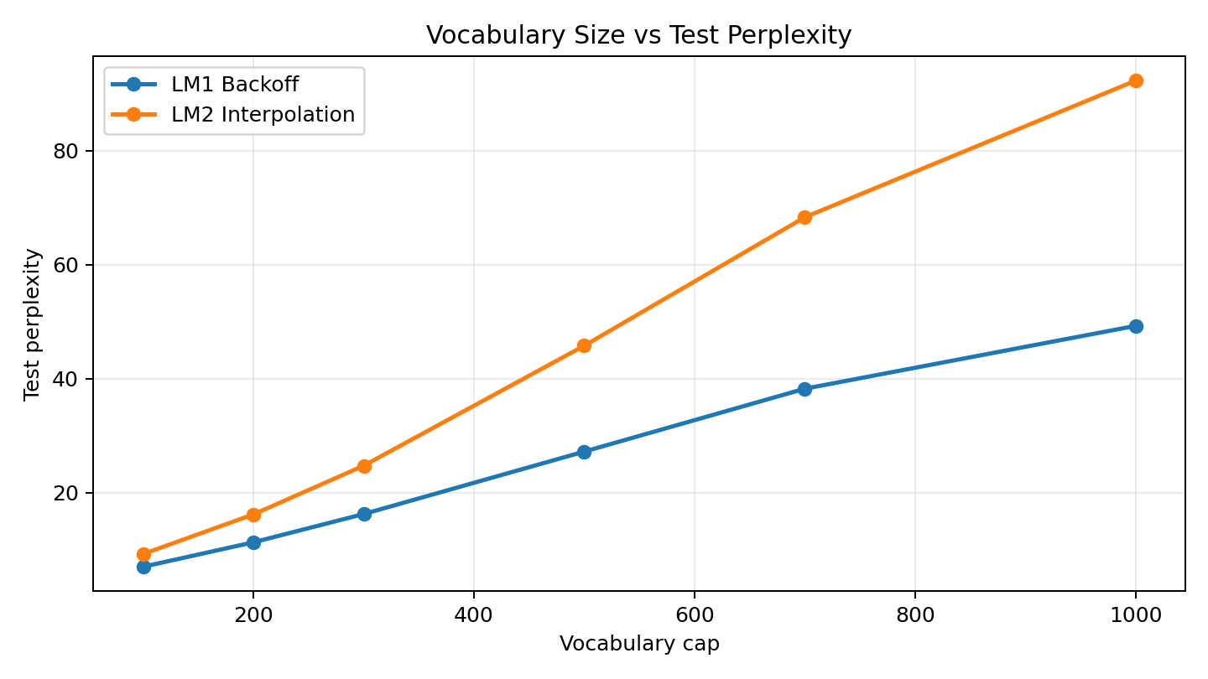
Vocabulary Trade-off
Small vocab
Lower perplexity, but many <UNK> tokens.
Large vocab
More readable words, but sparse counts and higher perplexity.
Chosen balance
Vocabulary size = 500
11

Slide 12
Text Generation Examples
Seed
ប្រាសាទ
LM1 Backoff
LM2 Interpolation
ប្រាសាទ នេះ កសាង នៅ ចុង សតវត្សរ៍ ទី ១២ និង ១៣។
ប្រាសាទ នេះ បង្ហាញ ឲ្យដឹង ថា ត្រូវបាន ទៅជា <UNK> ...
LM1 is cleaner for demo.
LM2 is valid but more mixed due to smoothing and interpolation.
Keep length around 20-30 tokens.
12

Slide 13
Live Demo Plan
Recommended demo settings
What to show
Seed: ប្រាសាទ អង្គរវត្ត Model: LM1 Backoff Length: 20-25
Click Generate Text and explain that each new token is predicted from previous context.
Seed
→
Context
→
Next token
→
Update context
→
Repeat
13

Slide 14
Why LM1 Beat LM2
Reason 1
Reason 2
Backoff uses strong observed local patterns when available.
Interpolation spreads probability across multiple n-gram levels.
Reason 3
Key message
Even with larger corpus, exact 4-grams remain sparse after Khmer segmentation.
LM2 is not guaranteed to beat LM1. The best model depends on corpus, tokenization, vocabulary, and test data.
14

Slide 15
Limitations and Future Work
Generated text is not perfectly natural because n-gram models do not understand meaning.
Some <UNK> remains because vocabulary limiting is required.
Readable output and low perplexity are a trade-off.
Future work: larger corpus, better Khmer segmentation, or neural language models.
How to defend this
The assignment is about implementing and evaluating 4-gram language models, not building a perfect modern chatbot.
15

Slide 16
Conclusion
Built both required 4-gram models.
Used validation to tune λ and k.
Evaluated with perplexity on the test set.
LM1 Backoff performed best: 27.2196 test perplexity.
Created a working text generator demo.
Thank you
16

