Slide 1
NLP Mini Project 1
Khmer 4-Gram Text Generation
Backoff vs Interpolation Language Models using Angkor-related Khmer Wikipedia corpus
19,681
500
27.22
tokens after preprocessing
vocabulary cap
best test perplexity
01

Slide 2
Presentation Roadmap
A 20-minute walkthrough from data to model results.
1. Corpus
2. Preprocess
3. Models
4. Results
Angkor Wat and related Khmer articles
Clean text and tokenize Khmer words
LM1 Backoff and LM2 Interpolation
Perplexity, vocabulary trade-off, demo
The deck follows the assignment structure, then explains the experimental result.
Graphs and tables are placed near the section they support.
The final slides explain why LM1 performs better and what can be improved.
02

Slide 3
Assignment Requirement Mapping
How the notebook satisfies the NLP mini project instructions.
Requirement | Implementation in this project
Corpus | Five Khmer Wikipedia articles about Angkor and Khmer history
Split | 70% train, 10% validation, 20% test
Tokenization | khmernltk.word_tokenize with fallback option
Vocabulary | Top 500 words kept; rare words mapped to <UNK>
Models | LM1 Backoff 4-gram and LM2 Interpolation 4-gram
Evaluation | Perplexity on validation/test data
Generator | Interactive seed-based text generation demo
03

Slide 4
Corpus Source and Scope
A focused historical corpus improves repeated phrase patterns.
Main topic: Angkor Wat and related Khmer historical/cultural articles.
Articles used: Angkor Wat, Angkor Thom, Bayon Temple, Siem Reap Province, Khmer Empire.
Raw fallback corpus size: about 96,199 characters.
The fallback corpus lets the notebook run even when scraping is unavailable.
Why this corpus?
The articles share words such as ប្រាសាទ, អង្គរ, ព្រះបាទ, ឆ្នាំ, and កម្ពុជា, giving the n-gram models stronger local patterns.
04

Slide 5
Preprocessing Pipeline
Turning raw article text into tokens for language modeling.
Raw Article
Clean Text
Tokenize
Vocabulary
Model Data
Wikipedia or fallback corpus
Remove labels and English-only lines
Khmer word segmentation
Keep top 500 tokens
Replace rare words with <UNK>
Key preprocessing choices
Keep punctuation separation so sentence endings can be learned.
Do not remove stop words because language modeling needs grammar words.
Use Khmer segmentation to improve token quality compared with plain split.
05

Slide 6
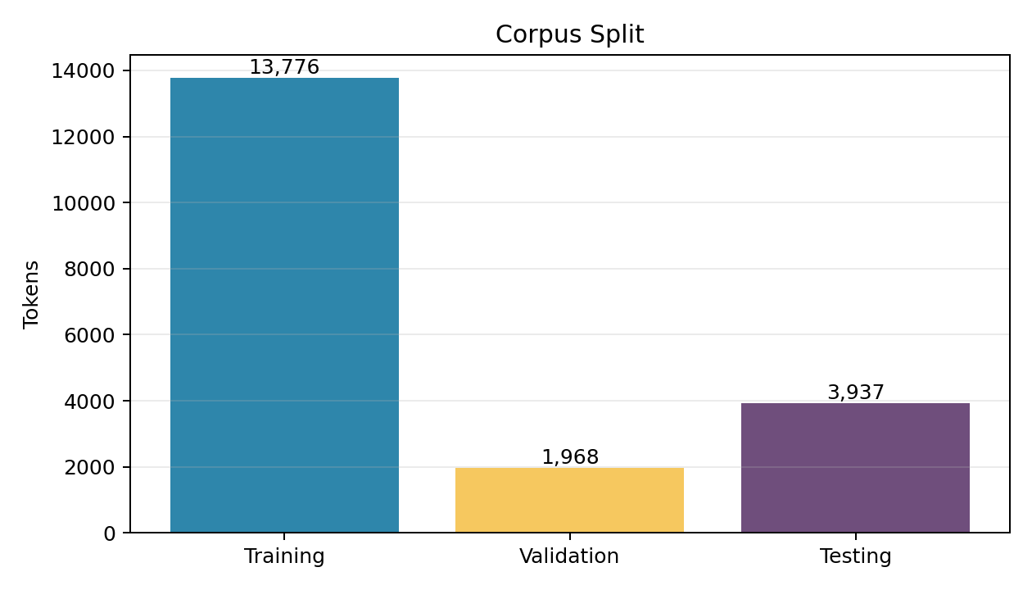
Dataset Split Result
The 70/10/20 split follows the assignment requirement.
13,776
1,968
training tokens
validation tokens
3,937
19,681
testing tokens
total tokens
Why validation matters
Validation data is used to choose LM2 lambda and k values before evaluating on the test set.
06

Slide 7
Vocabulary and <UNK>
Vocabulary limitation is required by the assignment.
Vocabulary cap: 500 most frequent tokens.
Words outside the vocabulary become <UNK>.
<UNK> means unknown token, not one exact recoverable word.
Validation <UNK>: 660 tokens; Test <UNK>: 1,433 tokens.
Token Type | Example / Meaning
Vocabulary word | ប្រាសាទ, អង្គរវត្ត, មាន, ក្នុង
Rare word | Low-frequency names, numbers, long terms
<UNK> | Shared placeholder for rare/out-of-vocabulary words
Generated example
ប្រាសាទ
អង្គរវត្ត
ត្រូវបាន
<UNK>
ក្នុង
ឆ្នាំ
<UNK>
07

Slide 8
How 4-Gram Generation Works
Both models use previous words to predict the next token.
A 4-gram sequence has four tokens:
ប្រាសាទ
អង្គរវត្ត
មាន
កម្ពស់
previous 3 words
predicted next word
The seed provides the starting context.
The generator predicts one token, appends it, then repeats.
If the seed has fewer than three words, shorter contexts are used at the beginning.
08

Slide 9
LM1: Unsmoothed Backoff 4-Gram
Use the most specific context first, then back off if needed.
4-gram
w1 w2 w3 -> next
3-gram
w2 w3 -> next
2-gram
w3 -> next
1-gram
overall frequency
LM1 is strong when the corpus contains repeated phrases.
It performed best in this experiment with test perplexity 27.2196.
Lower perplexity means the model predicts the test text better.
09

Slide 10
LM2: Interpolation with Add-k Smoothing
Combine several probability levels instead of choosing only one.
P(next) = λ1·P1 + λ2·P2 + λ3·P3 + λ4·P4
Parameter | Selected value | Meaning
lambdas | (0.4, 0.3, 0.2, 0.1) | 40% unigram, 30% bigram, 20% trigram, 10% 4-gram
k | 0.001 | Small add-k smoothing value
Validation PP | 47.4493 | Best validation score found in grid search
Test PP | 45.7879 | Final performance on unseen test data
Interpretation
LM2 is theoretically robust, but in this corpus smoothing and sparsity made it less accurate than LM1.
10

Slide 11
Hyperparameter Tuning
LM2 parameters were selected using validation perplexity.
Tested multiple lambda combinations for unigram, bigram, trigram, and 4-gram weights.
Tested k values: 0.001, 0.005, 0.01, 0.02, 0.05, 0.10.
Selected the setting with the lowest validation perplexity.
Best result: lambdas=(0.4, 0.3, 0.2, 0.1), k=0.001.
Why tune?
Different corpora need different smoothing and probability weights.
Selection rule
Choose lowest validation perplexity before testing.
Final LM2
Validation PP: 47.4493
11

Slide 12
Main Result Table
The final comparison shows LM1 is the better model for this corpus.
Model | Method | Best parameters | Validation PP | Test PP
LM1 | Unsmoothed backoff 4-gram | No lambda/k | - | 27.2196
LM2 | Interpolation + add-k | λ=(0.4,0.3,0.2,0.1), k=0.001 | 47.4493 | 45.7879
27.2196
45.7879
Conclusion from table
Lower perplexity is better, so LM1 Backoff is selected as the stronger final model for this experiment.
LM1 test perplexity
LM2 test perplexity
12

Slide 13
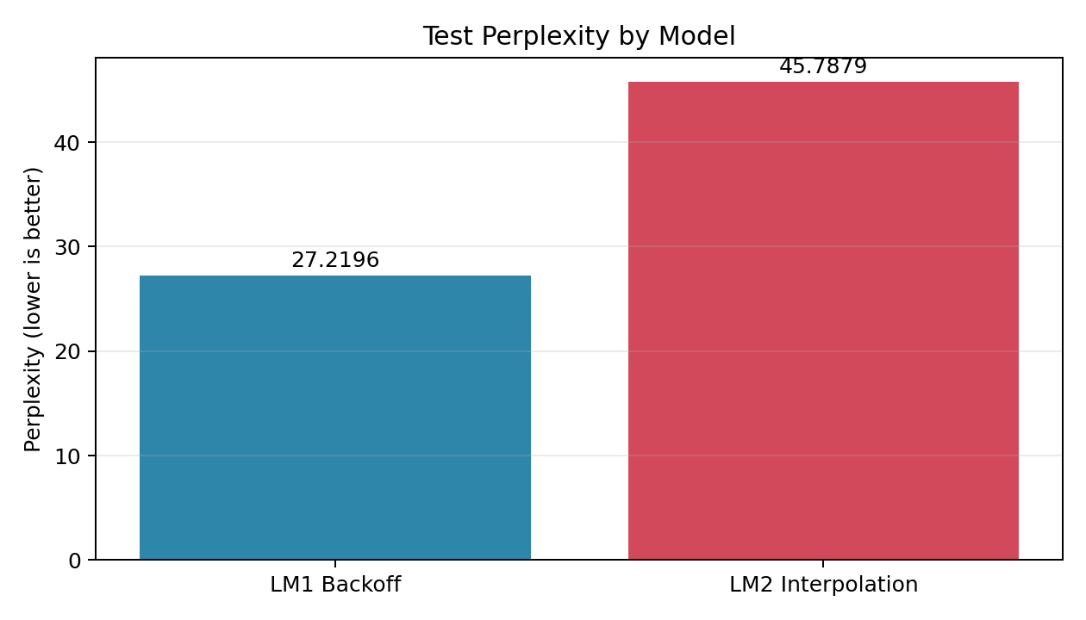
Model Perplexity Graph
Visual comparison of final test perplexity.
LM1 has lower perplexity than LM2.
This means LM1 gives higher probability to the actual test sequence.
The result does not mean interpolation is bad; it means this corpus/setting favored backoff.
Key message
For the final notebook result, LM1 is easier to defend because it has the best test perplexity.
13

Slide 14
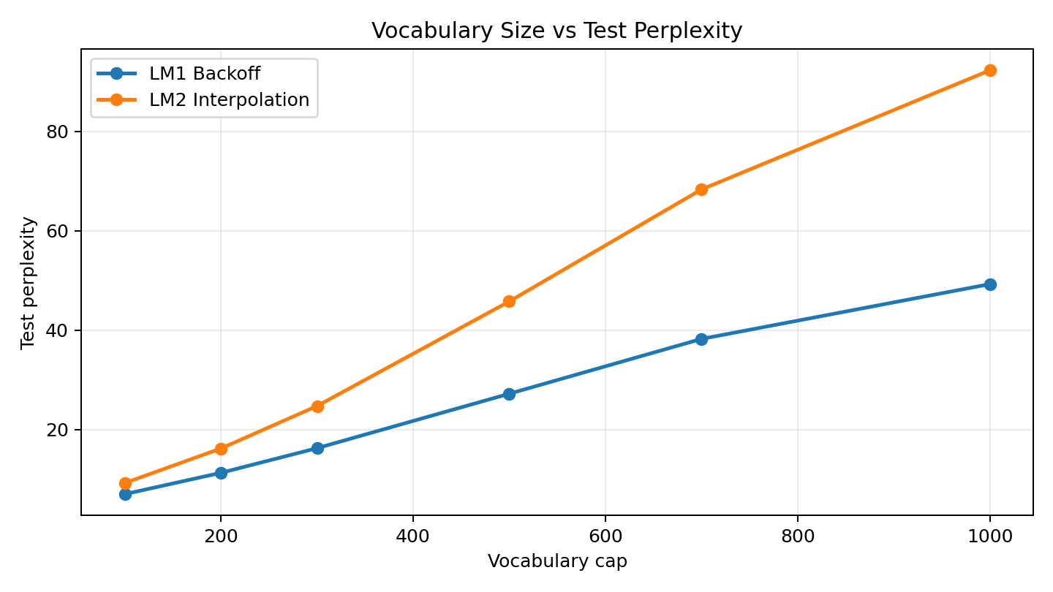
Vocabulary Size vs Perplexity
Readability and probability are in tension.
Vocabulary sizes tested: 100, 200, 300, 500, 700, 1000.
Larger vocabulary reduces <UNK> but creates sparser n-gram counts.
In this experiment, perplexity increased when vocabulary became too large.
Vocabulary cap 500 was chosen as a practical balance.
14

Slide 15
Text Generation Demo
The demo lets a user test the model with a seed phrase.
Seed
Raw Text
Example: ប្រាសាទ អង្គរវត្ត
Shows the real output, including <UNK>.
Model Selector
Choose LM1 Backoff or LM2 Interpolation
Clean Text
Removes <UNK> only for easier reading.
Length
Controls how many tokens the model generates
Important: clean text is for display only; evaluation uses the real processed tokens.
15

Slide 16
Interpreting <UNK> in Generated Text
The exact original word behind <UNK> cannot be recovered.
Generated:
ប្រាសាទ អង្គរវត្ត ត្រូវបាន <UNK> ក្នុង ឆ្នាំ <UNK> ...
Possible original article phrase:
ប្រាសាទ អង្គរវត្ត ត្រូវបាន កសាងឡើង ក្នុង ឆ្នាំ ១១២២ ...
The possible phrase is inferred from article context.
The model itself only predicted the <UNK> category.
This limitation is caused by replacing many rare words with one shared token.
16

Slide 17
Why LM1 Performed Better
The result is explainable from corpus size and sparsity.
Repeated phrases
Sparse 4-grams
Smoothing spread
Backoff benefits when the article repeats exact local patterns.
Khmer segmentation and rare words make many contexts infrequent.
LM2 gives small probability to many tokens, which can increase perplexity.
LM2 is not automatically better in every corpus.
Interpolation usually helps when lambda and smoothing match the data well.
For this project, the validation-tuned LM2 still had higher test perplexity than LM1.
17

Slide 18
Limitations and Future Improvements
The project is complete, but the model has natural n-gram limits.
Generated Khmer text is sometimes not fully natural.
<UNK> tokens reduce readability.
Larger vocabulary reduces <UNK> but can worsen perplexity.
N-gram models do not understand semantic meaning.
Future improvements: larger corpus, stronger Khmer segmentation, better smoothing, and richer evaluation examples.
Submission position
The notebook stays strict to the assignment: 4-gram LM1, LM2, validation tuning, test perplexity, and generator.
18

Slide 19
Conclusion
The project successfully demonstrates classical Khmer n-gram language modeling.
LM1
27.22
500
4-gram
best final model
lowest test perplexity
vocabulary cap
previous 3 words -> next
Corpus quality, tokenization, vocabulary size, and smoothing strongly affect results.
Backoff performed better than interpolation on this specific corpus.
The interactive demo makes the model behavior clear through seed, length, raw text, and clean text.
Thank you
19

