Slide 1
Utilizing “Abstract Factory”
EditPartner form has multiple variants
Integration
Interface
Connection
Each variant has multiple sub-variants for each service type
webMethods
ActiveTransfer
SAP PO
webMethods IO
Etc.

Slide 2
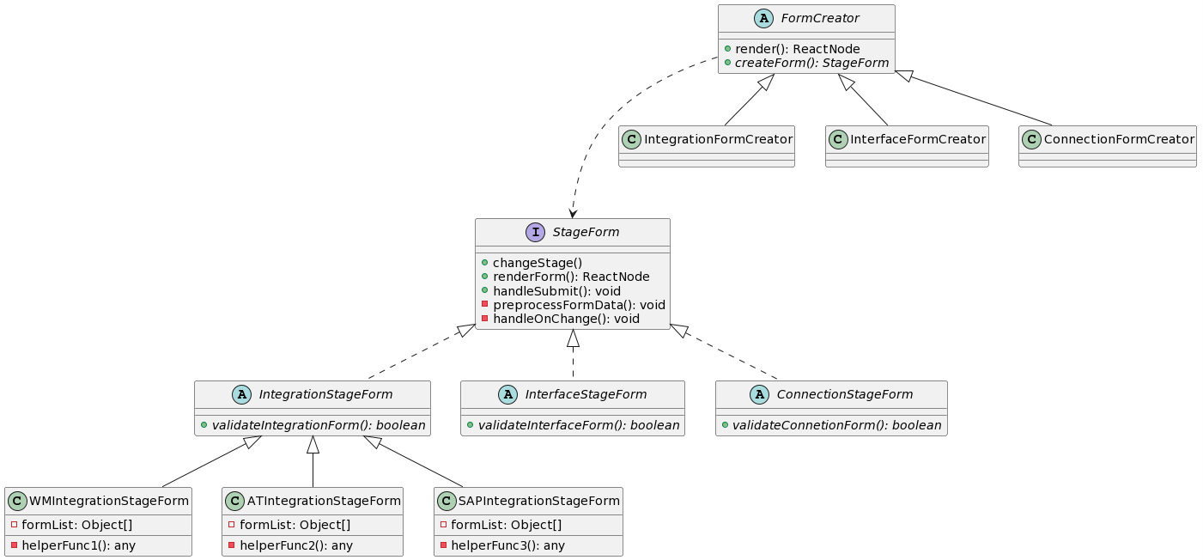
@startuml
interface StageForm{
+ changeStage()
+ renderForm(): ReactNode
+ handleSubmit(): void
- preprocessFormData(): void
- handleOnChange(): void
}
abstract class IntegrationStageForm implements StageForm{
+ {abstract} validateIntegrationForm(): boolean
}
abstract class InterfaceStageForm implements StageForm{
+ {abstract} validateInterfaceForm(): boolean
}
abstract class ConnectionStageForm implements StageForm{
+ {abstract} validateConnetionForm(): boolean
}
class WMIntegrationStageForm extends IntegrationStageForm {
- formList: Object[]
- helperFunc1(): any
}
class ATIntegrationStageForm extends IntegrationStageForm {
- formList: Object[]
- helperFunc2(): any
}
class SAPIntegrationStageForm extends IntegrationStageForm {
- formList: Object[]
- helperFunc3(): any
}
abstract class FormCreator{
+ render(): ReactNode
+ {abstract} createForm(): StageForm
}
class IntegrationFormCreator extends FormCreator{}
class InterfaceFormCreator extends FormCreator{}
class ConnectionFormCreator extends FormCreator{}
FormCreator ...> StageForm
@enduml
Factory (Friday idea) => Don’t suit the use case

Slide 3
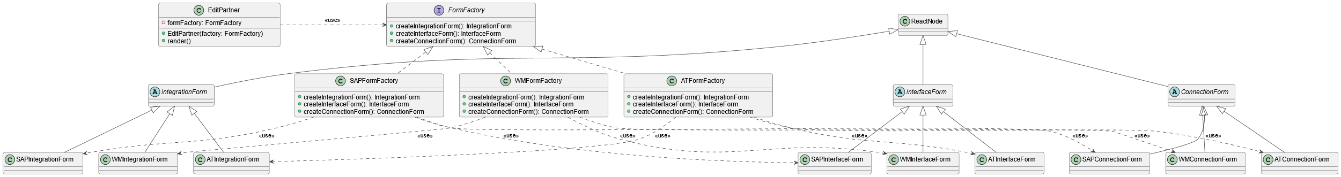
@startuml
!theme vibrant
class ReactNode{}
class EditPartner{
- formFactory: FormFactory
+ EditPartner(factory: FormFactory)
+ render()
}
together {
interface FormFactory{
+ createIntegrationForm(): IntegrationForm
+ createInterfaceForm(): InterfaceForm
+ createConnectionForm(): ConnectionForm
}
class WMFormFactory implements FormFactory{
+ createIntegrationForm(): IntegrationForm
+ createInterfaceForm(): InterfaceForm
+ createConnectionForm(): ConnectionForm
}
class ATFormFactory implements FormFactory{
+ createIntegrationForm(): IntegrationForm
+ createInterfaceForm(): InterfaceForm
+ createConnectionForm(): ConnectionForm
}
class SAPFormFactory implements FormFactory{
+ createIntegrationForm(): IntegrationForm
+ createInterfaceForm(): InterfaceForm
+ createConnectionForm(): ConnectionForm
}
}
together {
abstract class IntegrationForm extends ReactNode{}
class WMIntegrationForm extends IntegrationForm{}
class ATIntegrationForm extends IntegrationForm{}
class SAPIntegrationForm extends IntegrationForm{}
}
together {
abstract class InterfaceForm extends ReactNode{}
class WMInterfaceForm extends InterfaceForm{}
class ATInterfaceForm extends InterfaceForm{}
class SAPInterfaceForm extends InterfaceForm{}
}
together {
abstract class ConnectionForm extends ReactNode{}
class WMConnectionForm extends ConnectionForm{}
class ATConnectionForm extends ConnectionForm{}
class SAPConnectionForm extends ConnectionForm{}
}
EditPartner .Right.> FormFactory: <<use>>
WMFormFactory .down.> WMIntegrationForm: <<use>>
WMFormFactory .down.> WMInterfaceForm: <<use>>
WMFormFactory .down.> WMConnectionForm: <<use>>
ATFormFactory .down.> ATIntegrationForm: <<use>>
ATFormFactory .down.> ATInterfaceForm: <<use>>
ATFormFactory .down.> ATConnectionForm: <<use>>
SAPFormFactory .down.> SAPIntegrationForm: <<use>>
SAPFormFactory .down.> SAPInterfaceForm: <<use>>
SAPFormFactory .down.> SAPConnectionForm: <<use>>
@enduml
Abstract Factory (Monday idea)

Slide 4
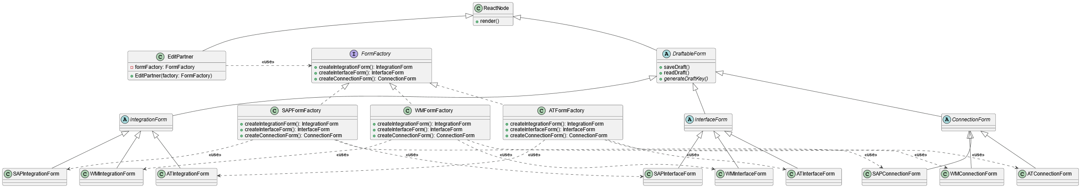

@startuml
!theme vibrant
class ReactNode{
+ render()
}
class EditPartner extends ReactNode{
- formFactory: FormFactory
+ EditPartner(factory: FormFactory)
}
together {
interface FormFactory{
+ createIntegrationForm(): IntegrationForm
+ createInterfaceForm(): InterfaceForm
+ createConnectionForm(): ConnectionForm
}
class WMFormFactory implements FormFactory{
+ createIntegrationForm(): IntegrationForm
+ createInterfaceForm(): InterfaceForm
+ createConnectionForm(): ConnectionForm
}
class ATFormFactory implements FormFactory{
+ createIntegrationForm(): IntegrationForm
+ createInterfaceForm(): InterfaceForm
+ createConnectionForm(): ConnectionForm
}
class SAPFormFactory implements FormFactory{
+ createIntegrationForm(): IntegrationForm
+ createInterfaceForm(): InterfaceForm
+ createConnectionForm(): ConnectionForm
}
}
abstract class DraftableForm extends ReactNode {
+ saveDraft()
+ readDraft()
+ {abstract} generateDraftKey()
}
together {
abstract class IntegrationForm extends DraftableForm {}
class WMIntegrationForm extends IntegrationForm{}
class ATIntegrationForm extends IntegrationForm{}
class SAPIntegrationForm extends IntegrationForm{}
}
together {
abstract class InterfaceForm extends DraftableForm {}
class WMInterfaceForm extends InterfaceForm{}
class ATInterfaceForm extends InterfaceForm{}
class SAPInterfaceForm extends InterfaceForm{}
}
together {
abstract class ConnectionForm extends DraftableForm {}
class WMConnectionForm extends ConnectionForm{}
class ATConnectionForm extends ConnectionForm{}
class SAPConnectionForm extends ConnectionForm{}
}
EditPartner .Right.> FormFactory: <<use>>
WMFormFactory .down.> WMIntegrationForm: <<use>>
WMFormFactory .down.> WMInterfaceForm: <<use>>
WMFormFactory .down.> WMConnectionForm: <<use>>
ATFormFactory .down.> ATIntegrationForm: <<use>>
ATFormFactory .down.> ATInterfaceForm: <<use>>
ATFormFactory .down.> ATConnectionForm: <<use>>
SAPFormFactory .down.> SAPIntegrationForm: <<use>>
SAPFormFactory .down.> SAPInterfaceForm: <<use>>
SAPFormFactory .down.> SAPConnectionForm: <<use>>
@enduml
Friday Morning Class Diagram
Added DraftableForm abstract class
saveDraft(),readDraft() is implemented here

Slide 5
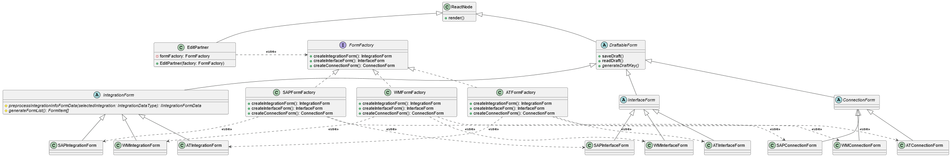

@startuml
!theme vibrant
class ReactNode{
+ render()
}
class EditPartner extends ReactNode{
- formFactory: FormFactory
+ EditPartner(factory: FormFactory)
}
together {
interface FormFactory{
+ createIntegrationForm(): IntegrationForm
+ createInterfaceForm(): InterfaceForm
+ createConnectionForm(): ConnectionForm
}
class WMFormFactory implements FormFactory{
+ createIntegrationForm(): IntegrationForm
+ createInterfaceForm(): InterfaceForm
+ createConnectionForm(): ConnectionForm
}
class ATFormFactory implements FormFactory{
+ createIntegrationForm(): IntegrationForm
+ createInterfaceForm(): InterfaceForm
+ createConnectionForm(): ConnectionForm
}
class SAPFormFactory implements FormFactory{
+ createIntegrationForm(): IntegrationForm
+ createInterfaceForm(): InterfaceForm
+ createConnectionForm(): ConnectionForm
}
}
abstract class DraftableForm extends ReactNode {
+ saveDraft()
+ readDraft()
+ {abstract} generateDraftKey()
}
together {
abstract class IntegrationForm extends DraftableForm {
# {abstract} preprocessIntegrationInfoFormData(selectedIntegration: IntegrationDataType): IIntegrationFormData
# {abstract} generateFormList(): FormItem[]
}
class WMIntegrationForm extends IntegrationForm{}
class ATIntegrationForm extends IntegrationForm{}
class SAPIntegrationForm extends IntegrationForm{}
}
together {
abstract class InterfaceForm extends DraftableForm {}
class WMInterfaceForm extends InterfaceForm{}
class ATInterfaceForm extends InterfaceForm{}
class SAPInterfaceForm extends InterfaceForm{}
}
together {
abstract class ConnectionForm extends DraftableForm {}
class WMConnectionForm extends ConnectionForm{}
class ATConnectionForm extends ConnectionForm{}
class SAPConnectionForm extends ConnectionForm{}
}
EditPartner .Right.> FormFactory: <<use>>
WMFormFactory .down.> WMIntegrationForm: <<use>>
WMFormFactory .down.> WMInterfaceForm: <<use>>
WMFormFactory .down.> WMConnectionForm: <<use>>
ATFormFactory .down.> ATIntegrationForm: <<use>>
ATFormFactory .down.> ATInterfaceForm: <<use>>
ATFormFactory .down.> ATConnectionForm: <<use>>
SAPFormFactory .down.> SAPIntegrationForm: <<use>>
SAPFormFactory .down.> SAPInterfaceForm: <<use>>
SAPFormFactory .down.> SAPConnectionForm: <<use>>
@enduml
Friday Afternoon Class Diagram
Added abstract method to IntegrationForm
generateFormList()
preprocessIntegrationInfoFormData

