Slide 1
EditIntegration refactor plan

Slide 2
Introduction

Slide 3
Utilizing “Abstract Factory”
EditIntegration form has multiple variants
Integration
Interface
Connection
Each variant has multiple sub-variants for each service type
webMethods
ActiveTransfer
SAP PO
webMethods IO
Etc.

Slide 4
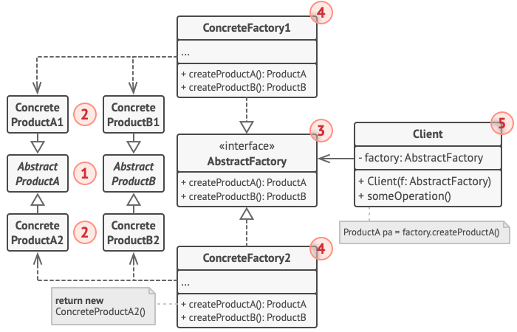
What is Abstract Factory
Creational Design pattern
Create “Group of Related object” without specifying concrete class
Related object => Integration stage form for each platform type
Source: https://refactoring.guru/design-patterns/abstract-factory

Slide 5
Design progress
PlantUML script are provided.

Slide 6
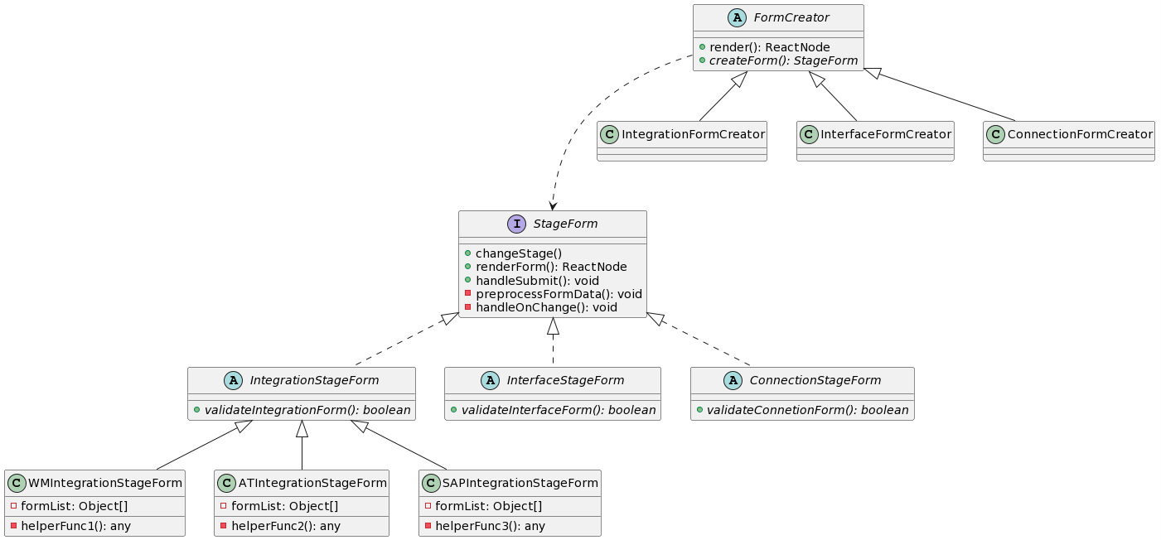
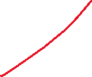
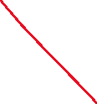
@startuml
interface StageForm{
+ changeStage()
+ renderForm(): ReactNode
+ handleSubmit(): void
- preprocessFormData(): void
- handleOnChange(): void
}
abstract class IntegrationStageForm implements StageForm{
+ {abstract} validateIntegrationForm(): boolean
}
abstract class InterfaceStageForm implements StageForm{
+ {abstract} validateInterfaceForm(): boolean
}
abstract class ConnectionStageForm implements StageForm{
+ {abstract} validateConnetionForm(): boolean
}
class WMIntegrationStageForm extends IntegrationStageForm {
- formList: Object[]
- helperFunc1(): any
}
class ATIntegrationStageForm extends IntegrationStageForm {
- formList: Object[]
- helperFunc2(): any
}
class SAPIntegrationStageForm extends IntegrationStageForm {
- formList: Object[]
- helperFunc3(): any
}
abstract class FormCreator{
+ render(): ReactNode
+ {abstract} createForm(): StageForm
}
class IntegrationFormCreator extends FormCreator{}
class InterfaceFormCreator extends FormCreator{}
class ConnectionFormCreator extends FormCreator{}
FormCreator ...> StageForm
@enduml
Factory (Friday idea) => Don’t suit the use case

Slide 7
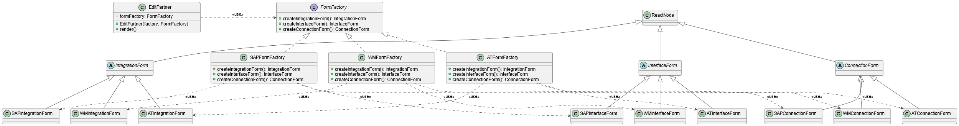
@startuml
!theme vibrant
class ReactNode{}
class EditPartner{
- formFactory: FormFactory
+ EditPartner(factory: FormFactory)
+ render()
}
together {
interface FormFactory{
+ createIntegrationForm(): IntegrationForm
+ createInterfaceForm(): InterfaceForm
+ createConnectionForm(): ConnectionForm
}
class WMFormFactory implements FormFactory{
+ createIntegrationForm(): IntegrationForm
+ createInterfaceForm(): InterfaceForm
+ createConnectionForm(): ConnectionForm
}
class ATFormFactory implements FormFactory{
+ createIntegrationForm(): IntegrationForm
+ createInterfaceForm(): InterfaceForm
+ createConnectionForm(): ConnectionForm
}
class SAPFormFactory implements FormFactory{
+ createIntegrationForm(): IntegrationForm
+ createInterfaceForm(): InterfaceForm
+ createConnectionForm(): ConnectionForm
}
}
together {
abstract class IntegrationForm extends ReactNode{}
class WMIntegrationForm extends IntegrationForm{}
class ATIntegrationForm extends IntegrationForm{}
class SAPIntegrationForm extends IntegrationForm{}
}
together {
abstract class InterfaceForm extends ReactNode{}
class WMInterfaceForm extends InterfaceForm{}
class ATInterfaceForm extends InterfaceForm{}
class SAPInterfaceForm extends InterfaceForm{}
}
together {
abstract class ConnectionForm extends ReactNode{}
class WMConnectionForm extends ConnectionForm{}
class ATConnectionForm extends ConnectionForm{}
class SAPConnectionForm extends ConnectionForm{}
}
EditPartner .Right.> FormFactory: <<use>>
WMFormFactory .down.> WMIntegrationForm: <<use>>
WMFormFactory .down.> WMInterfaceForm: <<use>>
WMFormFactory .down.> WMConnectionForm: <<use>>
ATFormFactory .down.> ATIntegrationForm: <<use>>
ATFormFactory .down.> ATInterfaceForm: <<use>>
ATFormFactory .down.> ATConnectionForm: <<use>>
SAPFormFactory .down.> SAPIntegrationForm: <<use>>
SAPFormFactory .down.> SAPInterfaceForm: <<use>>
SAPFormFactory .down.> SAPConnectionForm: <<use>>
@enduml
Abstract Factory (Monday idea)

Slide 8
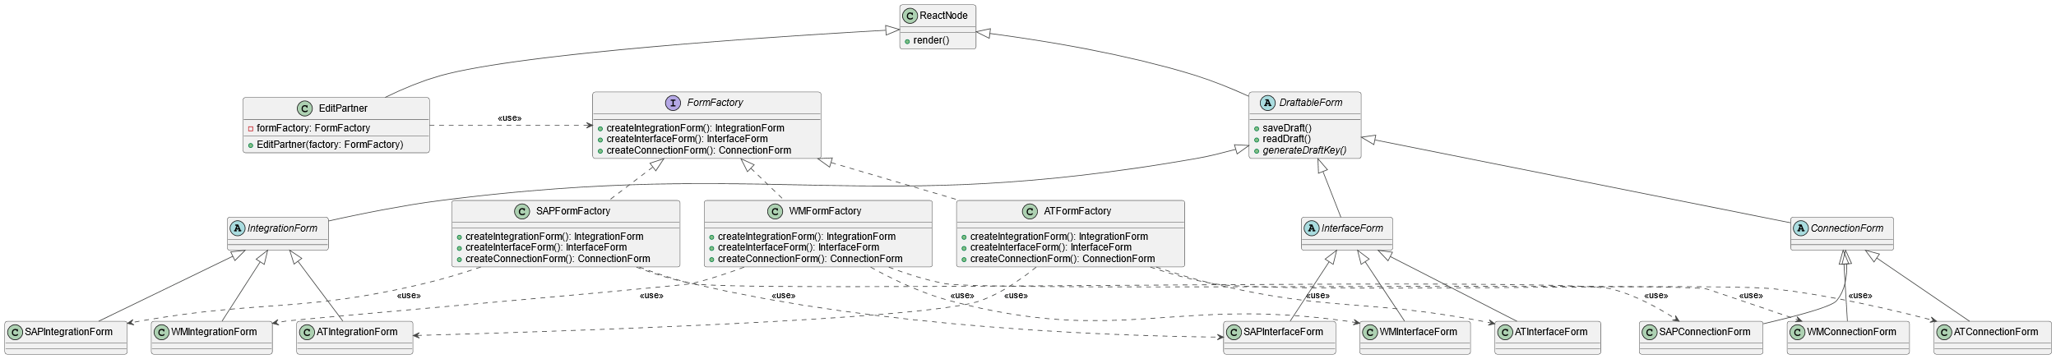

@startuml
!theme vibrant
class ReactNode{
+ render()
}
class EditPartner extends ReactNode{
- formFactory: FormFactory
+ EditPartner(factory: FormFactory)
}
together {
interface FormFactory{
+ createIntegrationForm(): IntegrationForm
+ createInterfaceForm(): InterfaceForm
+ createConnectionForm(): ConnectionForm
}
class WMFormFactory implements FormFactory{
+ createIntegrationForm(): IntegrationForm
+ createInterfaceForm(): InterfaceForm
+ createConnectionForm(): ConnectionForm
}
class ATFormFactory implements FormFactory{
+ createIntegrationForm(): IntegrationForm
+ createInterfaceForm(): InterfaceForm
+ createConnectionForm(): ConnectionForm
}
class SAPFormFactory implements FormFactory{
+ createIntegrationForm(): IntegrationForm
+ createInterfaceForm(): InterfaceForm
+ createConnectionForm(): ConnectionForm
}
}
abstract class DraftableForm extends ReactNode {
+ saveDraft()
+ readDraft()
+ {abstract} generateDraftKey()
}
together {
abstract class IntegrationForm extends DraftableForm {}
class WMIntegrationForm extends IntegrationForm{}
class ATIntegrationForm extends IntegrationForm{}
class SAPIntegrationForm extends IntegrationForm{}
}
together {
abstract class InterfaceForm extends DraftableForm {}
class WMInterfaceForm extends InterfaceForm{}
class ATInterfaceForm extends InterfaceForm{}
class SAPInterfaceForm extends InterfaceForm{}
}
together {
abstract class ConnectionForm extends DraftableForm {}
class WMConnectionForm extends ConnectionForm{}
class ATConnectionForm extends ConnectionForm{}
class SAPConnectionForm extends ConnectionForm{}
}
EditPartner .Right.> FormFactory: <<use>>
WMFormFactory .down.> WMIntegrationForm: <<use>>
WMFormFactory .down.> WMInterfaceForm: <<use>>
WMFormFactory .down.> WMConnectionForm: <<use>>
ATFormFactory .down.> ATIntegrationForm: <<use>>
ATFormFactory .down.> ATInterfaceForm: <<use>>
ATFormFactory .down.> ATConnectionForm: <<use>>
SAPFormFactory .down.> SAPIntegrationForm: <<use>>
SAPFormFactory .down.> SAPInterfaceForm: <<use>>
SAPFormFactory .down.> SAPConnectionForm: <<use>>
@enduml
Friday Morning Class Diagram
Added DraftableForm abstract class
saveDraft(),readDraft() is implemented here

Slide 9
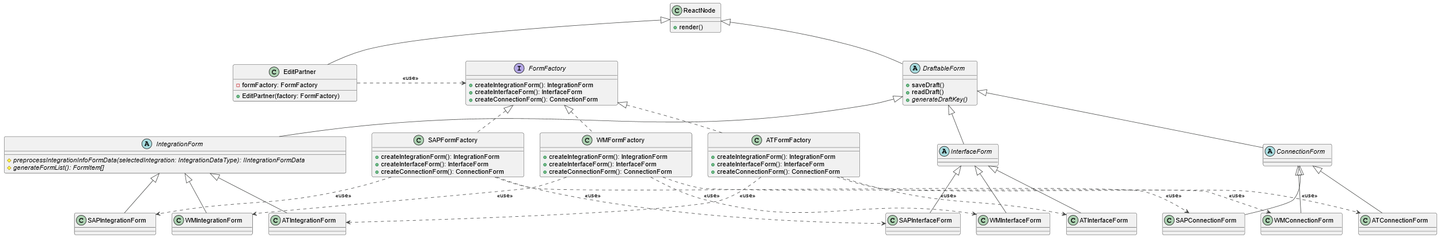

@startuml
!theme vibrant
class ReactNode{
+ render()
}
class EditPartner extends ReactNode{
- formFactory: FormFactory
+ EditPartner(factory: FormFactory)
}
together {
interface FormFactory{
+ createIntegrationForm(): IntegrationForm
+ createInterfaceForm(): InterfaceForm
+ createConnectionForm(): ConnectionForm
}
class WMFormFactory implements FormFactory{
+ createIntegrationForm(): IntegrationForm
+ createInterfaceForm(): InterfaceForm
+ createConnectionForm(): ConnectionForm
}
class ATFormFactory implements FormFactory{
+ createIntegrationForm(): IntegrationForm
+ createInterfaceForm(): InterfaceForm
+ createConnectionForm(): ConnectionForm
}
class SAPFormFactory implements FormFactory{
+ createIntegrationForm(): IntegrationForm
+ createInterfaceForm(): InterfaceForm
+ createConnectionForm(): ConnectionForm
}
}
abstract class DraftableForm extends ReactNode {
+ saveDraft()
+ readDraft()
+ {abstract} generateDraftKey()
}
together {
abstract class IntegrationForm extends DraftableForm {
# {abstract} preprocessIntegrationInfoFormData(selectedIntegration: IntegrationDataType): IIntegrationFormData
# {abstract} generateFormList(): FormItem[]
}
class WMIntegrationForm extends IntegrationForm{}
class ATIntegrationForm extends IntegrationForm{}
class SAPIntegrationForm extends IntegrationForm{}
}
together {
abstract class InterfaceForm extends DraftableForm {}
class WMInterfaceForm extends InterfaceForm{}
class ATInterfaceForm extends InterfaceForm{}
class SAPInterfaceForm extends InterfaceForm{}
}
together {
abstract class ConnectionForm extends DraftableForm {}
class WMConnectionForm extends ConnectionForm{}
class ATConnectionForm extends ConnectionForm{}
class SAPConnectionForm extends ConnectionForm{}
}
EditPartner .Right.> FormFactory: <<use>>
WMFormFactory .down.> WMIntegrationForm: <<use>>
WMFormFactory .down.> WMInterfaceForm: <<use>>
WMFormFactory .down.> WMConnectionForm: <<use>>
ATFormFactory .down.> ATIntegrationForm: <<use>>
ATFormFactory .down.> ATInterfaceForm: <<use>>
ATFormFactory .down.> ATConnectionForm: <<use>>
SAPFormFactory .down.> SAPIntegrationForm: <<use>>
SAPFormFactory .down.> SAPInterfaceForm: <<use>>
SAPFormFactory .down.> SAPConnectionForm: <<use>>
@enduml
Friday Afternoon Class Diagram
Added abstract method to IntegrationForm
generateFormList()
preprocessIntegrationInfoFormData

Slide 10
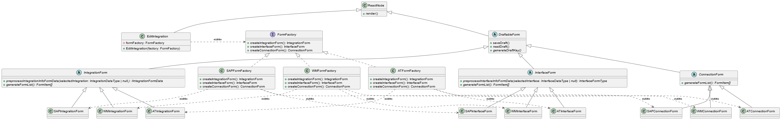
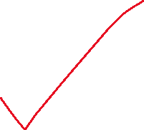

@startuml
!theme vibrant
class ReactNode{
+ render()
}
class EditIntegration extends ReactNode{
- formFactory: FormFactory
+ EditIntegration(factory: FormFactory)
}
together {
interface FormFactory{
+ createIntegrationForm(): IntegrationForm
+ createInterfaceForm(): InterfaceForm
+ createConnectionForm(): ConnectionForm
}
class WMFormFactory implements FormFactory{
+ createIntegrationForm(): IntegrationForm
+ createInterfaceForm(): InterfaceForm
+ createConnectionForm(): ConnectionForm
}
class ATFormFactory implements FormFactory{
+ createIntegrationForm(): IntegrationForm
+ createInterfaceForm(): InterfaceForm
+ createConnectionForm(): ConnectionForm
}
class SAPFormFactory implements FormFactory{
+ createIntegrationForm(): IntegrationForm
+ createInterfaceForm(): InterfaceForm
+ createConnectionForm(): ConnectionForm
}
}
abstract class DraftableForm extends ReactNode {
+ saveDraft()
+ readDraft()
+ {abstract} generateDraftKey()
}
together {
abstract class IntegrationForm extends DraftableForm {
+ {abstract} preprocessIntegrationInfoFormData(selectedIntegration: IntegrationDataType | null,): IIntegrationFormData
+ {abstract} generateFormList(): FormItem[]
}
class WMIntegrationForm extends IntegrationForm{}
class ATIntegrationForm extends IntegrationForm{}
class SAPIntegrationForm extends IntegrationForm{}
}
together {
abstract class InterfaceForm extends DraftableForm {
+ {abstract} preprocessInterfaceInfoFormData(selectedInterface: InterfaceDataType | null): InterfaceFormType
+ {abstract} generateFormList(): FormItem[]
}
class WMInterfaceForm extends InterfaceForm{}
class ATInterfaceForm extends InterfaceForm{}
class SAPInterfaceForm extends InterfaceForm{}
}
together {
abstract class ConnectionForm extends DraftableForm {
+ {abstract} generateFormList(): FormItem[]
}
class WMConnectionForm extends ConnectionForm{}
class ATConnectionForm extends ConnectionForm{}
class SAPConnectionForm extends ConnectionForm{}
}
EditIntegration .Right.> FormFactory: <<use>>
WMFormFactory .down.> WMIntegrationForm: <<use>>
WMFormFactory .down.> WMInterfaceForm: <<use>>
WMFormFactory .down.> WMConnectionForm: <<use>>
ATFormFactory .down.> ATIntegrationForm: <<use>>
ATFormFactory .down.> ATInterfaceForm: <<use>>
ATFormFactory .down.> ATConnectionForm: <<use>>
SAPFormFactory .down.> SAPIntegrationForm: <<use>>
SAPFormFactory .down.> SAPInterfaceForm: <<use>>
SAPFormFactory .down.> SAPConnectionForm: <<use>>
@enduml
Final Diagram
- ConnectionForm will be implemented differently
Renamed to EditIntegration

Slide 12
Summary
XXFormFactory abstract class implemented FormFactory interface
XXForm class extends DraftableForm abstract class
DraftableForm is generic class with 2 params <P extends DraftableFormProps, S extends DraftableFormState>
Implemented this way to enable ability to add more prop/state to sub-class
Usually, XXForm will render ReusableForm (more about this in the next section)
XXForm will implemented all abstract method

Slide 13
Notes

Slide 14
Regarding useEffect, useState, useContext
Class component can’t use React Hook
For useEffect hook, use component lifecycle method to update the data
For useState hook, use this.state and setState() to update state value
For useContext hook, specified contextType and use with this.context

Slide 15
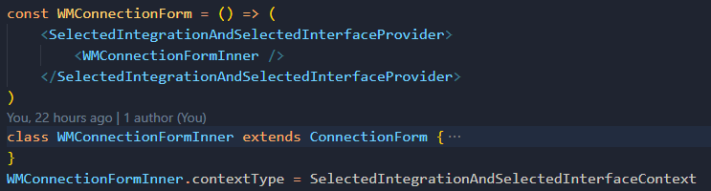
Regarding context
Class component can only use one context
To use multiple context in class component,
create a provider that combined multiple contexts together.
Wrapped the component that will make use of combined context with the provider
Set contextType to be the created provider

Slide 16
Other hooks in class component
Design pattern is based on Object-Oriented concept
Must use class component to achieved
Old components are functional component which utilized heavy usage of React Hook
Class component can’t use hook
This link could be useful to make use of the hook in class component.
https://www.glennstovall.com/how-to-use-useeffect-and-other-hooks-in-class-components/

Slide 17
Draft key generation
Draft key generated from generateDraftKey() will be consumed by saveDraft() and readDraft()
Suggested key pattern is the following
Prefix with partnerId
Each stage have more ID according to how it’s nested
Integration stage -> integrationId
Interface stage -> integrationId, interfaceId
Start with the the most general item’s ID and follow with more specific item’s ID
GOOD: integrationId -> interfaceId
BAD: interfaceId -> integrationId
Suffix with <Technology><Stage>Draft
WMInterfaceDraft
ATIntegrationDraft
Join each part with “-”
Ex: (at webMethod interface stage) 1234-43-25-WMInterfaceDraft
1234 = partnerId
43 = integrationId
25 = interfaceId
Normally, the data to use with draft (from PoC), comes from context

Slide 18
Interacting with “unrelated draft”
“Unrelated draft” = information that don’t directly belong to the form stage
Ex: selectedIntegration in Interface form stage
The “unrelated draft” saveDraft(), readDraft(), generateDraftKey() function must be implemented on-demand and the implementation pattern (for these functions) is not enforced
But try to keep the pattern for easier maintenance work

Slide 19
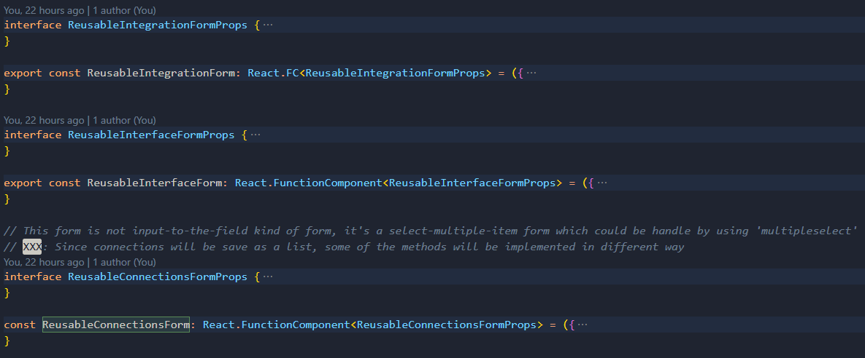
ReusableForm
For ease of development and higher reusablity, create ReusableForm component for each stage of editing
ReusableIntegrationForm
ReusableInterfaceForm
ReusableConnectionForm
ReusableForm will be use for
Form rendering
Draft saving
Update integration and related data
Should be return from render() of IntegrationForm, InterfaceForm, ConnectionForm

Slide 20
ReusableForm (cont’d)
Since ReusableForm use useForm hook, it must be functional component.
Hence, ReusableForm method implementation can’t be enforced
Check implementation example below to understand the intended behavior.
Implementation: https://github.com/TanapolWong-asa/abstract-factory-form/blob/master/src/pages/EditPartner/Form/reusableForm.tsx

Slide 21
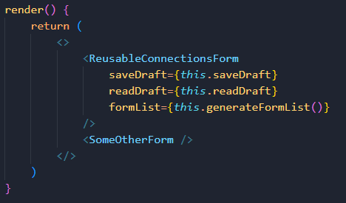
Additional Form for each stage
In case of any stage required additional form,
Render it in class component along side with ReusableForm
Keep in mind the following functionalities
Form rendering
Draft saving
Update related data***

Slide 22
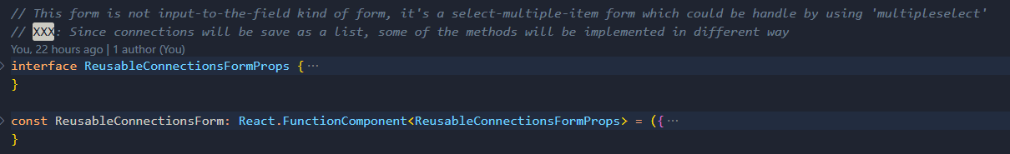
Breaking the pattern
Some component might need a specific implementation
First, try to follow the pattern.
If couldn’t be done, ignore the pattern then…
Document what break the pattern
Document why you need to break the pattern

