Slide 1
COOKIE GALORE
CSX3009 ALGORITHM DESIGN
6228104 Kaung Khant Si Thu
6311020 Piyaphon Wu

Slide 2
TABLE OF CONTENTS
01
PROBLEM STATEMENT
02
THE APPROACH
03
SUBMISSION RESULT

Slide 3
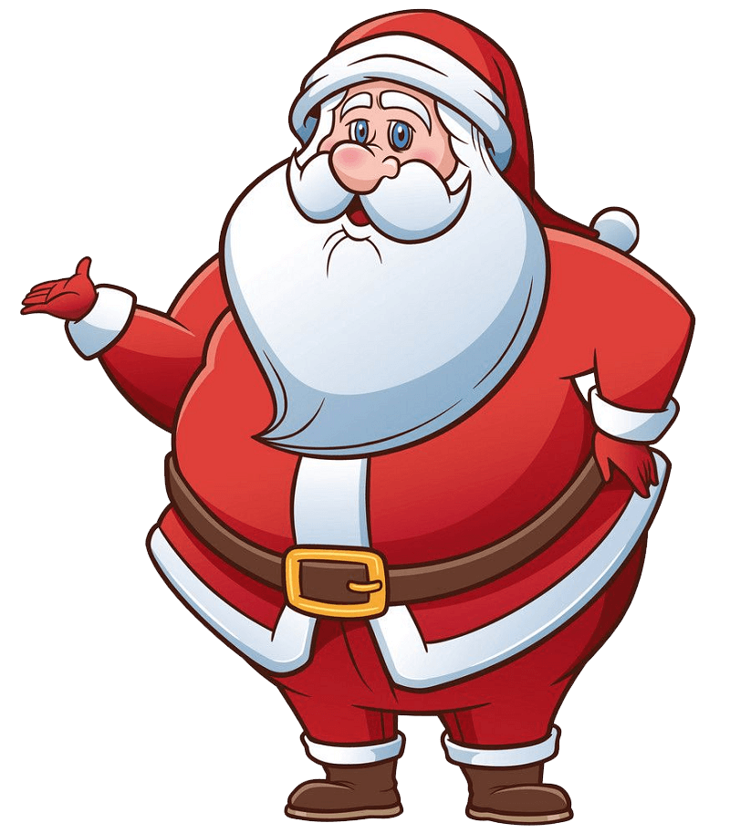

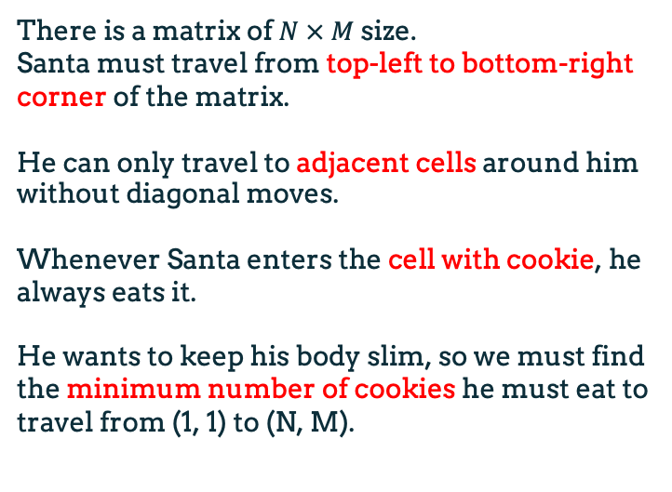
PROBLEM STATEMENT
There is a matrix of $N × M$size.
Santa must travel from top-left to bottom-right corner of the matrix.
He can only travel to adjacent cells around him without diagonal moves.
Whenever Santa enters the cell with cookie, he always eats it.
He wants to keep his body slim, so we must find the minimum number of cookies he must eat to travel from (1, 1) to (N, M).

Slide 4


SAMPLE
Output
Input
3
6 4
C..C
.CCC
CC.C
..CC
CC..
C.C.

Slide 5
THE APPROACH
2 CONSTRAINTS
Adjacent Moves
Valid moves
V
V

Slide 6

GRID MATRIX
01
VISITED MATRIX
02
DYNAMIC TABLE MATRIX
03
NEEDED MATRIX SIZE OF $N×M$
1 | 0 | 0
1 | 1 | 1
0 | 0 | 1
Replace “.” and “C”
by 0 and 1 respectively.
T | F | F
F | F | F
F | F | F
Contain False values when initiated. Update to be True when visited.
1 | ∞ | ∞
∞ | ∞ | ∞
∞ | ∞ | ∞
Contain infinity values when initiated.
Update the minimum cookies taken in the cell.

Slide 7
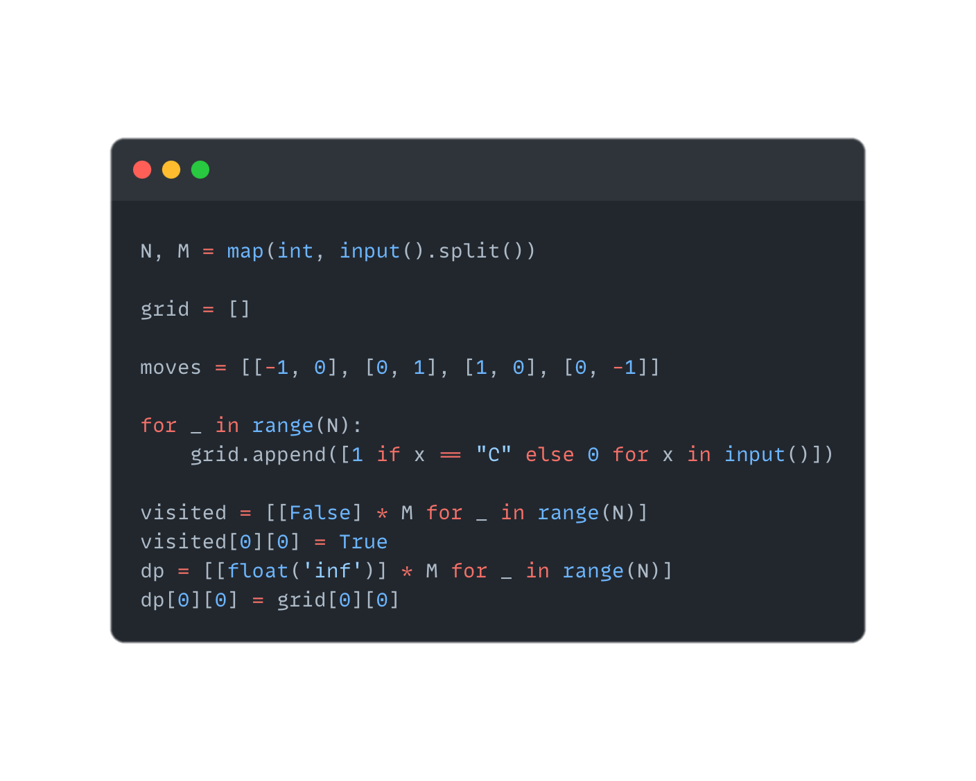

Slide 8
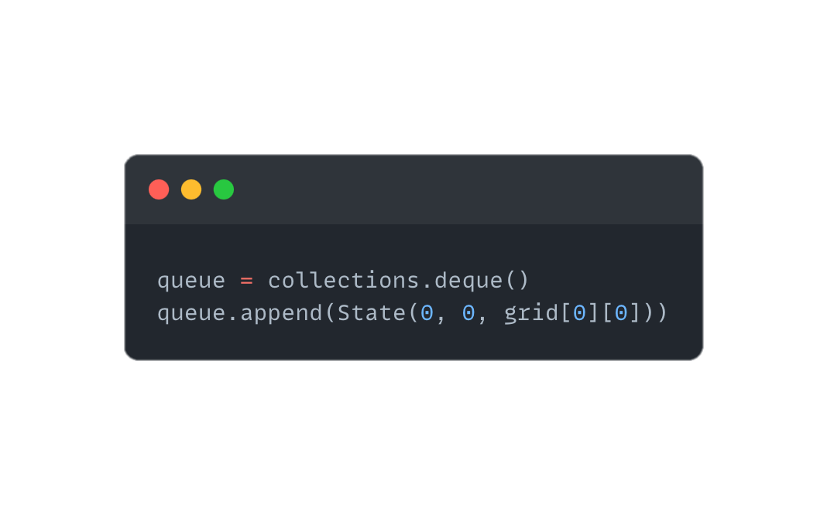

Slide 9
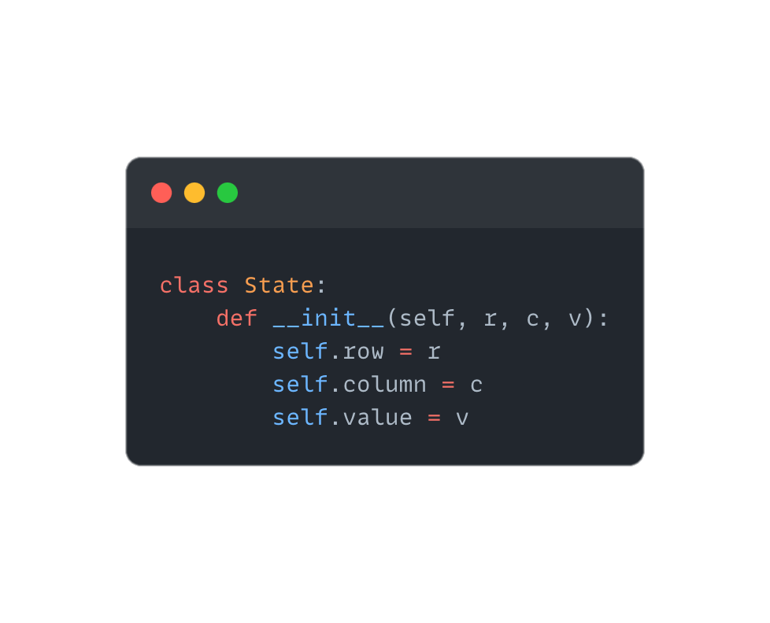

Slide 10
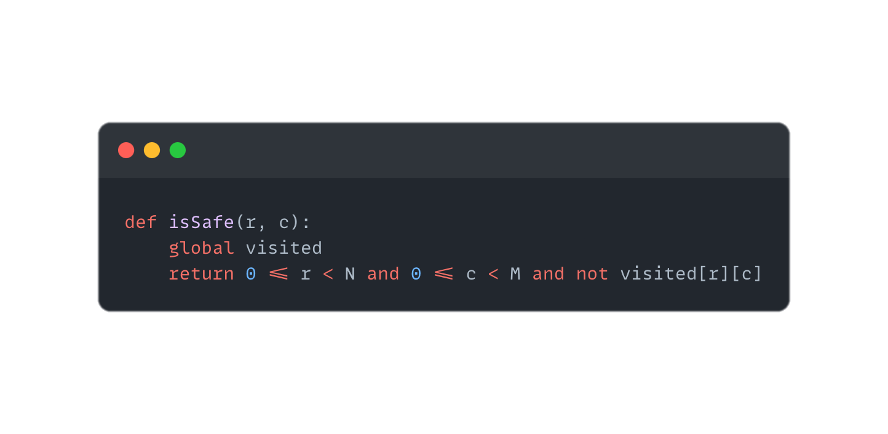

Slide 11
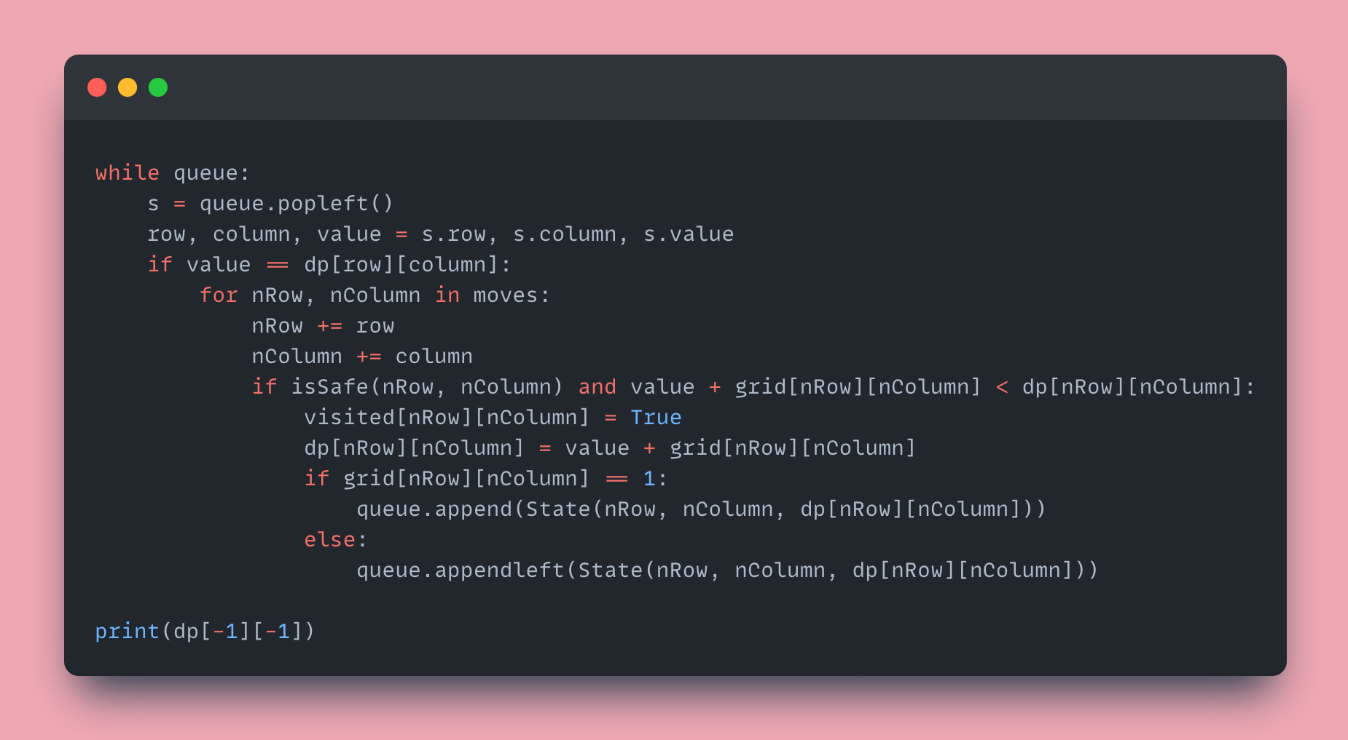

Slide 12
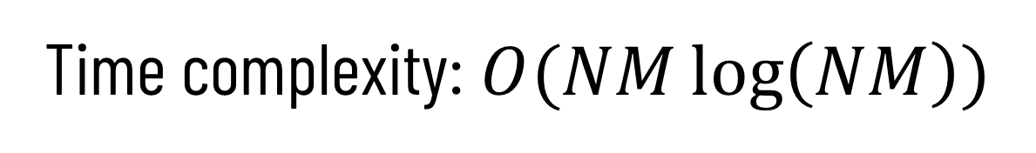
Time complexity:$O(NM\log\left(NM\right))$

Slide 13
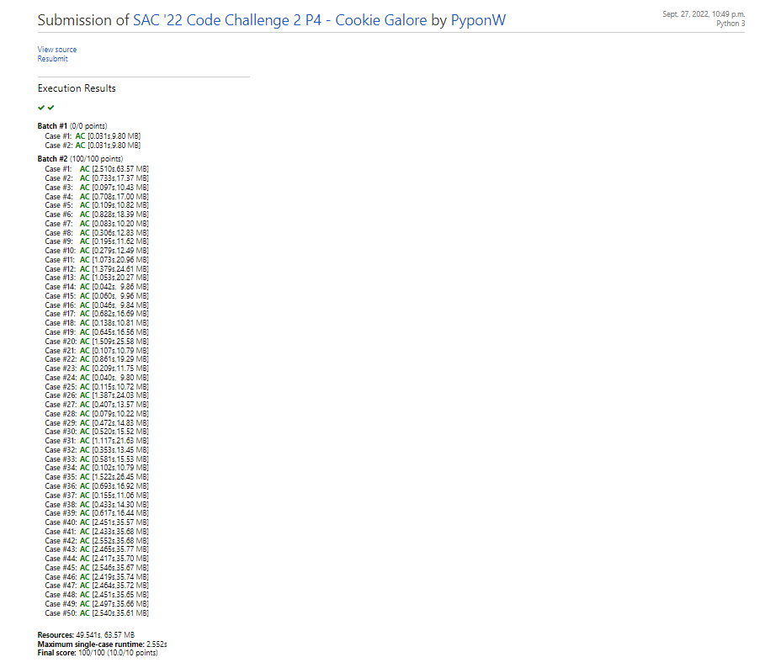
SUBMISSION RESULT

Slide 14
REFERENCES
Jakob, K. et al. (2022, June 8). 0-1 BFS. Retrieved from Algorithms for Competitive Programming: https://cp-algorithms.com/graph/01_bfs.html
Maxwell, C. (2022). SAC '22 Code Challenge 2 P4 - Cookie Galore. Retrieved from DM::OJ: https://dmoj.ca/problem/sac22cc2p4/editorial
Waseem, M. (2021, July 15). Collections In Python : Everything You Need To Know About Python Collections. Retrieved from Edureka: https://www.edureka.co/blog/collections-in-python/
Reducible. (2020, September 26). Breadth First Search (BFS): Visualized and Explained.
Retrieved from Youtube: https://www.youtube.com/watch?v=xlVX7dXLS64

Slide 15
THANK YOU

