Slide 1

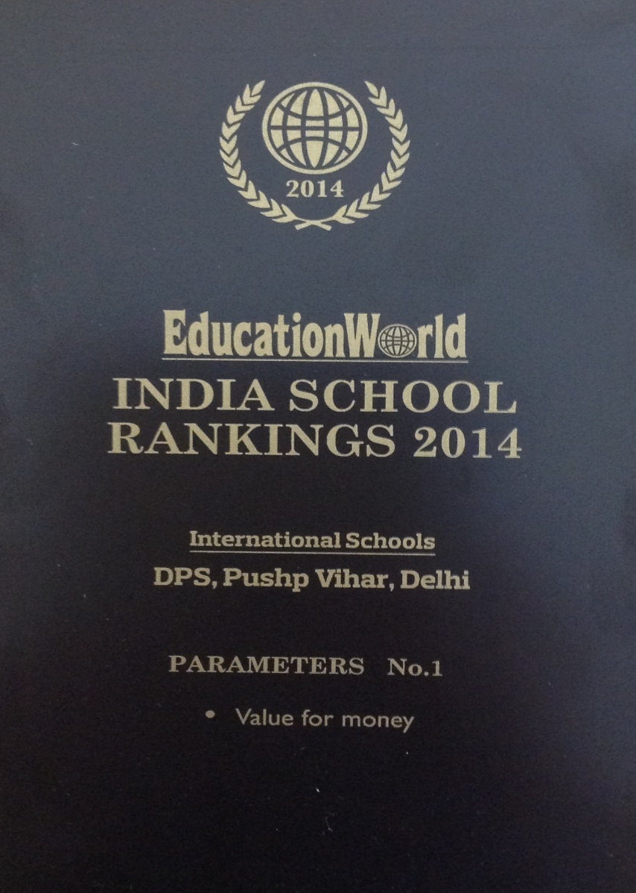
Awarded by Education World
No. 1: Value for Money

Slide 2
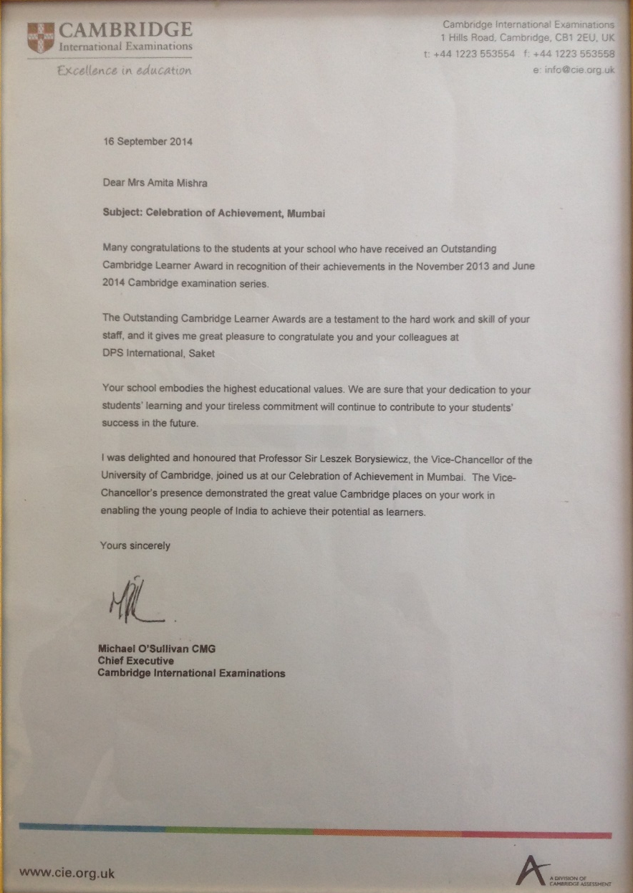
Awarded by CIE
Certificate of Achievement

