Slide 1

MLA Data Challenge – Group 21
Electrical Load Forecast of the LV MDB – ETA Research Factory
Kevin Vagadiya (2783406)
Tanay Patel (2845454)
Shikhar Bhatia (2613990)
Neelay Deshmukh (2623391)
Prof. Uwe Klingauf
Prof. Matthias Weigold
Prof. Kristian Kersting
M. Sc. Immo Schmidt
M. Sc. Robin Zink

Slide 2
Motivation and Goals
Motivation
Energy is a critical and costly production enabler; complex interdependent loads require balancing cost and reliability.
Energy cost optimization requires accurate load forecasting
Industry perspective: Forecasting allows scheduling, peak load management, and renewable integration for climate-neutral production.
Goals
Forecast LV MDB electrical load (kW) for next 24 h at 1 h resolution; evaluated with MAE per horizon.

Slide 3
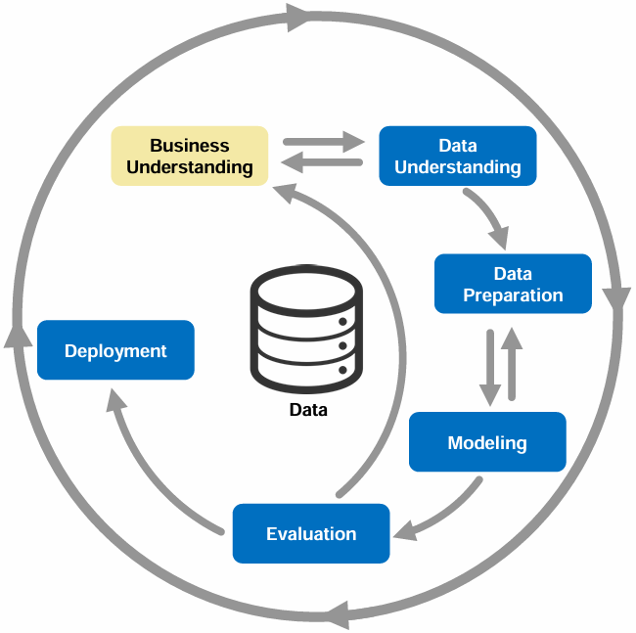
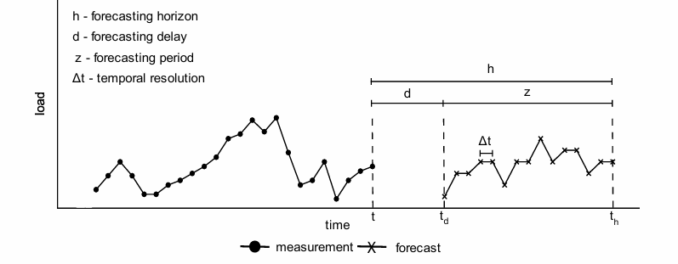
Business Understanding
Task: Electrical load forecast (kW) at each time step for the next 24 hours (h = z = 24 h) in hourly time resolution (Δt = 1 h)
Target error metric: Mean absolute error (MAE) per horizon.
Features:
▪ Power measurement features
▪ Datetime features
▪ Weather features
Source: ftp://public.dhe.ibm.com/software/analytics/spss/documentation/modeler/18.0/en/ModelerCRISPDM.pdf
Based on source: https://tuprints.ulb.tu-darmstadt.de/21767/

Slide 4
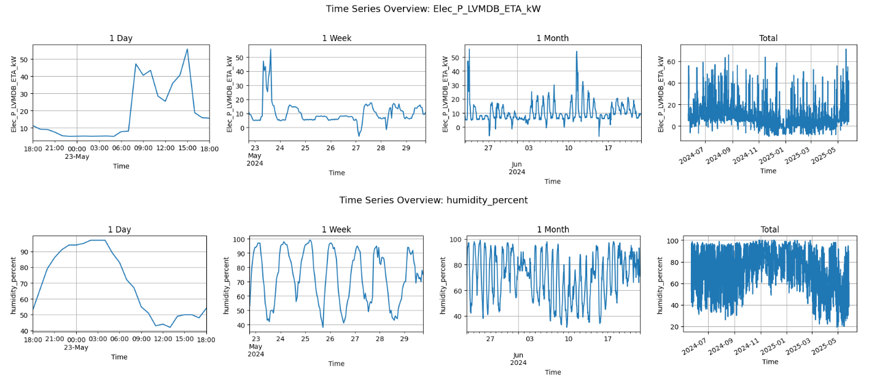
Data Understanding and Filtering
Data Visualization to get an initial overview of patterns, seasonality, and potential outliers before cleaning.

Slide 5
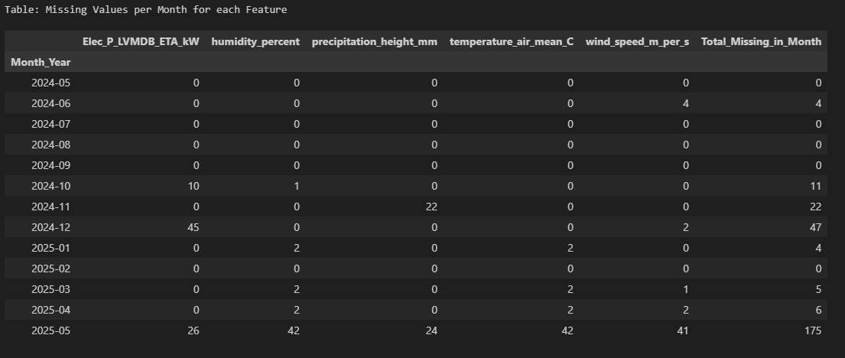
Data Understanding and Filtering
Missing values check

Slide 6
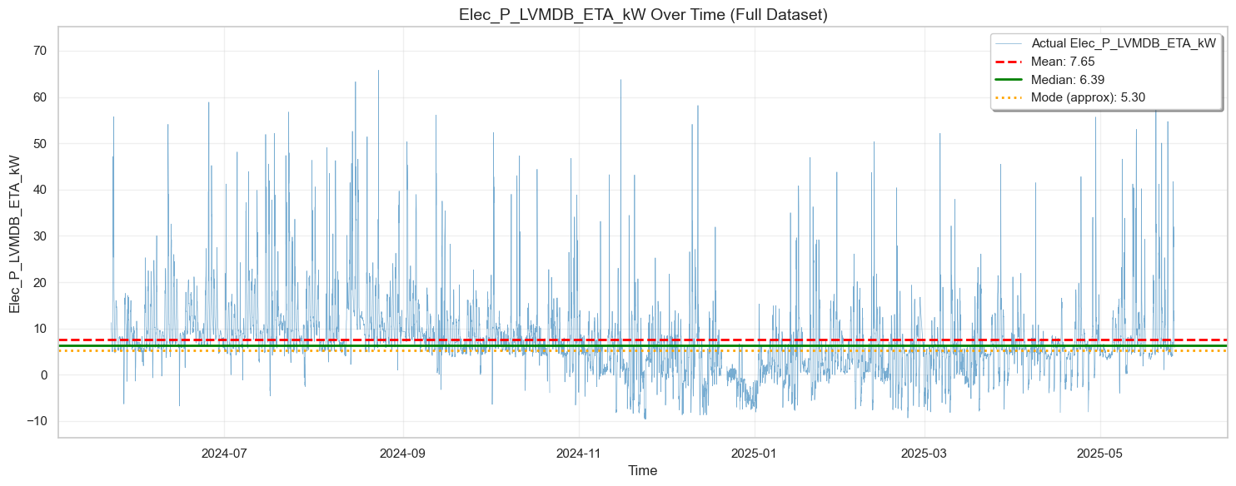
Data Understanding and Filtering

Slide 7
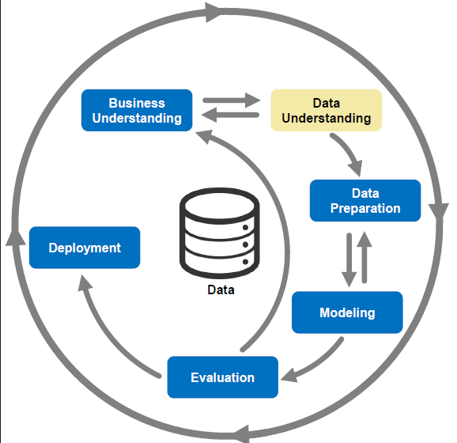
Data Understanding and Filtering
Null data
Negative load at night and day
Random Peak load
Filtering:
Mean from previous day and hour
Treated Negative load at night as outliers
Reduce extremely high peak load to average peak
Apply smoothing
Source: ftp://public.dhe.ibm.com/software/analytics/spss/documentation/modeler/18.0/en/ModelerCRISPDM.pdf

Slide 8
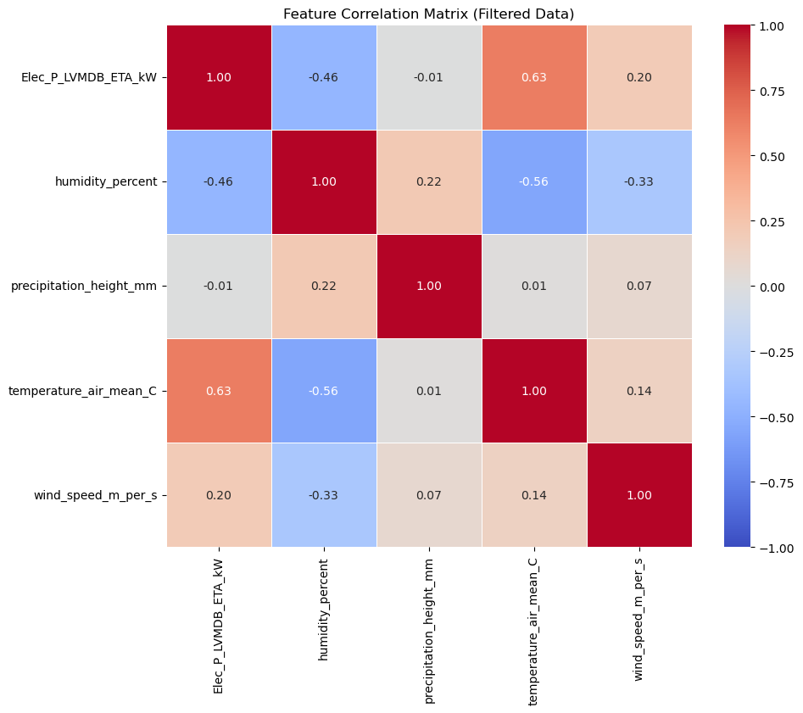
Feature Engineering and Methodology of Regular Model
Feature Added
Hours
Day of Week
Month
Working day
Working hour
Lag feature
Feature Remove
Precipitation

Slide 9
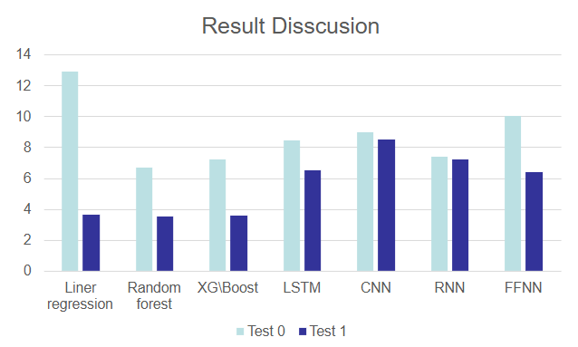
Modelling and Evaluation of Regular Model
Models Used:
Linear regression
Random Forest
XGBoost
LSTM
CNN
RNN
FFNN
MAE
Model Removed
LSTM
CNN
RNN
FFNN
Reasons:
Insufficient training data
Large computational time
Hyper-parameter Optimization issues
Models are improved here with different hyper parameter (For e.g estimators, learning rate, depth)

Slide 10
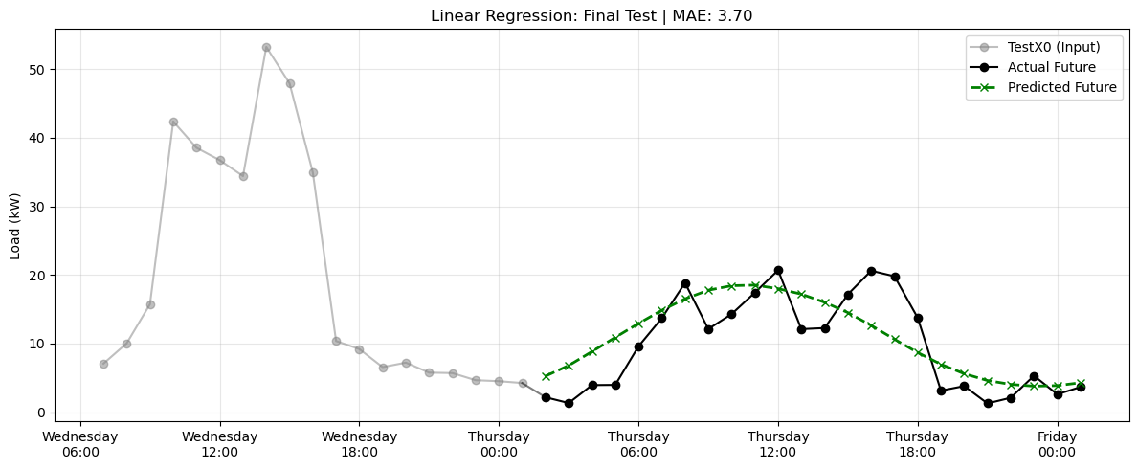

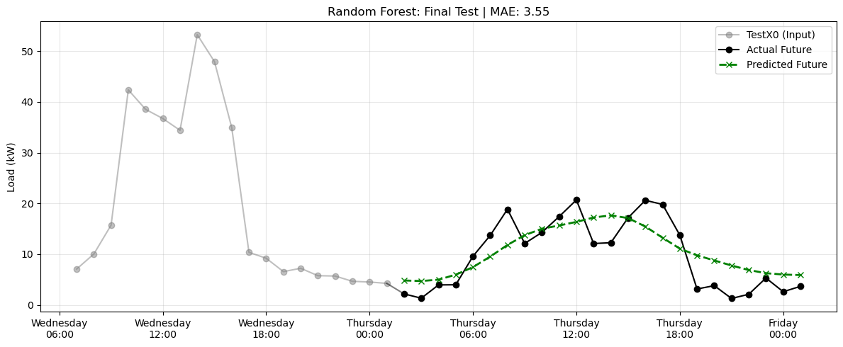
Modelling and Evaluation of Regular Model

Slide 11
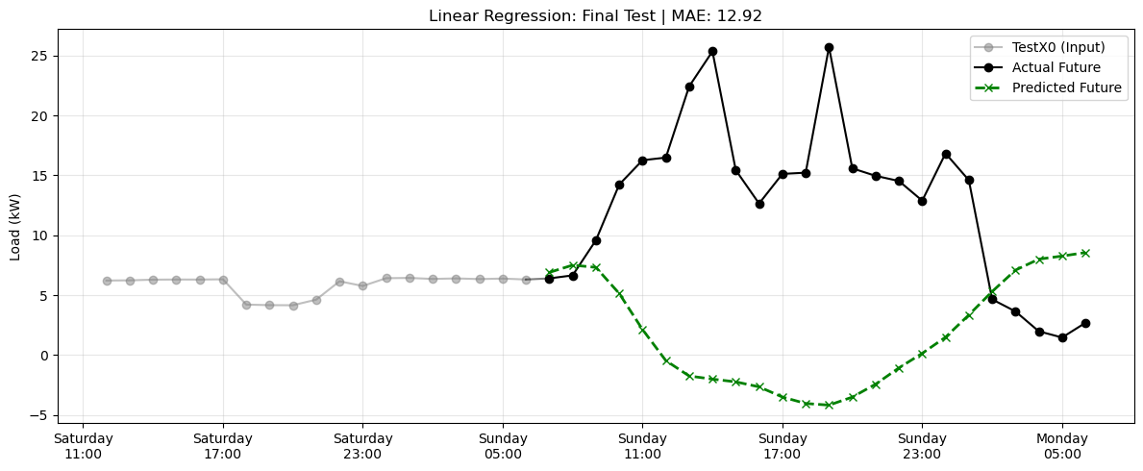
Evaluation and Feature Engineering
Graph from Regular model for linear Regression TestX0
Observations:
Working Sunday and Holiday
Filtering step: Accounted for holidays and working Sundays such that the real pattern is not lost
Feature Engineering: is_working_sunday, is_holiday, next_is_working, next_is_holiday, next_is_ws

Slide 12
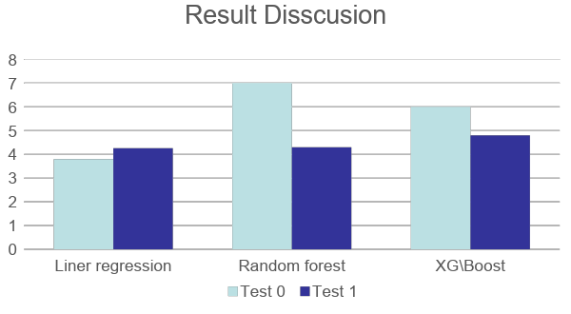
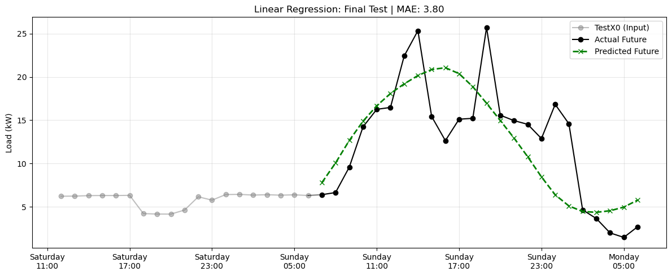
Modeling and Evaluation of Special Model
We found that the Special model performs much better than the earlier regular model for testX0.
However, the results for TestX1 slice worsened. Due to the more complexity.
Prediction for TestX0
MAE

Slide 13
Evaluation and Filtering of new Special Model
After our first iteration, we realized that the factory load behaves very differently on some holidays/weekends as it has same working load as a normal workdays.
Therefore, we categorize those events as special case.
This filtering allows later models to specialize on the patterns they are best suited for.
The Special Pipeline is designed for working holidays (holidays, weekends, bridge days, winter break, etc.).
The Regular Pipeline focuses on normal workdays (Monday–Friday, excluding holidays and working Sundays).

Slide 14
Modeling of Hybrid Model
Special Model: Uses Linear Regression
Regular Model: Uses Random Forest
Hybrid model
Repeats 24 times
(further optimized using hyperparameters for e.g estimators and depth)
If time step is special case
If time step is regular case
Get prediction from special model
Get prediction from regular model
Stitching all predictions

Slide 15
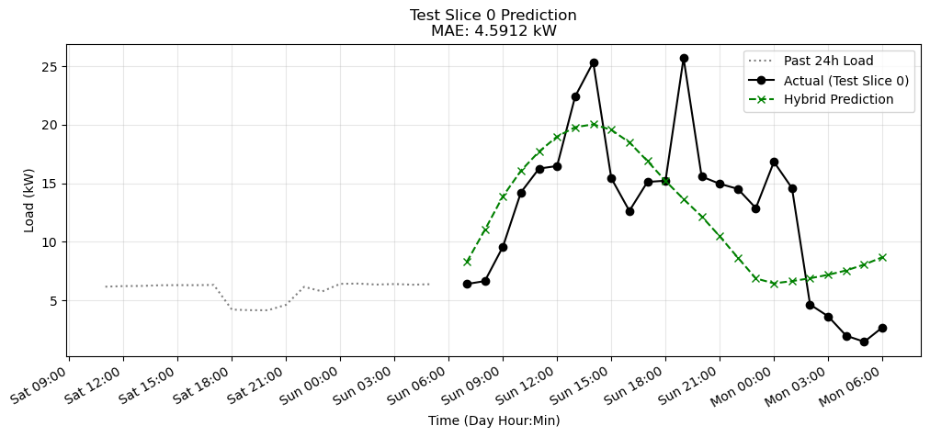
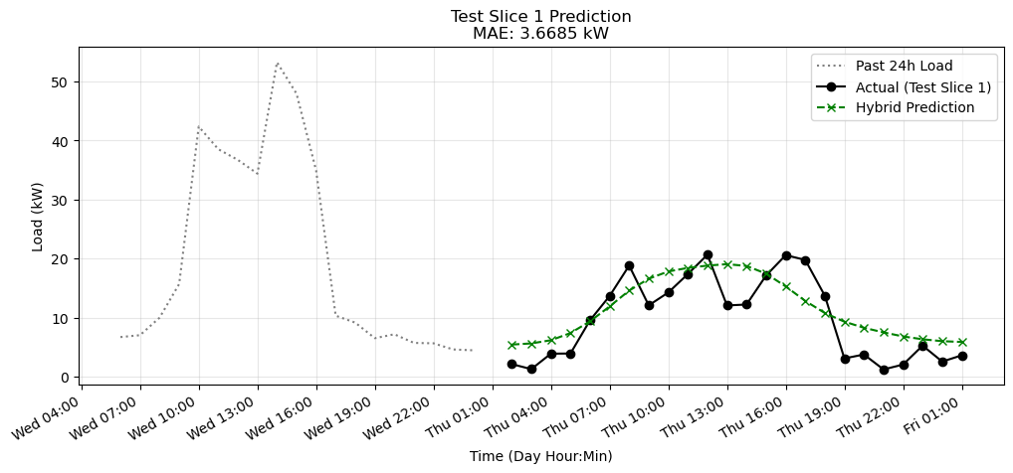
Evaluation of Hybrid Model
Thus, by using both the models to predict the load the MAE has significantly improved.
Prediction for TestX0
Prediction for TestX1

Slide 16
Conclusion
Model Performance & Limitations
The hybrid model yielded a Mean Absolute Error (MAE) of 3.66 on regular days, with a final MAE of 5.7 on the final test data . This indicates decent accuracy but there is room for refinement. A key limitation is the model's inability to accurately capture special days in the factory's load profile, though performance on regular days was acceptable.
Future Recommendations
Our team recommended that transition to a gradient-boosted framework, specifically XGBoost, to better capture complex non-linearities and high-dimensional interactions. This transition should include improvements in features and hyperparameters. Additionally, more extensive longitudinal datasets are necessary to enhance the prediction of the factory’s electrical load .

