Slide 1

CREATING A PPT FOR Music Web Application
Student Name :
Tanay Rajendra Tare
College Name :
Maratha Vidya Prasarak Samaj's Karmaveer Adv. Baburao Ganpatrao Thakare College of Engineering, Nashik, Maharashtra.
Student ID:
STU65c607c33c08b1707476931

Slide 2
CAPSTONE PROJECT SHOWCASE
Music Web-Application
Music Web Application with Django Framework
Abstract | Problem Statement | Project Overview | Proposed Solution | Technology Used | Modelling & Results | Conclusion | Q&A

Slide 3
Abstract
1
The purpose of this project of this project is to develop web application using Django framework and using gain hands-on experience in full stack web development while building a functional and user-friendly application .
2
The app leverages python for backend logic and database management, ensuring robust performance and scalability .
3
With a clean and intuitive interface, the app prioritizes user experience, offering smooth navigation and efficient functionalities built using HTML, CSS and Bootstrap.
4
Login and registration features provide users with secure access to the music web app, allowing new users to create accounts and returning users to sign in, ensuring personalized experiences and access to saved preferences.

Slide 4


Problem Statement
The development of a music web app using the Django framework aims to address the need for a centralized platform where users can seamlessly discover, stream their favorite music tracks across various genres and artists. The current landscape lacks a comprehensive solution that integrates robust search functionalities, personalized recommendations, and social features, leading to fragmented user experiences across multiple platforms. This project seeks to fill this gap by delivering a user-friendly and feature-rich music streaming platform that offers a cohesive experience while leveraging the power and flexibility of Django for efficient development and scalability.

Slide 5

Project Overview
1. Intuitive User Interface: VibeVault boasts a visually appealing and user-friendly interface designed with HTML, CSS, and Bootstrap. The layout is responsive, ensuring optimal viewing across various devices, including desktops, tablets, and smartphones.
2. Music Library: The platform provides access to an music library spanning diverse genres, artists, and albums. Users can easily search for specific songs or artists and explore curated playlists tailored to their preferences.
3. Bootstrap for UI Consistency and Reusability: Bootstrap is leveraged for creating responsive and consistent UI components across the web application. The use of Bootstrap ensures code reusability, simplifies frontend development, and enhances the overall aesthetic appeal of the application.
4. Login and Signup Features: To access the full suite of VibeVault's features, users can create accounts via a signup process. Returning users can log in securely to access their personalized playlists, saved tracks, and other preferences.
5. High-Quality Audio Playback: The platform ensures high-quality audio playback, delivering an immersive listening experience for users. Whether streaming music on desktop or mobile devices, VibeVault maintains audio fidelity to enhance user enjoyment.
6. Backend Powered by Django: Leveraging the Django framework for backend development, VibeVault ensures robust performance, security, and scalability. Django's built-in authentication system facilitates secure user management, while its ORM simplifies database operations.

Slide 6
Proposed Solution
1.Setup and Environment: Set up a development environment with Django installed, ensuring compatibility with Python. Initialize a Django project and create necessary app modules.
2. User Interface Design: Create a clean and responsive UI using HTML, CSS, and Bootstrap, prioritizing simplicity and ease of use.
3. Authentication: Implement Django's built-in authentication system for user registration, login, and logout functionalities.
4. Database Modeling: Define Django models for users, music tracks ensuring efficient data storage and retrieval.
5. Music Library: Creating a pre-defined list of songs exists within the system (due to copyright limitations).
6. Basic User Interactions: Implement features for creating, editing as well as adding and removing tracks.
7. Testing and Debugging: Conduct thorough testing to ensure the functionality, performance, and usability of the music web app. Debug any issues and optimize code for efficiency.

Slide 7
Technology used
1. Frontend Technologies:
HTML (Hypertext Markup Language): HTML is the standard markup language used to structure and create web pages. It provides the basic building blocks for organizing content on a web page, including headings, paragraphs, links, and images.
CSS (Cascading Style Sheets): CSS is a stylesheet language used to control the presentation and layout of HTML elements on a web page. It allows developers to apply styles such as colors, fonts, margins, and positioning to enhance the visual appearance of the website.
Bootstrap: Bootstrap is a popular front-end framework that provides pre-designed components, CSS styles, and JavaScript plugins for building responsive and mobile-first web applications. It simplifies frontend development by offering ready-to-use UI components and layout grids.
2. Backend Technologies :
Django: Django is a high-level Python web framework that encourages rapid development and clean, pragmatic design. It provides a set of built-in features and conventions for building web applications, including URL routing, database modeling, form handling, and user authentication. Django follows the Model-View-Controller (MVC) architectural pattern, where models represent data structures, views handle user requests, and templates render HTML output.
Python: Python is a versatile and easy-to-read programming language used for backend development in Django. Python's simplicity and readability make it well-suited for web development tasks such as database interactions, business logic implementation, and API integrations.

Slide 8
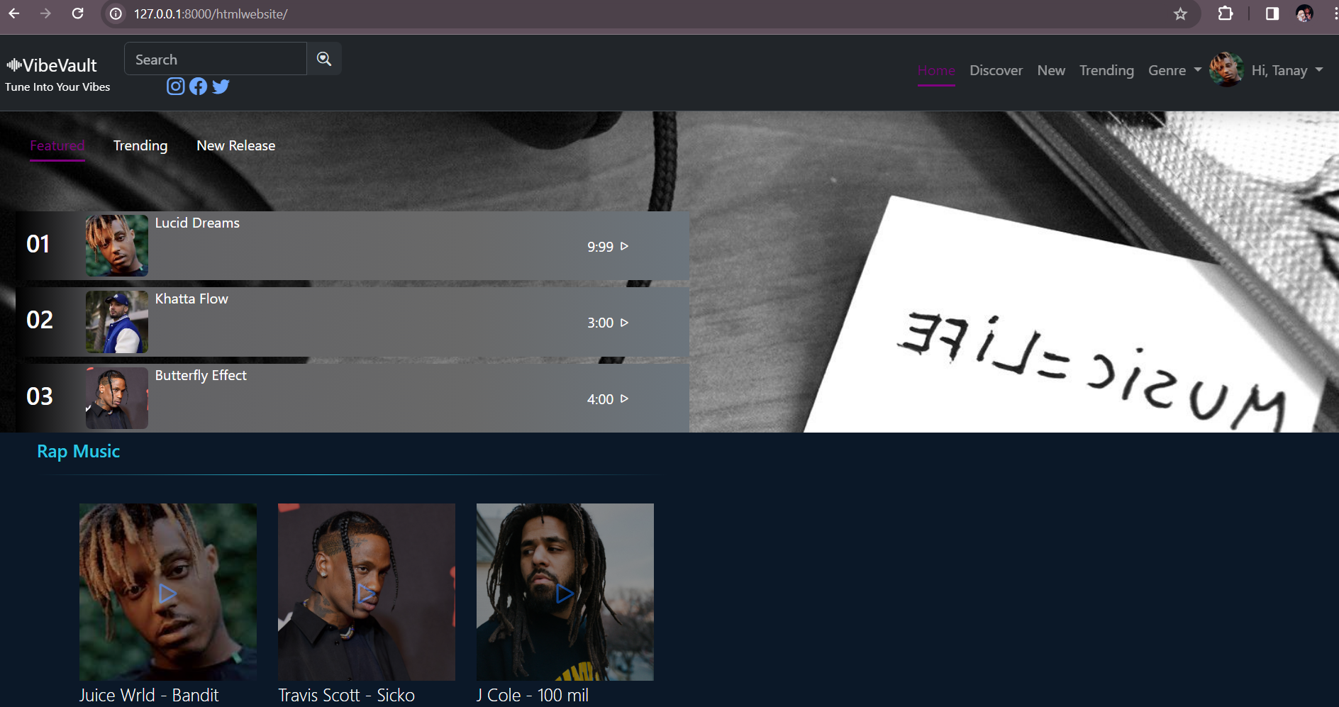
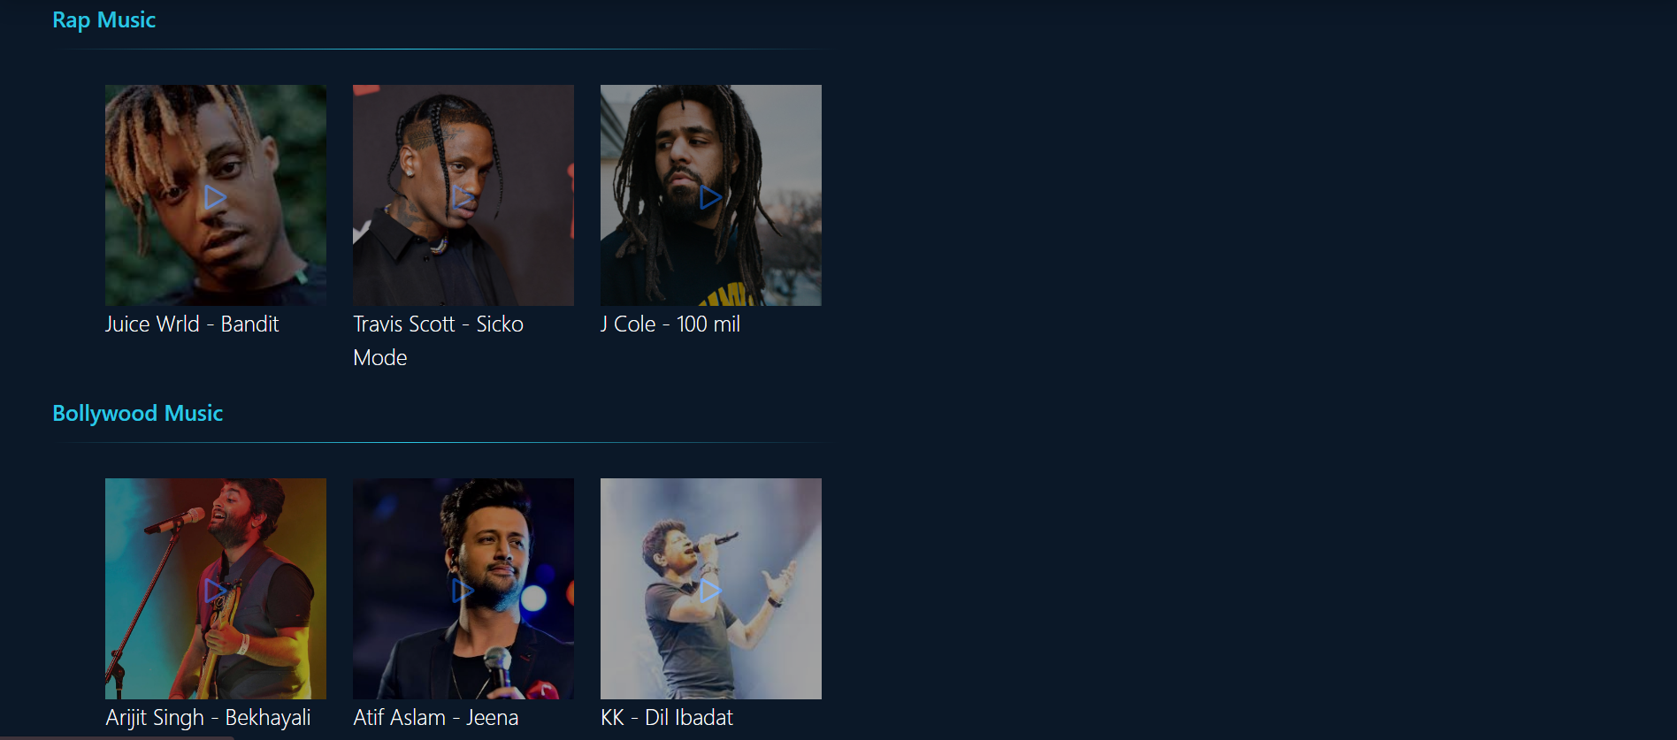
Modelling & Result(Home page)

Slide 9
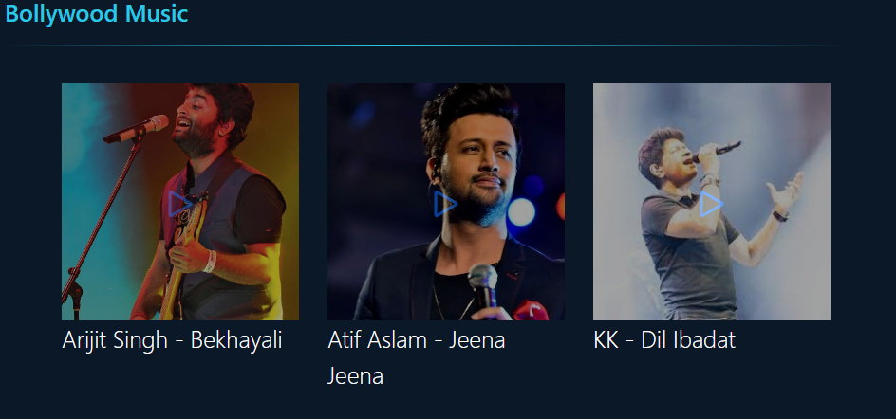
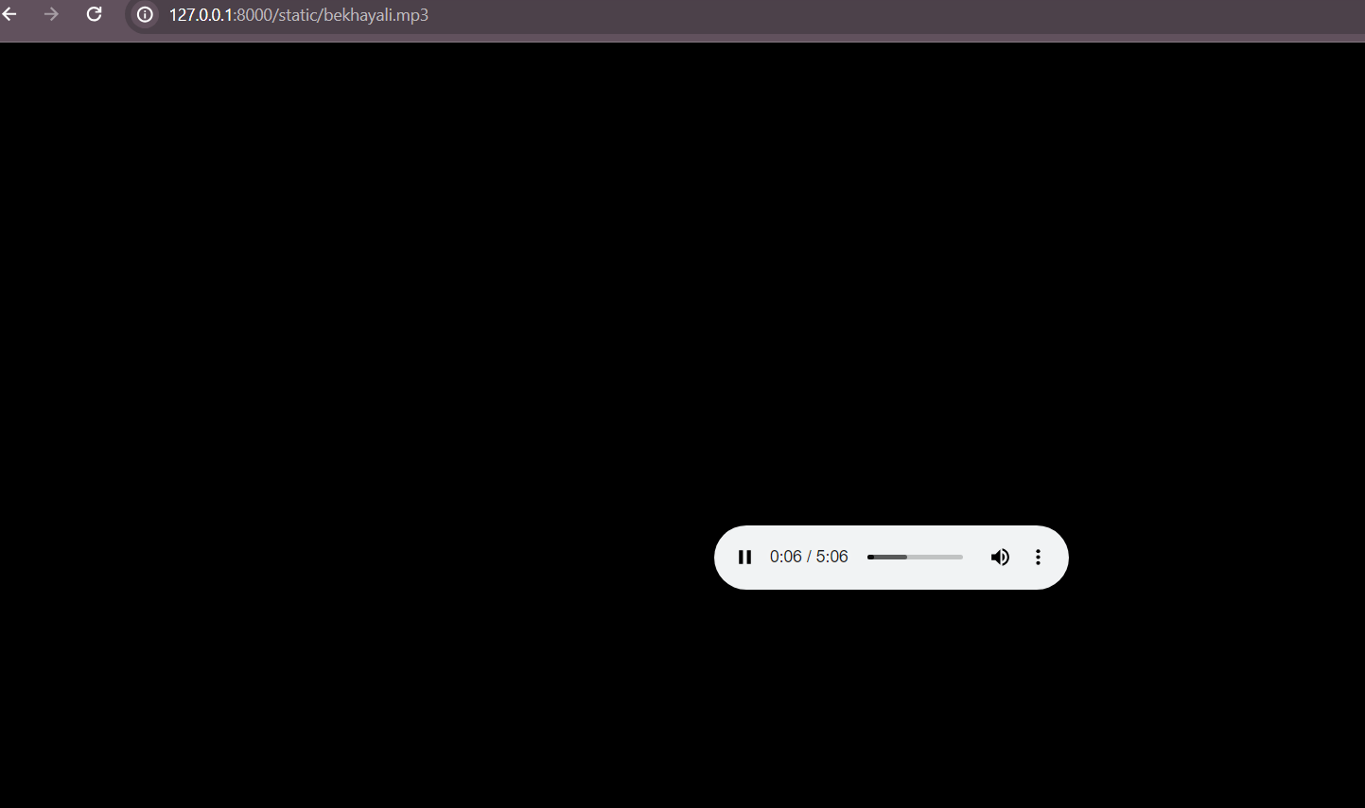
Modelling & Result(Song Section and Corresponding Basic Musicplayer )

Slide 10
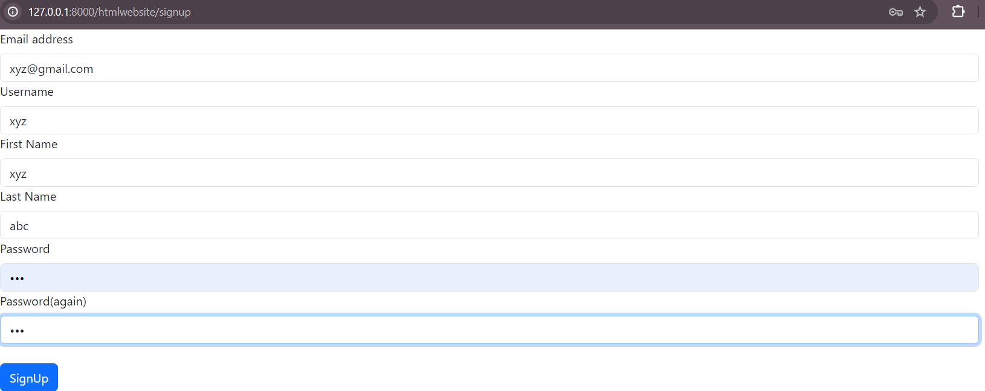
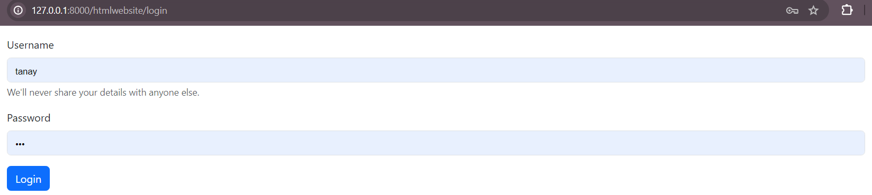
Modelling & Result(Login & SignUp Page)

Slide 11

Conclusion
In conclusion, the development of a music web app using the Django framework presents an opportunity to create a feature-rich and user-centric platform for music enthusiasts. Leveraging Django's powerful capabilities for backend development, alongside HTML, CSS, and Bootstrap for frontend design, allows for the creation of an intuitive and visually appealing user interface. Through the integration of authentication, database modeling, and music streaming APIs, the music web app offers essential features such as user registration, login, playlist creation, and music playback.
Furthermore, the use of Django promotes efficient code writing, modularity, and scalability, making it an ideal choice for developing robust web applications. With its comprehensive documentation, active community support, and extensive ecosystem of libraries and plugins, Django streamlines the development process, enabling interns and developers to build sophisticated web applications with ease. Overall, the music web app developed with Django framework offers a seamless and enjoyable experience for users, while providing interns with valuable hands-on experience in web development and project management.

Slide 12
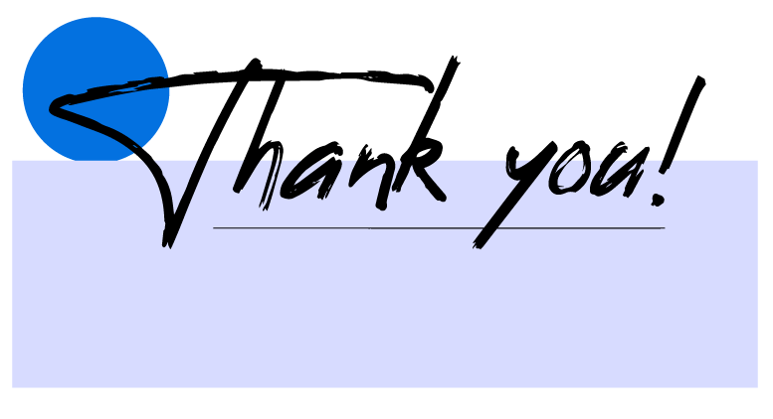

Notes:
Thank You !!

