Slide 1

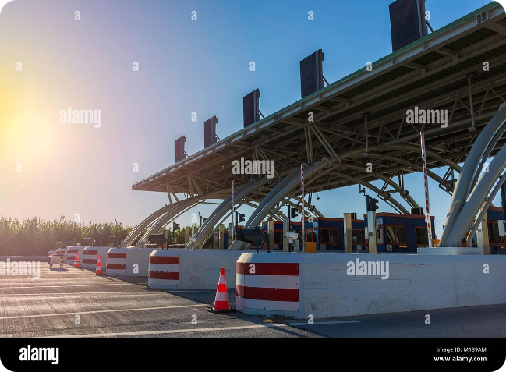
GPS Toll-Based System Simulation
In today's fast-paced world, efficient transportation systems are crucial for both individuals and businesses. Toll collection plays a vital role in financing infrastructure development and maintenance, but traditional toll booths often lead to traffic congestion and delays. To address these challenges, a novel system based on GPS technology has emerged, offering a seamless and user-friendly experience. This presentation will delve into the concept of a GPS Toll-Based System Simulation, exploring its unique features, benefits, and technical aspects.

Slide 2

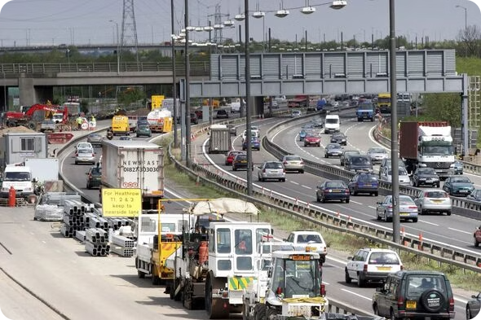
Problem Statement
The primary challenge addressed in this project is the need for an efficient and automated system to calculate toll charges based on the distance traveled by vehicles on highways, using GPS technology. Traditional toll collection systems often require physical toll booths, leading to traffic congestion, delays, and inefficient toll collection. This project aims to provide a seamless, real-time toll calculation system that improves the user experience and reduces operational costs.
1
Traffic Congestion
2
Increased Travel Time
Traditional toll booths often lead to significant traffic congestion, especially during peak hours.
Traffic congestion caused by toll booths increases travel times, leading to frustration for drivers.
3
Environmental Impact
4
Costly Infrastructure
Congestion and idling vehicles contribute to increased pollution and carbon emissions.
Building and maintaining physical toll booths can be expensive and require significant resources.

Slide 3




Unique Idea Brief (Solution)
This project presents a simulation-based solution that leverages GPS data to calculate toll charges based on the distance traveled by vehicles. By simulating vehicle movement on major highways, the system can determine the toll costs dynamically, without the need for physical toll booths. This approach ensures smoother traffic flow, reduces congestion, and provides accurate toll charges, thereby enhancing overall efficiency.
Key features of this system include:
Real-time vehicle tracking
Automatic toll calculation based on distance traveled
Electronic payment processing
Seamless integration with existing transportation infrastructure
Data analytics for traffic management and infrastructure optimization
Real-time Tracking
Automatic Toll Calculation
Electronic Payment
Integration with Existing Infrastructure
GPS technology enables the system to track vehicles in real time, providing accurate information about their location and movement.
The system automatically calculates toll fees based on the distance traveled and predefined toll rates for different road sections.
Toll payments are processed electronically, eliminating the need for cash transactions and reducing delays at toll booths.
The system can be seamlessly integrated with existing transportation infrastructure, such as traffic lights and road signs, to provide real-time traffic information and toll updates.

Slide 4
Features Offered
The GPS Toll-Based System Simulation is designed to offer a wide range of features that enhance efficiency, convenience, and user experience. Here are some of the key features that make this system a compelling solution for modern transportation needs:
GPS-Based Toll calculation calculates toll fees for vehicles
Route Simulation simulate the movement of vehicles
Toll Avoidance is the practice of navigating routes that minimize the need of to pay tolls
Detailed Reporting is a crucial for transparency , efficiency and continual improvement
Interactive Map Visualization is creating for GPS-based Toll calculation and avoidance detection
Feature
Description
GPS-Based Toll Calculation
Calculates toll charges based on the actual distance traveled by vehicles using GPS coordinates.
Route Simulation
Simulates vehicle movement on predefined routes (major highways), tracking the start and end points.
Toll Avoidance
Allows vehicles to avoid toll booths if specified, adjusting routes accordingly. Real-Time Balance Tracking: Tracks the toll charges and updates the remaining balance of the driver in real-time.
Detailed Reporting
Generates detailed reports showing total toll paid, kilometers traveled, starting and ending points, and the routes taken.
Interactive Map Visualization
Provides a visual representation of vehicle routes, toll booths, and travel paths on a map using Folium.

Slide 5
Process Flow
The GPS Toll-Based System Simulation involves a well-defined process flow, ensuring efficient operation and accurate toll collection. Here's a step-by-step breakdown of the process:
1
Initialization
The simulation environment is initialized, and vehicle objects are created with specific routes and attributes.
2
Route Assignment
Vehicles are assigned routes based on predefined highways and may have toll avoidance features enabled.
3
Movement Simulation
Vehicles move along their routes, calculating the distance traveled between coordinates and accumulating toll charges based on distance.
4
Balance Update
Toll charges are deducted from the driver's initial balance in real-time.
5
Data Collection
During the simulation, data such as total distance traveled, toll charges paid, and remaining balance are recorded.

Slide 6
Architecture Diagram
Central Processing Unit
(CPU)
Database Management System (DBMS)
GPS Receivers
GPS receivers are deployed strategically along toll zones to detect and track vehicles in real time.
The central processing unit (CPU) is responsible for processing GPS data, calculating toll fees, and managing electronic payments.
The database management system (DBMS) stores vehicle data, toll rates, payment information, and other relevant system data.

Slide 7
Technologies Used
Python: The primary programming language used for the simulation and data processing.
Pandas: For data manipulation and analysis, especially for handling route and toll data.
Jupyter Notebook: For developing and running the simulation code interactively.
Geopy: For distance calculations between geographical points.
Folium: For creating interactive maps to visualize vehicle routes and toll booths.
SimPy: A discrete-event simulation library in Python used to model the vehicle movements and toll calculations.

Slide 8





Team Members
Tanay Bhadade
Jelson Joseph
Pranali Mule
Shreya Talmale
Archit Kanadkhedkar

Slide 9
Conclusion
This project demonstrates an innovative solution to the traditional toll collection system by leveraging GPS technology and simulation.
By calculating toll charges based on the distance travelled, the system eliminates the need for physical toll booths, reducing congestion and improving efficiency.
The detailed reporting and map visualization provide valuable insights into vehicle movements and toll expenditures, making it a robust tool for modern transportation management.
This project highlights the potential of combining simulation, geospatial data, and data visualization to solve real-world problems effectively.

