Slide 1
Learning
Classification and Prediction
Courtesy: Jiawei Han , Department of Computer Science , University of Illinois at Urbana-Champaign
www.cs.uiuc.edu/~hanj
©2006 Jiawei Han and Micheline Kamber, All rights reserved

Slide 2
Classification and Prediction
What is classification? What is prediction?
Issues regarding classification and prediction
Classification by decision tree induction
Bayesian classification
Rule-based classification
Classification by back propagation
Support Vector Machines (SVM)
Associative classification
Lazy learners (or learning from your neighbors)
Other classification methods
Prediction
Accuracy and error measures
Ensemble methods
Model selection
Summary

Slide 3
Classification vs. Prediction
Classification
  predicts categorical class labels (discrete or nominal)
  classifies data (constructs a model) based on the training set and the values (class labels) in a classifying attribute and uses it in classifying new data
Prediction
  models continuous-valued functions, i.e., predicts unknown or missing values
Typical applications
  Credit approval
  Target marketing
  Medical diagnosis
  Fraud detection

Slide 4
Classification—A Two-Step Process
Model construction: describing a set of predetermined classes
  Each tuple/sample is assumed to belong to a predefined class, as determined by the class label attribute
  The set of tuples used for model construction is training set
  The model is represented as classification rules, decision trees, or mathematical formulae
Model usage: for classifying future or unknown objects
  Estimate accuracy of the model
    The known label of test sample is compared with the classified result from the model
    Accuracy rate is the percentage of test set samples that are correctly classified by the model
    Test set is independent of training set, otherwise over-fitting will occur
  If the accuracy is acceptable, use the model to classify data tuples whose class labels are not known

Slide 5



Process (1): Model Construction
Classification
Algorithms
Training
Data
Classifier
(Model)
IF rank = ‘professor’
OR years > 6
THEN tenured = ‘yes’

Slide 6




Process (2): Using the Model in Prediction
Classifier
Testing
Data
Unseen Data
(Jeff, Professor, 4)
Tenured?

Slide 7
General Approach
To build a classification model, the labeled data set is initially partitioned in to two disjoint sets, known as training set and test set, respectively
Next, a classification technique is applied to the training set to induce a classification model
Each classification technique applies a
learning algorithm

Slide 8
General Approach
The goal of a learning algorithm is to build a model that has good generalization capability
– That is it must not only fit the training set well but can also predict correctly the class labels of many previously unseen records
To evaluate how well the induced model performs on records it has not seen earlier, we can apply it to the test set

Slide 9
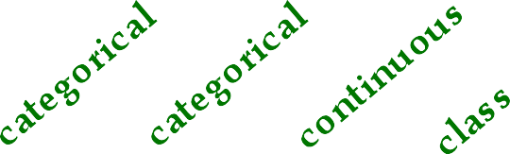
University of Florida
CISE department
Gator Engineering
General Approach
Test Set
Learn
Classifier
Training Set
Model

Slide 10
Supervised vs. Unsupervised Learning
Supervised learning (classification)
  Supervision: The training data (observations, measurements, etc.) are accompanied by labels indicating the class of the observations
  New data is classified based on the training set
Unsupervised learning (clustering)
  The class labels of training data is unknown
  Given a set of measurements, observations, etc. with the aim of establishing the existence of classes or clusters in the data

Slide 11
Chapter 6. Classification and Prediction
What is classification? What is prediction?
Issues regarding classification and prediction
Classification by decision tree induction
Bayesian classification
Rule-based classification
Classification by back propagation
Support Vector Machines (SVM)
Associative classification
Lazy learners (or learning from your neighbors)
Other classification methods
Prediction
Accuracy and error measures
Ensemble methods
Model selection
Summary

Slide 12
Issues: Data Preparation
Data cleaning
  Preprocess data in order to reduce noise and handle missing values
Relevance analysis (feature selection)
  Remove the irrelevant or redundant attributes
Data transformation
  Generalize and/or normalize data

Slide 13
Issues: Evaluating Classification Methods
Accuracy
  classifier accuracy: predicting class label
  predictor accuracy: guessing value of predicted attributes
Speed
  time to construct the model (training time)
  time to use the model (classification/prediction time)
Robustness: handling noise and missing values
Scalability: efficiency in disk-resident databases
Interpretability
  understanding and insight provided by the model
Other measures, e.g., goodness of rules, such as decision tree size or compactness of classification rules

Slide 14
University of Florida
CISE department
Gator Engineering
Classification Model
In general a classification model can be used for the following purposes:
  It can serve as a explanatory tool for distinguishing objects of different classes. This is the descriptive element of the classification model
  It can be used to predict the class labels of new records. This is the predictive element of the classification model

Slide 15
Chapter 6. Classification and Prediction
What is classification? What is prediction?
Issues regarding classification and prediction
Classification by decision tree induction
Bayesian classification
Rule-based classification
Classification by back propagation
Support Vector Machines (SVM)
Associative classification
Lazy learners (or learning from your neighbors)
Other classification methods
Prediction
Accuracy and error measures
Ensemble methods
Model selection
Summary

Slide 16
Classification Techniques
Decision Tree based Methods
Rule-based Methods
Memory based reasoning
Neural Networks
Genetic Algorithms
Naïve Bayes and Bayesian Belief Networks
Support Vector Machines

Slide 17
Decision Tree Based Classification
A decision tree is a hierarchical structure of nodes and directed edges. There are three types of nodes in a decision tree:
  A root node, which has no incoming edges and zero or more outgoing edges
  Internal nodes, each of which have exactly one incoming edge and two or more outgoing edges
  Leaf nodes, each of which have exactly one incoming edge and no outgoing edges. Each leaf node also has a class label attached to it
Internal node
Root node
Decision Tree
Gender
= F = M
Height
Height
< 1.3m
> 1.8m
< 1.5m
> 2 m
Short Medium Tall
Short Medium Tall
Source: Data Mining – Introductory and Advanced topics by Margaret Dunham
Leaf node

Slide 18
Decision Tree Based Classification
One of the most widely used classification technique
Highly expressive in terms of capturing relationships among discrete variables
Relatively inexpensive to construct and extremely fast at classifying new records
Easy to interpret
Can effectively handle both missing values and noisy data
Comparable or better accuracy than other techniques in many applications

Slide 19
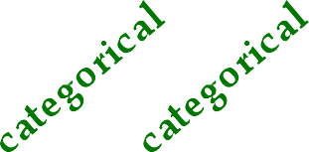
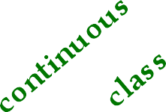
Example Decision Tree
Splitting Attributes
Refund
Yes
No
NO
MarSt
Single, Divorced
Married
TaxInc
NO
< 80K
> 80K
NO YES
The splitting attribute at a node is determined based on the GINI index

Slide 20
Another Example of Decision Tree
MarSt
Single, Divorced
Married
NO
Refund
Yes
No
NO
TaxInc
< 80K
> 80K
YES
NO
There could be more than one tree that fits the same data!

Slide 21
Decision Tree Algorithms
Many algorithms
  Hunt’s algorithm (one of the earliest)
  CART
– ID3, C4.5
  SLIQ, SPRINT
General Structure
  Tree induction
  Tree pruning

Slide 22
Tree nduction
Determine how to split the records
  Use greedy heuristics to make a series of locally optimum decision about which attribute to use for partitioning the data
  At each step of the greedy algorithm, a test condition is applied to split the data in to subsets with a more homogenous class distribution
    How to specify test condition for each attribute
    How to determine the best split
Determine when to stop splitting
  A stopping condition is needed to terminate tree growing process. Stop expanding a node
    if all the instances belong to the same class
    if all the instances have similar attribute values

Slide 23
Methods For Splitting
A key step towards building a decision tree is to find an appropriate test condition for splitting data
Categorical attributes
– The test condition can be expressed as an attribute- value pair (A = v?), whose outcomes are Yes / No, or as a question about the value of an attribute (A?)
l Status?
Marital Status =
{Married}?
Single
Divorced
Married
Yes
No

Slide 24
Methods For Splitting
Continuous attributes
– The test condition can be expressed in terms of a binary decision (A < v ?) or (A >= v?), whose outcomes are Yes / No, or as a range query whose outcomes are v_{i} <= A <= v_{i+1}, for i = 1, 2, … k
Taxable Income
> 80K ?
Taxable Income?
< 10K
> 80K
{10K, 25K}
{50K, 80K}
Yes
No
{25K, 50K}

Slide 25
Splitting Based on Nominal Attributes
Each partition has subset of values signifying it
Multi-way split: Use as many partitions as distinct values
Car type
Family
Sports
Luxury
Binary split: Divides values in to two subsets. Need to find optimal partitioning
Car type Car type
OR
{Sports, Luxury}
{Family}
{Family, Luxury}
{Sports}

Slide 26
Splitting Based on Ordinal Attributes
Each partition has subset of values signifying it
Multi-way split: Use as many partitions as distinct values
Size
Small
Large
Medium
Binary split: Divide values in to two subsets. Need to find optimal partitioning
Car type
OR
Car type
{Small, Medium}
{Large}
{Small}
{Medium, Large}
Car type
{Small, Large}
{Medium}
What about this split?

Slide 27
Splitting Criterion
There are many test conditions one could apply to partition a collection of records in to smaller subsets
Various measures are available to determine which test condition provides the best split
  Gini Index
  Entropy / Information Gain
  Classification Error

Slide 28

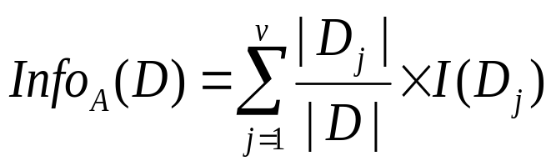

Attribute Selection Measure: Information Gain (ID3/C4.5)
Select the attribute with the highest information gain
Let p_{i} be the probability that an arbitrary tuple in D belongs to class C_{i}, estimated by |C_{i, D}|/|D|
Expected information (entropy) needed to classify a tuple in D:
Information needed (after using A to split D into v partitions) to classify D:
Information gained by branching on attribute A
Notes:
I : the expected information needed to classify a given sample
E (entropy) : expected information based on the partitioning into subsets by A

Slide 29




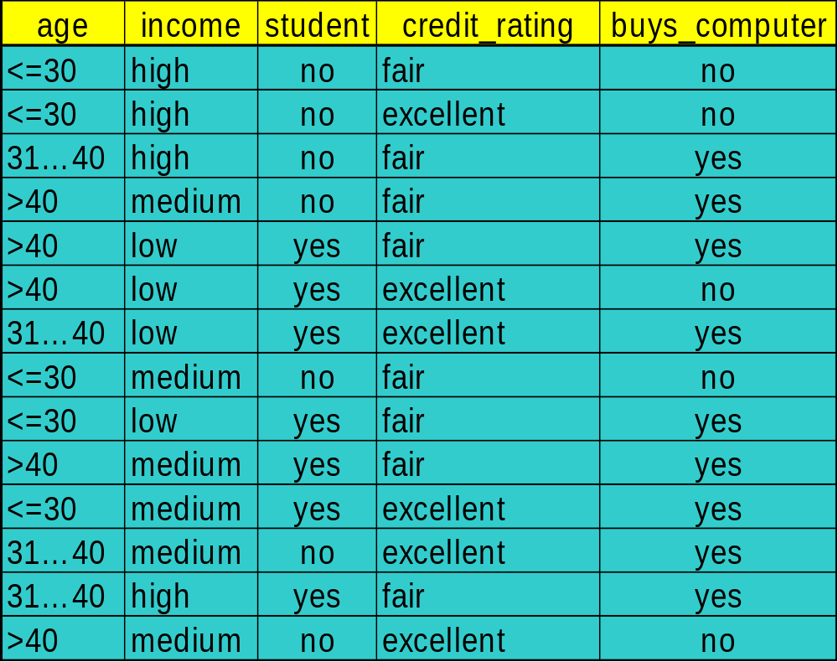

Attribute Selection: Information Gain
Class P: buys_computer = “yes”
Class N: buys_computer = “no”
means “age <=30” has 5 out of 14 samples, with 2 yes’es and 3 no’s. Hence
Similarly,
Data Mining: Concepts and Techniques

Slide 30


Slide 31
Computing Information-Gain for Continuous-Value Attributes
Let attribute A be a continuous-valued attribute
Must determine the best split point for A
  Sort the value A in increasing order
  Typically, the midpoint between each pair of adjacent values is considered as a possible split point
    (a_{i}+a_{i+1})/2 is the midpoint between the values of a_{i} and a_{i+1}
  The point with the minimum expected information requirement for A is selected as the split-point for A
Split:
  D1 is the set of tuples in D satisfying A ≤ split-point, and D2 is the set of tuples in D satisfying A > split-point

Slide 32

Gain Ratio for Attribute Selection (C4.5)
Information gain measure is biased towards attributes with a large number of values
C4.5 (a successor of ID3) uses gain ratio to overcome the problem (normalization to information gain)
  GainRatio(A) = Gain(A)/SplitInfo(A)
Ex.
  gain_ratio(income) = 0.029/0.926 = 0.031
The attribute with the maximum gain ratio is selected as the splitting attribute

Slide 33



Gini index (CART, IBM IntelligentMiner)
If a data set D contains examples from n classes, gini index, gini(D) is defined as
where p_{j} is the relative frequency of class j in D
If a data set D is split on A into two subsets D₁ and D₂, the gini index gini(D) is defined as
Reduction in Impurity:
The attribute provides the smallest gini_{split}(D) (or the largest reduction in impurity) is chosen to split the node (need to enumerate all the possible splitting points for each attribute)

Slide 34
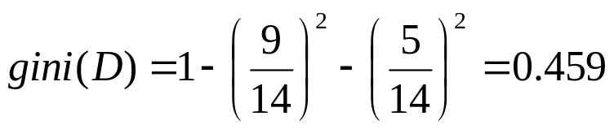

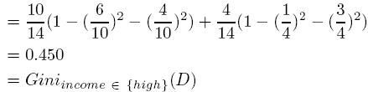
Gini index (CART, IBM IntelligentMiner)
Ex. D has 9 tuples in buys_computer = “yes” and 5 in “no”
Suppose the attribute income partitions D into 10 in D₁: {low, medium} and 4 in D₂
  but gini_{{medium,high}} is 0.30 and thus the best since it is the lowest
All attributes are assumed continuous-valued
May need other tools, e.g., clustering, to get the possible split values
Can be modified for categorical attributes
Data Mining: Concepts and Techniques

Slide 35
Comparing Attribute Selection Measures
The three measures, in general, return good results but
  Information gain:
    biased towards multivalued attributes
  Gain ratio:
    tends to prefer unbalanced splits in which one partition is much smaller than the others
  Gini index:
    biased to multivalued attributes
    has difficulty when # of classes is large
    tends to favor tests that result in equal-sized partitions and purity in both partitions
Data Mining: Concepts and Techniques

Slide 36
Other Attribute Selection Measures
CHAID: a popular decision tree algorithm, measure based on χ² test for independence
C-SEP: performs better than info. gain and gini index in certain cases
G-statistics: has a close approximation to χ² distribution
MDL (Minimal Description Length) principle (i.e., the simplest solution is preferred):
  The best tree as the one that requires the fewest # of bits to both (1) encode the tree, and (2) encode the exceptions to the tree
Multivariate splits (partition based on multiple variable combinations)
  CART: finds multivariate splits based on a linear comb. of attrs.
Which attribute selection measure is the best?
  Most give good results, none is significantly superior than others
Data Mining: Concepts and Techniques

Slide 37
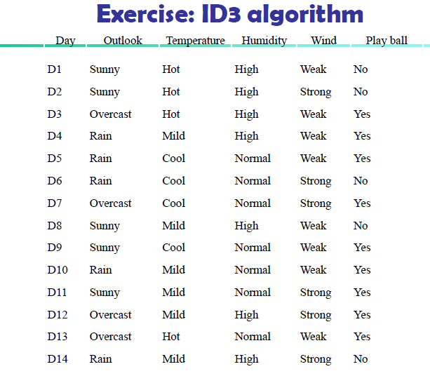
Data Mining: Concepts and Techniques

Slide 38
University of Florida
CISE department
Gator Engineering
Practical Challenges in Classification
Over-fitting
  Model performs well on training set, but poorly on test set
Missing Values
Data Heterogeneity
Costs
  Costs for measuring attributes
  Costs for misclassification
Data Mining Sanjay Ranka Spring 2011

Slide 39
The k-Nearest Neighbor Algorithm
Knn is a non-parametric supervised learning technique in which we try to classify the data point to a given category with the help of training set.
In simple words, it captures information of all training cases and classifies new cases based on a similarity.
Why KNN is non-parametric?
Non-parametric means not making any assumptions on the underlying data distribution. Non-parametric methods do not have fixed numbers of parameters in the model. Similarly in KNN, model parameters actually grows with the training data set - you can imagine each training case as a "parameter" in the model.

Slide 40
The k-Nearest Neighbor Algorithm
All instances correspond to points in the n-D space
The nearest neighbor are defined in terms of Euclidean distance, dist(X₁, X₂)
Target function could be discrete- or real- valued
For discrete-valued, k-NN returns the most common value among the k training examples nearest to x_{q}
Vonoroi diagram: the decision surface induced by 1-NN for a typical set of training examples
_
.
_
_
.
+
_
.
+
.
.
_
x_{q}
+
_
.
+
Data Mining: Concepts and Techniques

Slide 41
The k-Nearest Neighbor Algorithm
Predictions are made for a new instance (x) by searching through the entire training set for the K most similar cases (neighbors) and summarizing the output variable for those K cases.
In classification this is the mode (or most common) class value.

Slide 42
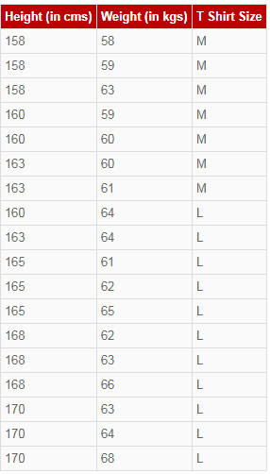
Suppose we have height, weight and T-shirt size of some customers
We need to predict the T-shirt size of a new customer given only height and weight information.
Data including height, weight and T-shirt size information is shown below -

Slide 43
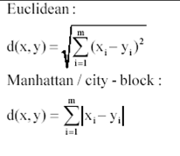
The k-Nearest Neighbor Algorithm
Step 1 : Calculate Similarity based on distance function
There are many distance functions but Euclidean is the most commonly used measure.
It is mainly used when data is continuous.
Manhattan distance is also very common for continuous variables.
The idea to use distance measure is to find the distance (similarity) between new sample and training cases and then finds the k-closest customers to new customer in terms of height and weight.

Slide 44
The k-Nearest Neighbor Algorithm
New customer named 'Monica' has height 161cm and weight 61kg.
Euclidean distance between first observation and new observation (monica) is as follows –
=SQRT((161-158)^2+(61-58)^2)
Similarly, we will calculate distance of all the training cases with new case and calculates the rank in terms of distance.
The smallest distance value will be ranked 1 and considered as nearest neighbor.

Slide 45
The k-Nearest Neighbor Algorithm
Step 2 : Find K-Nearest Neighbors
Let k be 5.
Then the algorithm searches for the 5 customers closest to Monica, i.e. most similar to Monica in terms of attributes, and see what categories those 5 customers were in.
If 4 of them had ‘Medium T shirt sizes’ and 1 had ‘Large T shirt size’ then your best guess for Monica is ‘Medium T shirt.

Slide 46
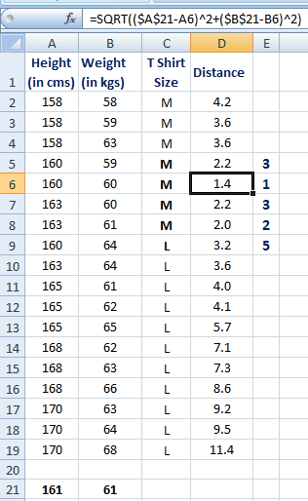

Slide 47
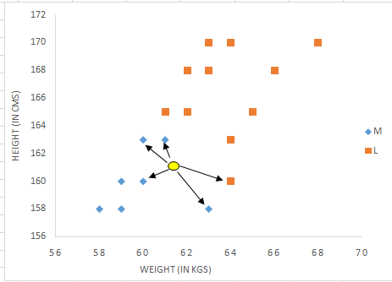
In the graph below,
Binary dependent variable (T-shirt size) is displayed in blue and orange color.
'Medium T-shirt size' is in blue color and 'Large T-shirt size' in orange color.
New customer information is exhibited in yellow circle.
Four blue highlighted data points and one orange highlighted data point are close to yellow circle.
So the prediction for the new case is blue highlighted data point which is Medium T-shirt size.

Slide 48
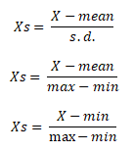
Assumptions of KNN
Standardization
When independent variables in training data are measured in different units, it is important to standardize variables before calculating distance.
For example, if one variable is based on height in cms, and the other is based on weight in kgs then height will influence more on the distance calculation.
In order to make them comparable we need to standardize them which can be done by any of the following methods :

Slide 49
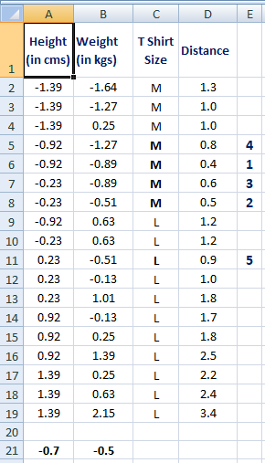
The k-Nearest Neighbor Algorithm
After standardization, 5th closest value got changed as height was dominating earlier before standardization.
Hence, it is important to standardize predictors before running K-nearest neighbor algorithm.

Slide 50
The k-Nearest Neighbor Algorithm
2. Outlier
Low k-value is sensitive to outliers and a higher K-value is more resilient to outliers as it considers more voters to decide prediction.

Slide 51
KNN vs. K-mean
Many people get confused between these two statistical techniques- K-mean and K-nearest neighbor. See some of the difference below -
K-mean is an unsupervised learning technique (no dependent variable) whereas KNN is a supervised learning algorithm (dependent variable exists)
K-mean is a clustering technique which tries to split data points into K-clusters such that the points in each cluster tend to be near each other whereas K-nearest neighbor tries to determine the classification of a point, combines the classification of the K nearest points

Slide 52
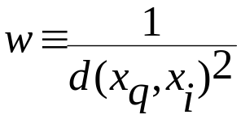
Discussion on the k-NN Algorithm
k-NN for real-valued prediction for a given unknown tuple
  Returns the mean values of the k nearest neighbors
Distance-weighted nearest neighbor algorithm
  Weight the contribution of each of the k neighbors according to their distance to the query x_{q}
    Give greater weight to closer neighbors
Robust to noisy data by averaging k-nearest neighbors
Curse of dimensionality: distance between neighbors could be dominated by irrelevant attributes
  To overcome it, axes stretch or elimination of the least relevant attributes
Data Mining: Concepts and Techniques

Slide 53
Bagging: Boostrap Aggregation
Analogy: Diagnosis based on multiple doctors’ majority vote
Training
  Given a set D of d tuples, at each iteration i, a training set D_{i} of d tuples is sampled with replacement from D (i.e., boostrap)
  A classifier model M_{i} is learned for each training set D_{i}
Classification: classify an unknown sample X
  Each classifier M_{i} returns its class prediction
  The bagged classifier M* counts the votes and assigns the class with the most votes to X
Prediction: can be applied to the prediction of continuous values by taking the average value of each prediction for a given test tuple
Accuracy
  Often significant better than a single classifier derived from D
  For noise data: not considerably worse, more robust
  Proved improved accuracy in prediction
Data Mining: Concepts and Techniques

Slide 54
Boosting
Analogy: Consult several doctors, based on a combination of weighted diagnoses—weight assigned based on the previous diagnosis accuracy
How boosting works?
  Weights are assigned to each training tuple
  A series of k classifiers is iteratively learned
  After a classifier M_{i} is learned, the weights are updated to allow the subsequent classifier, M_{i+1}, to pay more attention to the training tuples that were misclassified by M_{i}
  The final M* combines the votes of each individual classifier, where the weight of each classifier's vote is a function of its accuracy
The boosting algorithm can be extended for the prediction of continuous values
Comparing with bagging: boosting tends to achieve greater accuracy, but it also risks overfitting the model to misclassified data
Data Mining: Concepts and Techniques

Slide 55


Adaboost (Freund and Schapire, 1997)
Given a set of d class-labeled tuples, (X₁, y₁), …, (X_{d}, y_{d})
Initially, all the weights of tuples are set the same (1/d)
Generate k classifiers in k rounds. At round i,
  Tuples from D are sampled (with replacement) to form a training set D_{i} of the same size
  Each tuple’s chance of being selected is based on its weight
  A classification model M_{i} is derived from D_{i}
  Its error rate is calculated using D_{i} as a test set
  If a tuple is misclssified, its weight is increased, o.w. it is decreased
Error rate: err(X_{j}) is the misclassification error of tuple X_{j}. Classifier M_{i} error rate is the sum of the weights of the misclassified tuples:
The weight of classifier M_{i}’s vote is
Data Mining: Concepts and Techniques

Slide 56
Summary (I)
Classification and prediction are two forms of data analysis that can be used to extract models describing important data classes or to predict future data trends.
Effective and scalable methods have been developed for decision trees induction, Naive Bayesian classification, Bayesian belief network, rule-based classifier, Backpropagation, Support Vector Machine (SVM), associative classification, nearest neighbor classifiers, and case-based reasoning, and other classification methods such as genetic algorithms, rough set and fuzzy set approaches.
Linear, nonlinear, and generalized linear models of regression can be used for prediction. Many nonlinear problems can be converted to linear problems by performing transformations on the predictor variables. Regression trees and model trees are also used for prediction.
Data Mining: Concepts and Techniques

Slide 57
Summary (II)
Stratified k-fold cross-validation is a recommended method for accuracy estimation. Bagging and boosting can be used to increase overall accuracy by learning and combining a series of individual models.
Significance tests and ROC curves are useful for model selection
There have been numerous comparisons of the different classification and prediction methods, and the matter remains a research topic
No single method has been found to be superior over all others for all data sets
Issues such as accuracy, training time, robustness, interpretability, and scalability must be considered and can involve trade-offs, further complicating the quest for an overall superior method
Data Mining: Concepts and Techniques

