Slide 1
On the Power of Ensemble
*Slides and references available at http://ews.uiuc.edu/~jinggao3/sdm10ensemble.htm

Slide 2



Stories of Success
Million-dollar prize
  Improve the baseline movie recommendation approach of Netflix by 10% in accuracy
  The top submissions all combine several teams and algorithms as an ensemble
Data mining competitions
  Classification problems
  Winning teams employ an ensemble of classifiers

Slide 3
Netflix Prize
Supervised learning task
  Training data is a set of users and ratings (1,2,3,4,5 stars) those users have given to movies.
  Construct a classifier that given a user and an unrated movie, correctly classifies that movie as either 1, 2, 3, 4, or 5 stars
  $1 million prize for a 10% improvement over Netflix’s current movie recommender
Competition
  At first, single-model methods are developed, and performances are improved
  However, improvements slowed down
  Later, individuals and teams merged their results, and significant improvements are observed

Slide 4
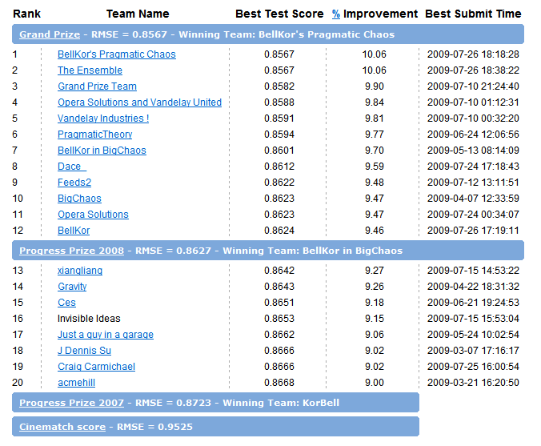
Leaderboard
“Our final solution (RMSE=0.8712) consists of blending 107 individual results. “
“Predictive accuracy is substantially improved when blending multiple predictors. Our experience is that most efforts should be concentrated in deriving substantially different approaches, rather than refining a single technique. “

Slide 5
Motivations
Motivations of ensemble methods
  Ensemble model improves accuracy and robustness over single model methods
  Applications:
    distributed computing
    privacy-preserving applications
    large-scale data with reusable models
    multiple sources of data
  Efficiency: a complex problem can be decomposed into multiple sub-problems that are easier to understand and solve (divide-and-conquer approach)

Slide 6
Why Ensemble Works? (1)
Intuition
  combining diverse, independent opinions in human decision-making as a protective mechanism (e.g. stock portfolio)
Uncorrelated error reduction
  Suppose we have 5 completely independent classifiers for majority voting
  If accuracy is 70% for each
    10 (.7^3)(.3^2)+5(.7^4)(.3)+(.7^5)
    83.7% majority vote accuracy
  101 such classifiers
    99.9% majority vote accuracy
from T. Holloway, Introduction to Ensemble Learning, 2007.

Slide 7
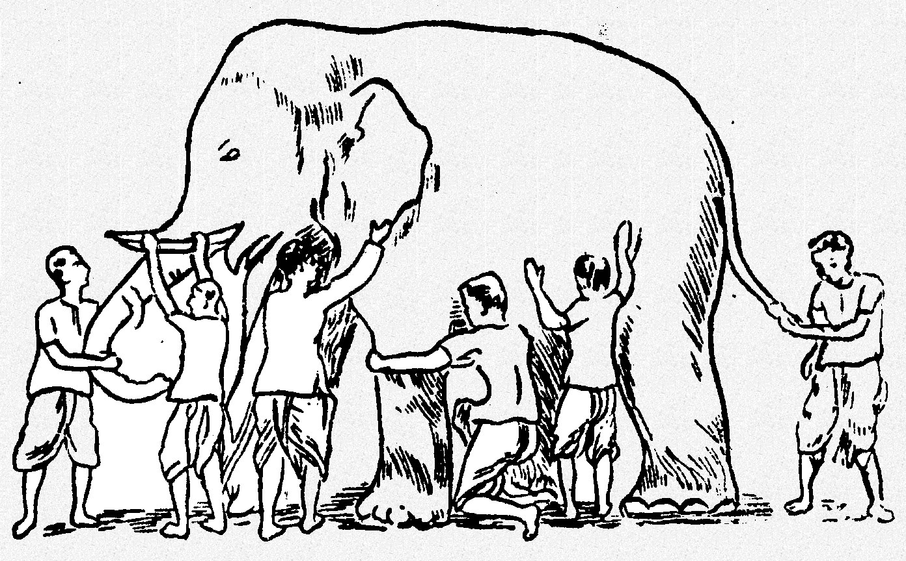
Why Ensemble Works? (2)
Some unknown distribution
Model 1
Model 6
Model 3
Model 5
Model 2
Model 4
Ensemble gives the global picture!

Slide 8
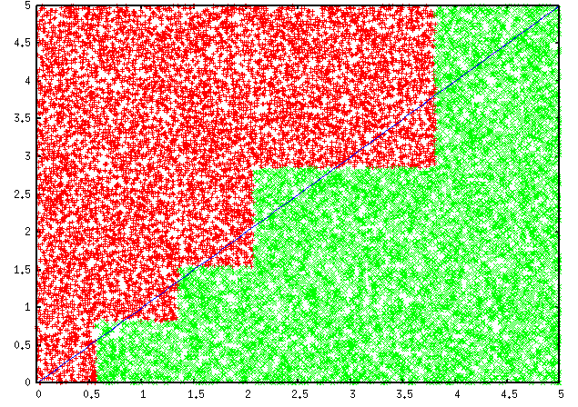
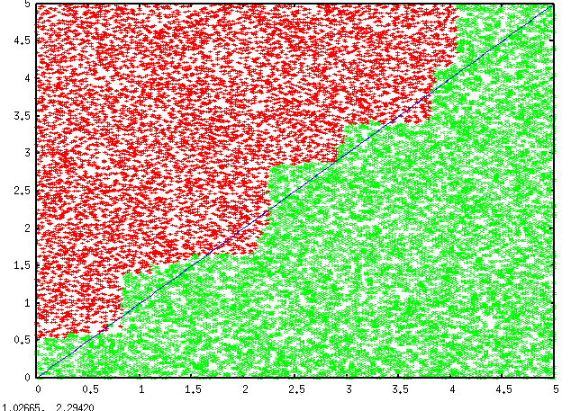
Why Ensemble Works? (3)
Overcome limitations of single hypothesis
  The target function may not be implementable with individual classifiers, but may be approximated by model averaging
Decision Tree
Model Averaging

Slide 9
Supervised Ensemble Methods
Problem
  Given a data set D={x₁,x₂,…,x_{n}} and their corresponding labels L={l₁,l₂,…,l_{n}}
  An ensemble approach computes:
    A set of classifiers {f₁,f₂,…,f_{k}}, each of which maps data to a class label: f_{j}(x)=l
    A combination of classifiers f* which minimizes generalization error: f*(x)= w₁f₁(x)+ w₂f₂(x)+…+ w_{k}f_{k}(x)

Slide 10
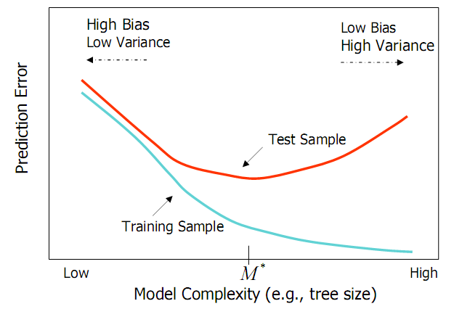
Bias and Variance
Ensemble methods
  Combine learners to reduce variance
from Elder, John. From Trees to Forests and Rule Sets - A Unified Overview of Ensemble Methods. 2007.

Slide 11
Generating Base Classifiers
Sampling training examples
  Train k classifiers on k subsets drawn from the training set
Using different learning models
  Use all the training examples, but apply different learning algorithms
Sampling features
  Train k classifiers on k subsets of features drawn from the feature space
Learning “randomly”
  Introduce randomness into learning procedures

Slide 12
Bagging* (1)
Bootstrap
  Sampling with replacement
  Contains around 63.2% original records in each sample
Bootstrap Aggregation
  Train a classifier on each bootstrap sample
  Use majority voting to determine the class label of ensemble classifier
*[Breiman96]

Slide 13
Bootstrap Method
The bootstrap is a powerful statistical method for estimating a quantity from a data sample.
When the sample dataset is small and error is high, we can improve the accuracy using the bootstrap procedure:
Create many (e.g. 1000) random sub-samples of our dataset with replacement (meaning we can select the same value multiple times).
For example:
If we begin with the sample 2, 4, 5, 6, 6, then all of the following are possible bootstrap samples:
      2 ,5, 5, 6, 6
      4, 5, 6, 6, 6
      2, 2, 4, 5, 5
      2, 2, 2, 4, 6
      2, 2, 2, 2, 2
      4,6, 6, 6, 6

Slide 14
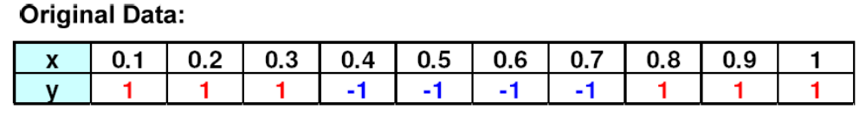
Bagging (2)
Bootstrap samples and classifiers:
Combine predictions by majority voting
from P. Tan et al. Introduction to Data Mining.

Slide 15

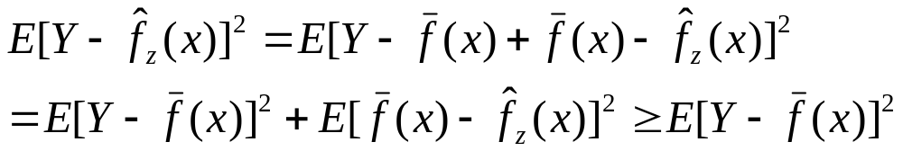
Bagging (3)
Error Reduction
  Under mean squared error, bagging reduces variance and leaves bias unchanged
  Consider idealized bagging estimator:
  The error is
  Bagging usually decreases MSE
from Elder, John. From Trees to Forests and Rule Sets - A Unified Overview of Ensemble Methods. 2007.

Slide 16
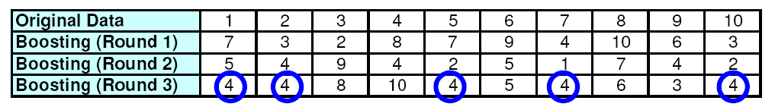
Boosting* (1)
Principles
  Boost a set of weak learners to a strong learner
  Make records currently misclassified more important
Example
  Record 4 is hard to classify
  Its weight is increased, therefore it is more likely to be chosen again in subsequent rounds
*[FrSc97]
from P. Tan et al. Introduction to Data Mining.

Slide 17
Boosting (2)
AdaBoost
  Initially, set uniform weights on all the records
  At each round
    Create a bootstrap sample based on the weights
    Train a classifier on the sample and apply it on the original training set
    Records that are wrongly classified will have their weights increased
    Records that are classified correctly will have their weights decreased
    If the error rate is higher than 50%, start over
  Final prediction is weighted average of all the classifiers with weight representing the training accuracy

Slide 18
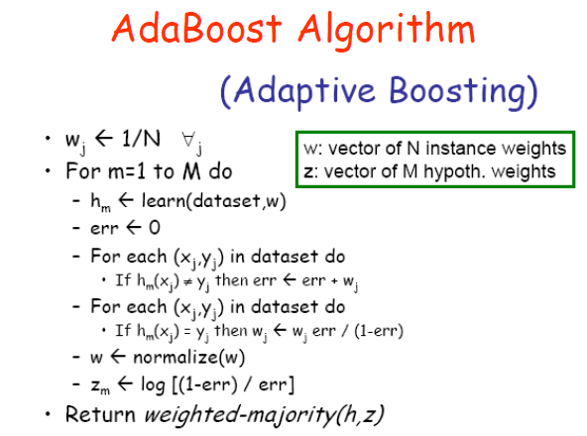

Slide 19
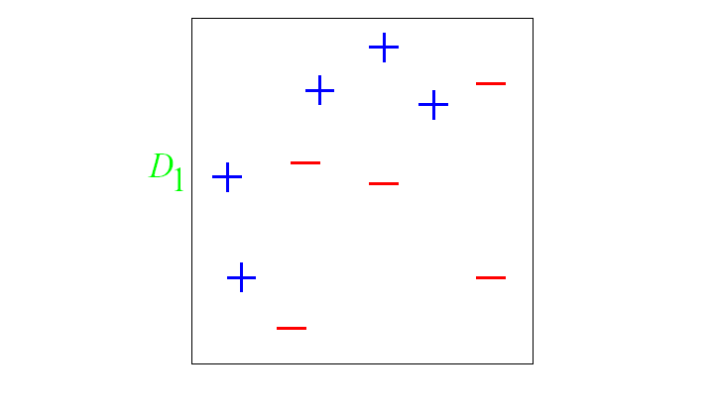
And in animation
Original training set: equal weights to all training samples
Taken from “A Tutorial on Boosting” by Yoav Freund and Rob Schapire

Slide 20
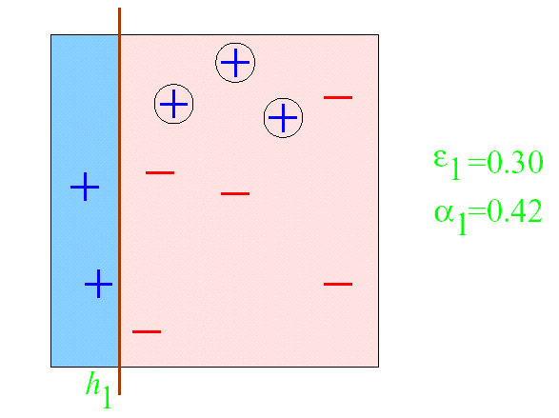
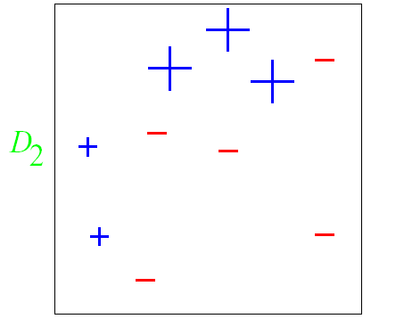
AdaBoost example
ε = error rate of classifier
α = weight of classifier
ROUND 1

Slide 21
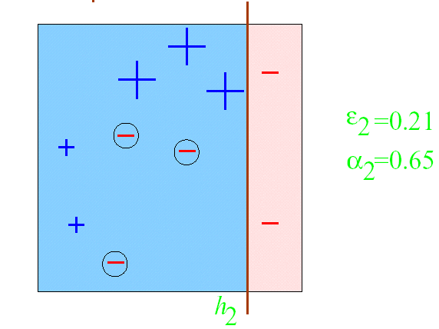
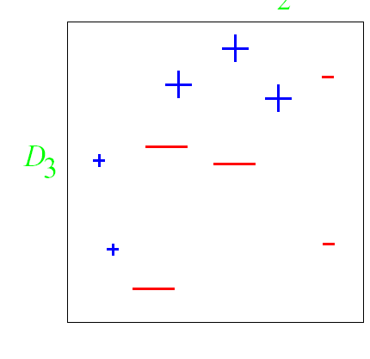
AdaBoost example
ROUND 2

Slide 22
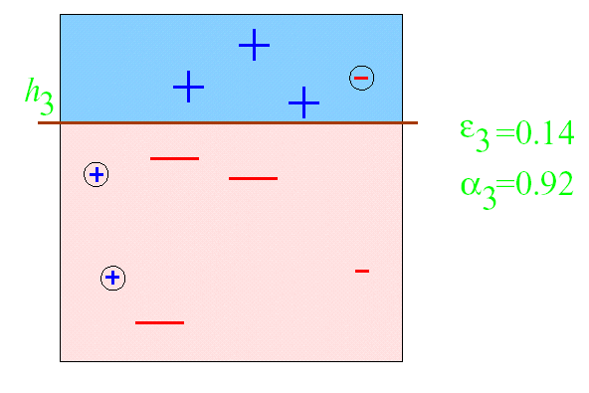
AdaBoost example
ROUND 3

Slide 23
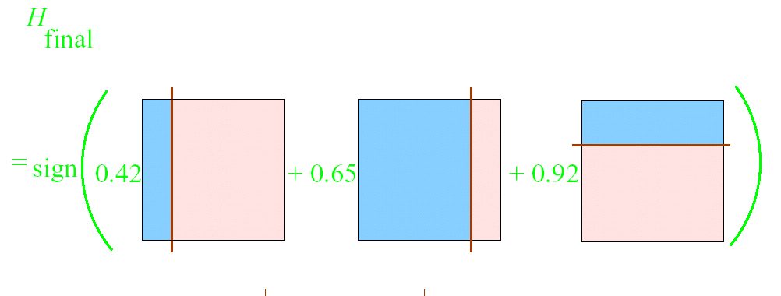
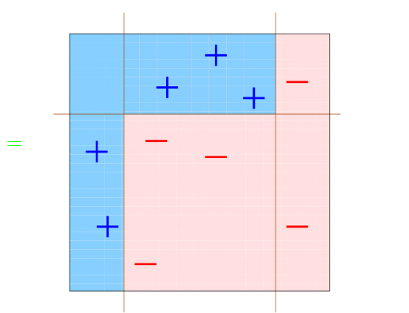
AdaBoost example

Slide 24
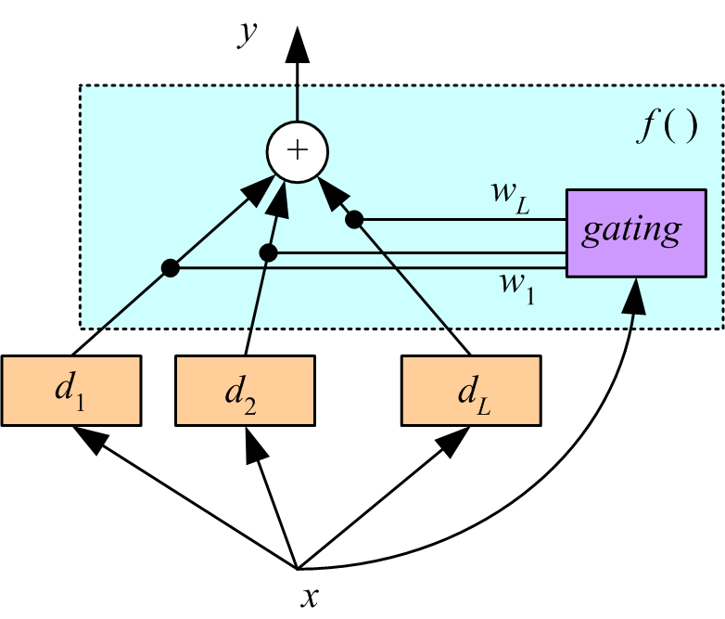
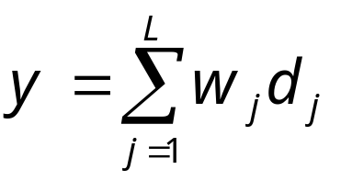
Mixture of experts
Voting where weights are input-dependent (gating)
Different input regions convered by different learners (Jacobs et al., 1991)
Gating decides which expert to use
Need to learn the individual experts as well as the gating functions w_{i}(x):
Σw_{j}(x) = 1, for all x

Slide 25
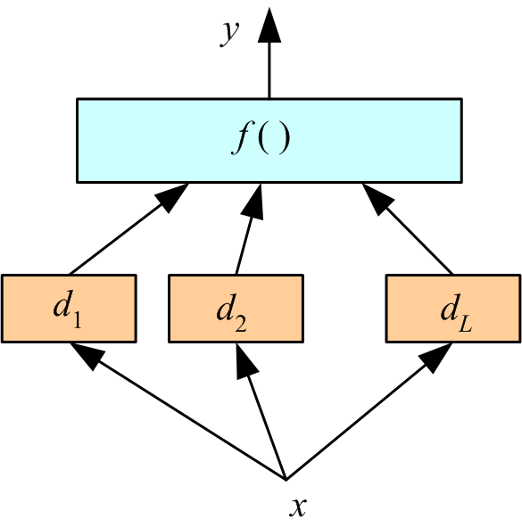
Stacking
Combiner f () is another learner (Wolpert, 1992)

Slide 26
Random Forest
Ensemble consisting of a bagging of un-pruned
decision tree learners with a randomized selection of
features at each split.
Grow many trees on datasets sampled from the original dataset with replacement (a bootstrap sample).
  Draw K bootstrap samples of a fixed size
  Grow a DT, randomly sampling a few attributes/dimensions to split on at each internal node
Average the predictions of the trees for a new query (or take majority vote)
Random Forests are state of the art classifiers!

Slide 27
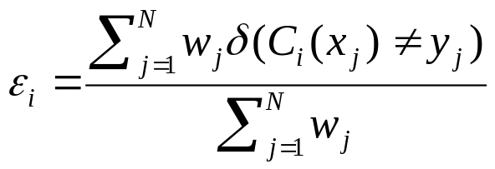
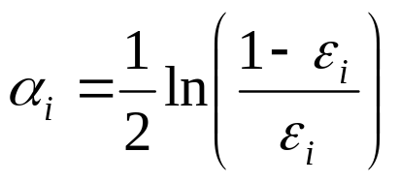
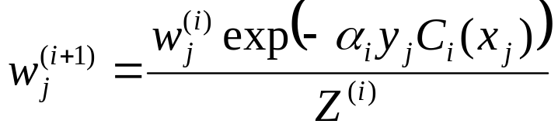
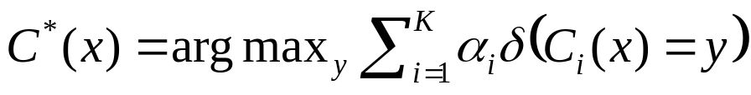
Boosting (3)
Determine the weight
  For classifier i, its error is
  The classifier’s importance is represented as:
  The weight of each record is updated as:
  Final combination:

Slide 28
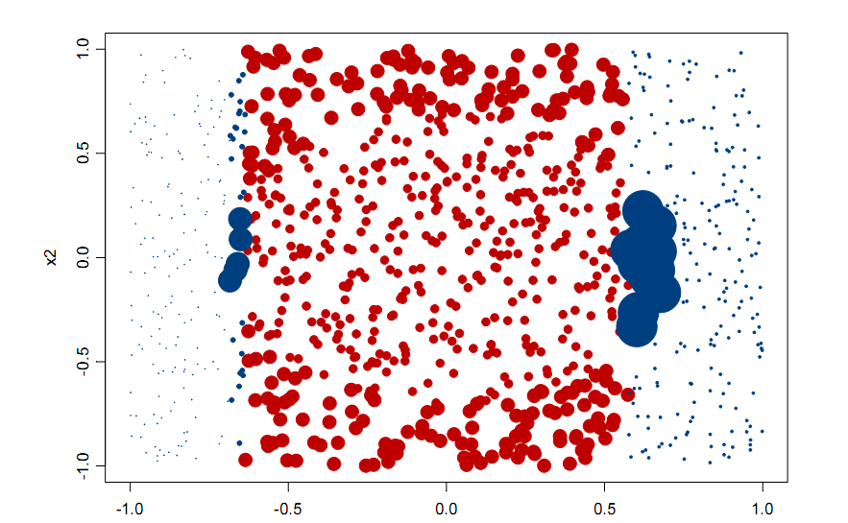
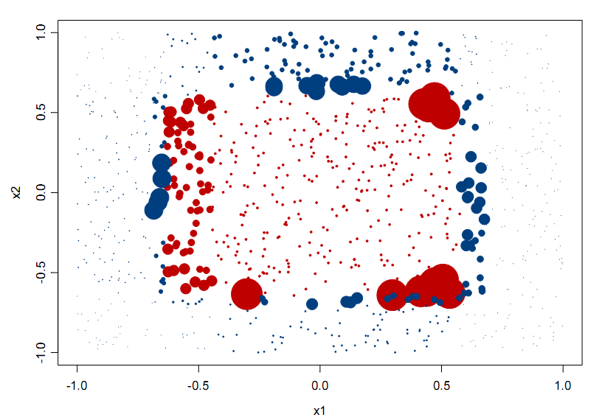
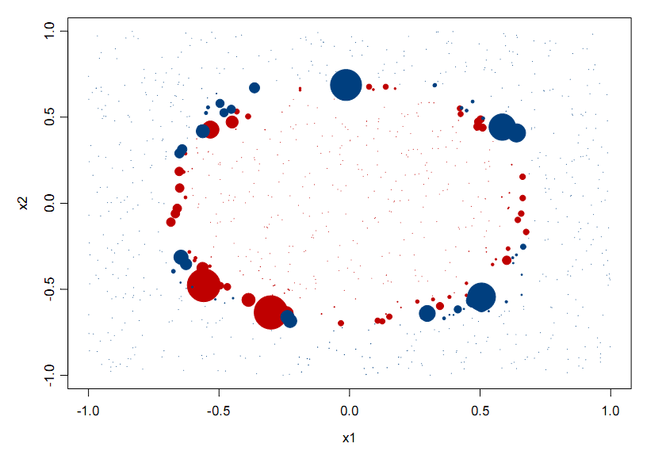
Classifications (colors) and
Weights (size) after 1 iteration
Of AdaBoost
20 iterations
3 iterations
from Elder, John. From Trees to Forests and Rule Sets - A Unified Overview of Ensemble Methods. 2007.
Notes:
Note after 1 iteration the step classes of a single decision tree.

Slide 29
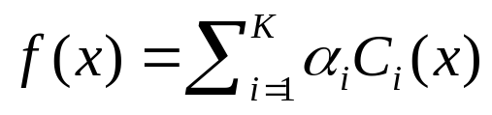
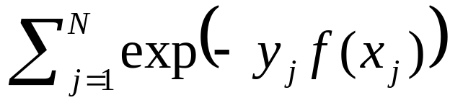
Boosting (4)
Explanation
  Among the classifiers of the form:
  We seek to minimize the exponential loss function:
  Not robust in noisy settings

Slide 30
Thank You

