Slide 1
Natural Language Processing

Slide 2
What is NLP
Computers use (analyze, understand, generate) natural language
Text Processing
Lexical: tokenization, part of speech, head, lemmas
Parsing and chunking
Semantic tagging: semantic role, word sense
Certain expressions: named entities
Discourse: coreference, discourse segments
Speech Processing
Phonetic transcription
Segmentation (punctuations)
Prosody

Slide 3
Bigger Applications
Intelligent computer systems
NLU interfaces to databases
Computer aided instruction
Information retrieval
Intelligent Web searching
Data mining
Machine translation
Speech recognition
Natural language generation
Question answering

Slide 4
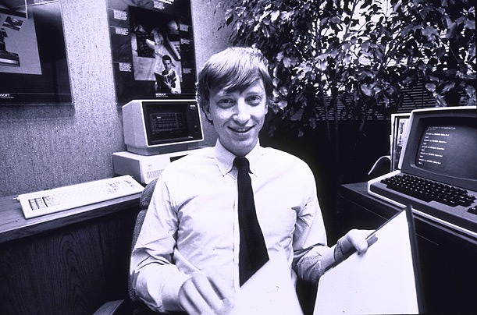







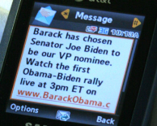

NLP for Big Data
640K ought to be enough for anybody.
Huge Size
Google processes 20 PB a day (2008)
Wayback Machine has 3 PB + 100 TB/month (3/2009)
Facebook has 2.5 PB of user data + 15 TB/day (4/2009)
eBay has 6.5 PB of user data + 50 TB/day (5/2009)
80% data is unstructured (IBM, 2010)
More importantly, Heterogeneous
Time/Location/
Cost Constraints
Texts
Authors
Venues
Notes:
The whole motivation comes from big data. When we talk about big data, we usually mean its big size. E.g. google processes 20 petabyte every day. Previous work cared about how to process this kind of large data efficiently. However, more importantly, 80% of these data is unstructured data. So we need some techniques to extract structured facts from it. Also even more importantly, all of these data come from hetereogenous source. Such as multimedia, differnet genres, languages, and embedded in rich context. Bill gates in 1981 said 640K is probably enough for everyone. This claim is probably still true.
₄

Slide 5

Two Generations of NLP
Hand-crafted Systems – Knowledge Engineering [1950s– ]
Rules written by hand; adjusted by error analysis
Require experts who understand both the systems
and domain
Iterative guess-test-tweak-repeat cycle
Automatic, Trainable (Machine Learning) System [1985s– ]
The tasks are modeled in a statistical way
More robust techniques based on rich annotations
Perform better than rules (Parsing 90% vs. 75% accuracy)

Slide 6
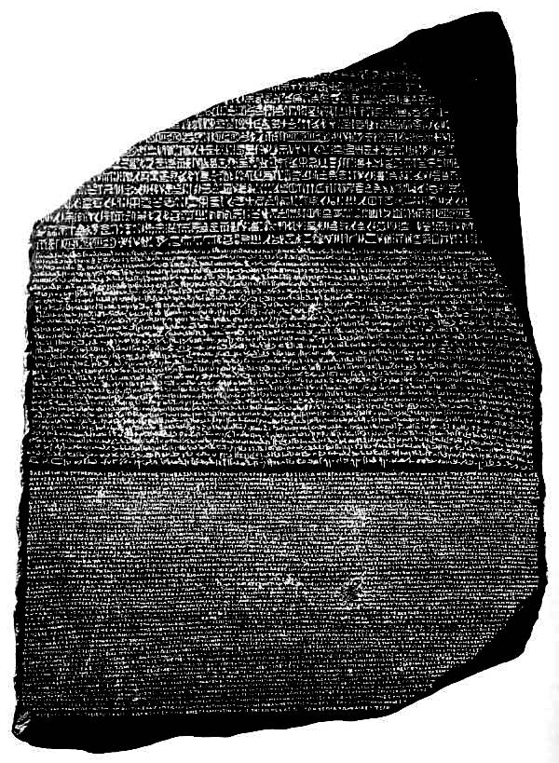
Corpora
A corpus is a collection of text
Often annotated in some way
Sometimes just lots of text
Balanced vs. uniform corpora
Examples
Newswire collections: 500M+ words
Brown corpus: 1M words of tagged “balanced” text
Penn Treebank: 1M words of parsed WSJ
Canadian Hansards: 10M+ words of aligned French / English sentences
The Web: billions of words of who knows what

Slide 7
Various processes of NLP
Tokenisation
Stop Word Removal
Stemming
Morphological Analysis
Data Representation
POS Tagging
Syntactical Analysis (Parsing)
Semantic Analysis

Slide 8
Text pre-processing
A token is a sequence of characters that are grouped together as a semantic unit
token
Romans
roman
roamns

Slide 9
Text pre-processing
Determining the tokens is the two major pre-processing steps
“Friends, Romans and Countrymen …”
tokenization
Friends , Romans , Countrymen
token normalization (determining terms)
friend roman countrymen

Slide 10
Basic tokenization
If I asked you to break a text into tokens, what might you try?
Split tokens on whitespace
Split or throw away punctuation characters

Slide 11
Tokenization issues: ‘
Finland’s capital…
?

Slide 12
Tokenization issues: ‘
Finland’s capital…
Finland
Finland ‘ s
Finland ‘s
Finlands
Finland s
Finland’s
What are the benefits/drawbacks?

Slide 13
Tokenization issues: hyphens
Hewlett-Packard
state-of-the-art
co-education
lower-case
?

Slide 14
Tokenization issues: hyphens
Hewlett-Packard
state-of-the-art
co-education
lower-case
Keep as is
merge together
HewlettPackard
stateoftheart
Split on hyphen
lower case
co education
What are the benefits/drawbacks?

Slide 15
More tokenization issues
Compound nouns: San Francisco, Los Angeles, …
One token or two?
Numbers
Examples
Dates: 3/12/91
Model numbers: B-52
Domain specific numbers: PGP key - 324a3df234cb23e
Phone numbers: (800) 234-2333
Scientific notation: 1.456 e-10
Splitting on white space may not always be desirable

Slide 16
Tokenization: language issues
莎拉波娃现在居住在美国东南部的佛罗里达。
Where are the words?
Chinese and Japanese have no spaces between words
A word can be made up of one or more characters
There is ambiguity about the tokenization, i.e. more than one way to break the characters into words
Word segmentation problem
thisissue
?
this issue
this is sue

Slide 17
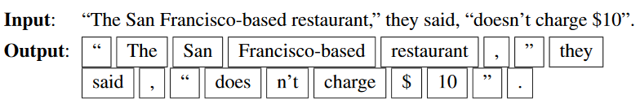
Tokeniser
One commonly used tokenization standard is known as the Penn Treebank tokenization standard, used for the parsed corpora (treebanks) released by the LinPenn Treebank tokenizationguistic Data Consortium (LDC), the source of many useful datasets. This standard separates out clitics (doesn’t becomes does plus n’t ), keeps hyphenated words together, and separates out all punctuation:

Slide 18
Stop words
Some extremely common words that would appear to be of little value in helping select documents
With a stop list, you exclude from the index/dictionary the most common words
Pros:
They have little semantic content: the, a, and, to, be
There are a lot of them: ~30% of postings for top 30 words
Cons
Phrase queries: “King of Denmark”
Song titles, etc.: “Let it be”, “To be or not to be”
“Relational” queries: “flights to London”

Slide 19
Stemming
Reduce terms to their “roots” before indexing
The term “stemming” is used since it is accomplished mostly by chopping off part of the suffix of the word
automate
automates automatic
automation
automat
run
runs
running
run

Slide 20
Stemming example
Taking a course in information retrieval is more exciting than most courses
Take a cours in inform retriev is more excit than most cours
http://maya.cs.depaul.edu/~classes/ds575/porter.html

Slide 21
Porter’s algorithm (1980)
Most common algorithm for stemming English
Results suggest it’s at least as good as other stemming options
Multiple sequential phases of reductions using rules, e.g.
sses → ss
ies → i
ational → ate
tional → tion
http://tartarus.org/~martin/PorterStemmer/

Slide 22
Lemmatization
Reduce inflectional/variant forms to base form
Lemmatization implies doing “proper” reduction to dictionary headword form
e.g.,
am, are, is → be
car, cars, car's, cars' → car
the boy's cars are different colors the boy car be different color

Slide 23
Lemmatization
Dictionary-based stemming
Use a vocabulary and morphological analysis of words to remove inflectional endings only and return the base or dictionary form of a word (lemma)
“saw” → “see” or “saw” depending on whether the token is used as a verb or a noun
Stemming is an approximation for lemmatization
Can bring very modest benefit for retrieval in
English – improving recall but may hurt accuracy

Slide 24
Defining POS Tagging
The process of assigning a part-of-speech or lexical class marker to each word in a corpus:
WORDS
TAGS
the
koala
put
the
keys
on
the
table
N
V
P
DET
24
Notes:
24

Slide 25
Word Classes
Words that somehow ‘behave’ alike:
Appear in similar contexts
Perform similar functions in sentences
Undergo similar transformations
~9 traditional word classes of parts of speech
Noun, verb, adjective, preposition, adverb, article, interjection, pronoun, conjunction
25
Notes:
25

Slide 26
Some Examples
N noun chair, bandwidth, pacing
V verb study, debate, munch
ADJ adjective purple, tall, ridiculous
ADV adverb unfortunately, slowly
P preposition of, by, to
PRO pronoun I, me, mine
DET determiner the, a, that, those
26
Notes:
26

Slide 27
Choosing a POS Tagset
To do POS tagging, first need to choose a set of tags
Could pick very coarse (small) tagsets
N, V, Adj, Adv.
More commonly used: Brown Corpus (Francis & Kucera ‘82), 1M words, 87 tags – more informative but more difficult to tag
Most commonly used: Penn Treebank: hand-annotated corpus of Wall Street Journal, 1M words, 45-46 subset
27
Notes:
27

Slide 28
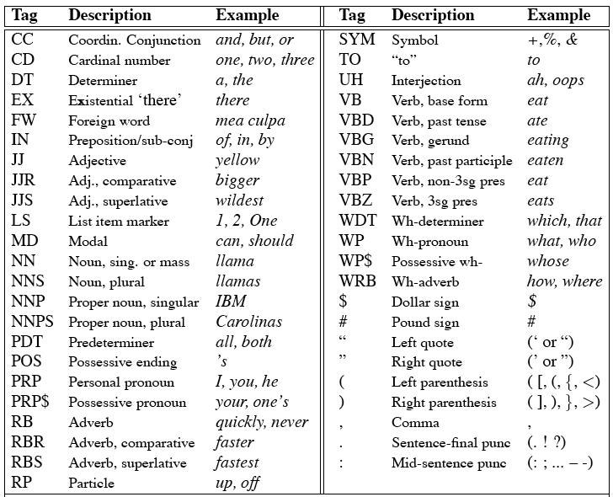
Penn Treebank Tagset
28
Notes:
28

Slide 29
Tag Ambiguity
Words often have more than one POS: back
The back door = JJ
On my back = NN
Win the voters back = RB
Promised to back the bill = VB
The POS tagging problem is to determine the POS tag for a particular instance of a word
29
Notes:
29

Slide 30
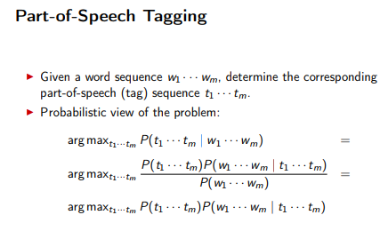

Slide 31
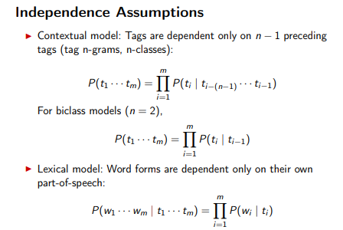

Slide 32
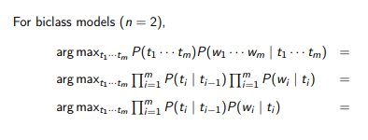

Slide 33
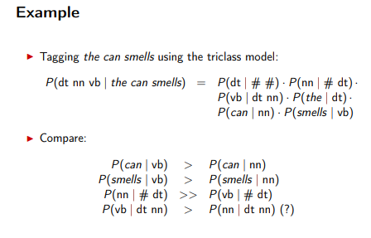

Slide 34
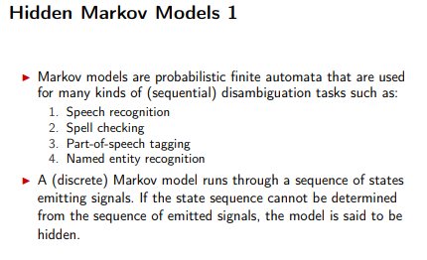

Slide 35
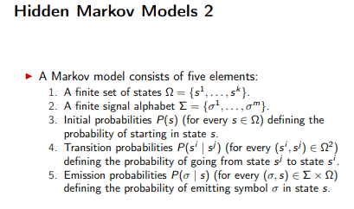

Slide 36
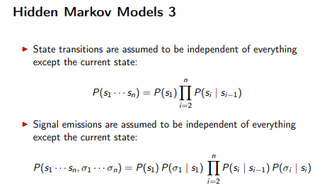

Slide 37
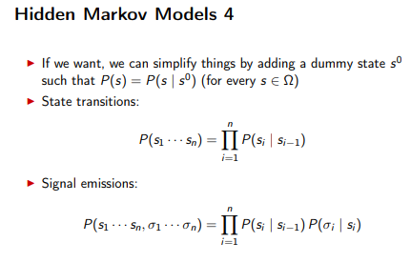

Slide 38
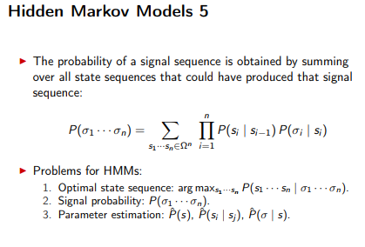

Slide 39
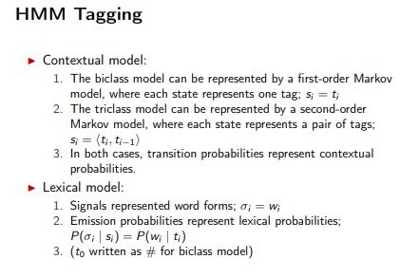

Slide 40
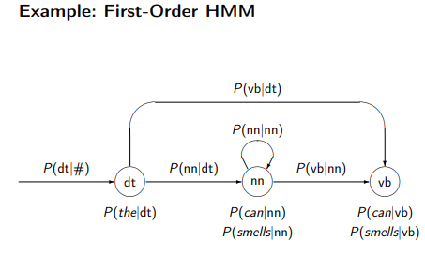

Slide 41
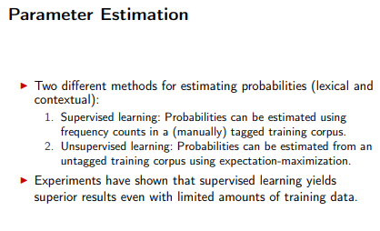

Slide 42
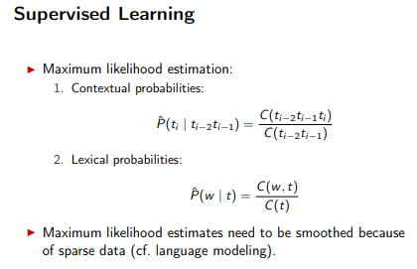

Slide 43
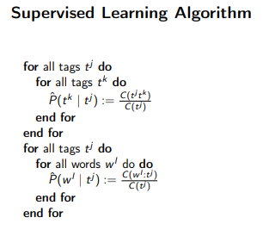

Slide 44
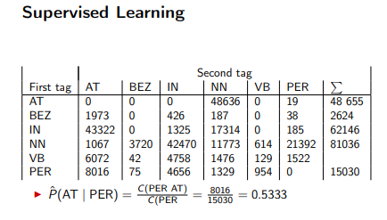

Slide 45
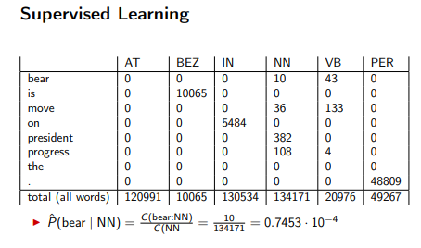

Slide 46
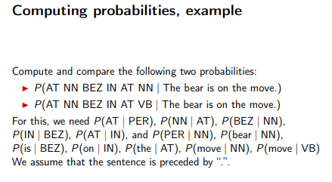

Slide 47
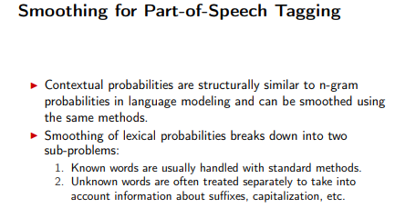

Slide 48
Question
Consider the following annotated (SIMPLIFIED)corpus for the POS tagger,
The/DT race/NN was/VB awesome/JJ ./.
The/DT boy/NN raced/VB to/TO the/DT school/NN./.
Modern/NN people/NN are/VB busy/JJ in/IN the/DT rat/NN race/NN ./.
Input sentence – “The race to the school was awesome”.

Slide 49
i/p sentence possible tags
The DT
race NN, VB
to TO
the DT
school NN
was VB
Awesome JJ
Ambiguity is with “race” only. To resolve this, apply rules designed at previous slide.

Slide 50
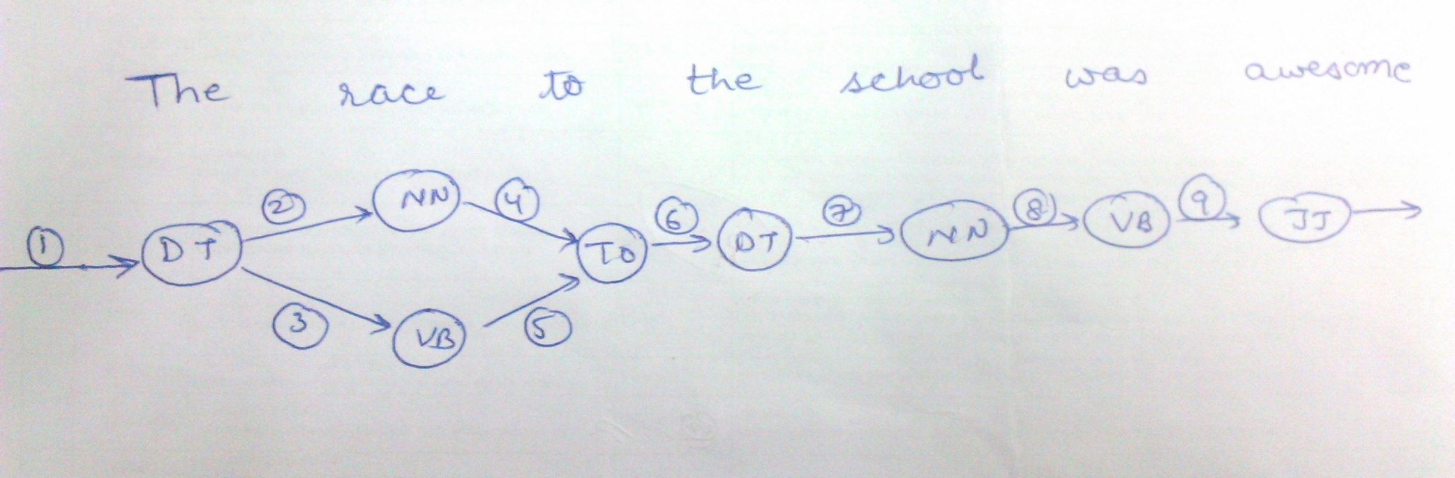
Look at the given three sentences and find the possible tags for each of the below given words.
For each edge, find the transition probabilities eg. Start → DT; DT → NN; DT → VB and so ie. P(DT|Start); P(NN|DT) etc.
------- representing matrix A (transition matrix)
2. For each edge, find the probability of occurrence word with specified tag.
ie. P(The |DT) ; P(race|NN); P(race|VB) and so.
------representing matrix B (Emission matrix)

Slide 51
Initial State Probabilities
P(DT|Start) = 2/3 as out of 3 given sentences 2 are starting with the so it is.

Slide 52
Transition matrix A
P(NN|DT) = P(DT, NN)/ P(DT)
P(VB|DT)= P(DT, VB)/ P(DT)
P(TO|NN) = P(NN, TO)/P(NN)
P(TO|VB) = P(VB,TO)/P(VB)
P(DT|TO) = P(TO, DT)/P(TO)
P(NN|DT) = P(DT,NN)/P(DT)
P(VB|NN) =P(NN, VB)/P(NN)
P(JJ|VB)=P(VB,JJ)/P(VB)
In total there should be a 6 (DT, NN, VB, TO, JJ, IN) x 6 (DT, NN, VB, TO, JJ, IN) matrix, but we have calculated only the required ones.

Slide 53
Emission/Observable matrix B
P(The |DT) = count(the,DT) / count (DT)
P(race|NN)
P(race|VB)
P(to |TO)
P(school | NN)
P(was|VB)
P(awesome|JJ)

Slide 54
Next Step
Solution 1:
Multiply all probabilities along path1 and path 2 and get the maximum one ie Maximum Likelihood
Consider smoothing factor =0.01
It is used if some probabilities comes out to be 0. Instead of taking it as 0, use the smoothing parameter.

Slide 55
Solution 1: Maximum Likelihood
P(W,T₁) = P(The |DT) * P(DT|Start) * P(race|NN) * P(NN|DT) *
P(to |TO) * P(TO|NN) *
P(the |DT) * P(DT|TO) *
P(school | NN) * P(NN|DT) *
P(was|VB) * P(VB|NN)*
P(awesome|JJ) * P(JJ|VB)

Slide 56
Solution 1: Maximum Likelihood...
P(W,T₂) = P(The |DT) * P(DT|Start) * P(race|VB) * P(VB|DT) *
P(to |TO) * P(TO|VB) *
P(the |DT) * P(DT|TO) *
P(school | NN) * P(NN|DT) *
P(was|VB) * P(VB|NN)*
P(awesome|JJ) * P(JJ|VB)

Slide 57
Solution 1: Maximum Likelihood...
Max(P(W,T₁), P(W,T₂))

Slide 58
Example 2
Let’s tag the sentence
Janet will back the bill;
the goal is the correct series of tags.
Janet/NNP will/MD back/VB the/DT bill/NN

Slide 59
Example 2
Let the HMM be defined by the two tables in Fig. 8.7 and Fig. 8.8.
First fig lists the ai,j probabilities for transitioning between the hidden states (part-of-speech tags).
Second Figure expresses the bi(ot) probabilities, the observation likelihoods of words given tags.
This table is (slightly simplified) from counts in the WSJ corpus.
So the word Janet only appears as an NNP,
back has 4 possible parts of speech, and
the word the can appear as a determiner or as an NNP (in titles like “Somewhere Over the Rainbow” all words are tagged as NNP).

Slide 60
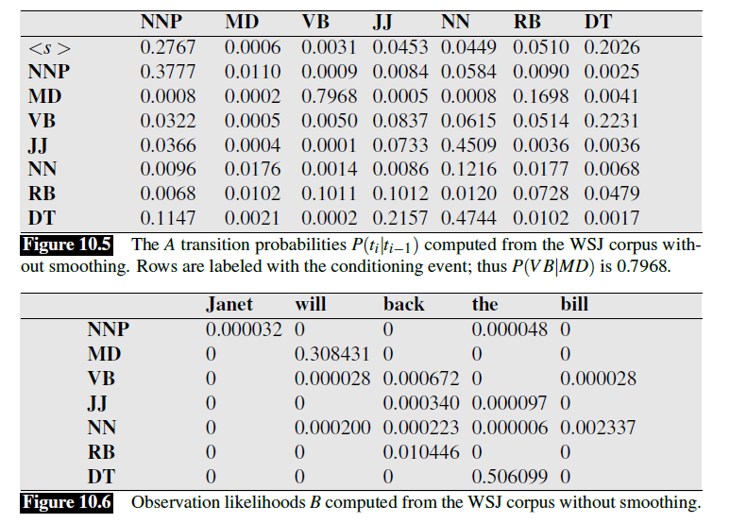
Ex 2

Slide 61
Input sentence is
Janet NNP
will MD
back VB, JJ
the DT
bill NN, VB
Apply MLE to disambiguate the POS tagging

Slide 62
Context-Free Grammars
G = (V, T, S, P)
Productions are of the form:
A → x
A ∈ V and x ∈ (V ∪ T)*

Slide 63
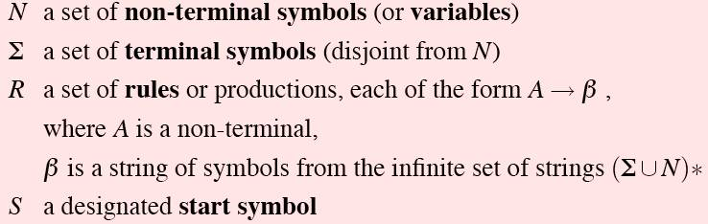
Definition
More formally, a CFG consists of

Slide 64
Example 1
G = ({S}, {a, b}, S, P)
P = { S → aSa
S → bSb
S → λ
}
S ⇒ aSa ⇒ aaSaa ⇒ aabSbaa ⇒ aabbaa

Slide 65
Example 2
G = ({S, A, B}, {a, b}, S, P)
P = { S → abB
A → aaBb
B → bbAa
A → λ
}
S ⇒ abB ⇒ abbbAa ⇒ abbbaaBba ⇒ abbbaabbAaba ⇒ abbbaabbaba

Slide 66
Example 3
P = { S → AS₁ | S₁B
S₁ → aS₁b | λ
A → aA | a
B → bB | b
}
Derive 2-3 strings using the grammar

Slide 67
Derivations
G = ({S, A, B}, {a, b}, S, {S → AB, A → aaA, A → λ, B → Bb, B → λ}) 1 2 3 4 5
S ⇒ AB ⇒ aaAB ⇒ aaB ⇒ aaBb ⇒ aab
S ⇒ AB ⇒ ABb ⇒ aaABb ⇒ aaAb ⇒ aab
1
2
3
4
5
1
4
2
5
3

Slide 68
Derivations
Leftmost: in each step the leftmost variable in the sentential form is replaced.
Rightmost: in each step the rightmost variable in the sentential form is replaced.

Slide 69
Example
G = ({S, A, B}, {a, b}, S, {S → AB, A → aaA, A → λ, B → Bb, B → λ}) 1 2 3 4 5
S ⇒ AB ⇒ aaAB ⇒ aaB ⇒ aaBb ⇒ aab Left
S ⇒ AB ⇒ ABb ⇒ aaABb ⇒ aaAb ⇒ aab Right
1
2
3
4
5
1
4
2
5
3

Slide 70
Derivation Trees
A → abABc
A
a
b
A
B
c
ordered tree

Slide 71
Derivation Trees
Let G = (V, T, S, P) be a context-free grammar.
An ordered tree is a derivation tree iff:
The root is labeled S.
Every leaf has a label from T ∪ {λ}.
Every interior vertex has a label from V.
A vertex has label A∈V and its children are labeled a₁, a₂, ..., a_{n} iff
P contains the production A → a₁ a₂ ... a_{n}.
A leaf labeled λ has no siblings.

Slide 72
Derivation Trees
Let G = (V, T, S, P) be a context-free grammar.
An ordered tree is a partial derivation tree iff:
The root is labeled S.
Every leaf has a label from T ∪ {λ}.
Every leaf has a label from V ∪ T ∪ {λ}.
Every interior vertex has a label from V.
A vertex has label A∈V and its children are labeled a₁, a₂, ..., a_{n} iff
P contains the production A → a₁ a₂ ... a_{n}.
A leaf labeled λ has no siblings.

Slide 73
Derivation Trees
The string of symbols obtained by reading the leaves of a tree from left to
right (omitting any λ's encountered) is called the yield of the tree.

Slide 74
Derivation Trees
S
S → aAB
A → bBb
B → A | λ
yield: abbbb
a
A
B
b
b
B
A
λ
b
b
B
λ

Slide 75
Derivation Trees
S
S → aAB
A → bBb
B → A | λ
a
A
B
b
b
B
A
λ
b
b
partial derivation tree
B
λ

Slide 76
Sentential Forms & Derivation Trees
Let G = (V, T, S, P) be a context-free grammar.
w∈L(G) iff there exists a derivation tree of G whose yield is w.
If t_{G} is a partial derivation tree of G whose root label is S,
then the yield of t_{G} is a sentential form of G.

Slide 77
Parsing
Parsing: finding a sequence of productions by which
w∈L(G) is derived.

Slide 78
Parsing
S → SS | aSb | bSa | λ w = aabb

Slide 79
Chomsky Normal Form
A context-free grammar G = (V, T, S, P) is in Chomsky normal form iff all productions are of the form:
A → BC
or
A → a
where A, B, C ∈ V and a ∈ T.

Slide 80
Example
Step 1
S→ABA’
A’→a
A→A’A’B’
B’→b
B→AC
C→c
Step 2
S→AD
D→BA’
A’→a
A→A’E’
E→A’B’
B’→b
B→AC
C→c
Ex:
S → ABa
A → aab
B → Ac

Slide 81
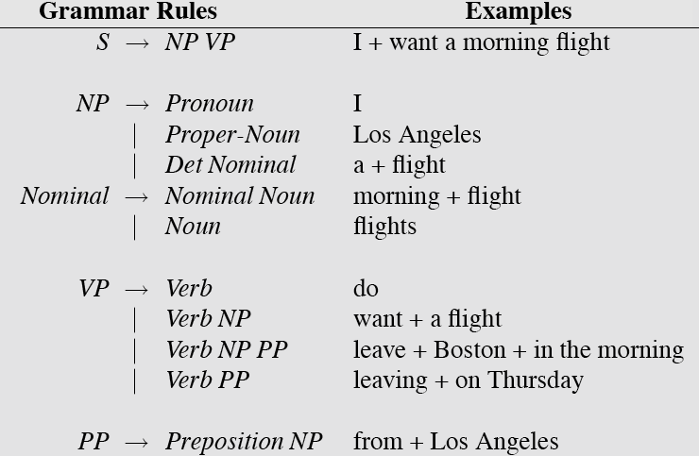
CFG example for English sentence

Slide 82
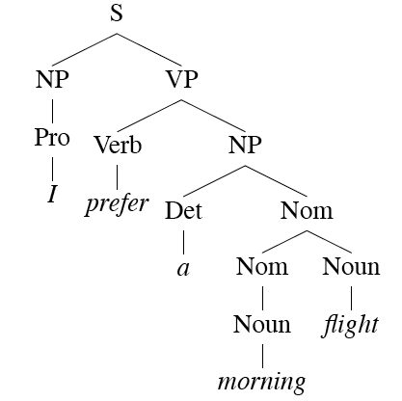
Derivations/ Parsing
Derive the string
“ I prefer a morning flight.”

Slide 83
CKY Parsing
First we’ll limit our grammar to epsilon-free, binary rules (more later) ie. CNF
Consider the rule A → BC
If there is an A somewhere in the input then there must be a B followed by a C in the input.
If the A spans from i to j in the input then there must be some k st. i<k<j
Ie. The B splits from the C someplace.

Slide 84
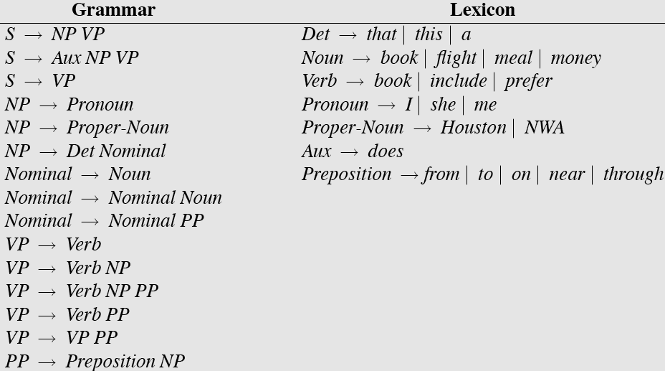
Sample L₁ Grammar

Slide 85
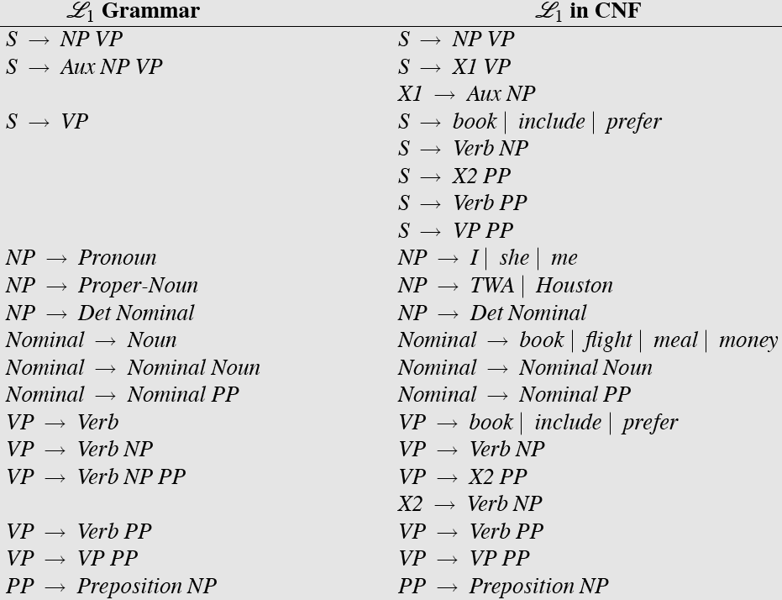
CNF Conversion

Slide 86
CKY
So let’s build a table so that an A spanning from i to j in the input is placed in cell [i,j] in the table.
So a non-terminal spanning an entire string will sit in cell [0, n]
Hopefully an S
If we build the table bottom-up, we’ll know that the parts of the A must go from i to k and from k to j, for some k.

Slide 87
CKY
Meaning that for a rule like A → B C we should look for a B in [i,k] and a C in [k,j].
In other words, if we think there might be an A spanning i,j in the input… AND
A → B C is a rule in the grammar THEN
There must be a B in [i,k] and a C in [k,j] for some i<k<j

Slide 88
CKY
So to fill the table loop over the cell[i,j] values in some systematic way
What constraint should we put on that systematic search?
For each cell, loop over the appropriate k values to search for things to add.

Slide 89
Final CFG in CNF form

Slide 90
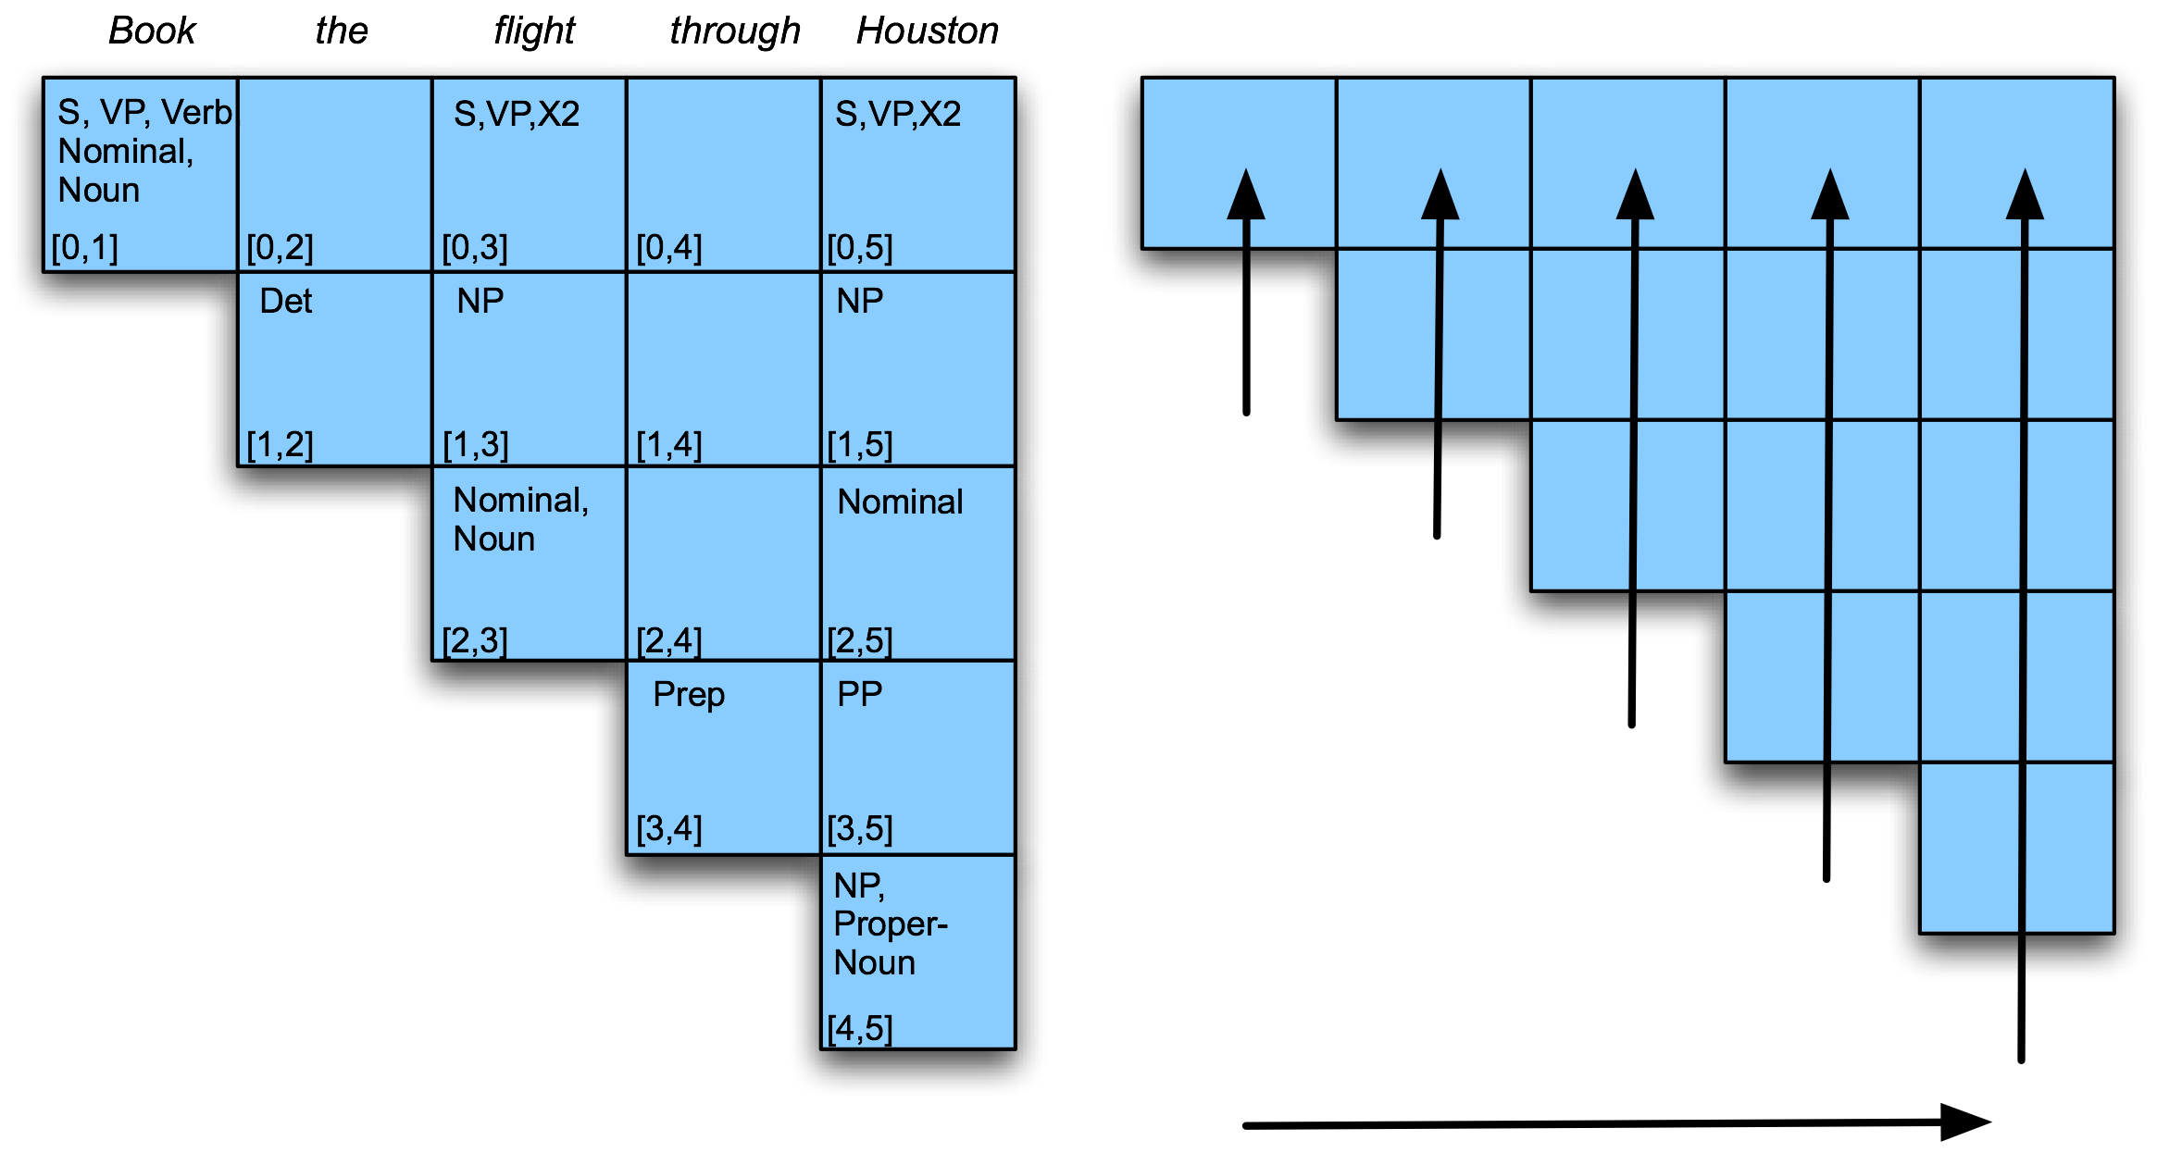
Example

Slide 91
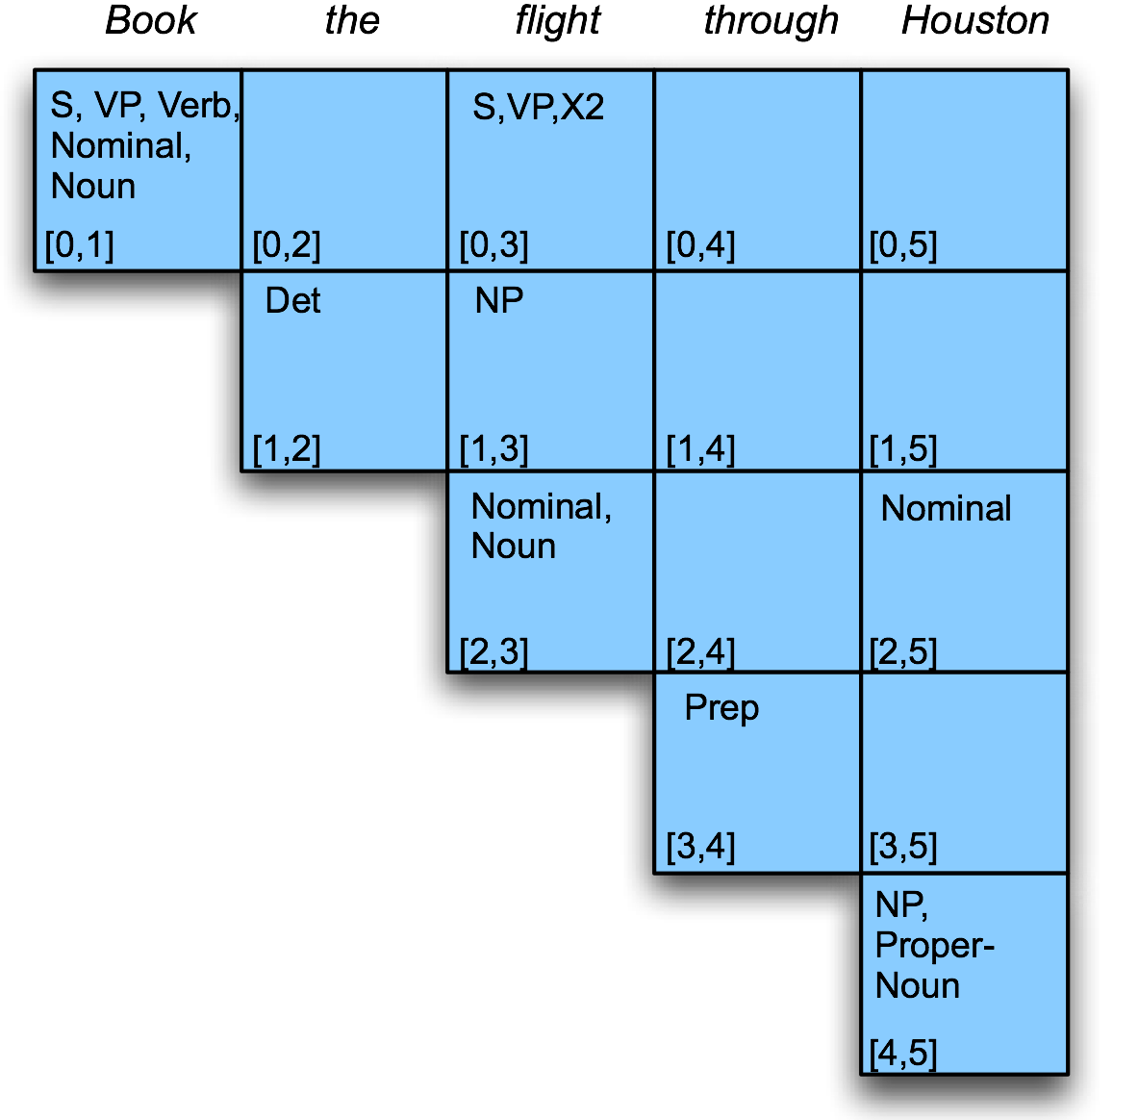
Example
Filling column 5
Notes:
For (02) ------(01)(12) -----------{s,vp,verb,noun, norminal} {Det}------- no prod so null
Simiralry fill (13) ; (24); (35)
Then for (03) --------- (01)(13) or (02)(23) explore tehm and see.

Slide 92
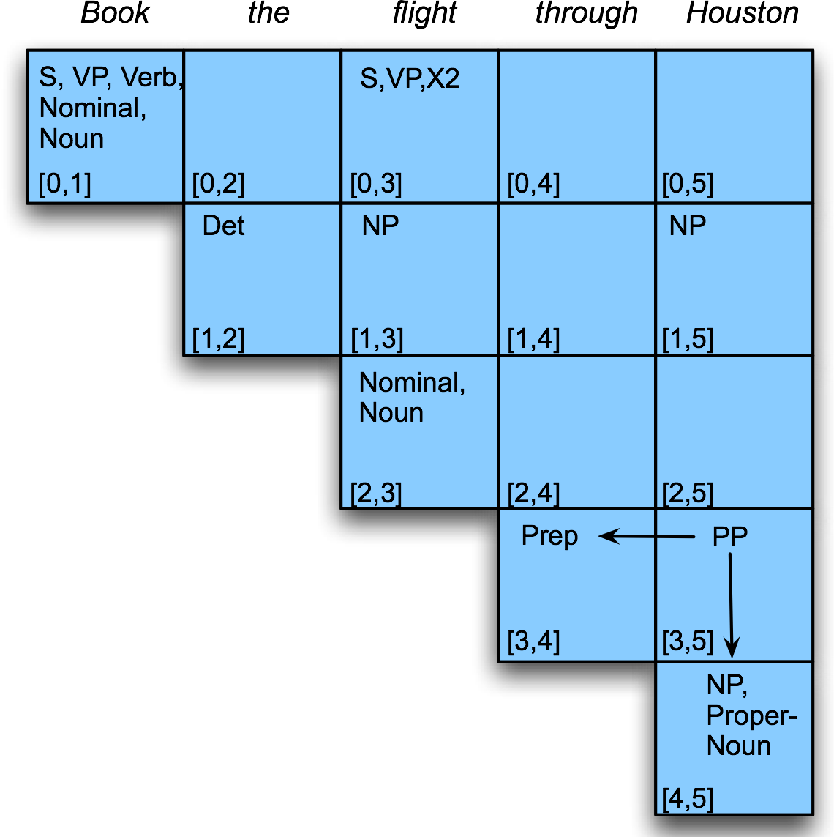
Example

Slide 93
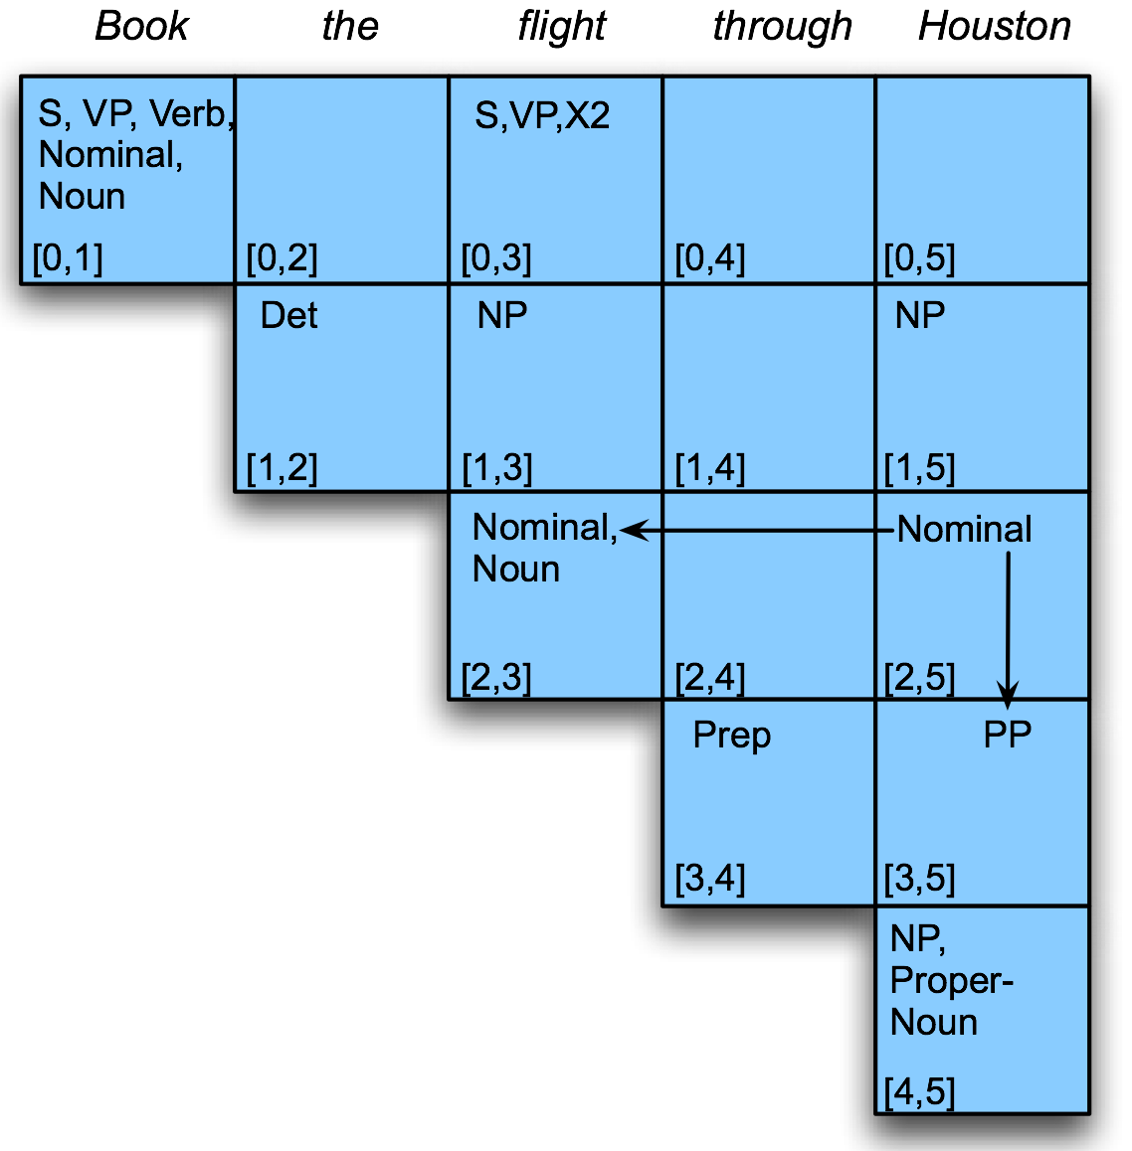
Example

Slide 94
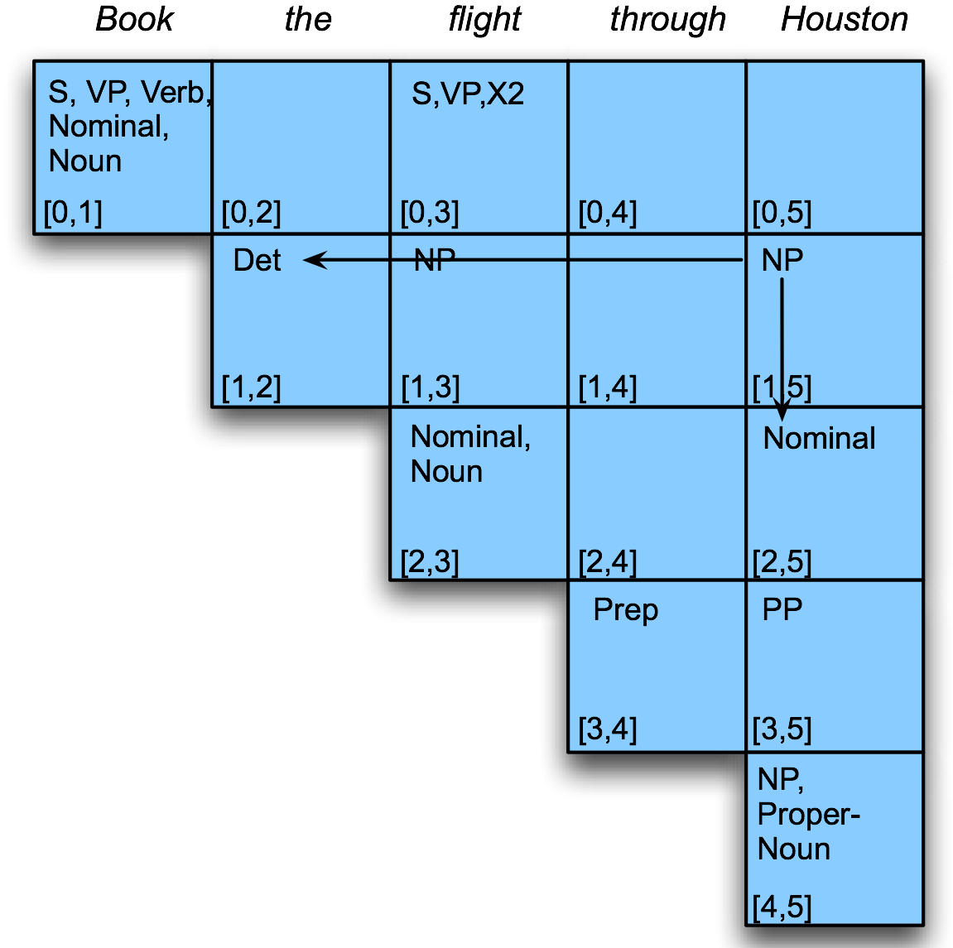
Example

Slide 95
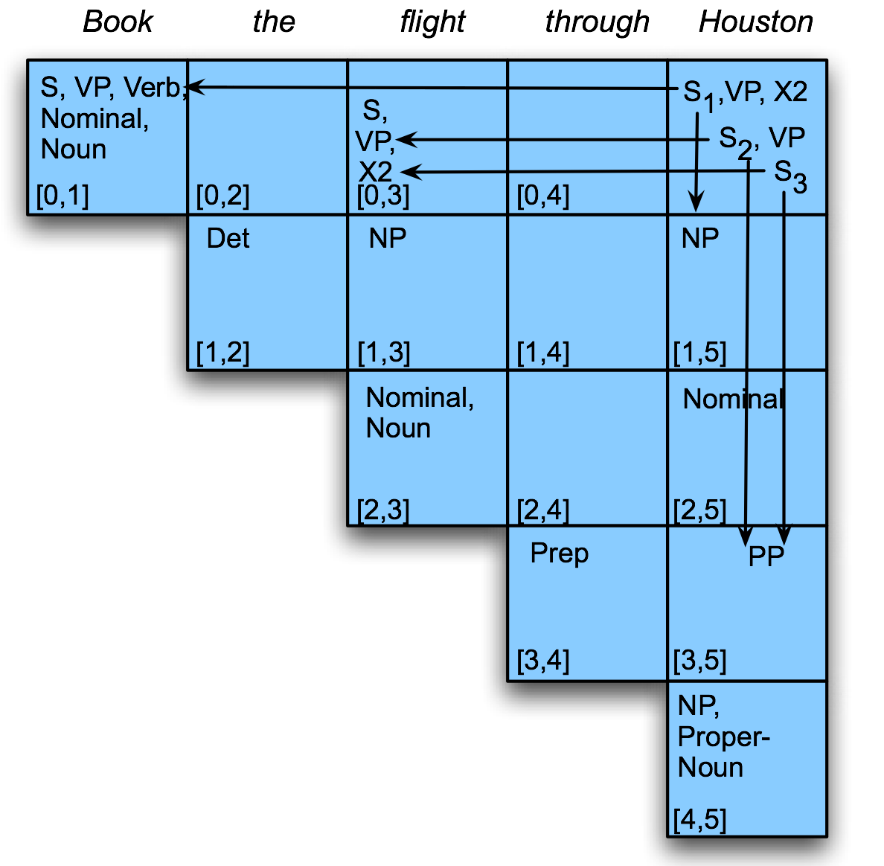
Example
Notes:
All possible parse tree are explored using CYK….. all the parses for a given input may incur considerable cost. Can be exponential cost

