Slide 1
Authentication

Slide 2
Contents of Module 4
Identification Versus Authentication
Authentication based on Something You Know
Authentication based on Something You Are
Authentication based on Something You Have
Federated Identity Management
Multifactor Authentication
Secure Authentication
Password policies

Slide 3
Identification
Identification is asserting who a person is.
It is the ability to identify uniquely a user of a system or an application running in the system.
Identity is typically public or well known e.g. Your email ID is your identity which is available to others.
Identity is often well known, guessable and predictable
Identity can be more than your name e.g. Your bank account, mobile, email etc. with which people/process/system can identify you.

Slide 4
Authentication
Authentication is act of proving that asserted identity.
It is the process of confirming who she says she is.
If someone’s identity is public, then anyone can claim to be that person but authentication separates pretender from the real person.
Authentication should be private and reliable.

Slide 5
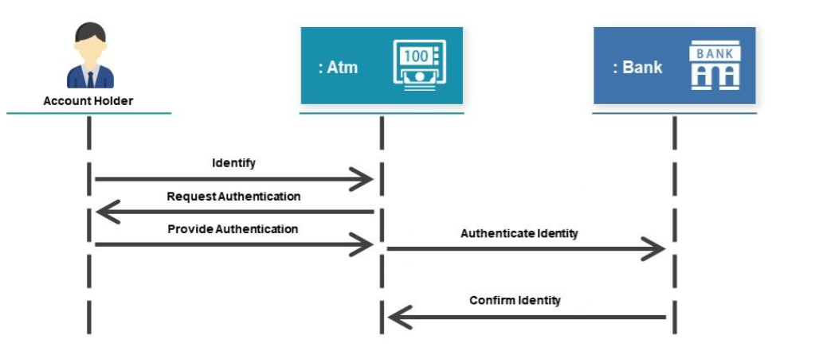
Identification Vs. Authentication

Slide 6
Mechanism used by Authentication for Identification
Something the user KNOWS
Passwords, PIN numbers, mother’s maiden name etc.
Something the user IS (biometrics)
based on a physical characteristic of the user.
fingerprint, retina scan, the pattern of a person’s voice, or a face (picture) etc.
Something the user HAS
Identity badges, physical keys, a driver’s license, token etc.
Source: Security in Computing, Fifth Edition, by Charles P. Pfleeger, et al. (ISBN: 9780134085043). Copyright 2015 by Pearson Education, Inc. All rights reserved.

Slide 7
Authentication: Something you know
Username + Password is the standard first line of defense.
Widely accepted, not to difficult to implement.
Can be expensive to manage password securely due to human practice.
Obtaining a valid password is a common attack.

Slide 8
Password Use
Use of password is fairly straightforward.
User enters some piece of identification e.g. username, userID etc.
The identification may be available publically as it does not provide real protection.
The system request password from user.
If the password matches then user is allowed access else the user is asked to re-enter password or user is denied access.
Suffer various drawbacks as : Time consuming, Disclosure, Revocation and Loss(Canot be retrieved, only reset)

Slide 9
Some password guessing steps
No password
Password same as User ID
Derived from UserID/Username
Common words list (aaaaa, qwerty, abc,abc123)
Complete English Dictionary word
Obtained by Brute force
Every password can be guessed; password strength is determined by how many guesses are required.

Slide 10
Attacks on Password
Dictionary Attacks
Inferring Passwords likely for a user
Guessing Probable Passwords
Defeating Concealment
Brute Force/Exhaustive Attack
https://www.softwaretestinghelp.com/password-cracker-tools/

Slide 11
Dictionary Attacks
Websites available which provide dictionary of phrases, science fiction character names, mythological names etc.
Useful for administrators to look for weak passwords.
But this dictionary can also be used by attacker.
Security auditing tools like COPS, Crack and SATAN (Security Analysis Tool for Auditing Networks) provide utilities for administrator to scan a system for weak passwords but these utilities can also be used by attackers.

Slide 12
Inferring Passwords likely for a user
If someone is selecting a password then he may not be choosing a word completely at random.
Most likely the password will be something meaningful to user.
People typically choose passwords such as name of friend, spouse, child, family member or pet.
For any given person, such possibilities can be a dozen or two.
Guessing such passwords by a computer may take a few seconds.

Slide 13
Inferring Passwords likely for a user
In 1979, Morris and Thomson did a case study on 3289 gathered passwords.
86% could be covered in one week’s time with 24 hours a day testing with an estimation of 1 millisecond per password check.
Source: Security in Computing, Fifth Edition, by Charles P. Pfleeger, et al. (ISBN: 9780134085043). Copyright 2015 by Pearson Education, Inc. All rights reserved.

Slide 14
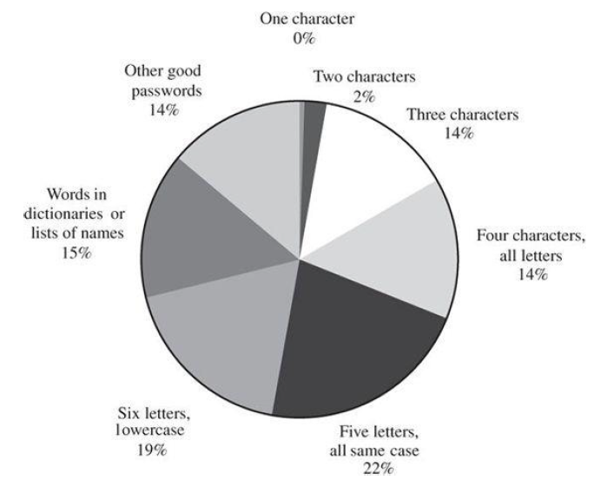
Inferring Passwords likely for a user
Source: Security in Computing, Fifth Edition, by Charles P. Pfleeger, et al. (ISBN: 9780134085043). Copyright 2015 by Pearson Education, Inc. All rights reserved.

Slide 15
Guessing Probable Passwords
Suppose a password is of length 3 or less then there are only
26¹ +26² +26³ = 18278 passwords
Testing 18278 passwords would be difficult for human but it is easy for computers.
If we assume that 1 password/ millisecond ca be checked then all these passwords can be checked in 18.267 seconds.
If we have have 4 characters in password then it will take 475 seconds and for 5 characters it will take approximately 12356 seconds (about 3.5 hours).
Source: Security in Computing, Fifth Edition, by Charles P. Pfleeger, et al. (ISBN: 9780134085043). Copyright 2015 by Pearson Education, Inc. All rights reserved.

Slide 16
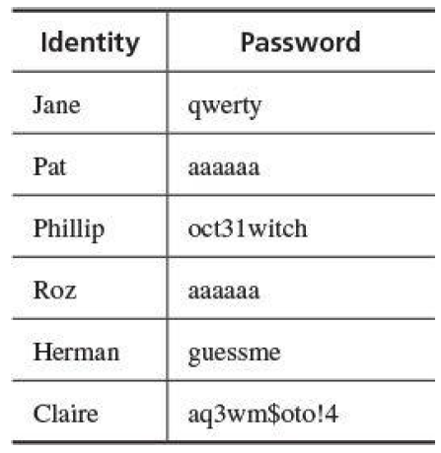
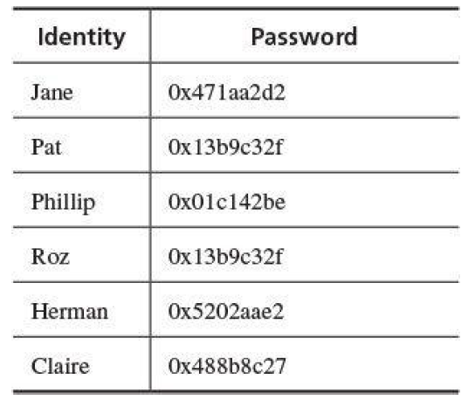
Defeating Concealment
Operating systems store passwords not in their public form but in a concealed form using encryption . This process is one-way.
Normal Password Table
Concealed Password Table
Source: Security in Computing, Fifth Edition, by Charles P. Pfleeger, et al. (ISBN: 9780134085043). Copyright 2015 by Pearson Education, Inc. All rights reserved.

Slide 17
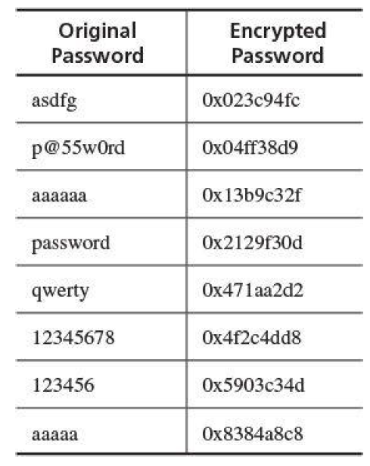
Defeating Concealment
The interceptor a rainbow table, a list of the concealed forms of the common passwords. https://kestas.kuliukas.com/RainbowTables/
Scrambled passwords have yet another vulnerability since for passwords all the copies will have the same concealed value.
To counter both these threats, some systems use an extra piece called the salt.
A salt is an extra data field different for each user, eg. the date the account was created or a part of the user’s name.
The salt value is joined to the password before the combination is transformed by concealment.
Two scrambled passwords have a different concealment value.
Also, an attacker cannot build a rainbow table because the common passwords now all have a unique component, too.
Rainbow Table
Source: Security in Computing, Fifth Edition, by Charles P. Pfleeger, et al. (ISBN: 9780134085043). Copyright 2015 by Pearson Education, Inc. All rights reserved.

Slide 18
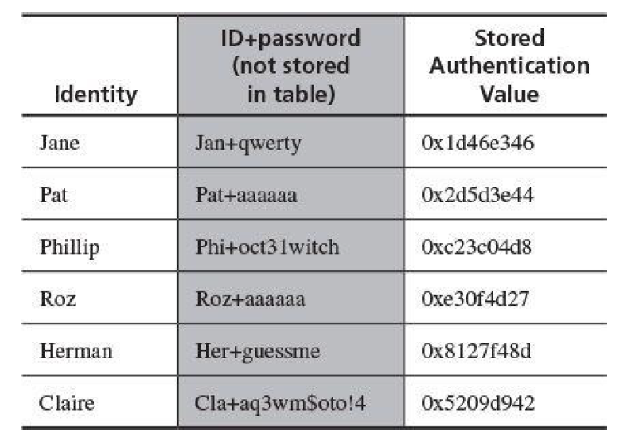
Defeating Concealment
Concealed Password Table with Salt
Source: Security in Computing, Fifth Edition, by Charles P. Pfleeger, et al. (ISBN: 9780134085043). Copyright 2015 by Pearson Education, Inc. All rights reserved.

Slide 19
Brute Force/Exhaustive Attack
In Brute Force, the attacker tries all possible passwords in some automated fashion.
The number of different passwords depends upon the number of characters used, lowercase/uppercase used, special character used and numbers.
If passwords are words consisting of 26 alphabets A-Z of different length then approximately 5 million possible passwords will be there.
If we try 1 password/millisecond then it will take 150 years to test all possible passwords.
If we speedup the processing upto 1 password/microsecond then it may take approximately 2 months.

Slide 20
Difficulties with use of Password
Use
Inconvenient and time consuming .
Disclosure
If password disclosed then anyone can misuse it.
If password is shared then changing it requires information to the other shared user.
Revocation
Revoking someone's access right requires changing the password which can cause problem state in disclosure.
Loss
If password is lost then sometimes it may be impossible to retrieve the same password even if administrator intervenes.

Slide 21
Password Aging
It is the requirement that a password be changed after some period of time or after some event has occurred.
Assume the average time to guess a password is 120 days.
Changing password within 120 days reduces the probability of guessing the password by the attacker.
If user choose simple password, then estimation of expected time to guess should be minimum.
Forcing the user to change the password may sometimes be annoying to the user.
Password aging is useless if user is allowed to set n previously used passwords as new password.

Slide 22
One Time Passwords
It is a password that is invalidated as soon as it is used.
A mechanism that uses one time password is a challenge response mechanism.
The challenge is the number of authentication attempt; the response is the one time password.
The response time should be less than the minimum time required guess the password.
The problem in OTP is the generation of random password as well synchronization of user’s system and server.

Slide 23
Good Password Policy
Use characters other than just a-z
Choose long passwords
Avoid actual names or words
Use a string you can remember
Use variants for multiple passwords
Change password regularly
Don’t write it down
Don’t tell anyone else

Slide 24
Authentication: Something you are
Biometrics are biological properties which are based on some physical characteristics of human body.
Some of the biometrics used in devices are
Fingerprint
Hand geometry(Shape and size of fingers)
Retina and Iris
Voice
Handwriting, signature, hand motion
Typing characteristics
Blood vessels in finger or hand
Face
Facial features like nose shape eye spacing etc.
Source: Security in Computing, Fifth Edition, by Charles P. Pfleeger, et al. (ISBN: 9780134085043). Copyright 2015 by Pearson Education, Inc. All rights reserved.

Slide 25
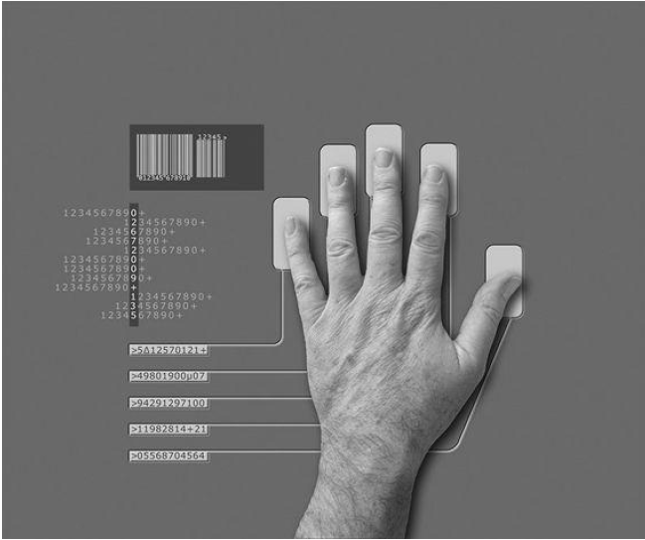
Examples of Biometric Authenticators
Hand Geometry Reader
Source: Security in Computing, Fifth Edition, by Charles P. Pfleeger, et al. (ISBN: 9780134085043). Copyright 2015 by Pearson Education, Inc. All rights reserved.

Slide 26
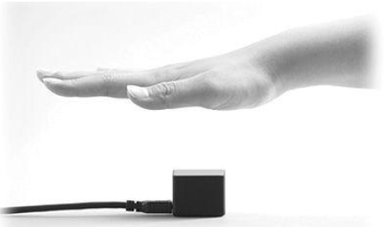
Examples of Biometric Authenticators
Hand Vein Reader
Source: Security in Computing, Fifth Edition, by Charles P. Pfleeger, et al. (ISBN: 9780134085043). Copyright 2015 by Pearson Education, Inc. All rights reserved.

Slide 27
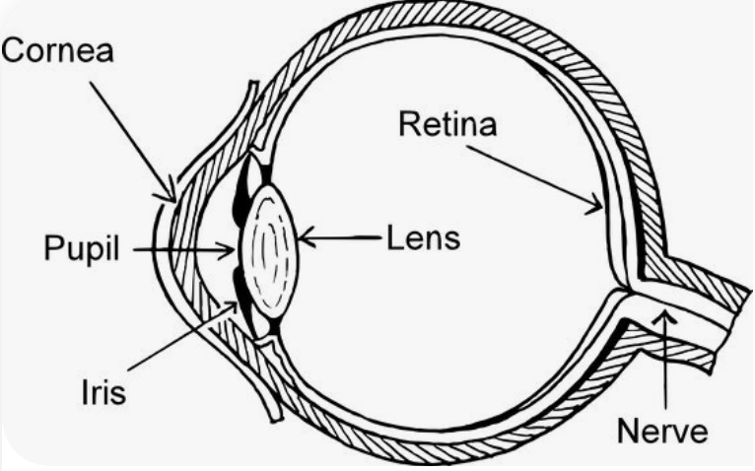
Examples of Biometric Authenticators
Iris and Retina Scan
Source: www.google.com

Slide 28
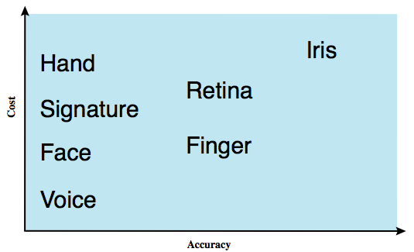
Cost vs. Accuracy of Some Biometric Authenticators
Source: www.google.com

Slide 29
Problems with the use of Biometrics
Biometrics are relatively new and some people resist biometrics.
Biometric devices are costly.
Biometric readers and comparison can become a single point of failure.
Variation reduces accuracy.
There are chances of false reading.
Source: Security in Computing, Fifth Edition, by Charles P. Pfleeger, et al. (ISBN: 9780134085043). Copyright 2015 by Pearson Education, Inc. All rights reserved.

Slide 30
False Positive and False Negative
 | Is the Person Claimed | Is not the Person Claimed
Test is Positive (There is a match) | True Positive(a) | False Positive(b)
Test is Negative (There is no match) | False Negative(c) | True Negative(d)
Source: Security in Computing, Fifth Edition, by Charles P. Pfleeger, et al. (ISBN: 9780134085043). Copyright 2015 by Pearson Education, Inc. All rights reserved.

Slide 31
False Positive and False Negative
Sensitivity
It measures the degree to which the screen selects those whose names correctly match the person sought.
It is the proportion of positive results among all possible correct matches.
It can be calculated as a/(a+c)
Where a= True Positive, c = False negative
Source: Security in Computing, Fifth Edition, by Charles P. Pfleeger, et al. (ISBN: 9780134085043). Copyright 2015 by Pearson Education, Inc. All rights reserved.

Slide 32
False Positive and False Negative
Specificity
It measures the proportion of negative results among all people who are not sought.
It can be calculated as d/(b+d)
Where b= False Positive, d = True Negative
Source: Security in Computing, Fifth Edition, by Charles P. Pfleeger, et al. (ISBN: 9780134085043). Copyright 2015 by Pearson Education, Inc. All rights reserved.

Slide 33
False Positive and False Negative
Accuracy
It measures the degree to which the test or screen correctly flags the condition or situation
It can be calculated as (a+d)/(a+b+c+d)
Where a= True Positive, b= False Positive,c= False Negative,
d = True negative
Source: Security in Computing, Fifth Edition, by Charles P. Pfleeger, et al. (ISBN: 9780134085043). Copyright 2015 by Pearson Education, Inc. All rights reserved.

Slide 34
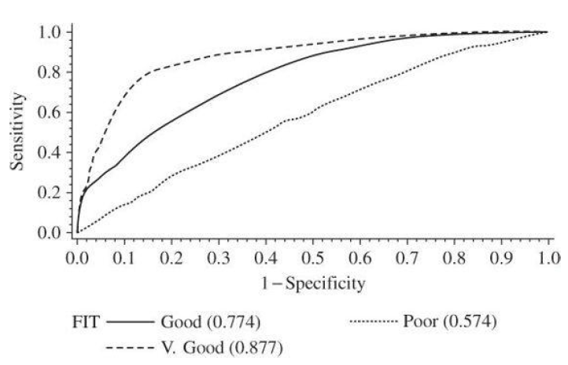
Receiver Operating Characteristic(ROC) Curve
Source: Security in Computing, Fifth Edition, by Charles P. Pfleeger, et al. (ISBN: 9780134085043). Copyright 2015 by Pearson Education, Inc. All rights reserved.

Slide 35
Authentication: Something you have (Tokens)
It means that you have a physical object in your possession.
Keys of Lock
Identity Cards
Passport
Debit/Credit Card
Mobile Phone SIM
Source: Security in Computing, Fifth Edition, by Charles P. Pfleeger, et al. (ISBN: 9780134085043). Copyright 2015 by Pearson Education, Inc. All rights reserved.

Slide 36
Types of Tokens on the basis of action
Active Tokens
Take some action
Communicate with a sensor
e.g. Credit card, Metro Card
Passive Tokens
Do not change.
e.g. Photo ID , Keys of Car, Passport
Source: Security in Computing, Fifth Edition, by Charles P. Pfleeger, et al. (ISBN: 9780134085043). Copyright 2015 by Pearson Education, Inc. All rights reserved.

Slide 37
Types of Tokens on the basis of internal state
Static Tokens
Do not change their internal state.
Their state remains fixed.
Useful for onsite authentication
e.g. Photo ID , Keys of Car, Passport
Dynamic Tokens
These token change their internal state
They have computing power
Useful for remote authentication
e.g. Magnetic strip card, SecurID token from RSA Laboratories.
Source: Security in Computing, Fifth Edition, by Charles P. Pfleeger, et al. (ISBN: 9780134085043). Copyright 2015 by Pearson Education, Inc. All rights reserved.

Slide 38
Federated Identity Management
Some systems require passwords, some fingerprint scan, some requires pin etc.
Remembering identities and distinct passwords for many systems is challenging.
A federated identity management scheme is a union of separate identification and authentication system.
Instead of maintaining separate profiles, a federated scheme maintains one profile with one authentication method.
Authentication is performed in one place and separate processes/systems determine already authenticated user to be activated.
Source: Security in Computing, Fifth Edition, by Charles P. Pfleeger, et al. (ISBN: 9780134085043). Copyright 2015 by Pearson Education, Inc. All rights reserved.

Slide 39
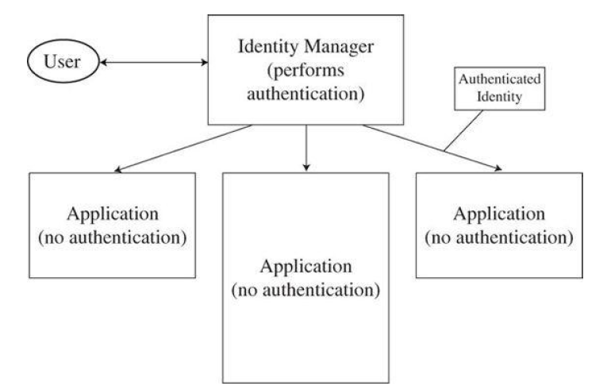
Federated Identity Management
Source: Security in Computing, Fifth Edition, by Charles P. Pfleeger, et al. (ISBN: 9780134085043). Copyright 2015 by Pearson Education, Inc. All rights reserved.

Slide 40
Multifactor Authentication
The single factor authentication approaches offer advantages and disadvantages.
We can compensate for the limitation of one form of authentication by combining it with another form.
Suppose you have Photograph based Debit/Credit, it has your photograph and signature .
While you make any offline transaction, the shopkeeper can see your photograph, you will enter your pin and once the transaction completes, he may ask you to sign the slip. He can authenticate you by using all three authentication methods.

Slide 41
Multifactor Authentication
Combining authentication information is called multifactor authentication.
Two forms of authentication is know as two-factor authentication.
Increase in the number of authentication although may increase the security but also increases the user’s inconvenience
Even if multifactor authentication is superior to single factor , we do not know which value of n makes n factor authentication is optimal

Slide 42
Secure Authentication
Passwords biometrics and tokens can all participate in secure authentication.
Simply using any or all of them is no guarantee that an authentication approach will be secure.
To achieve true security, we need to think about blocking possible attacks and attackers.
While developing a system, appropriate approach that achieves the security needs should be considered which is unambiguous and less vulnerable.

