Slide 1

Fundamentals of Computer Security Course Code: 20B12CS332

Slide 2
Course Outcome
After completion of the course, you will be able to
Explain the fundamental concepts of computer security and malware types
Identify types of cryptographic techniques and working of classical cryptosystems
Describe authentication and access control paradigms
Apply proactive solutions to security like Firewalls and IDS
Describe legal and ethical issues with respect to information security

Slide 3
Course Description(Module-wise)
Module No | Title of Module
1 | Security basics
2 | Introduction to Malware
3 | Threats to network communications and basics of Cryptography
4 | Authentication
5 | Access control
6 | Intrusion detection and response
7 | Firewalls
8 | Legal and Ethical Issues

Slide 4
Recommended Reading Material
Text Books:
1. | Security in Computing (5th edition), Pfleeger, Pfleeger and Margulies, Pearson.
2. | Computer Security: Art and Science by Matt Bishop, Addison-Wesley Educational Publishers Inc
Reference Books:
1. | Computer Security Fundamentals, (4th Edition), Chuck Easttum, Pearson Ed.
2. | Foundations of Computer Security, David Salomon, Springer
3. | Introduction to Modern Cryptography (2nd edition), Katz and Lindell, Chapman & Hall/CRC
4. | Elements of Computer Security, David Salomon, Springer
5. | Cryptography Theory and Practice (3rd edition), Stinson, Chapman & Hall/CRC

Slide 5
Evaluation Criteria
Components | Maximum Marks
T1 | 20
T2 | 20
End Term | 35
TA | 25 (Attendance-10, Quiz+Assignment+Tutsheets = 15)
Total | 100

Slide 6
What “Security” is all about?
The “Secure” word was added in English dictionary in 16th century which is derived from Latin securus meaning freedom from anxiety.
Security is about protection of assets
D. Gollmann, Computer Security, Wiley
Prevention
take measures that prevent your assets from being damaged/stolen
Detection
take measures so that you can detect when, how, and by whom an asset has been damaged/stolen
Reaction
take measures so that you can recover your assets

Slide 7
Real World example
Prevention
Locks at doors, windows, hire a security guard
Detection
Burglar alarms, missing items, damages items, closed circuit TV.
Reaction
Attack on burglar(not recommended ☺), Call the police, replace stolen items, make an insurance claim.

Slide 8
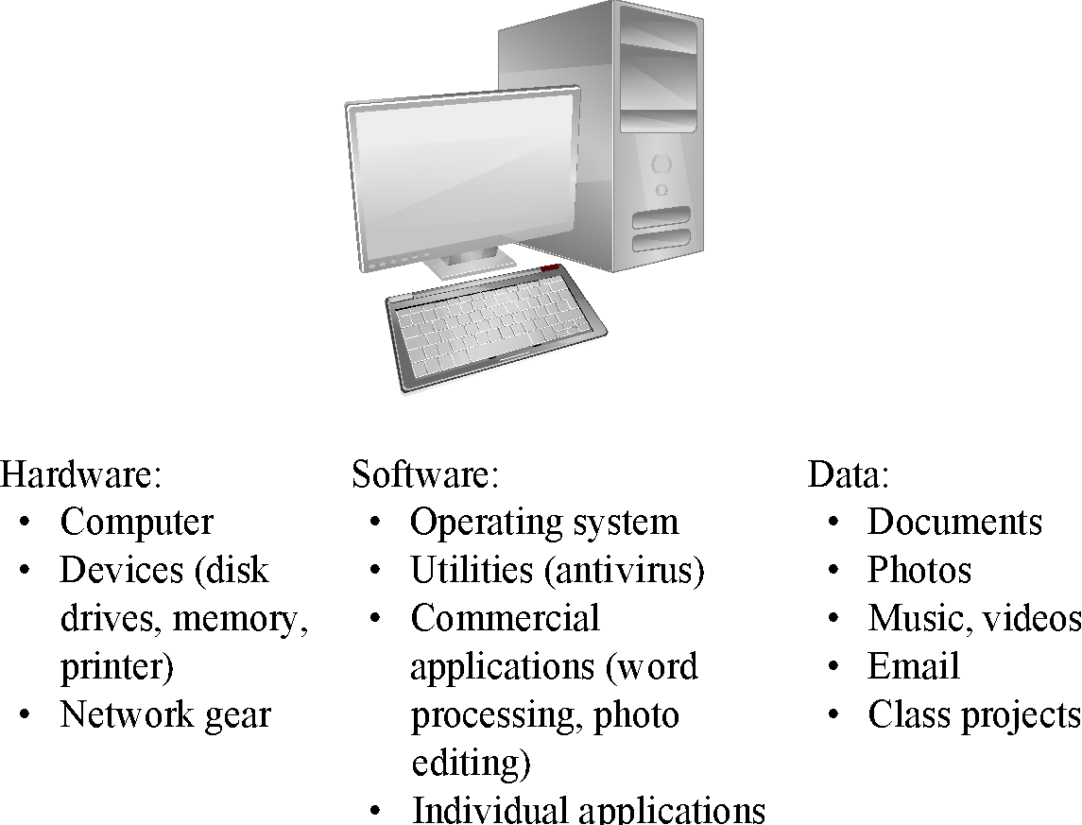
What is Computer Security?
Protection of assets - Hardware, Software and Data
Source: Security in Computing, Fifth Edition, by Charles P. Pfleeger, et al. (ISBN: 9780134085043). Copyright 2015 by Pearson Education, Inc. All rights reserved.

Slide 9
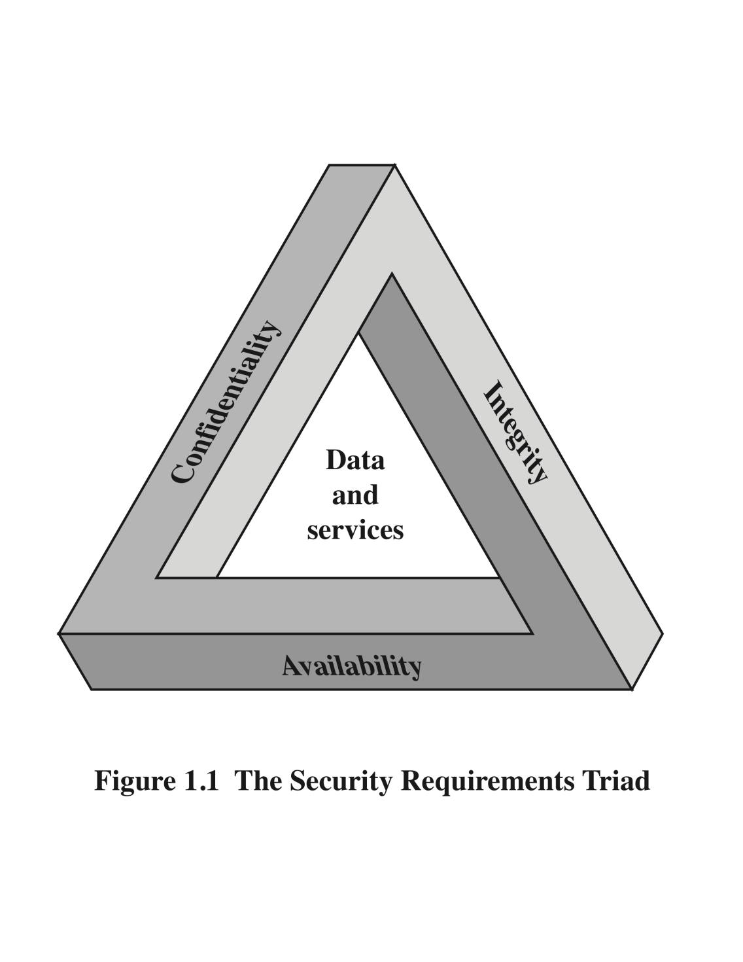
Essential Security Objectives
Confidentiality
Ability of a system to ensure that an asset is viewed only by authorized user
Existence of asset
Access Control
Resource Hiding
Integrity
Ability of a system to ensure that an asset is modified only by authorized user
Data integrity and Source integrity
Needs prevention and detection mechanisms
Correctness and trustworthyness
Availability
Ability of a system to ensure that an asset can be used by any authorized user at the desired time

Slide 10
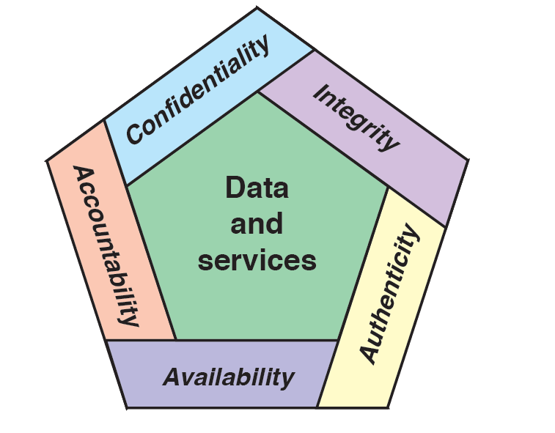
Additional/Desirable Security Objectives
Authenticity
Ability of a system to confirm the identity of user
Non Repudiation/ Accountability
Ability of a system to confirm that a user cannot convincingly deny when a security breach occurs

Slide 11
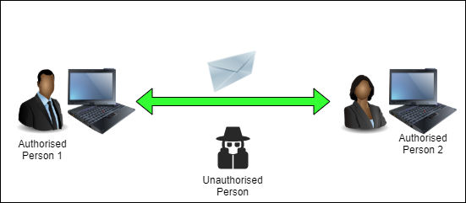
Security Objectives

