Slide 1

Fundamentals of Computer Security Course Code: 20B12CS332

Slide 2
Terminologies in security
Assets
Items which has some values e.g. hardware, software, data etc.
Asset’s values are personal, time dependent and often imprecise
Vulnerabilities
It is a weakness in the system that could be exploited to cause harm e.g. a server that doesn’t authenticate user
Threats
It is a set of circumstances that could cause harm.
Unintentional human errors, hardware design faults, and software failures, natural disasters
Adversary/Threat Agent/Attacker
An entity that attacks or is a threat to a system (human or system)

Slide 3
Terminologies in security
Attack
It is an action that exploits a vulnerability.
Active and passive attacks
Inside and outsider attacks
Control/Countermeasures
It prevent threats from exercising vulnerabilities .
An action, device, procedure, or technique to remove or reduce a vulnerability.
Security Policy
A set of rules and practices that specify or regulate how a system or organization provides security services to protect sensitive and critical system resources.

Slide 4
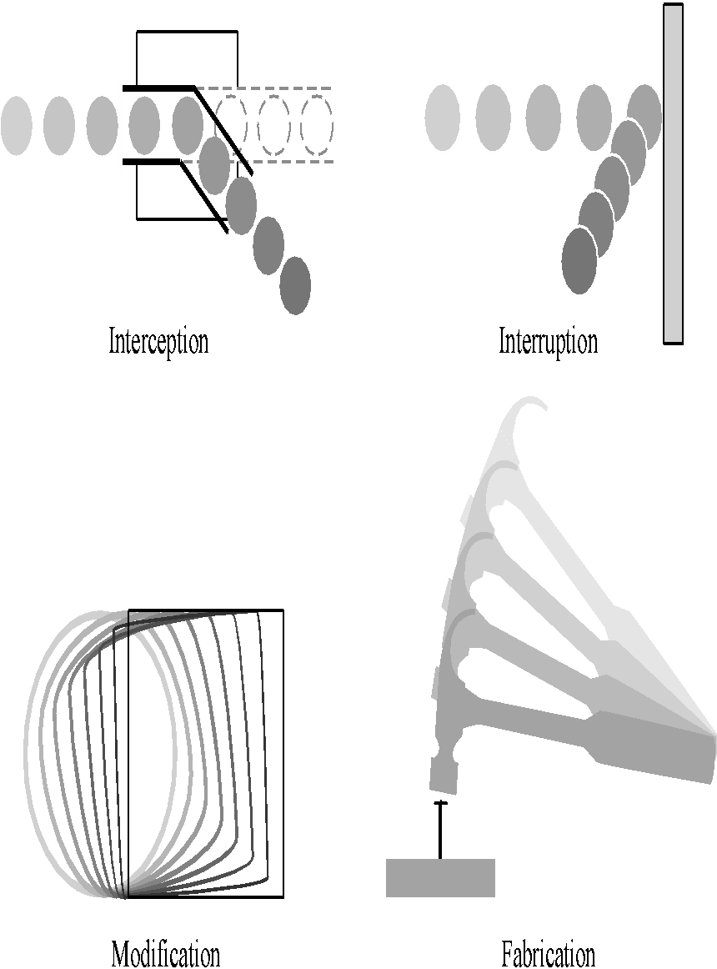
Types of harms
Interception (confidentiality)
an unauthorized party (human or not) gains access to an asset
Interruption (Availability)
an asset becomes lost, unavailable, or unusable
Modification (Integrity)
an unauthorized party changes the state of an asset
Fabrication (Integrity)
an unauthorized party counterfeits an asset
From Security in Computing, Fifth Edition, by Charles P. Pfleeger, et al. (ISBN: 9780134085043). Copyright 2015 by Pearson Education, Inc. All rights reserved.

Slide 5
Threats and attacks
Disclosure : A circumstance or event where an entity gains access to data for which it is not authorized. (Confidentiality)
Exposure, Interception, Inference, Intrusion
Deception : A circumstance or event in which an authorized entity receiving false data and believing it to be true. (Integrity)
Masquerade, Falsification, Repudiation
Disruption: It effects the availability or system integrity
Incapacitation, Corruption, Obstruction
Usurpation : It is seizure. illegal seizure of resources (system integrity)
Misappropriation, Misuse

Slide 6
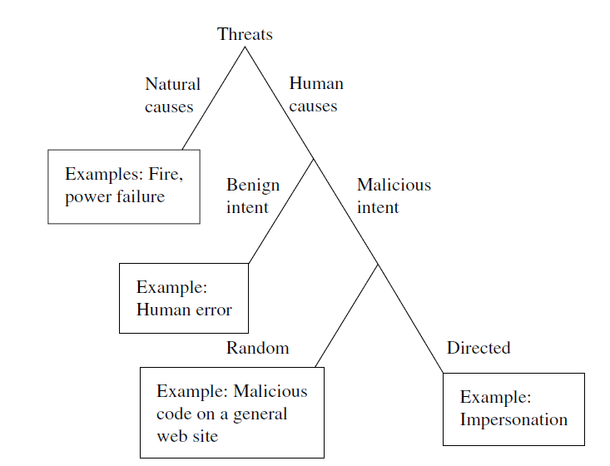
Types of Threats
From Security in Computing, Fifth Edition, by Charles P. Pfleeger, et al. (ISBN: 9780134085043). Copyright 2015 by Pearson Education, Inc. All rights reserved.

Slide 7
Types of Attacks
Types of attack
Active Attack
Interruption
Modification
Fabrication
Passive Attack
Interception
From Security in Computing, Fifth Edition, by Charles P. Pfleeger, et al. (ISBN: 9780134085043). Copyright 2015 by Pearson Education, Inc. All rights reserved.

Slide 8
Types of Attacks based on origin
Inside Attack
Initiated by an entity inside the security parameter .
The insider is authorised to access system resources but uses them in a way not approved by those who granted the authorisation.
Outside Attack
Initiated from outside the perimeter by an unauthorised or illegitimate user.
On the Internet, Potential outside attacker range from amateur pranksters to organised criminals, international terrorists and hostile government.
Types of attack
Inside Attack
Outside Attack
From William Stallings and Lawrie Brown. 2007. Computer Security: Principles and Practice (3rd. ed.). Prentice Hall Press, USA.

Slide 9
Some Common Attacks
Masquerade Attack:
When an unauthorized entity pretends to be another entity.
Man in the Middle Attack:
Attacker monitors the communication. Attacker can interrupt, modify, fabricate or intercept in the communication.
Denial of Service(DoS) Attack:
Attacker sends large number of requests to a system/server resulting in crashing or inability to perform ordinary functions or preventing legitimate user from accessing some services which they are eligible for.
Distributed Denial of Service (DDoS) Attack
When multiple attackers/System generate DoS attack.

Slide 10
Some Common Attacks
Packet Sniffing Attack:
Attackers only listen to the communication between two legitimate entities for some specific purpose
Packet Spoofing/IP Spoofing Attack:
The attacker conceals the source address of the packet and impersonate another computing system.
Replay Attack:
When a malicious user captures a sequence of events or some data units and re-sends them for some specific purpose.

Slide 11
Some Common Attacks
Phishing Attack:
Attacker pose as a trusted individual and trick the legitimate user to open a text, email etc. for stealing the credentials.
SQL Injection Attack:
Attacker executes SQL query to manipulate backend databases to access information that was not intended for display.
Brute Force Attack:
Attacker tries to log into account by trying all possible passwords until finding the correct login.

