Slide 1

Fundamentals of Computer Security Course Code: 20B12CS332

Slide 2
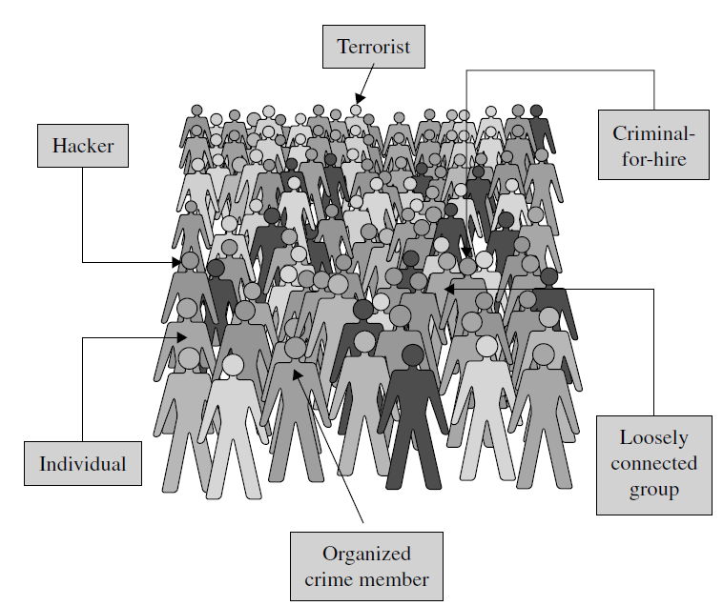
Types of Attackers
From Security in Computing, Fifth Edition, by Charles P. Pfleeger, et al. (ISBN: 9780134085043). Copyright 2015 by Pearson Education, Inc. All rights reserved.

Slide 3
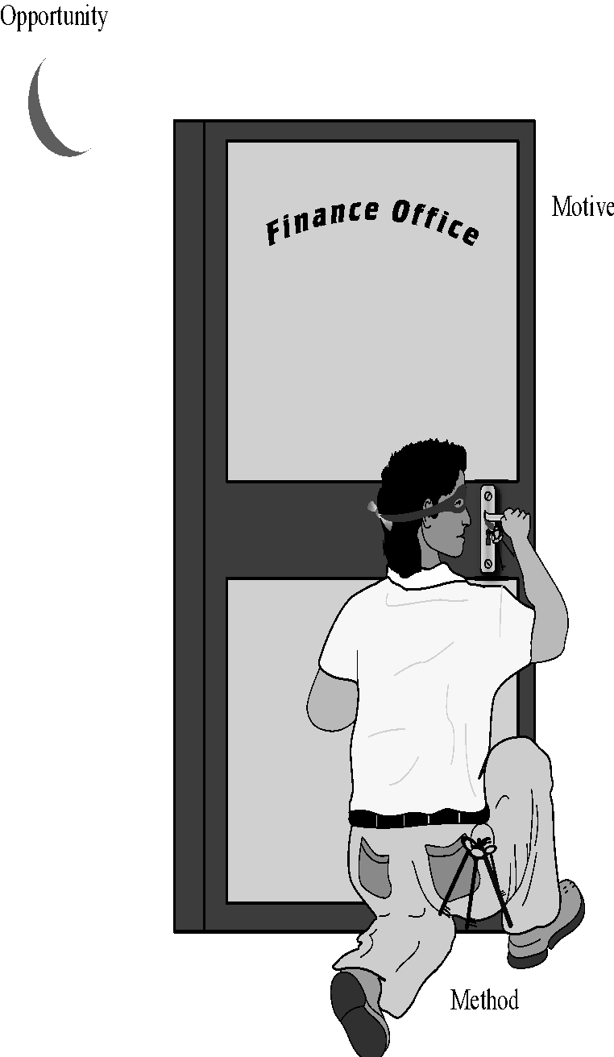
Method-Opportunity-Motive
Method:
It answers “how” to accomplish the attack
the skills, knowledge, tools, and other things with which to be able to pull off the attack
Knowledge of systems are widely available
Opportunity:
It answers “When” to accomplish the attack
the time and access to accomplish the attack
Systems available to the public are accessible to them
Motive:
It answers “Why” to accomplish the attack
a reason to perform this attack against this system
“Deny the attacker any of these three and the attack will not succeed”
From Security in Computing, Fifth Edition, by Charles P. Pfleeger, et al. (ISBN: 9780134085043). Copyright 2015 by Pearson Education, Inc. All rights reserved.

Slide 4
Methods of Defense
We can deal with harm in several ways. We can seek to
prevent it, by blocking the attack or closing the vulnerability
deter it, by making the attack harder but not impossible
deflect it, by making another target more attractive (or this one less so)
detect it, either as it happens or some time after the fact
recover from its effects

Slide 5
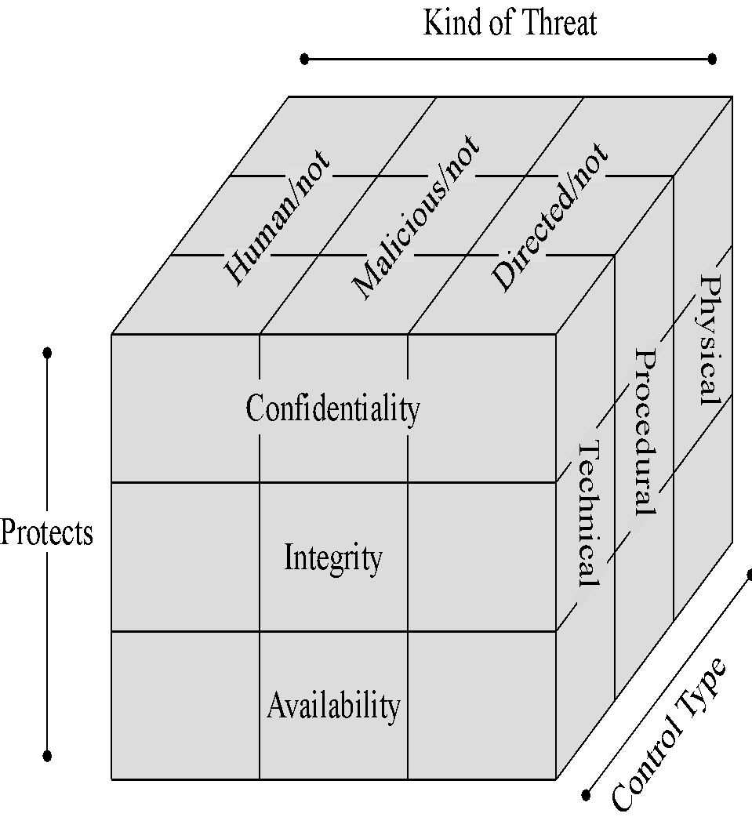
Control/Countermeasures
Physical Controls: Stop or block an attack by using something tangible too, such as walls and fences
locks
human guards
Sprinklers and other fire extinguishers
Procedural or Administrative Controls: use a command or agreement that
requires or advices people to act
laws, regulations, policies, procedures, guidelines
Copyright, patents, contracts, agreements
Technical controls: counter threats with technology(hardware or software)
passwords, program or operating system access controls
Network protocols, firewalls, intrusion detection systems, network flow regulators, encryption
From Security in Computing, Fifth Edition, by Charles P. Pfleeger, et al. (ISBN: 9780134085043). Copyright 2015 by Pearson Education, Inc. All rights reserved.

Slide 6
Vulnerabilities
Hardware Vulnerabilities
Involuntary machine slaughter: Accidental acts not intended to seriously damage the hardware.
Voluntary machine slaughter /machinicide: Deliberate attacks on equipment, limit availability, involves theft or destruction
Software Vulnerabilities
Deletion, modification, use of malicious code
Data vulnerabilities
From Security in Computing, Fifth Edition, by Charles P. Pfleeger, et al. (ISBN: 9780134085043). Copyright 2015 by Pearson Education, Inc. All rights reserved.

Slide 7
Principles of Computer Security
Principle of Easiest Penetration:
An intruder must be expected to use any available means of penetration.
This principle implies that computer security specialists must consider all possible means of penetration
Principle of Adequate Protection:
Computer items must be protected to a degree consistent with their value and only until they loose their value.
Principle of Effectiveness:
Controls must be used and used properly to be effective.
They must be efficient, easy to use, and appropriate.
Principle of Weakest Link:
Security can be no stronger than its weakest link.
From Security in Computing, Fifth Edition, by Charles P. Pfleeger, et al. (ISBN: 9780134085043). Copyright 2015 by Pearson Education, Inc. All rights reserved.

Slide 8
How can we secure a system?
Identify following:
Threat
What threat is being raised?
How does it work?
On what does it depend?
Who are the potential attackers?
What are the potential attacks?
What tools and knowledge are needed to realize the attack?
Harm
What harm can or did this attack cause?
If the attack can support other attacks, what are they?
How serious is the harm?
Vulnerability
What vulnerability is being exploited?
Is it a general weakness or specific to one computer or situation?
Is there more than one vulnerability?
Are all vulnerabilities required for the threat to be actualized?
Control.
How can the vulnerability be controlled?
Does the control nullify the threat or close the vulnerability?
Is there more than one control?
Are the controls strong or can they be defeated or bypassed?
Are they expensive or hard to use?

Slide 9
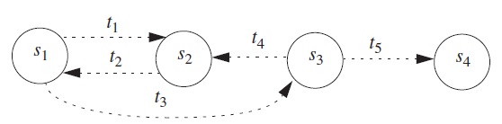
Security Policy
It defines “Secure” for a system or a set of systems.
It can be informal or highly mathematical in nature.
If we consider a computer system as finite state automaton then a security policy partitions the state of a system into a set of authorized/secure(s₁, s₂) and unauthorized/insecure states(s₃, s₄) with t_{i} transitions.
A secure system starts in an authorized state and cannot enter an unauthorized state.
A breach of security occurs when a system enters an unauthorized state.
If we remove the transition t₃ from s₁-s₃ then the system is secure.

