Slide 1


Slide 2
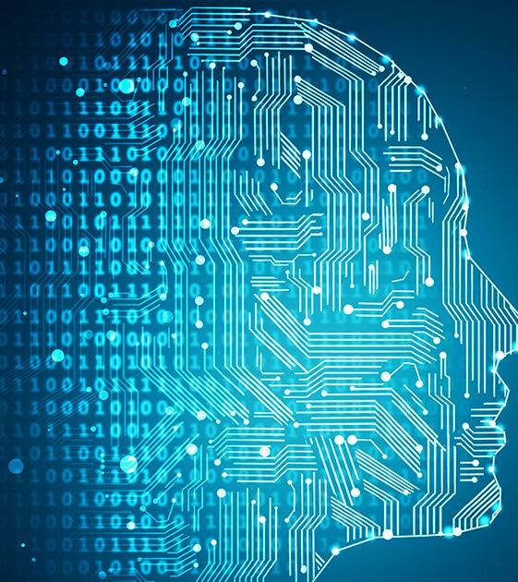
Introduction to Machine Learning
Machine learning is a subfield of artificial intelligence (AI) that focuses on the development of algorithms and statistical models that enable computer systems to improve their performance on a specific task or set of tasks through the analysis of data and the identification of patterns, without being explicitly programmed. In essence, it involves training a computer to learn from data and make predictions or decisions based on that learning.

Slide 3
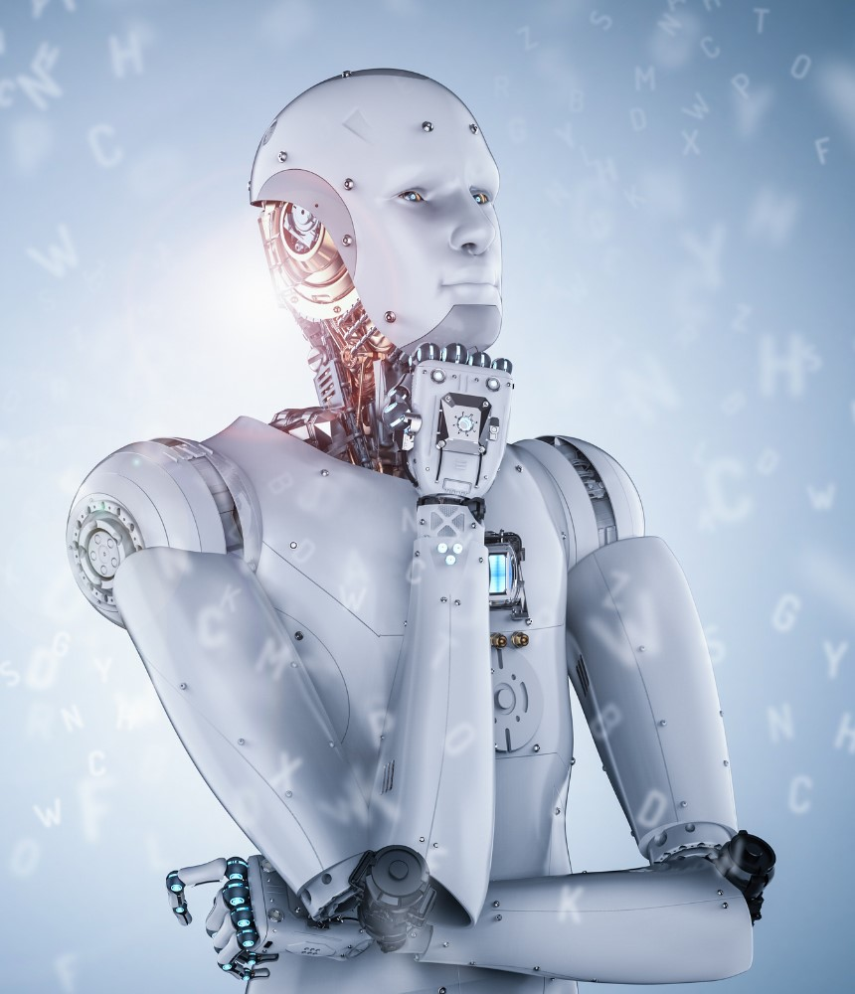
Objectives
Prediction and Classification
Pattern Recognition
Reduce Human Effort
Enhance Efficiency
Address Real World Challenges

Slide 4
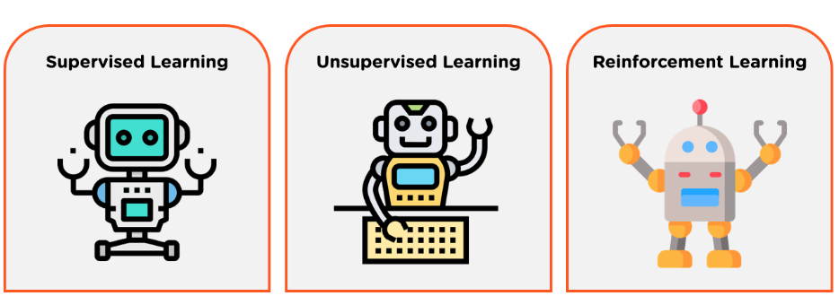
Machine Learning Algorithm

Slide 5
Machine Learning Algorithm
Supervised Learning - Supervised learning is a type of Machine learning in which the machine needs external supervision to learn
Unsupervised Learning – It is a type of machine learning in which the machine does not need any external supervision to learn from the data
Reinforcement Learning - In Reinforcement learning, an agent interacts with its environment by producing actions, and learn with the help of feedback

Slide 6
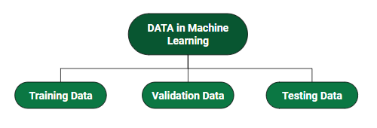
Data in Machine Learning

Slide 7
Data in Machine Learning
TRAINING DATA - Training data is a set of labeled examples used to teach a machine learning model
VALIDATION DATA – Validation data is the subset of data used in ML to increase the performance of model
TESTING DATA - Testing data is a separate set of examples that the model has not seen during training

Slide 8
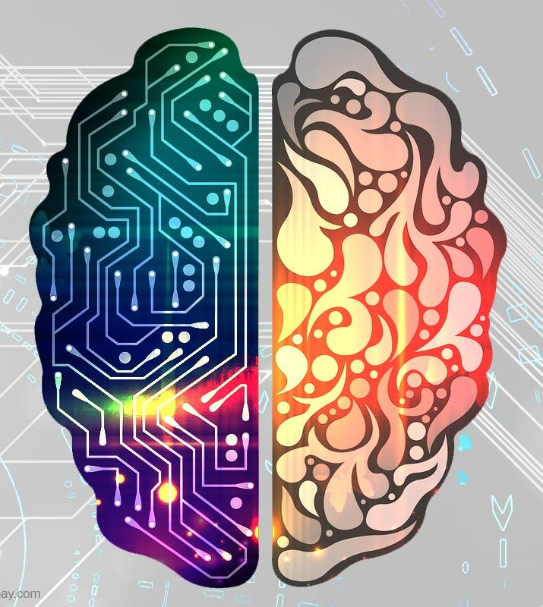
Key Concepts in Machine Learning
Algorithm
Model
Labels
Hyperparameters
Overfitting

Slide 9
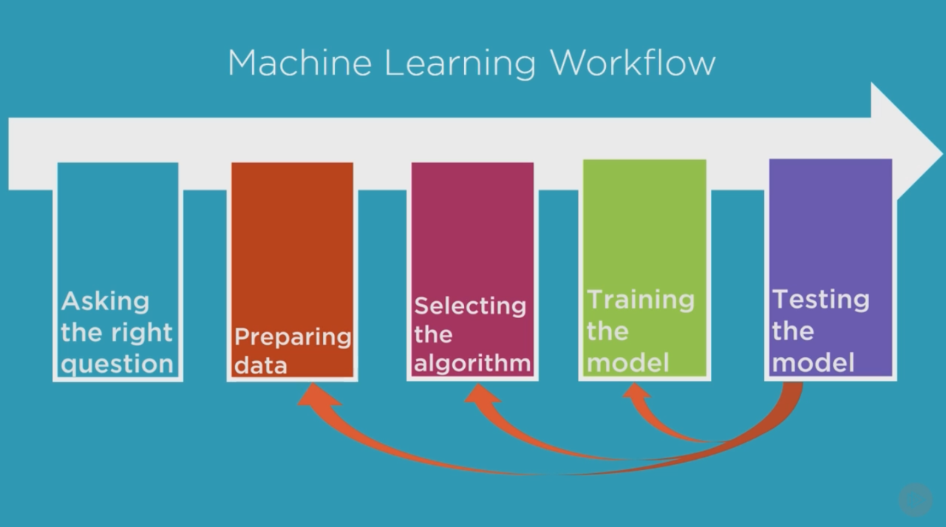
Machine Learning Workflow

Slide 10
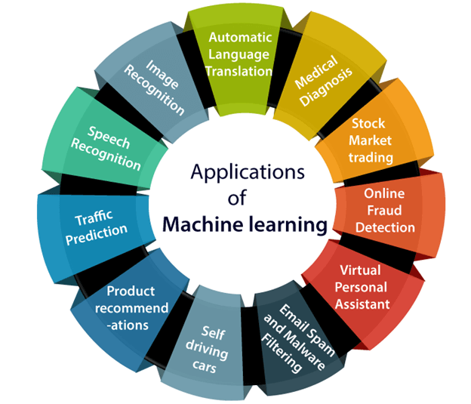
Real World Applications
Machine learning has a wide range of applications across various industries and domains. Its ability to analyze data, recognize patterns, and make predictions or decisions without explicit programming has led to its adoption in numerous fields

Slide 11

Any Questions ?

